Slide 1
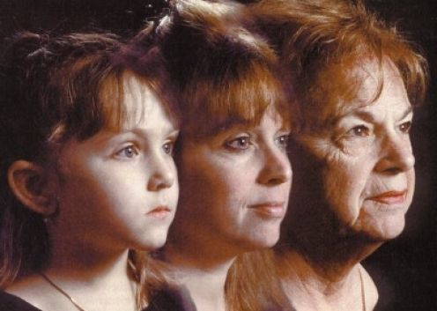
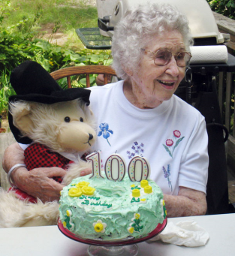
Aging and Chronic Disease Epidemiology: Lessons from the US
MPH 624
Steven A. Cohen, DrPH, MPH
Assistant Professor
February 15, 2016
Department of Family Medicine & Population Health
VCU School of Medicine
Richmond, Virginia

Slide 2
Today’s objectives
Describe population aging and its effects in the United States
Compare and contrast aging processes in the US to other world nations
Define life expectancy as a tool for measuring population health and list pros and cons
List and describe disparities in life expectancy across the US
Identify and describe direct and indirect effects of population aging in the US
Explain major issues in the study of the epidemiology of aging
Identify major research needs in the field of gerontology
Define compression of morbidity and describe its implications on population health

Slide 3
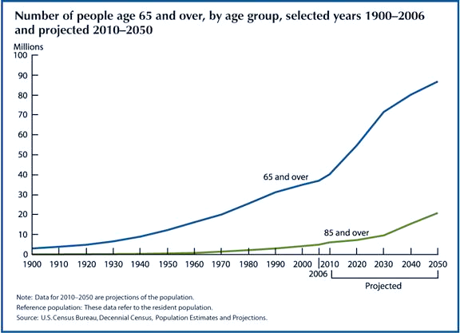
The “graying” of America

Slide 4
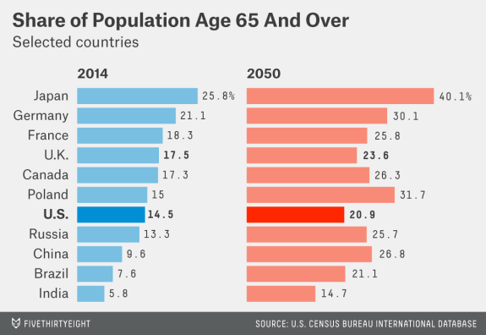

Slide 5
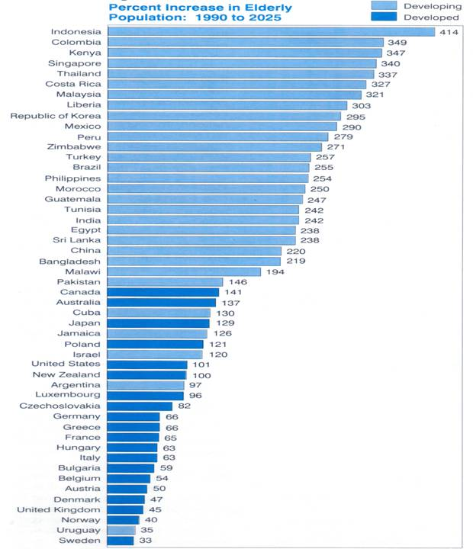
Percent increase in older population

Slide 6
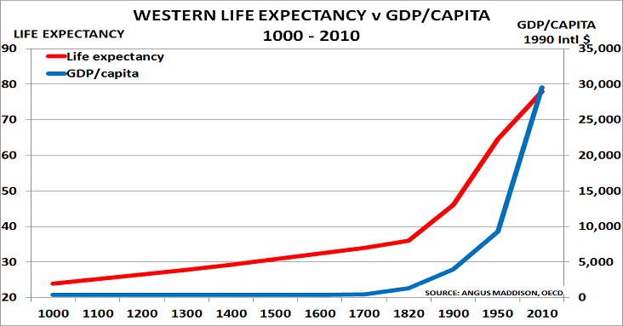
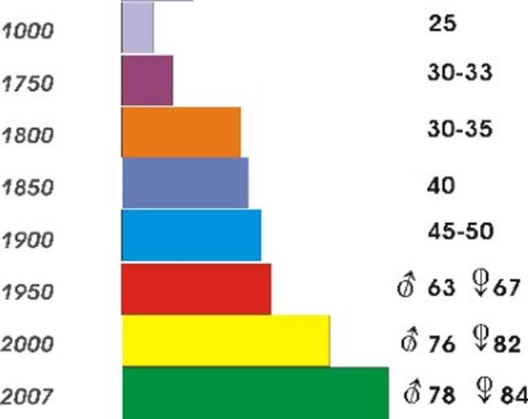
Life expectancy over 1000+ years

Slide 7
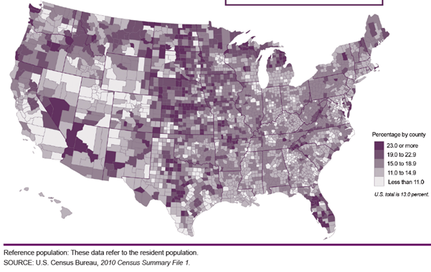
Where are older adults (age 65+)?

Slide 8
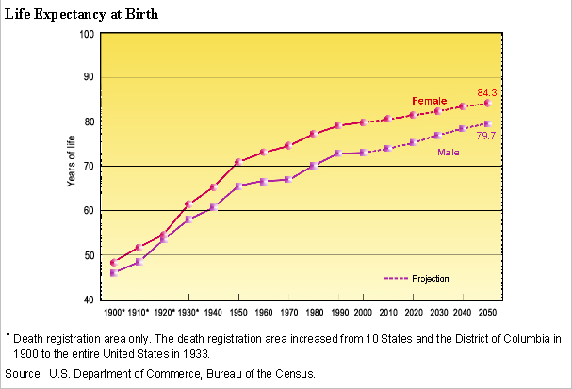
Life expectancy in the US

Slide 9
How the US stacks up
Country Rankings
 | 1.00–2.33
 | 2.34–4.66
 | 4.67–7.00
 |  | AUS | CAN | GER | NETH | NZ | UK | US
OVERALL RANKING (2010) |  | 3 | 6 | 4 | 1 | 5 | 2 | 7
Quality Care |  | 4 | 7 | 5 | 2 | 1 | 3 | 6
Effective Care |  | 2 | 7 | 6 | 3 | 5 | 1 | 4
Safe Care |  | 6 | 5 | 3 | 1 | 4 | 2 | 7
Coordinated Care |  | 4 | 5 | 7 | 2 | 1 | 3 | 6
Patient-Centered Care |  | 2 | 5 | 3 | 6 | 1 | 7 | 4
Access |  | 6.5 | 5 | 3 | 1 | 4 | 2 | 6.5
Cost-Related Problem |  | 6 | 3.5 | 3.5 | 2 | 5 | 1 | 7
Timeliness of Care |  | 6 | 7 | 2 | 1 | 3 | 4 | 5
Efficiency |  | 2 | 6 | 5 | 3 | 4 | 1 | 7
Equity |  | 4 | 5 | 3 | 1 | 6 | 2 | 7
Long, Healthy, Productive Lives |  | 1 | 2 | 3 | 4 | 5 | 6 | 7
Health Expenditures/Capita, 2007 |  | $3,357 | $3,895 | $3,588 | $3,837* | $2,454 | $2,992 | $7,290
Note: * Estimate. Expenditures shown in $US PPP (purchasing power parity).
Source: Calculated by The Commonwealth Fund based on 2007 International Health Policy Survey; 2008 International Health Policy Survey of Sicker Adults; 2009 International Health Policy Survey of Primary Care Physicians; Commonwealth Fund Commission on a High Performance Health System National Scorecard; and Organization for Economic Cooperation and Development, OECD Health Data, 2009 (Paris: OECD, Nov. 2009).

Slide 10
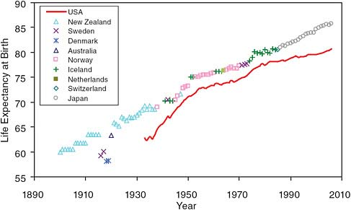
Life expectancy: US vs. other countries
Trend in highest recorded level of female life expectancy achieved versus trend in life expectancy in the United States. Data from Oeppen and Vaupel (2002) [Supplemental tables]; Human Mortality Database (http://www.mortality.org/ [accessed December 8, 2010]).

Slide 11
Limits to life expectancy?
Vaupel, et al., Broken limits to life expectancy. Science 2002

Slide 12
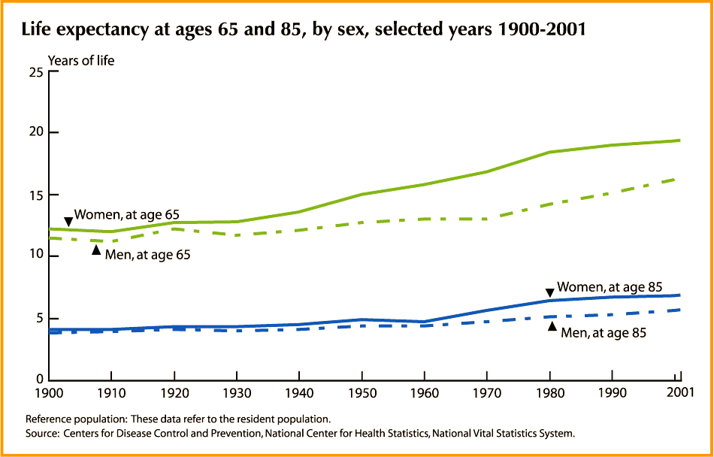
Living healthier longer?

Slide 13
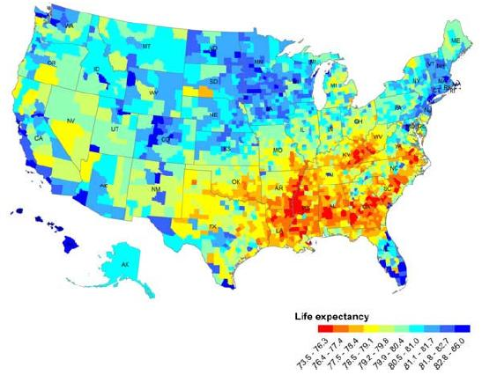
Life expectancy by county (females)

Slide 14
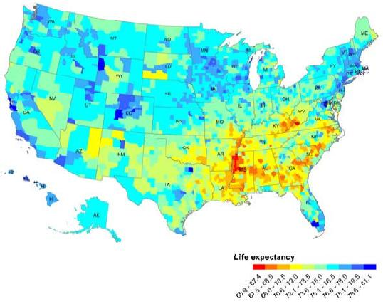
Life expectancy by county (males)

Slide 15
Life expectancy by race

Slide 16
Milestones in assisting older adults
1883- National compulsory health insurance program enacted in Germany
1902- First U.S. worker’s comp law enacted (later declared unconstitutional) ☺
1934- Committee on Economic Security created by President Roosevelt
1935- Social Security Act signed into law (Roosevelt)
1965- Medicare signed into law by President Johnson (A & B)
1997- Medicare part C begins
2006- Medicare Part D begins

Slide 17
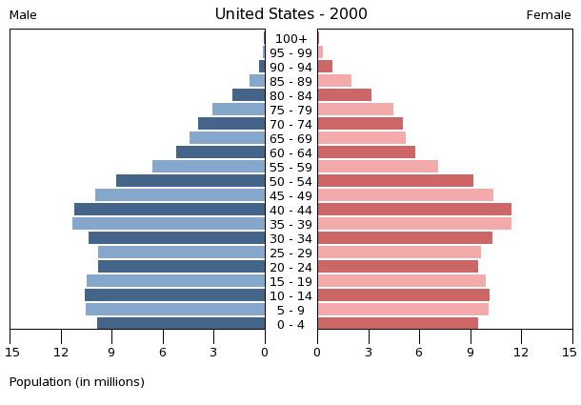
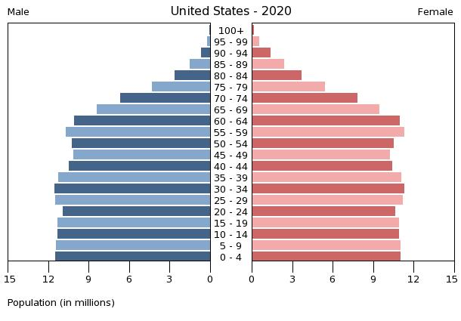
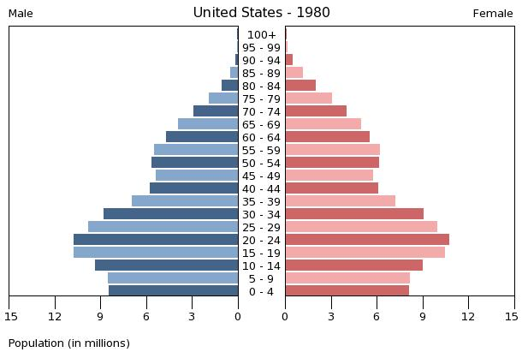
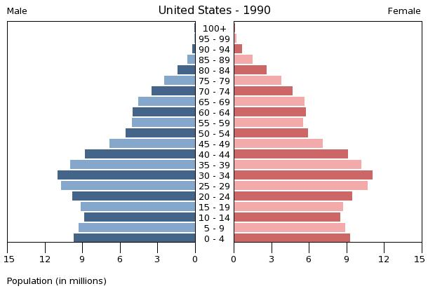
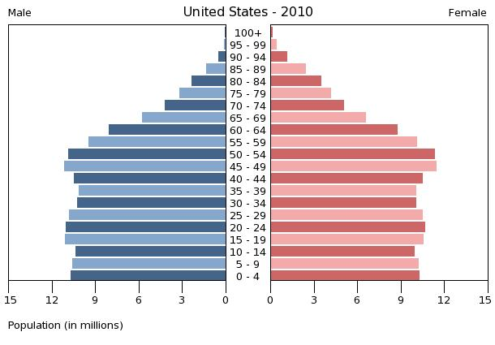
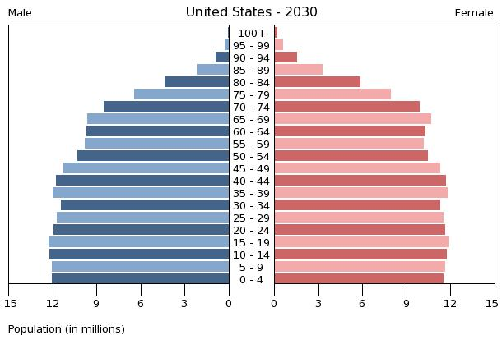
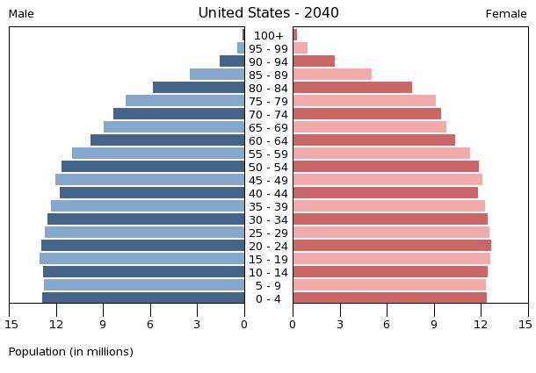
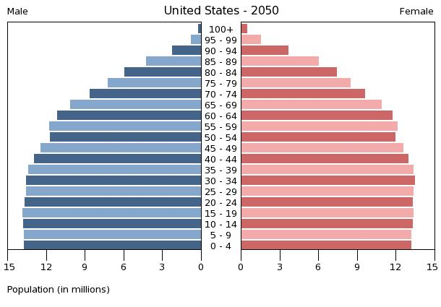
Population aging in the US

Slide 18
Causes of population aging
Epidemiological and Demographic Transitions
Improved medical care
Advances in prevention and treatment
Increased longevity
People living with disease longer
Transition from type of disease (Epi Trans.)
Reduction in fertility (Dem. Trans.)
Fewer babies born each year
Baby bust (1970s)

Slide 19
Implications of aging: Workforce
Postponing retirement
Fewer jobs for younger adults
Need to care for older adults
New businesses
New jobs (projections between 10,000 and 150,000 in the coming decade)
Increased number of women in workforce
Continue adding to the economy

Slide 20
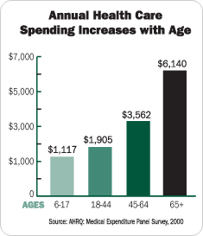
Implications of aging: Health care
Cohen, et al., The Rising Costs of Medicare: Spatiotemporal, Age-Related Trends in Medicare Expenditures in the Elderly, 1998-2002 . Population Association of America, 2009

Slide 21
Implications of aging: Health care (2)
Increasing prevalence of diseases of old age
Alzheimer’s Disease and dementia
Cancers
Medicare
Over $500 billion in expenditures annually (20% of national health expenditures)
Alzheimer’s annual bill alone: $130 billion
Shrinking ratios to contribute

Slide 22
Epidemiology of aging
Going beyond the demographic focus, epidemiology has made additional contribution to the understanding of health status and functional trajectory of older individuals.
Geriatric epidemiology studies health, functional status, quality of life and mortality of representative populations of elderly, also in order to generate intervention to improve life of millions of older individuals.
Stefania Maggi, Demography and Longevituy

Slide 23
Epidemiology of aging: Mortality
The increase in life expectancy has been attributed to reduced mortality at older ages
First half of the 20th century saw large decline in child mortality
Second half of the century unprecedented declines in mortality occured in the older segment of the population
The 5 leading causes of death among older adults:
Heart disease
Cancer
Stroke
Chronic lower respiratory tract disease
Alzheimer’s disease
(Minino et al. National Vital Statistics Reports 2007; 55(9):1-120)
Stefania Maggi, Demography and Longevituy

Slide 24
Epidemiology of aging: Diseases
Among people aged 65+, the most commonly reported conditions are hypertension, followed by CHD and stroke.
Arthritis and chronic joint symptoms are reported by a large proportion of older persons, may have large impact on health and quality of life but do no appear on the list of most common conditions causing death.
Stefania Maggi, Demography and Longevituy

Slide 25
Epidemiology of aging: Disability
A large body of epidemiologic studies allowed a greater understanding of occurence, determinants, and consequences of disability in the older population.
Epidemiologic studies have clearly identified disability as the most powerful markers in predicting adverse outcomes. Disability measures are able to capture the presence and the severity of multiple pathologies, including physical, cognitive, psychological conditions.
Stefania Maggi, Demography and Longevituy

Slide 26
Research on aging
The demographic causes of aging of the population, in terms of fertility rates and mortality rates, are generally predictable. A variety of population projections are available, prepared by the US Census, UN (Yearbook), and EU
What is less predictable is the interaction of these forces with social context, health status, economic changes, cultural influences and hence international migrations.
Stefania Maggi, Demography and Longevituy

Slide 27
Research on aging
For this reason further research on biodemography, dynamic of health, epidemiology, economics, psychology, social sciences and aging are needed.
Longitudinal data are essential in order to sort causal relationships among demographic, biological, psychosocial and economic factors, and health.
Cross-national comparisons are important, considering variability across societies, in terms of status and well-being of older persons, experiences of health and mortality, family and social support.
Stefania Maggi, Demography and Longevituy

Slide 28
Indirect effects: Formal caregiving
Assist older adults in-home
“Hired help”: Nurses, home health aides
Duties
Household Meal preparation, house cleaning, laundry, shopping, and transportation
Personal Care Bathing, eating, dressing, toilet assistance and getting around the home
Health Management Medications, injections, IV therapy, wound care, diabetes treatment, speech, occupational and physical therapy
Hospice care

Slide 29
Indirect effects: Informal caregiving
Also called family caregiving
Relatives for friends provide “informal care” to aging person
Usually unpaid
Services vary
“Sandwich generation” increasing demands
Decreased health of caregiver
Aging and intergenerational gaps

Slide 30
Research Question
How does the distribution of informal caregiving duties (“caregiving intensity”) vary by sociodemographic characteristics in the US?

Slide 31
Summary of findings
Females, NH Blacks, and those in the lowest income brackets had the highest levels of caregiving intensity.
Age differences in caregiving intensity were mixed.
Associations between caregiving intensity and caregiver burden varied substantially by age, sex, race/ethnicity, and income.
Patterns are complex and vary by:
Type of caregiving intensity (e.g. ADL, hours, etc.)
Type of caregiver burden outcome (e.g. social, emotional, etc.)

Slide 32
Cohort effects
Will the older adults of the coming decades resemble the older adults of today?
Baby Boomer cohort different than existing older adults
Increased health risks (e.g. obesity, heart disease)
Psychological and social factors
Experienced events differently than predecessors (cumulative risk)

Slide 34
Cohort effects (2)
Martin et al, considering data from the NHANES and the NHIS, conclude that health and disability of elderly improved during the last two decades of 20th century.
At the same time, population aged 40-64 years has not shown a consistent improvement and there is some evidence of increase in disability in this age group.
(Martin LG, Schoeni RF, Andreski PM. Demography 2010; 47:S41-S64)

Slide 35
Compression of morbidity
From James Fries
Hypothesis: If the age at the onset of the first chronic infirmity can be postponed more rapidly than the age of death, then the lifetime illness burden may be compressed into a shorter period of time nearer to the age of death.
Evidence supporting this hypothesis thus must take two forms
It is possible to substantially delay the onset of infirmity
The accompanying increases in longevity will be comparatively modest

Slide 36
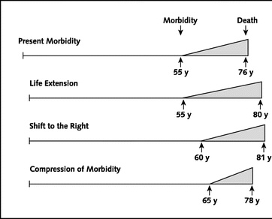
Compression of morbidity

Slide 37
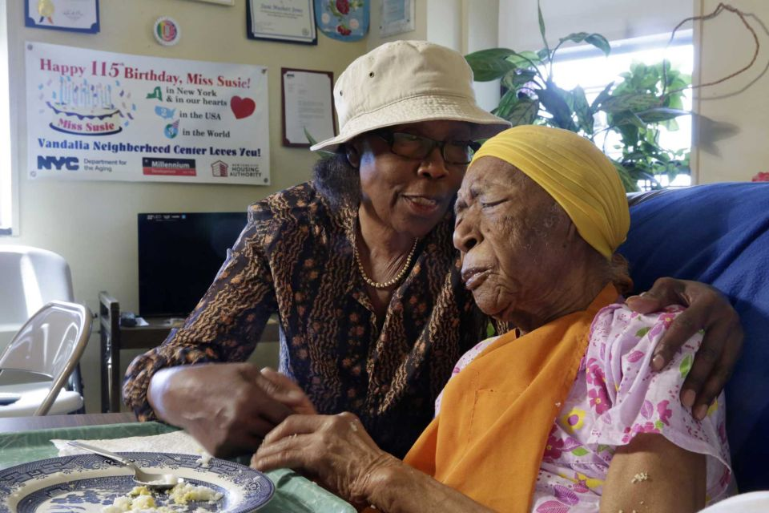
Getting back to Mr. Willard Scott
Longevity
Individual vs. population perspective
Accumulation of risks
Genetic components?
Boston University Centenarian Study
http://www.bumc.bu.edu/centenarian/
Susannah Mushatt Jones
7/6/1899-present
(World’s oldest living person)

