Slide 1
Diabetes
Asmi Shah, Brittany Cox, Clara Bergeron, Nang Pann Ei Kham

Slide 2
Overview
In 2011, approximately 20 million American
Diabetes is a chronic disease in which there is a high level of sugar in the blood
Diabetes is caused:
Pancreas does not make enough insulin
Cells do not respond normally to insulin being produced
Both
Insulin is a hormone produced by the pancreas to control blood sugar

Slide 3
Overview cont’d.
The role of insulin is to move glucose from the bloodstream into muscle, fat, and liver cells, where it can be used as fuel
Diabetes = Body cannot move sugar into muscle, liver, and fat cells to be stored for energy
Lack of sufficient insulin supply to the body
There are two major types of diabetes
Type 1 and Type 2
Gestational Diabetes (Minor type of diabetes)

Slide 4
Types of Diabetes
Type 1 Diabetes
Most often diagnosed in children, teens, or young adults
The body makes little or no insulin
Daily injections of insulin are needed
Manually or through an insulin pump
Type 2 Diabetes
Makes up most diabetes cases
Most often occurs in adulthood
High obesity rates = teens and young adults are now being diagnosed with it
Many people with type 2 diabetes do not know they have it
Gestational Diabetes
High blood sugar develops at any time during pregnancy in a woman who does not have diabetes prior to pregnancy

Slide 5
Risk Factors Type 1 Diabetes
Genetics and family history
The ADA recommends that anyone with a first-degree relative with type 1 diabetes is at higher or increased risk
Simple blood test can used to diagnose
Diseases of the pancreas
Injury or diseases of the pancreas can inhibit its ability to produce insulin and lead to type 1 diabetes
Infection or illness
A range of relatively rare infections and illnesses can damage the pancreas and cause type 1 diabetes

Slide 6
Risk Factors for Type 2 Diabetes
Obesity or being overweight
Research at the Harvard School of Public Health showed that the single best predictor of type 2 diabetes is being obese or overweight
BMI of 25 to 29.9 is considered overweight
BMI of 30 or higher considered obese

Slide 7
Other Risk Factors
May accelerate the harmful effects of diabetes
Smoking
Physical Inactivity
Hypertension
High Cholesterol

Slide 8
Current Treatment Options
Type 2 diabetes can be reversed with lifestyle changes
Losing weight through:
Exercising
Eating healthier foods
Some cases, weight-loss surgery
Currently type 1 diabetes can not be reversed
Treating both types of diabetes involves medicines, diet, and exercise to control blood sugar level

Slide 9
Medication
Metformin (oral antidiabetic drug)
First line treatment for type 2 diabetes
When insulin is used in type 2 diabetes
A long-acting formulation is usually added
While continuing oral medications
Type 1 diabetes is typically treated with a combinations of regular and synthetic insulin

Slide 10
To prevent diabetes complications
Visit health care providers at least two to four times a year
Talk about any problems that arise

Slide 11
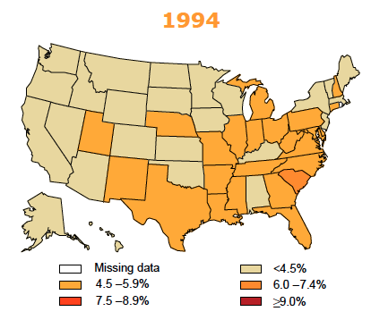
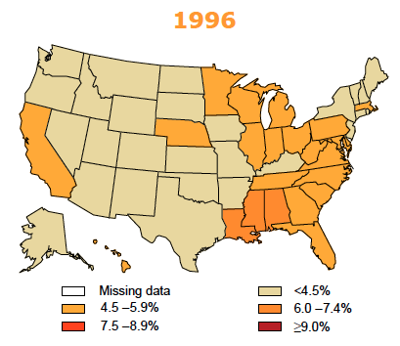
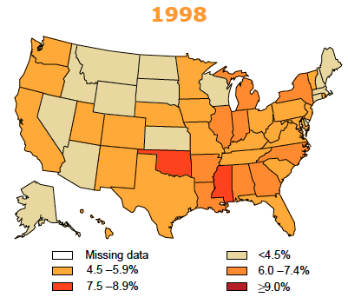
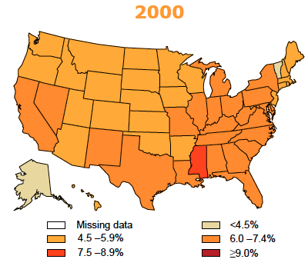
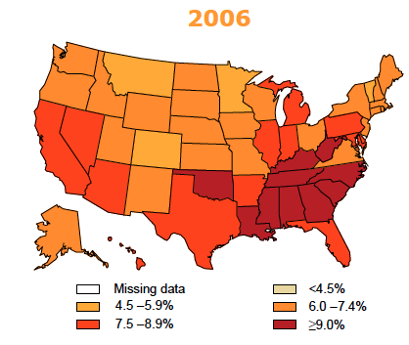
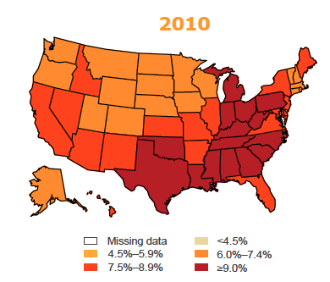
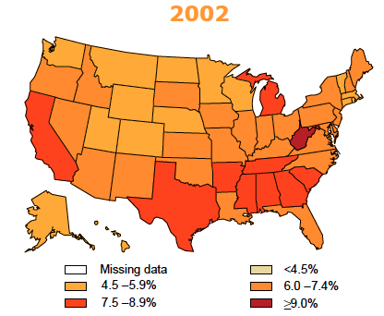
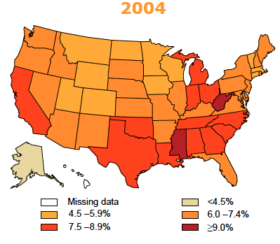
Age-Adjusted Prevalence of Diagnosed Diabetes Among US Adults, 1994-2010
Notes:
http://www.cdc.gov/diabetes/statistics/slides/maps_diabetes_trends.pdf

Slide 12
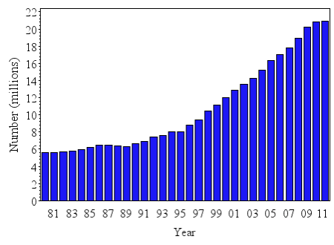
Prevalence of Diagnosed Diabetes in all Individuals in the United States, 1980-2011
Diabetes is becoming more common in the United States.
Total number of diagnosed individuals has tripled in just 30 years.
1980 - 5.6 million people
2011 - 20.9 million people
http://www.cdc.gov/diabetes/statistics/prev/national/figpersons.htm
Notes:
http://www.cdc.gov/diabetes/statistics/prev/national/figpersons.htm

Slide 13
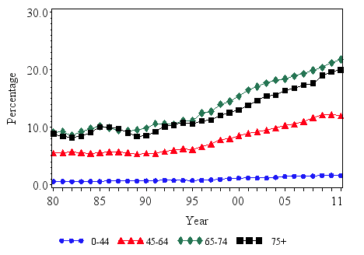
Percentage of Civilians with Diagnosed Diabetes, By Age, United States, 1980-2011
Ages 0-44 (0.6% - 1.6%)
Ages 45-64 (5.5% - 12.0%)
Ages 65-74 (9.1% - 21.8%)
Ages 75+ (8.9% - 20.0%)
http://www.cdc.gov/diabetes/statistics/prev/national/figbyage.htm
Notes:
In general, the number of civilians with diagnosed diabetes increased for every age group from 1980-2011. But as you can see, the age group from 65-74 has had relatively the highest percentage of diabetes patients over the last 30 years.

Slide 14
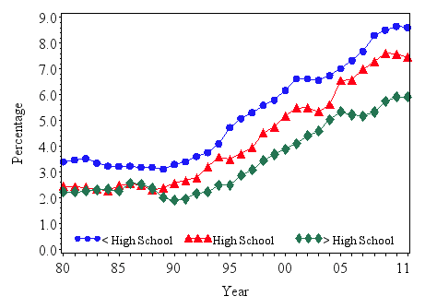
Age-Adjusted Percentage of Civilians with Diagnosed Diabetes by Education, United States, 1980-2011
Less than high school education (3.4% - 8.6%)
With a high school education (2.4% - 7.5%)
More than high school education (2.2% - 5.9%)
http://www.cdc.gov/diabetes/statistics/prev/national/figbyeducation.htm
Notes:
As you can see, throughout the period, the age-adjusted percentage was highest in those with less than a high school education compared to the higher level educated individuals.

Slide 15
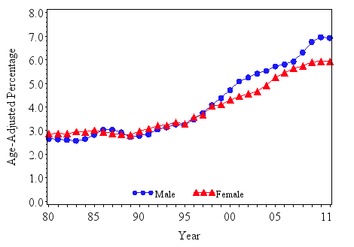
Age-Adjusted Percentage of Individuals with Diabetes, by Sex, United States, 1980-2011
1980-1998 similar for both
1999 onwards, percentage of men increase at a faster rate than women
Men (2.7% - 6.9%)
Women (2.9% - 5.9%)
http://www.cdc.gov/diabetes/statistics/prev/national/figbysex.htm

Slide 16
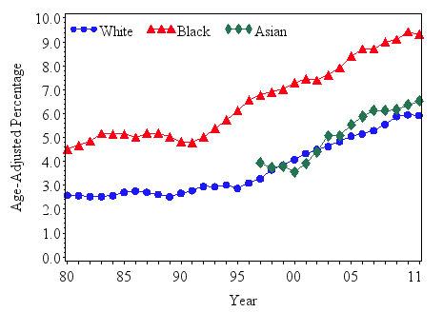
Age-Adjusted Percentage of Civilians with Diabetes, by Race, United States, 1980-2011
Whites (2.6% - 5.9%)
Blacks (4.5% - 9.3%)
Asians (3.9% - 6.5%) from 1997-2011
http://www.cdc.gov/diabetes/statistics/prev/national/figbyrace.htm
http://www.hopkinsmedicine.org/healthlibrary/conditions/diabetes/diabetes_statistics_85,P00353/
Notes:
Over the last 3 decades, blacks have had a higher percentage of people diagnosed with diabetes compared to whites and asians. Although not shown in the graph, more than 10% of Hispanic Americans (2 million) have diabetes. They are twice as likely to have diabetes than non-Hispanic whites. Also, American Indians and Alaska Natives are more than twice as likely to develop diabetes as are white Americans. 14.2% of American Indian adults have type 2 diabetes which is also increasing among children.

Slide 17
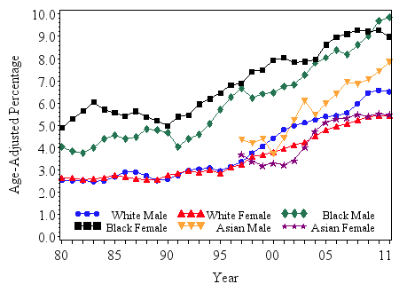
Age-Adjusted Percentage of Civilians with Diabetes, by Race and Sex, United States, 1980-2011
White males (2.5% - 6.5%)
White females (2.6% - 5.4%)
Black males (4.0% - 9.9%)
Black females (4.9% - 9.0%)
Asian males (4.3% - 7.8%)
Asian females (3.7% - 5.5%)
Asian individuals show data from 1997-2011
http://www.cdc.gov/diabetes/statistics/prev/national/figraceethsex.htm
Notes:
Although the adjusted prevalence of diagnosed diabetes is higher in black individuals compared to whites and asians, it’s highest in general in black females. However in 2010 and 2011 it has been shown that black males have had a higher prevalence in diabetes.

Slide 18
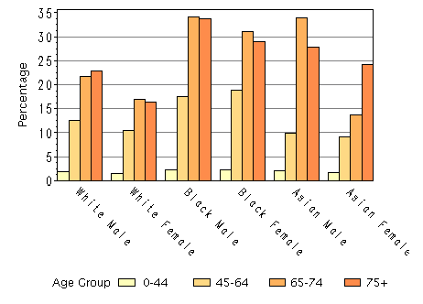
Age-Specific Percentage of Civilians with Diabetes, by Age, Race, and Sex, United States, 2011
Percentage of the population highest among persons aged 65 years and older
Percentage of population lowest among persons aged 45 years and younger
Decrease in Asian males from 65-74 compared to 75+ age group
Asian male and Black male in age group 65-74
http://www.cdc.gov/diabetes/statistics/prev/national/fig2004.htm
Notes:
There’s a significant decrease in Asian males from the age group 65-74 compared to the 75+ age group whereas most of the other groups have a gradual increase in age and prevalence. In general, the Asian male and black male in the age group 65-74 have the highest percentages of diagnosed diabetes.

Slide 19
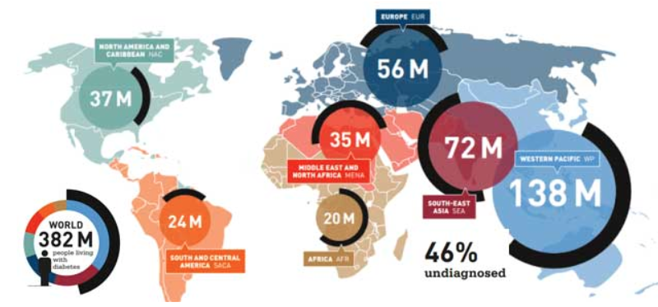
Prevalence of Diabetes Shown Globally for 2013
http://www.idf.org/worlddiabetesday/toolkit/gp/facts-figures
Notes:
Diabetes is not just a problem in the United States. It is an international problem also creating a burden on society and economy. Today, 382 million people in the world have some type of diabetes. Although this map is shown in numbers of people, the highest country with the highest percent prevalence of diabetes is the Middle East and North Africa. Next highest is North America and Caribbean. The lowest percent prevalence is in Africa. The highest number of people with diabetes reside in the Western Pacific with South-East Asia coming in second. At the rate we’re going, diabetes is believed to increase to 592 million people in the year 2035 (that’s a 55% increase).

Slide 20
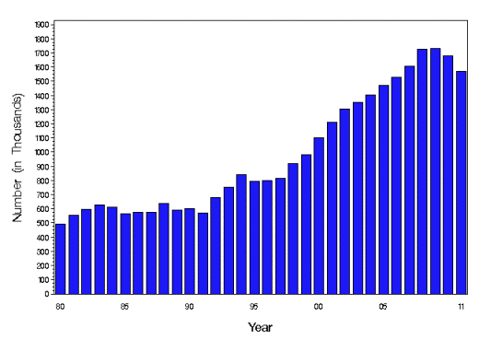
Incidence - Annual Number of New Cases of Diabetes in Adults 18-79 Years, United States, 1980-2011
Number of adults with newly diagnosed diabetes has tripled from 493,000 to 1.5 million
Substantial increase from 1990s to 2006
No significant change from 2006 to 2011
http://www.cdc.gov/diabetes/statistics/incidence/fig1.htm

Slide 21
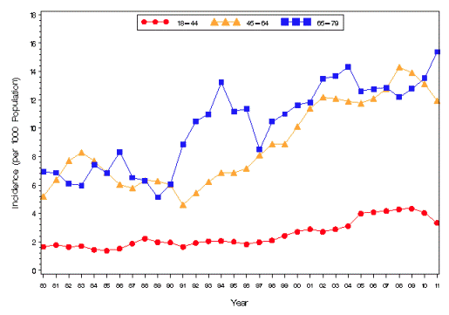
Incidence of Diagnosed Diabetes per 1,000 Population Aged 18-79 Years, 1980-2011
Ages 18-44, incidence increased from 1980-2003
Ages 45-64, incidence fluctuated in 1980s and increase from 1990-2002
Neither showed significant change between 2000-2011
Ages 65-79, incidence significantly increased from 6.9 to 15.4 per 1000 in 2011
http://www.cdc.gov/diabetes/statistics/incidence/fig3.htm

Slide 22
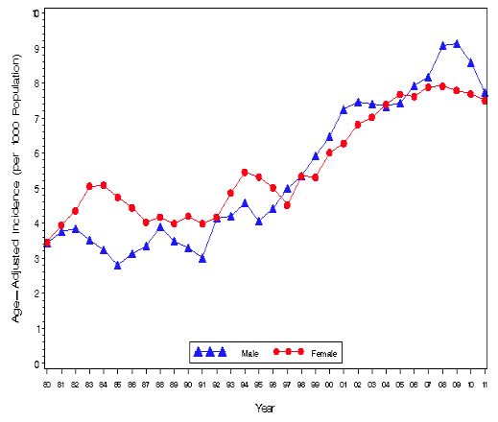
Incidence of Diagnosed Diabetes per 1000 Population Aged 18-79 Years, by Sex, United States, 1980-2011
Age-Adjusted incidence of diagnosed diabetes significantly increase for men and women
Incidence is twice as high in 2011 compared to 1980
In 2011, the incidence was very similar (7.7 men vs 7.5 women)
http://www.cdc.gov/diabetes/statistics/incidence/fig4.htm

Slide 23
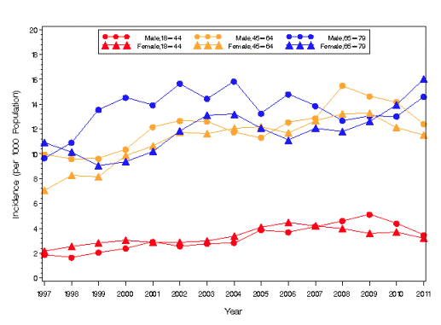
Crude Incidence per 1,000 Population Aged 18-79 Years, by Sex and Age, United States, 1997-2011
Incidence increased for all age groups among women
Incidence increased for men in age group 18-44 and 45-64 years
No significant change found in incidence for men aged 65-79 years
http://www.cdc.gov/diabetes/statistics/incidence/fig5.htm

Slide 24
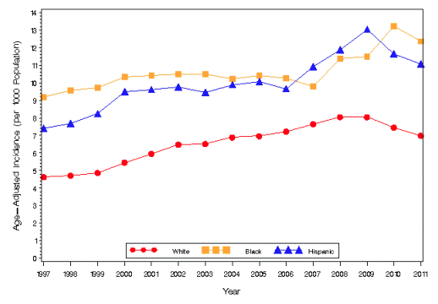
Incidence of Diabetes per 1,000 Population Aged 18-79 Years, by Race/Ethnicity, United States, 1997-2011
Most increase during this time period was among blacks and Hispanics
For whites, most incidence increase during 1997-2007
For whites, no significant change from 2007-2011
In 2011 incidence of diagnosed diabetes was...
12.4/1,000 in blacks
11.1/1,000 in Hispanics
7.0/1,000 in whites
http://www.cdc.gov/diabetes/statistics/incidence/fig6.htm

Slide 25
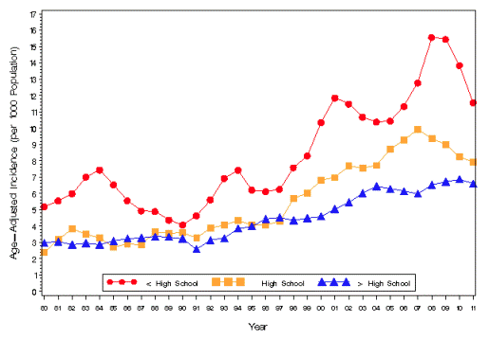
Age-Adjusted Incidence per 1,000 Population Aged 18-79 Years, by Education, United States, 1980-2011
Overall incidence during this time period has increase for all education levels
Higher incidence among people with less than a high school education
In 2011
11.6/1,000 for < high school education
7.9/1,000 for high school equivalent
6.6/1,000 for > high school education

Slide 26
Morbidity
7 out of 10 deaths among Americans each year are from chronic diseases.
Heart disease, cancer and stroke account for more than 50% of all deaths each year.
Obesity has become a major health concern. 1 in every 3 adults is obese and almost 1 in 5 youth between the ages of 6 and 19 is obese (BMI ≥ 95th percentile of the CDC growth chart).
Arthritis is the most common cause of disability, with nearly 19 million Americans reporting activity limitations.
Diabetes continues to be the leading cause of kidney failure, nontraumatic lower-extremity amputations, and blindness among adults, aged 20-74.
Excessive alcohol consumption is the third leading preventable cause of death in the U.S., behind diet and physical activity and tobacco.
Notes:
http://www.cdc.gov/chronicdisease/overview/index.htm

Slide 27
Morbidity: Diabetes Complications
Cardiovascular Disease (CVD): Heart Disease or Stroke (related to High Blood Pressure)
Diabetes Ketoacidosis (DKA)
End-Stage Renal Disease (ESRD)
Limitations in mobility
Visual impairments
Depression
Poor pregnancy outcomes
Notes:
Premature mortality

Slide 28
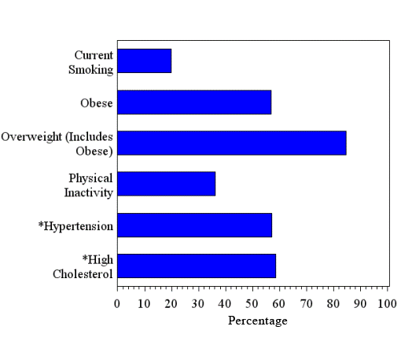
Age-Adjusted Percentage of Adults Aged 18 Years or Older with Diagnosed Diabetes Who Have Risk Factors for Complications, United States, 2010

Slide 29
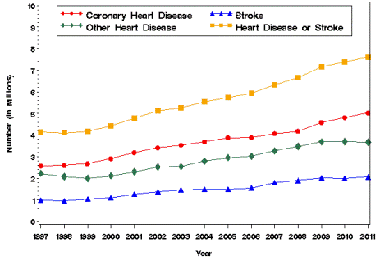
CVD: Number (in Millions) of People with Diabetes Aged 35 Years or Older with Self-Reported Heart Disease or Stroke, 1997–2011
htt
From 1997 to 2011,
4.2 million to 7.6 million
In 2011,
coronary heart disease - 5.0 million
other heart disease or condition - 3.7 million
stroke - 2.1 million
http://www.cdc.gov/diabetes/statistics/complications_national.htm#1

Slide 30
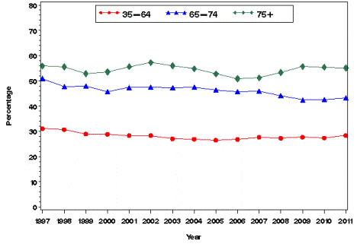
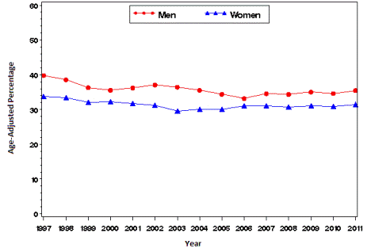
Percentage of People with Diabetes Aged 35 Years or Older Reporting Heart Disease or Stroke, by Age and Sex, 1997–2011
Notes:
From 1997 to 2011, the percentage of adults with diabetes reporting heart disease or stroke decreased until 2004 and leveled off afterwards for those aged 35–64 years, declined among those aged 65–74 years, and showed no consistent trend for people aged 75 years or older. Throughout the period, percentages were greater with increasing age. In 2011, the percentage reporting heart disease or stroke was 28.3% among people aged 35–64 years, 43.1% among those aged 65–74 years, and 55.1% among those aged 75 years or older.
From 1997 to 2011, the age-adjusted percentage of persons aged 35 years or older with diabetes reporting heart disease or stroke showed little or no change among men and among women. Throughout the period, the age-adjusted percentage was higher among men than among women. In 2011, the age-adjusted percentage reporting heart disease or stroke was 35.5% for men and 31.5% for women.

Slide 31
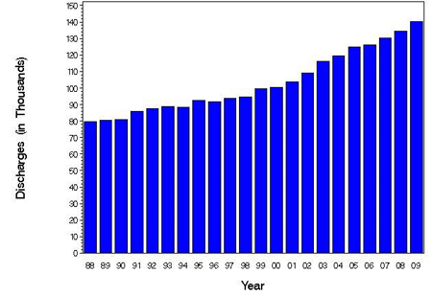
DKA:Number (in Thousands) of Hospital Discharges with Diabetic Ketoacidosis as First-Listed Diagnosis, 1988–2009
http://www.cdc.gov/diabetes/statistics/dkafirst
Notes:
Diabetic ketoacidosis (DKA) is a serious condition that can lead to diabetic coma (passing out for a long time) or even death.
number of hospital discharges with diabetic ketoacidosis (DKA) as the first-listed diagnosis increased from about 80,000 discharges in 1988 to about 140,000 in 2009.

Slide 32
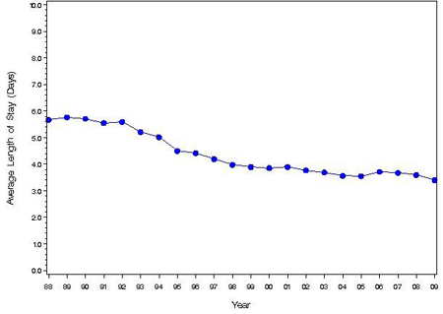
Average Length of Stay in Days of Hospital Discharges with Diabetic Ketoacidosis as First-Listed Diagnosis, 1988–2009
Average Length of Stay (LOS)
decreased by 2.3 days
(from 5.7 to 3.4 days)
decreases seen among all age and race-sex groups

Slide 33
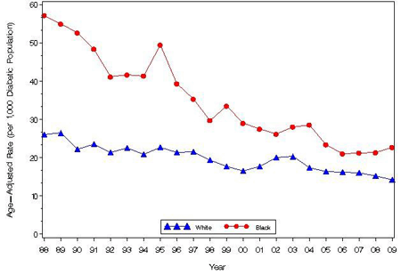
Age-Adjusted Hospital Discharge Rates for DKA as First-Listed Diagnosis per 1,000 Diabetic Population, by Race
From 1988 to 2009,
declined rates among blacks vs whites (60.5% vs 45.0%)
In 2009,
14.3 per 1,000 whites with diagnosed diabetes vs 22.7 per 1,000 blacks with diagnosed diabetes

Slide 34
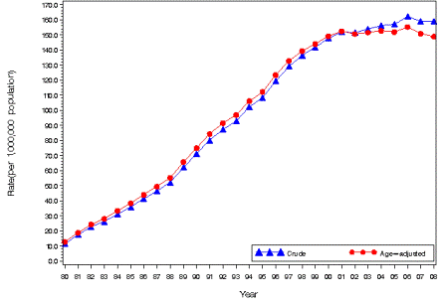
ESRD-DM: Crude and Age-Adjusted Incidence of ESRD-DM per 1,000,000 Population, 1980–2008
Both crude and age-adjusted rates increased sharply from 1980s-1999 and slowed down
In 2008
crude rate was 158.9 per 1,000,000 population vs age-adjusted rate 148.8 per 1,000,000 population
Notes:
Between 1980 and 2008, the rate of initiation of treatment for ESRD-DM per 1,000,000 population did not increase at a contant rate. Both the crude and age-adjusted rates increased sharply from the 1980s until 1999, and then slowed down. Throughout the period, the crude and age-adjusted rates were similar. In 2008, the crude rate was 158.9 per 1,000,000 population and the age-adjusted rate was 148.8 per 1,000,000 population.

Slide 35
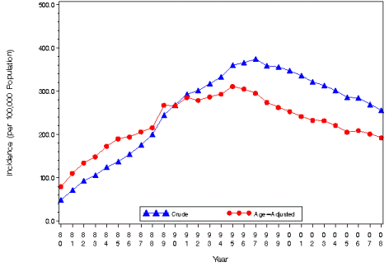
Crude and Age-Adjusted Incidence of (ESRD-DM) per 100,000 Diabetic Population, United States, 1980–2008
Initiation of treatment for (ESRD-DM) per 100,000 diabetic population---increased from 1980 until mid-1990s, then decreased
ESRD-D incidence among persons with diagnosed diabetes has declined since 1996
age-adjusted rate of ESRD-D among persons with diagnosed diabetes declined 35% overall, and declined in all U.S. regions and in most states.
Notes:
http://www.cdc.gov/mmwr/preview/mmwrhtml/mm5942a2.htm?s%20cid=mm5942a2w
Incidence of End-Stage Renal Disease Attributed to Diabetes Among Persons With Diagnosed Diabetes --- United States and Puerto Rico, 1996--2007
During 2007, approximately 110,000 persons in the United States and Puerto Rico began treatment for end-stage renal disease (ESRD) (i.e., kidney failure requiring dialysis or transplantation) (1). Diabetes is the leading cause of ESRD in the United States, accounting for 44% of new cases in 2007

Slide 36
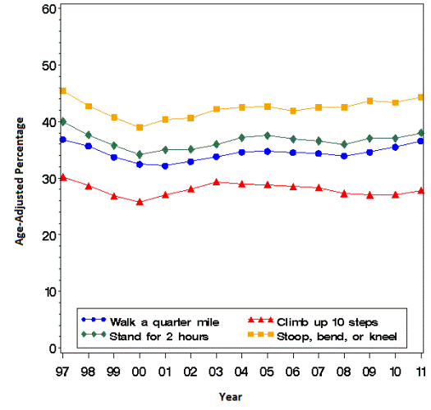
Mobility: Age-Adjusted Percentage of Adults with Diagnosed Diabetes Reporting Mobility Limitation, by Task, 1997–2011
According to 2011 data,
27.8%----climbing up 10 steps,
36.6%---walking a quarter mile
38.0%----standing for 2 hours, and
44.3%----stooping, bending, or kneeling

Slide 37
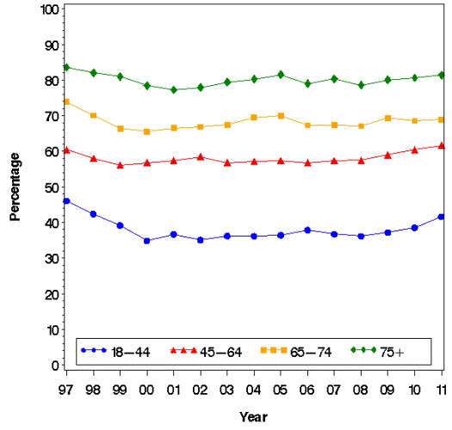
Percentage of Adults with Diagnosed Diabetes Reporting Any Mobility Limitation, by Age, 1997–2011

Slide 38
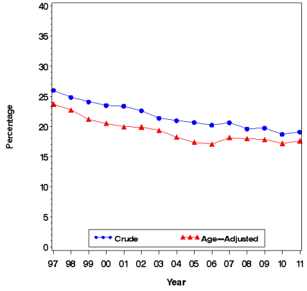
Visual Impairment: Crude and Age-Adjusted Percentage of Adults Aged 18 Years or Older with Diagnosed Diabetes Reporting Visual Impairment, 1997–2011
Notes:
From 1997 to 2011, the crude percentage of adults with diagnosed diabetes who reported visual impairment decreased 26.5% (from 26.0% to 19.1%). Trends in the crude and age-adjusted percentages of people reporting visual impairment were similar, suggesting that the aging of the population had little or no effect on trends during this time period.

Slide 39
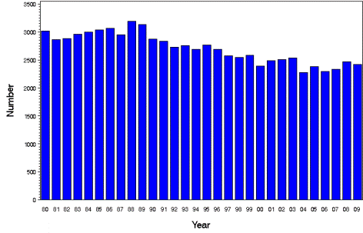
Mortality:Hyperglycemic Crises
In 2009, hyperglycemic crises caused
●2,417 deaths,
●vs 3,012 deaths (19.8% lower) in 1980
Number of Deaths for Hyperglycemic Crises as Underlying Cause, United States, 1980–2009
Notes:
Diabetic hyperglycemic crises, including diabetic ketoacidosis and hyperglycemic hyperosmolar state, are serious acute complications of diabetes that can lead to death.
The number of deaths due to hyperglycemic crises was stable in the 1980s and then began to decrease in the 1990s. In 2009, hyperglycemic crises caused 2,417 deaths, 19.8% lower than the 3,012 deaths in 1980.

Slide 40
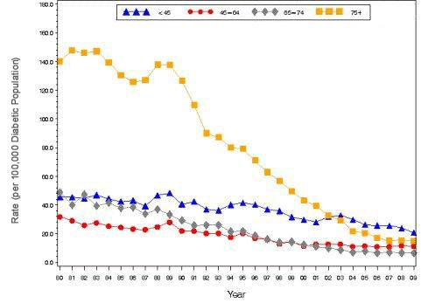
Death Rates for Hyperglycemic Crises as Underlying Cause per 100,000 Diabetic Population, By Age, 1980–2009
Notes:
From 1980 to 2009, death rates per 100,000 diabetic population for hyperglycemic crises as underlying cause of death declined in all age groups, with the largest decreases occurring among those aged 75 years and older. Although the oldest age group had the highest death rates near the beginning of the study time period, these rates steadily declined and eventually became even lower than the rates of the youngest age group.

Slide 41
Complications | Hospital Discharge rate (per 1,000) Year 1980 | Hospital Discharge rate (per 1,000) Year 1995 | Hospital Discharge rate (per 1,000) Year 2003
Ischemic heart disease | 24.5 | 36.0 | 21.5
Heart failure | 7.1 | 19.5 | 18.5
Stroke | 8.5 | 13.4 | 8.7
DKA | 27.5 | 32.4 | 26.8
ESRD | 1.7 | 3.1 | 2.3
Peripheral arterial disease | 3.6 | 7.4 | 3.3
Ulcer/Inflammation/Infection | 5.4 | 7.7 | 6.9
Neuropathy | 7.2 | 4.6 | 6.8
Lower extremity amputation | 4.4 | 7.6 | 4.4
Notes:
Age adjusted hospital discharge rates for first listed complications per 1,000 population with diabetes, US, 1980-2003
Source: Chronic Disease Epidemiology and Control (3rd Edition)

Slide 42
Value and Non-Value of Screening
Type 1 Diabetes
Population screening NOT recommended
Why not?
infrequent occurrence of the disorder
short time between onset of hyperglycemia and the onset of symptoms in most patients
(American Diabetes Association 2004)

Slide 43
Value and Non-Value of Screening
Type 2 Diabetes
Selective screening IS recommended for defined high-risk groups
over 45 years old (every 3 years)
Native Americans, Hispanics, African Americans
strong family history of type 2 diabetes
BMI greater than 30
with conditions including coronary heart disease, stroke, hypertension, hypertriglyceridemia, low HDL
(American Diabetes Association 2004)

Slide 44
Value and Non-Value of Screening
Gestational Diabetes
Population screening IS recommended for ALL pregnant women after 24 weeks
(American Diabetes Association 2014, USPSTF 2014)

Slide 45
Screening Process
Fasting plasma glucose test
no food consumption for 8 hours prior
most reliable: two high readings on different days
Oral glucose tolerance test
used primarily in Gestational Diabetes screening
Random plasma glucose test
not sufficient for a diagnosis
must be used in conjunction with patient presenting typical symptoms

Slide 46
Financial Impact in the U.S.
Direct medical costs in 2007.........................$116 billion
Indirect medical costs in 2007.........................$58 billion
Total costs in 2007........................................$174 billion
(American Diabetes Association 2008a)
Direct medical costs in 2012.........................$176 billion
Indirect medical costs in 2012.........................$69 billion
Total costs in 2012........................................$245 billion
(American Diabetes Association 2013)
Bottom Line: 41% increase in spending in 5 years

Slide 47
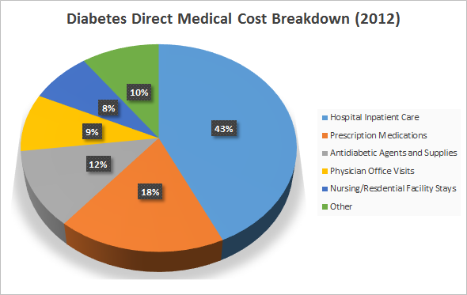
What are direct medical costs?
(American Diabetes Association 2013)

Slide 48
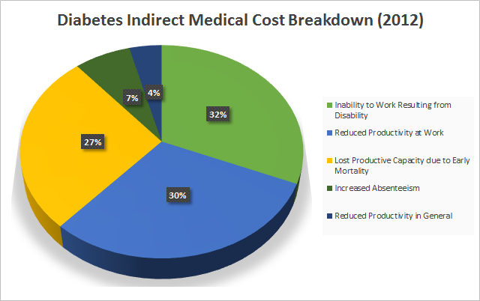
What are indirect medical costs?
(American Diabetes Association 2013)

Slide 49
Cost per Person per Year in the U.S.
Diagnosed with Diabetes..................$13,700
Absence of Diabetes...........................$5,800
Annual Cost of Diabetes per Person...$7,900
People with diagnosed diabetes have medical expenditures that are
2.3 times higher than if they did not have diabetes.
(American Diabetes Association 2013)

Slide 50
Financial Impact Data: Reliability and Validity
These estimates omit:
intangibles from pain and suffering
resources from care provided by non-paid caregivers
burden associated with undiagnosed diabetes
So in reality, the true cost of diabetes is likely even higher than $245,000,000,000 per year.

Slide 51
Current Major Research Efforts
National Diabetes Prevention and Control Program (NDPCP)
Goals
defining the diabetes burden
conducting applied translational research
strengthening state-based diabetes control programs
partnering on national diabetes efforts
National Diabetes Educational Program (NDEP)
Budget: $63 million from Congress
$30 million distributed to Diabetes Prevention and Control Programs (DPCP’s)

Slide 52
Current Major Research Efforts
Prevention Research Centers (PRCs)
33 PRCs
community-based research and translation into practice
Racial and Ethnic Approaches to Community Health (REACH)
15/40 REACH grantees address diabetes specifically
Steps to a Healthier U.S.
in 40 communities; $50 million budget
addresses obesity, diabetes, and asthma via their common risk factors

Slide 53
Future Areas of Study
Determining the necessary intensity, frequency, and duration of physical activity
Better elucidating healthy/preventative dietary components and amounts
Investigating effectiveness of lifestyle interventions for obese adults with normal glucose tolerance or prediabetes
Examining potential effectiveness of lifestyle interventions that rely on “nonselective” community recruitment
Determining effective lifestyle behavior change maintenance strategies
Investigating long-term outcomes of lifestyle interventions on diabetes complications

Slide 54
Additional Questions
What is the most effective way to identify individuals at high risk for prediabetes?
What changes in the health system and policy are needed to support and sustain lifestyle interventions?
What roles, responsibilities, and resources are most suitably placed in the hands of the physician, the healthcare system, or public health in a manner that will endure effective collaboration?

Slide 55
We hope you enjoyed learning

