Slide 1
Hypertension and Stroke
Emily Godbout DO
Epidemiology of Chronic Disease
3/20/2017

Slide 2
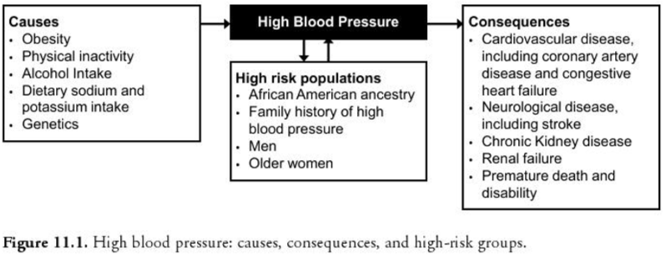
Objectives

Slide 3
BACKGROUND

Slide 4
Incidence and Economic Burden
1 in 3 US Adults or about 75 million people have high blood pressure
Only about half (54%) of these people have their blood pressure under control
Nearly 1 in 3 American adults has prehypertension
High blood pressure costs the nation $46 billion each year

Slide 5
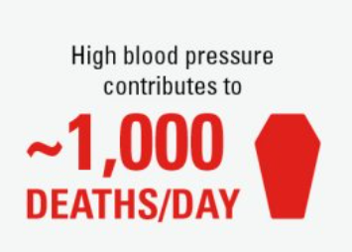
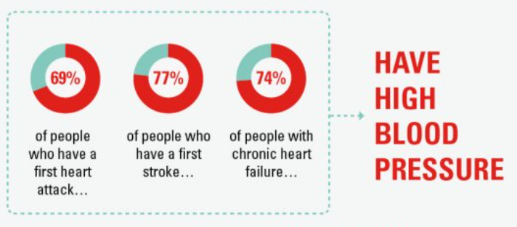
Why Blood Pressure Matters
More than 360,000 American deaths in 2013 included high blood pressure as a primary or contributing cause
Increases your risk for other health conditions:

Slide 6
DEFINITION

Slide 7
What is high blood pressure?
Force of blood pushing against the walls of the larger, low resistance arteries as the heart pumps blood
Systolic pressure: blood pressure when the heart beats while pumping blood
Diastolic pressure: blood pressure when the heart is at rest between beats
Known as the “silent killer” because there are no warning signs or symptoms and many people do not know they have it

Slide 8
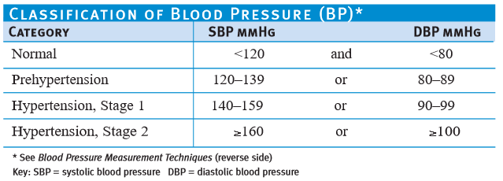
How is blood pressure classified?
People with diabetes or chronic kidney disease should keep their blood pressure below 130/80 mmHg
Notes:
Precise blood pressure definitions are those above which blood pressure lowering interventions have been shown to reduce the risk of stroke and CAD
Diagnosis is based on the average of at least two BP measurements taken on at least two sequential clinic visits

Slide 9
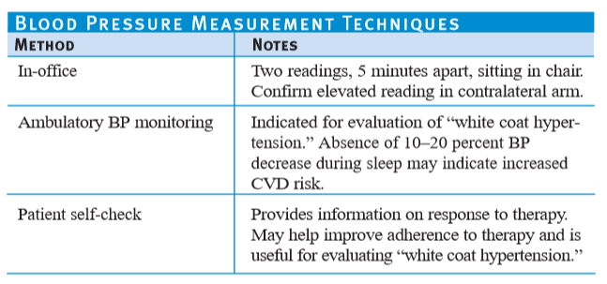
How to Measure Blood Pressure:

Slide 10
PATHOPHYSIOLOGY

Slide 11
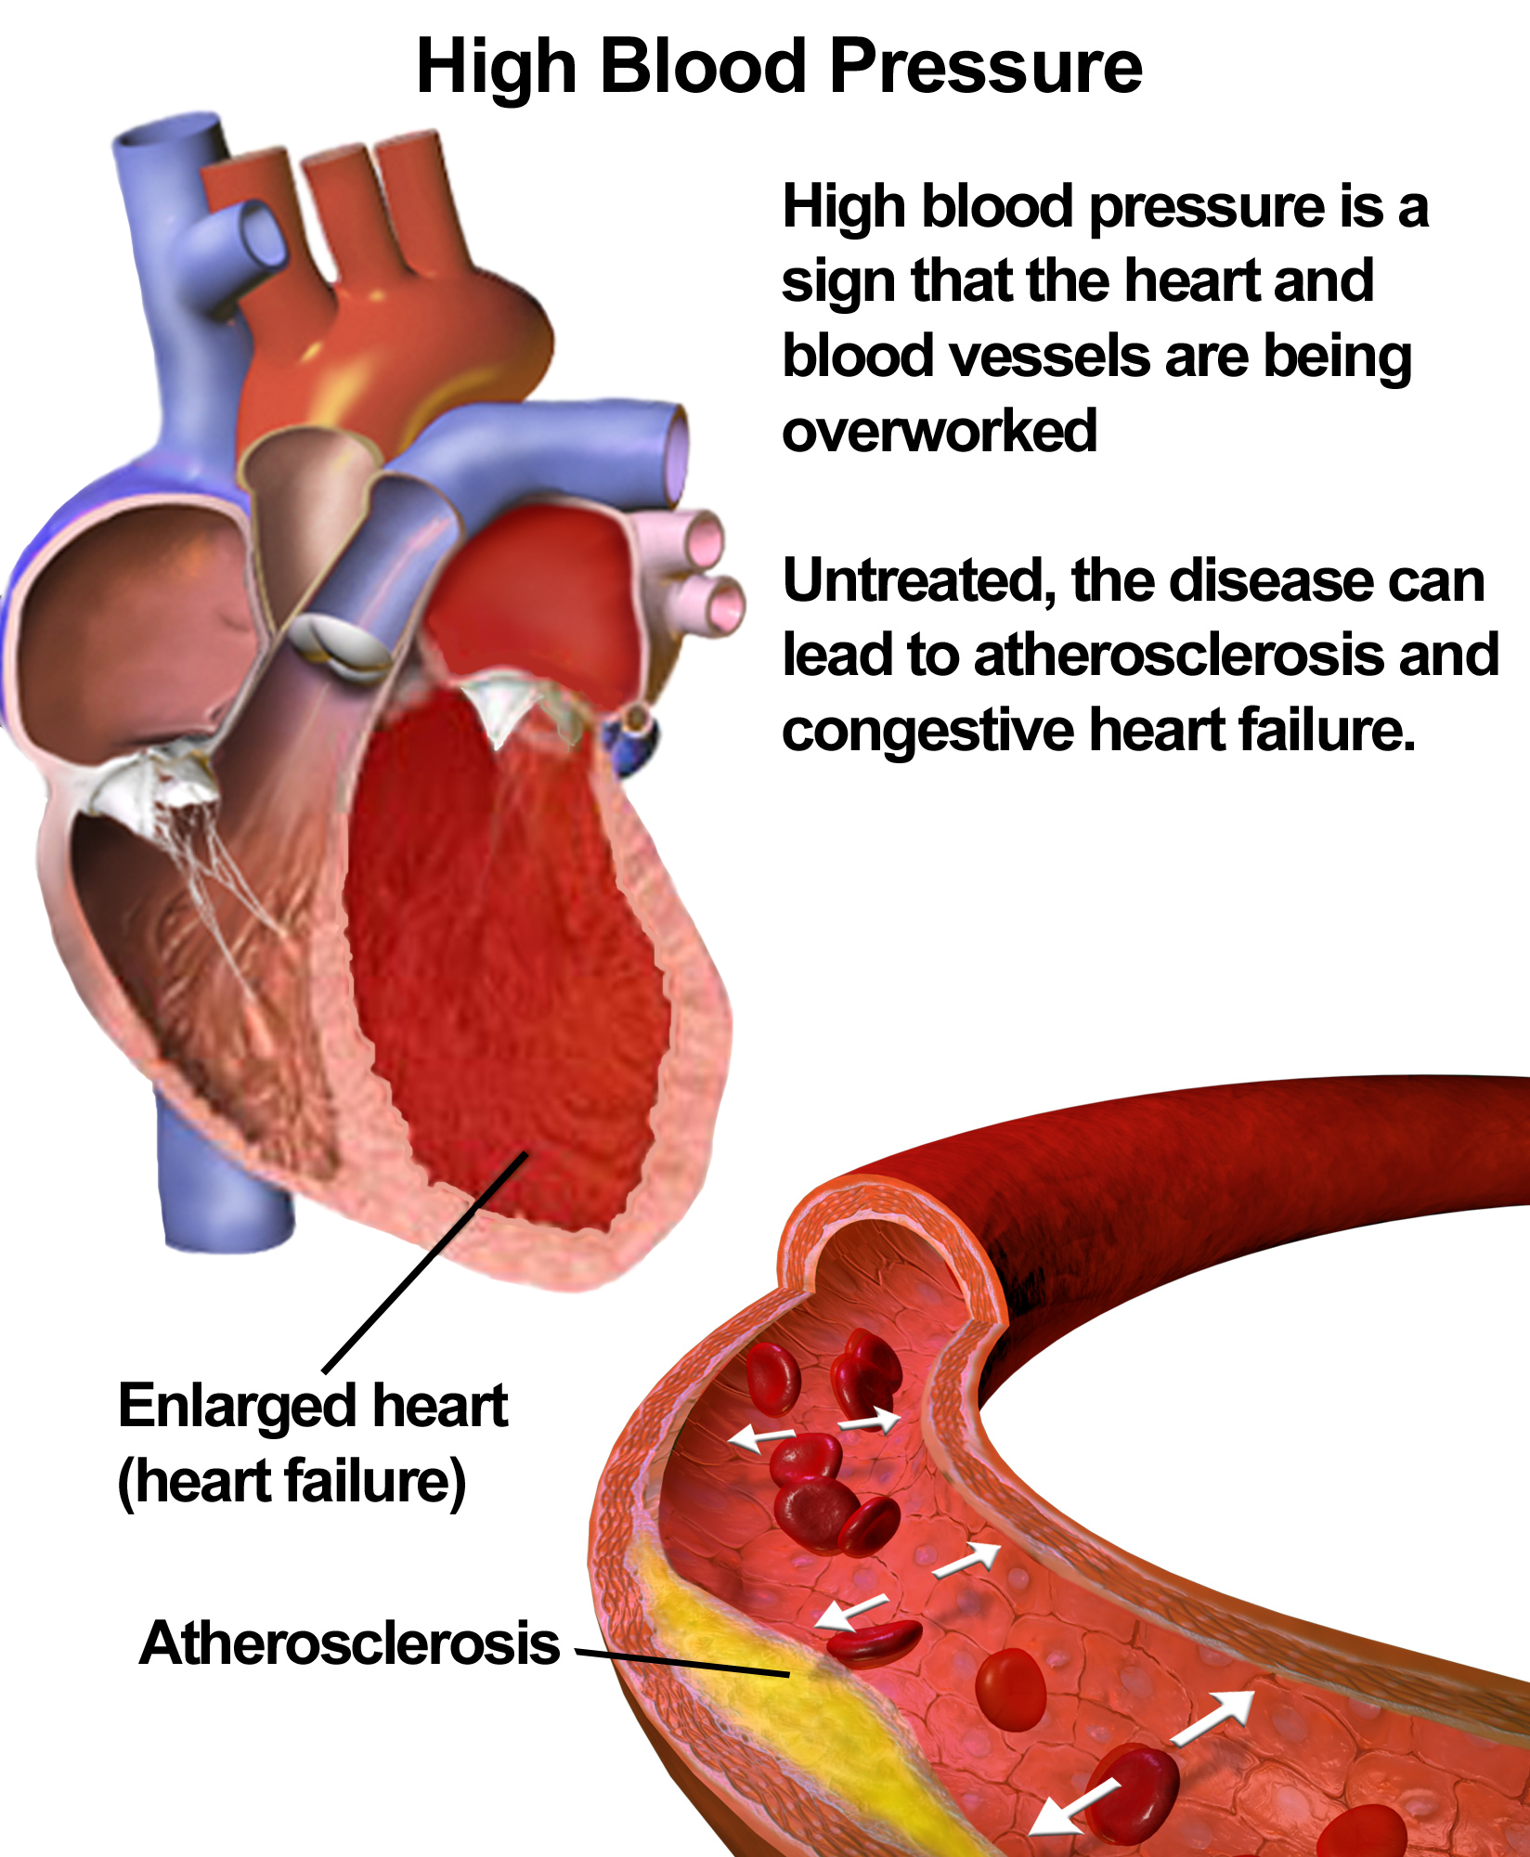
Pathophysiology
Notes:
Mean arterial pressure is the product of cardiac output, the volume of blood pumped by the heart by unit of time
Systemic vascular resistance is the force that small peripheral arteries oppose the circulation in the blood
Kidney, sympathetic nervous system and renin-angiotensin system all play a role

Slide 12
PREVALENCE

Slide 13
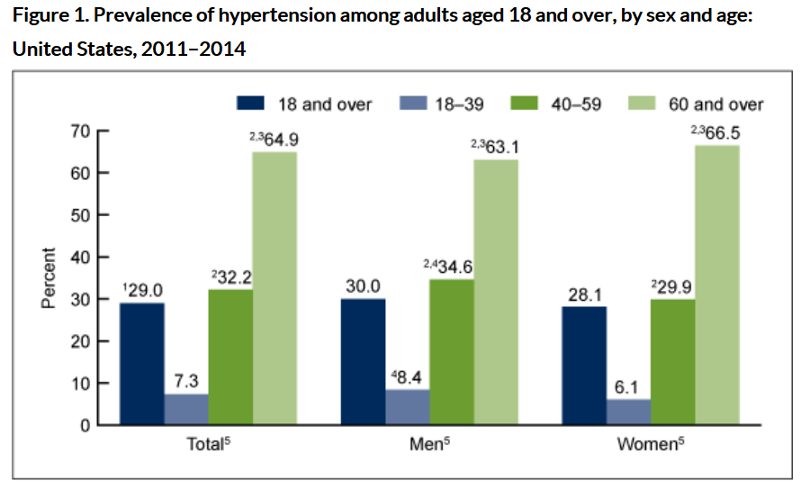
Prevalence: Sex and Age
Notes:
Prevalence of hypertension among adults was 29.0% in 2011–2014 and increased with age: 18–39, 7.3%; 40–59, 32.2%; and 60 and over, 64.9%.

Slide 14
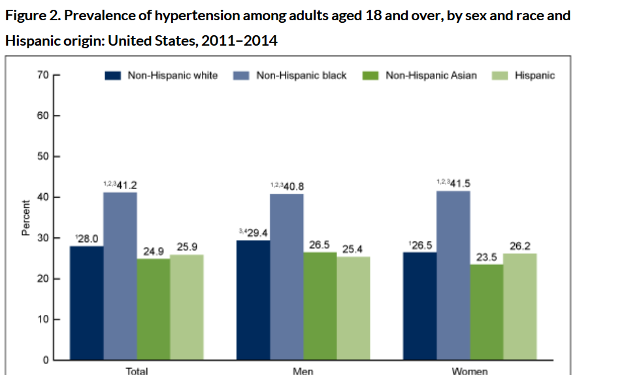
Prevalence: Sex and Race
Notes:
Hypertension prevalence was higher among non-Hispanic black (41.2%) than non-Hispanic white (28.0%), non-Hispanic Asian (24.9%), or Hispanic (25.9%) adults.

Slide 15
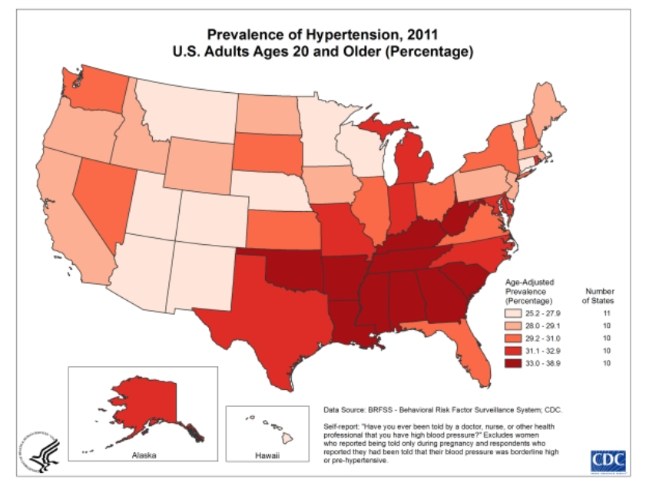
Prevalence: Geographic Location
Notes:
Rates are highest in African Americans so the prevalence is higher in states and communities with a higher proportion of African Americans
South and Southeastern US

Slide 16
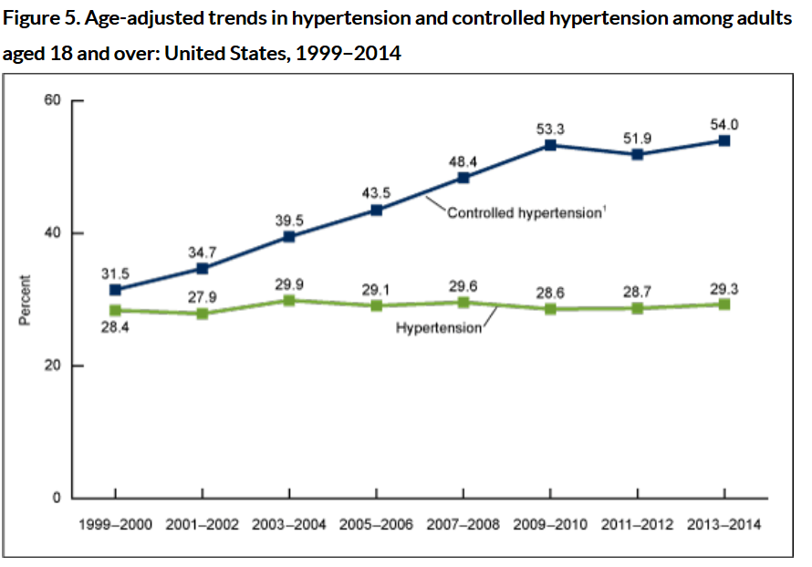
Prevalence: Time Trends
Notes:
From 1999 through 2014, no significant change was seen in the percentage of adults with hypertension. For controlled hypertension, a significant increase was noted in the percentage of adults with controlled hypertension from 1999 to 2014; however, no significant change was noted from 2009 to 2014

Slide 17
RISK FACTORS

Slide 18
Risk Factors: Nonmodifiable vs. Modifiable
NONMODIFIABLE | MODIFIABLE
Race | Obesity
Age | Dietary intake of salt
Gender | Physical Activity
Genetic susceptibility | Alcohol

Slide 19
NONMODIFIABLE RISK FACTORS

Slide 20
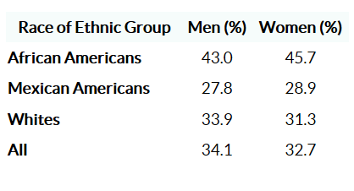
Risk Factors: Race and Ethnicity
African American develop high blood pressures more often, and at an earlier age, than whites and Hispanics
More African American women then men have high blood pressure
cdc.gov

Slide 21
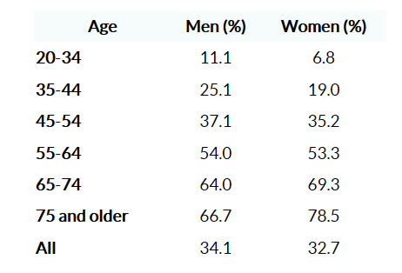
Risk Factors: Age and Gender
Women are about as likely as men to develop high blood pressure during their lifetimes
For people younger than 45 years old, the condition affects more men than women
For people> 65 years old or older, high blood pressure affects more women than men

Slide 22
Risk Factors: Genetic Factors
40% of BP variability is explained by genetic factors (Harrap et al 2000)
Risk of developing high BP age <50 doubles for each first degree relative with a history of high BP (Hopkins and Hunt 2003)
Identifying genes has been difficult due to etiologic heterogeneity of high BP

Slide 23
MODIFIABLE RISK FACTORS

Slide 24
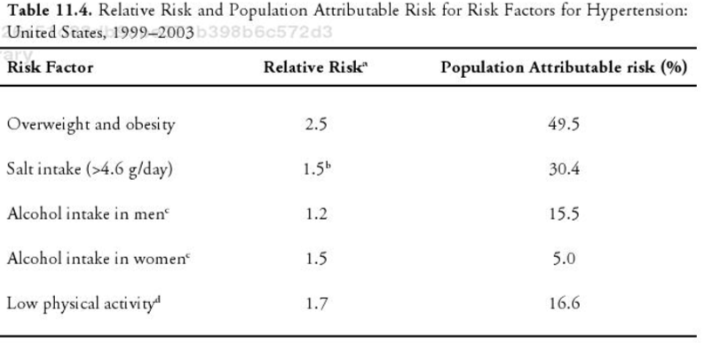
Risk Factors: Obesity
Excessive accumulation of body fat leads to higher BP
?Overactivation of sympathetic system?
Prevalence increases progressively with BMI
18% normal BMI
30.7% overweight BMI
42% obesity BMI
Neter et al 2003
Field et al 2001
Notes:
Overall, about 50% of all new cases of high BP are attributable to overweight and obesity combined

Slide 25
Risk Factors: Salt Intake
High dietary salt diet is associated with development of high BP
Compromises kidney’s capacity to excrete sodium leading to a persistent increase in blood volume and blood pressure
Neter et al 2003
Notes:
Overall, about 30% of all new cases of high BP are attributable to salt
Potassium has been associated with lower BP

Slide 26
Risk Factors: Alcohol Intake
Alcohol is associated with high BP
Biologic mechanism unclear
Neter et al 2003
Notes:
Alcohol intake corresponds to a population attributable risk of 5% in women and 15.5% in men

Slide 27
Risk Factors: Physical Activity
Inverse relationship between physical activity and BP
Reduced stroke volume, systemic arterial resistance, sympathetic activity, urinary sodium retention and insulin resistance
Studies have shown decreased odds in men and women who exercise BUT no beneficial effects of physical activity on BP were observed in African Americans in two major randomized control studies (ARIC and CARDIA cohorts)
Notes:
Low physical activity carries a population attributable risk for high BP of about 17%

Slide 28
PREVENTION

Slide 29
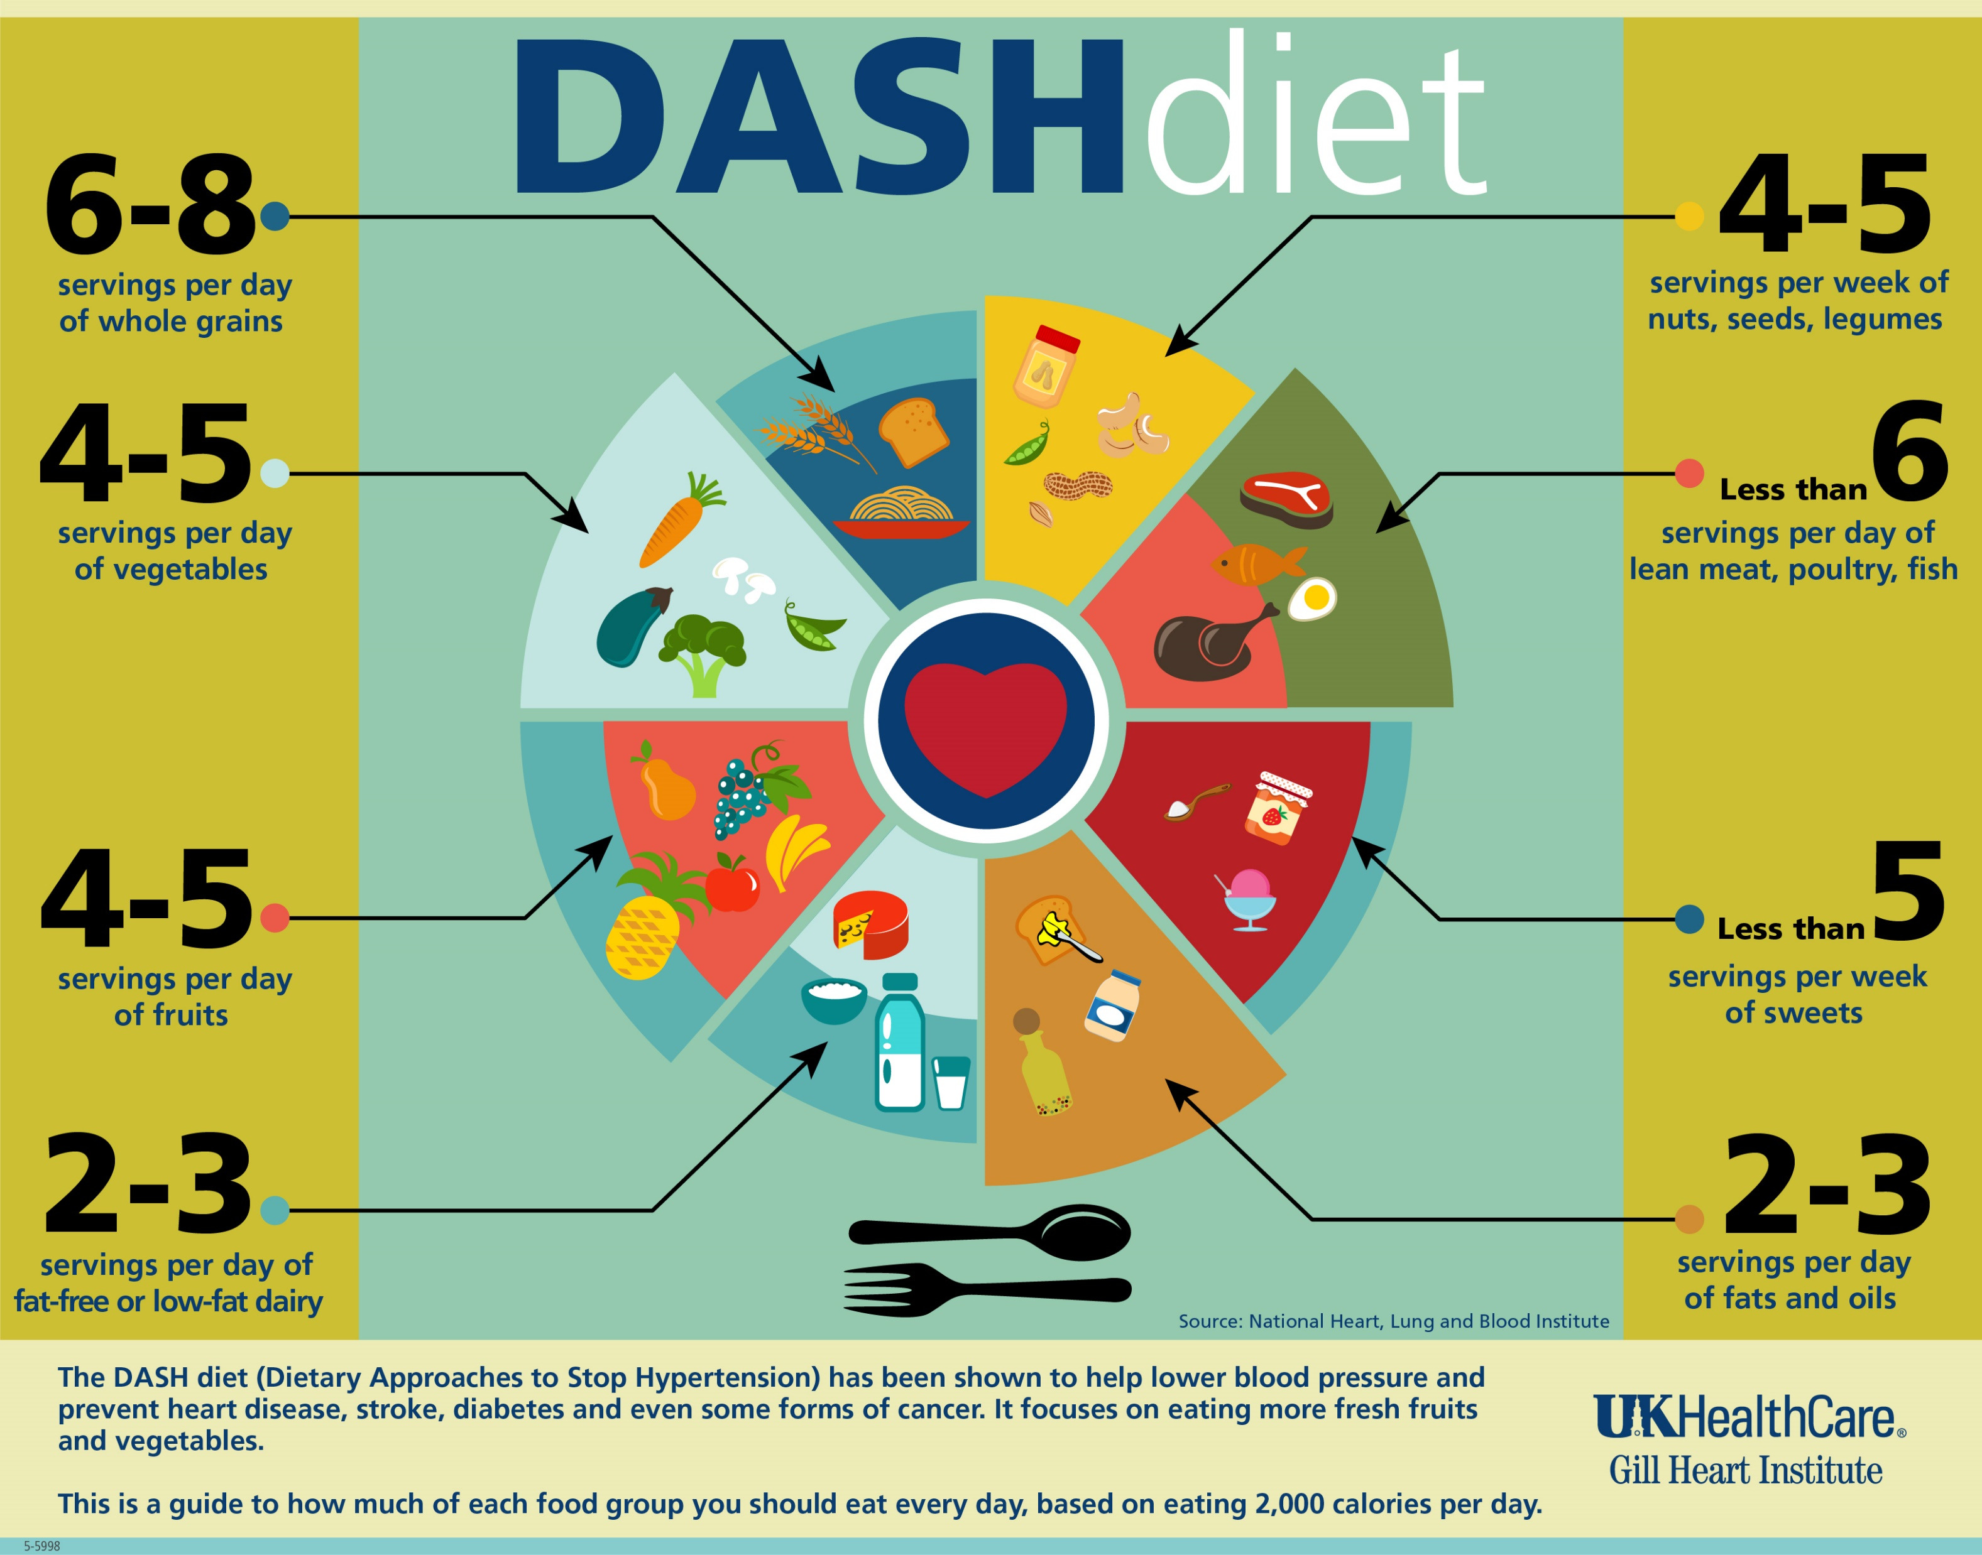
Primary Prevention: Lifestyle Modifications
Detection and management of modifiable risk factors through lifestyle changes
Weight Reduction
Salt Intake Reduction
Dietary Potassium Increase
Moderation of alcohol intake
Physical Activity
Change in dietary pattern (DASH diet)
Notes:
Dietary Approaches to Stop Hypertension

Slide 30
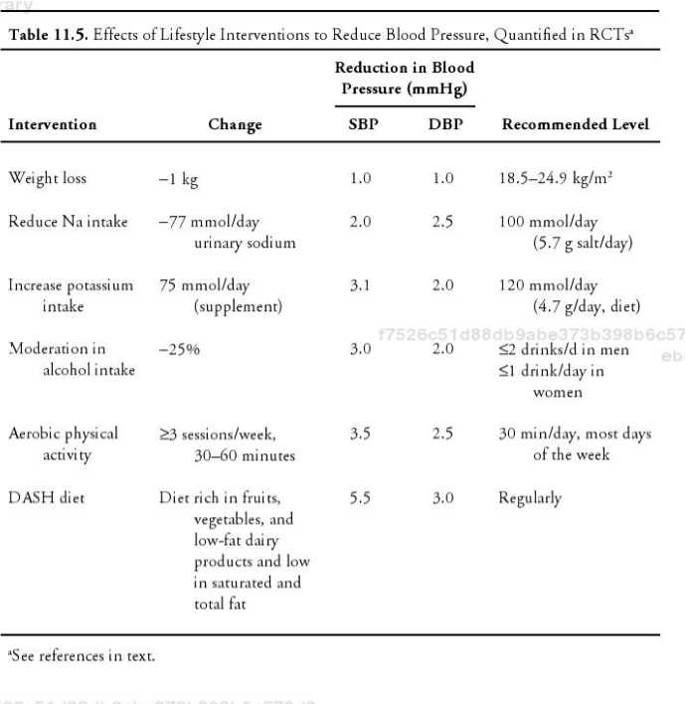
Primary Prevention: Lifestyle Modifications
Fagard 2001
Notes:
Dietary Approaches to Stop Hypertension

Slide 31
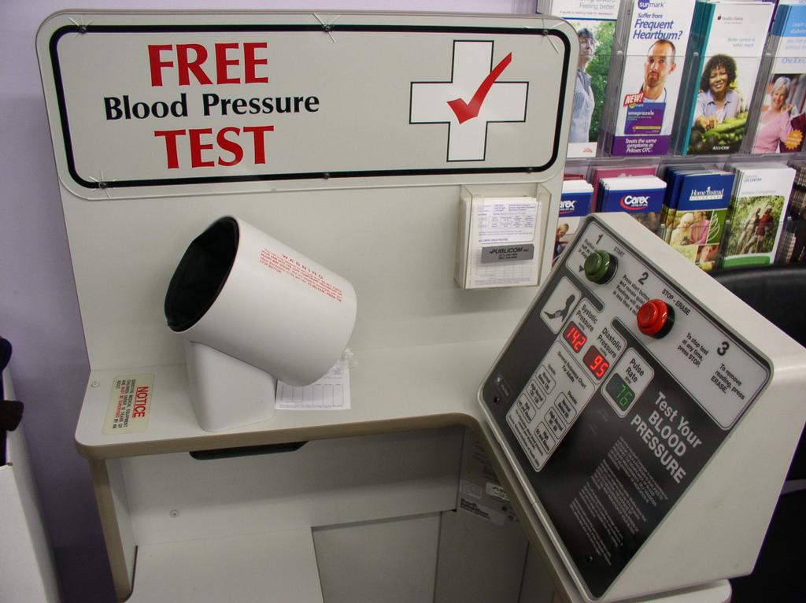
Secondary Prevention: Screening
Notes:
Dietary Approaches to Stop Hypertension

Slide 33
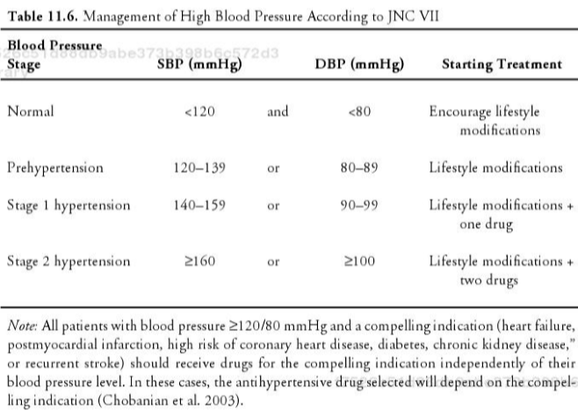
Tertiary Prevention: Pharmacological Treatment
Aim = avoid complications of high BP
Notes:
Dietary Approaches to Stop Hypertension

Slide 34
Pharmacological Treatment
In most patients with uncomplicated high BP, thiazide diuretic is preferred initial drug
Calcium channel blockers
Angiotensin-converting enzyme inhibitors
Beta-blockers
No better at preventing heart attacks and are less effective at preventing stroke than other anti-hypertensives (Cushman 2007)
Reduces the risk of cardiovascular events and that reduction in risk is proportional to the reduction in BP (Turnbull 2003)
Notes:
Dietary Approaches to Stop Hypertension

Slide 35
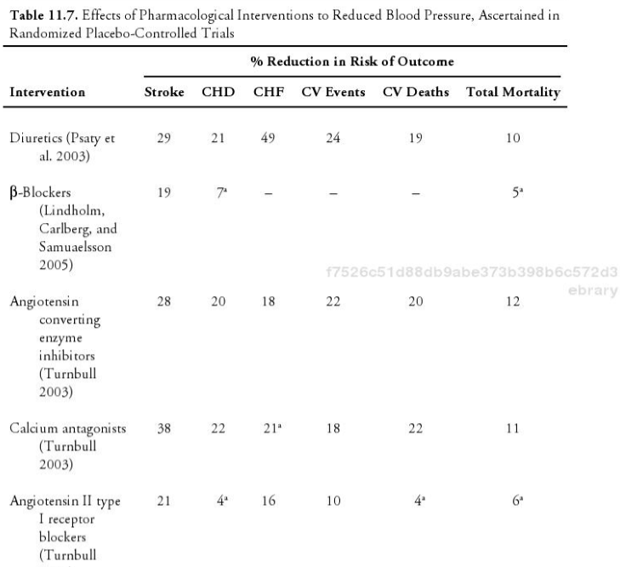
Pharmacological Treatment

Slide 36
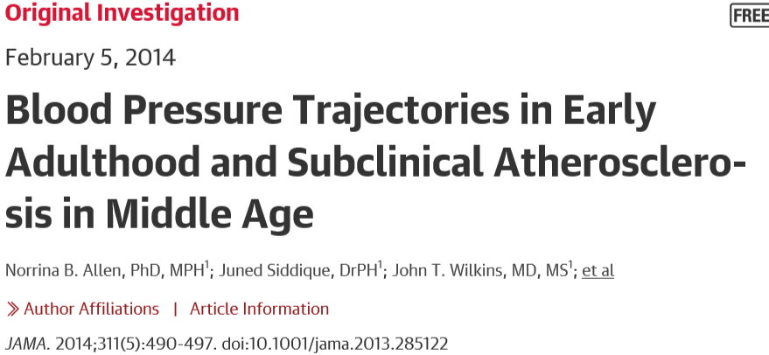
Prospective cohort data from 4681 participants in CARDIA study
25 years of follow-up
BP trajectories vary throughout young adulthood
High BP trajectories were associated with increased coronary artery calcification during middle age

Slide 37
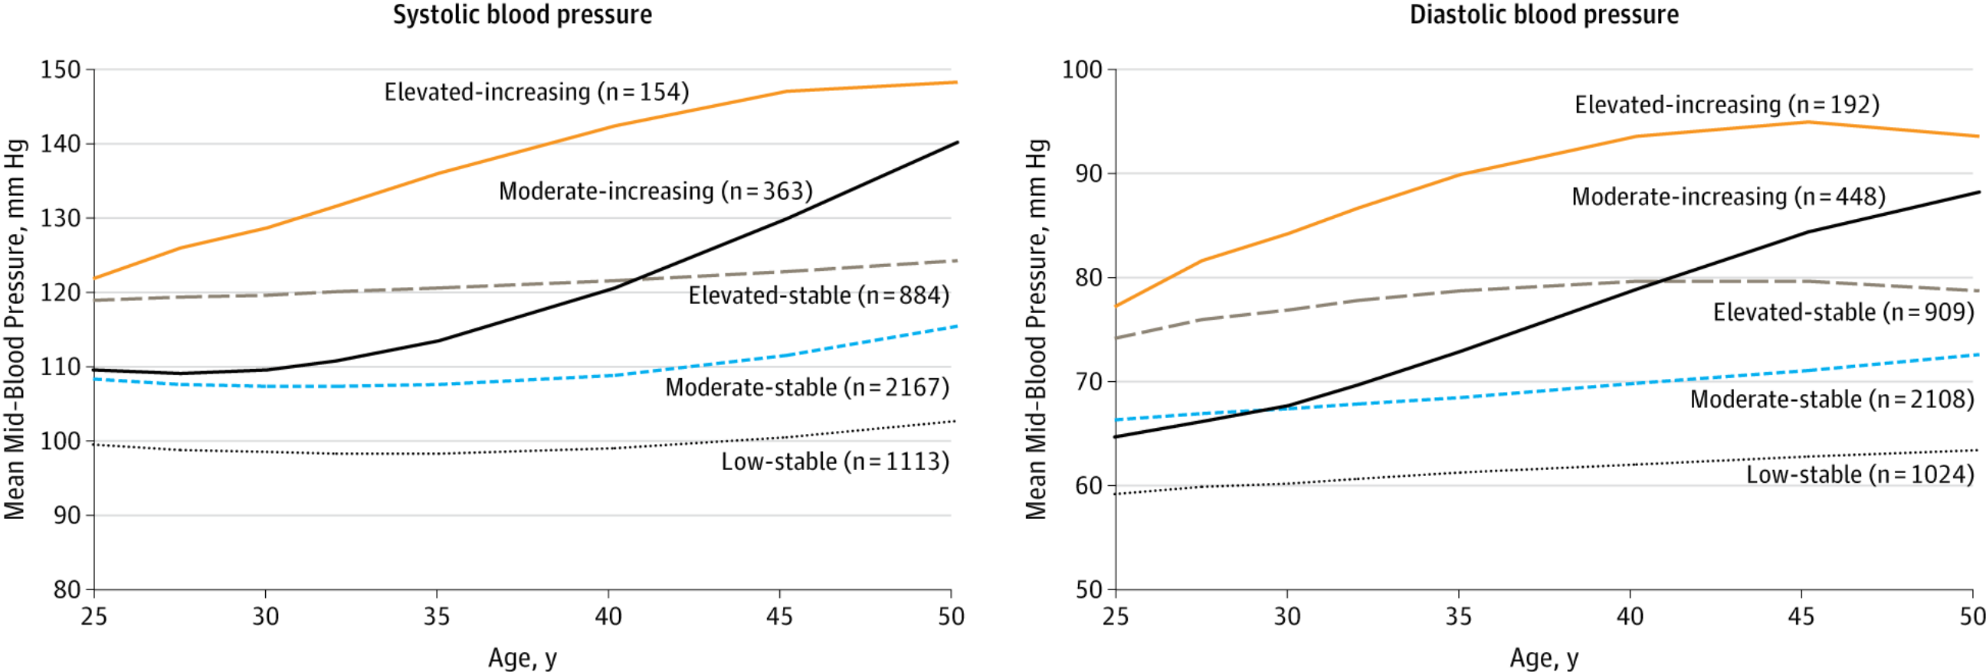
From: Blood Pressure Trajectories in Early Adulthood and Subclinical Atherosclerosis in Middle Age
JAMA. 2014;311(5):490-497. doi:10.1001/jama.2013.285122
Figure Legend:
Trajectories in Systolic and Diastolic Blood Pressure in the Coronary Artery Risk Development in Young Adults (CARDIA) StudyTrajectory classes identified for systolic and diastolic blood pressure, their pattern by age, and number of CARDIA participants in each class.
Date of download: 3/18/2017
Copyright © 2017 American Medical Association. All rights reserved.

Slide 38
CONSEQUENCES

Slide 39
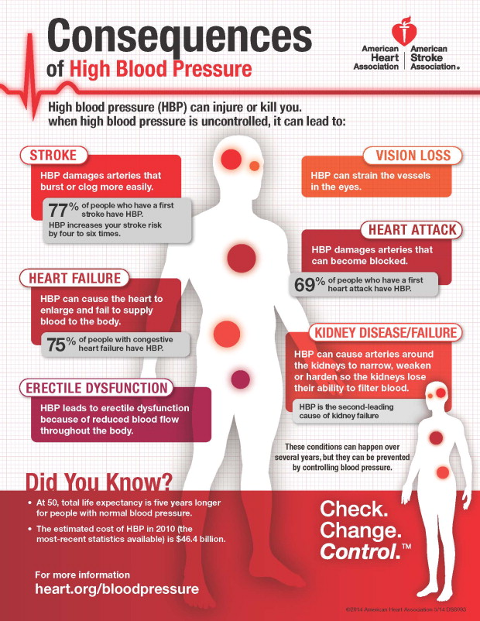
CONSEQUENCES
Aneurysms
Chronic Kidney Disease
Cognitive Changes
Eye Damage
Heart Attack
Heart Failure
Peripheral Artery Disease
Stroke
Notes:
Aneurysms:
Abnormal bulge in wall of artery
Grow and develop for years with symptoms until they rupture
Chronic Kidney Disease
When blood vessels narrow in the kidney
Cognitive Changes
Research shows that over time, higher blood pressure can lead to cognitive changes
Memory loss, difficulty finding words, losing focus during conversations
Eye Damage
Blood vessels in the eyes burst or bleeding
Vision changes or blindness
Heart Failure
When heart can’t pump enough blood to meet the body’s needs
Peripheral Artery Disease
Plaque builds up in leg arteries and affects blood flow in legs
Symptoms: pain, cramping, numbness, aching, heaviness in legs, feet and buttocks
Stroke

Slide 40
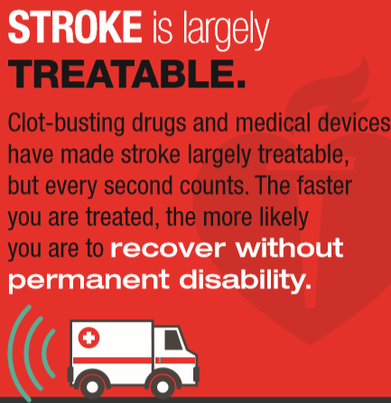
STROKE

Slide 41
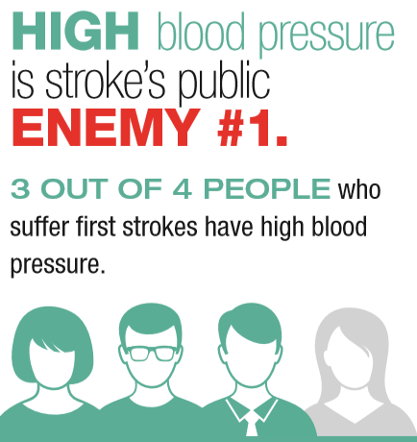
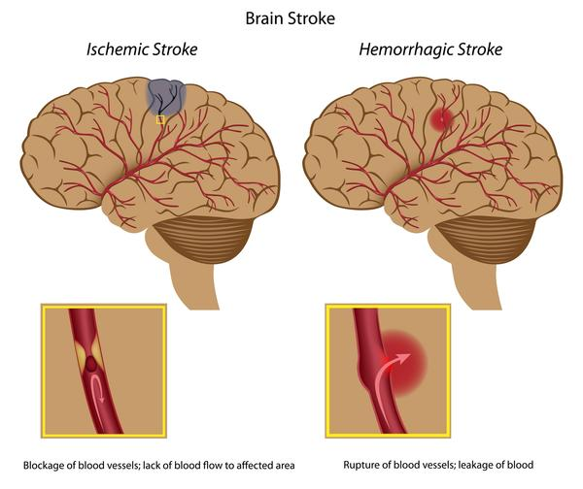
What is a stroke?
https://www.youtube.com/watch?v=pcmrgwNCPwM
About 87% of all strokes are ischemic, in which blood flow to the brain is blocked

Slide 42
Incidence and Economic Burden
Fifth leading cause of death in the US, killing more than 130,000 Americans each year – that’s 1 of every 20 deaths
Someone in the US has a stroke every 40 seconds; every four minutes, someone dies
Every year, about 795,000 people in the US have a stroke
Costs the nation $33 billion annually
A leading cause of serious long-term disability
Notes:
In 2010, there were an estimated 11.6 million events of incident ishemic troke and 5.3 million events of hemorrhagic storks
Incidence of ischemic stroke is decreasing from 1990 to 2010

Slide 43
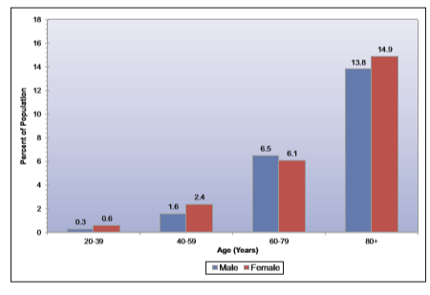
Prevalence of Stroke by Age and Gender

Slide 44
Stroke Statistics: Race
Risk is twice as high for African Americans as for whites, and African Americans are more likely to die following a stroke than whites
Hispanic’s risk for stroke falls between that of whites and blacks
American Indians, Alaska Natives and blacks are more likely to have a stroke than are other groups

Slide 45
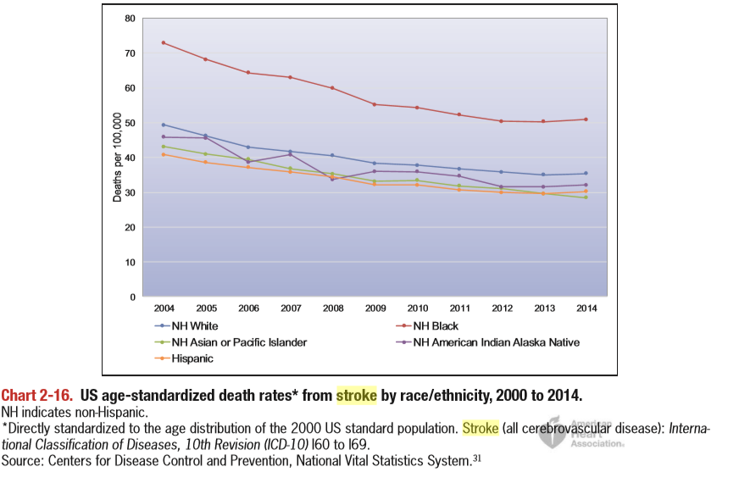
Stroke Death Rates by Race/Ethnicity

Slide 46
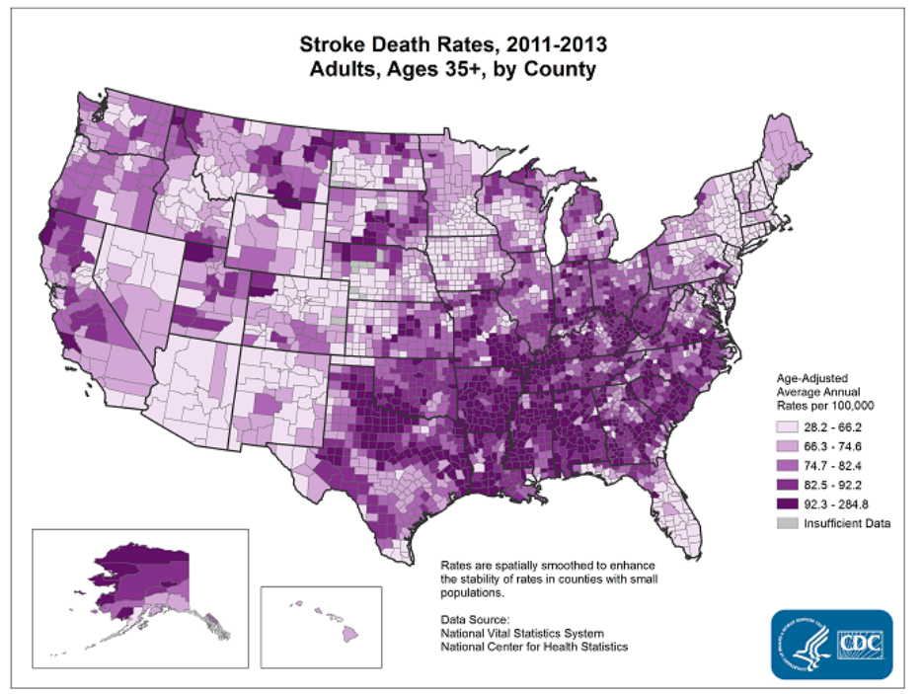
Stroke Death Rates

Slide 47
Effect of BP on Cardiovascular Mortality (Lewington et al 2002)
Meta-Analysis of cohort studies with more than 1 million adults
An increase of 20 mmHg in SPB increased CAD & stroke death rates by:
AGE | CAD DEATH RATE | STROKE DEATH RATE
40-49 | 100% | 180%
50-59 | 100% | 160%
60-69 | 90% | 130%
70-79 | 70% | 100%
80-89 | 50% | 50%

Slide 48
Stroke: Risk Factors
High BP
Median SBP declined 16 mmHg between 1959-2010 → reductions in stroke mortality
Antihypertensive therapy
Diabetes Mellitus
Increases risk of ischemic stroke incidence at all ages, but risk more prominent before 65 years in both whites and African Americans
Disorders of Heart Rhythm
High Cholesterol (and other lipids)
Smoking Use
Physical Inactivity
Nutrition
Chronic Kidney Disease

Slide 49
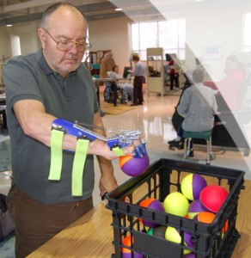
Stroke: Complications and Recovery
Leading cause of serious long-term disability in the US

Slide 50
Stroke: Prevention
A review of recent clinical trials identified the benefit of intense BP reduction, which reduced risks of stroke outcomes
Adherence to a Mediterranean-style diet that was higher in nuts and olive oil was associated with a reduced risk of stroke

Slide 51
Stroke is Treatable
Learn the signs of stroke
Getting fast treatment is important in preventing death and disability from stroke
Public Health England’s act FAST campaign
https://www.youtube.com/watch?v=WYHaSyN5eeg
Canadian Heart & Stroke
https://www.youtube.com/watch?v=1i3nMJHXk5A

Slide 52
Stroke: Treatment
If you arrive to the hospital within 3 hours of the first symptoms of an ischemic stroke
Tissue plasminogen activator (tPA) → break up clots
tPA improved chances of recovering → less disability and less likely to need long-term care in a nursing home
Hemorrhagic Stroke:
Endovascular procedures
Long tube thru a major artery in the leg or arm and guide the tube to the weak spot or break in a blood vessel
Coil is placed
Surgical Treatment
If bleeding is caused by ruptured aneurysm, a metal clip ma be put in place to stop the blood loss

Slide 53
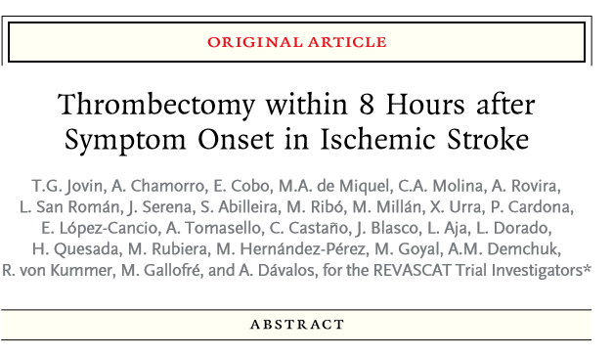
2-year randomized control trial with 206 ischemic stroke patients
Medical therapy + Endovascular therapy OR medical therapy alone (control)
Stent retriever thrombectomy reduced the severity of post-stoke disability and increased rate of functional independence

Slide 54
PSA

Slide 55
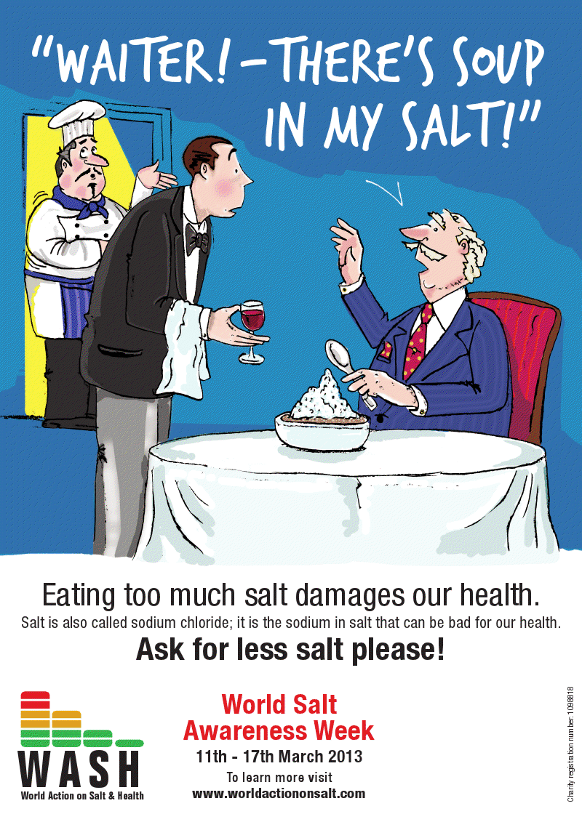
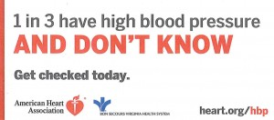
PSA

Slide 56
QUESTIONS?

