Slide 1
Dementias & Neurological Diseases
Prachi Desai
Epidemiology of Chronic Diseases

Slide 2
Neurological/Nervous System Diseases(MedlinePlus)
What if effects?
Nervous system: brain, spinal cord, and nerves
Control all the workings of the body
affects moving, speaking, swallowing, breathing, learning memory, senses, or mood
600 neurologic diseases
Major Diseases:
-Huntington's disease and muscular dystrophy
-Spina bifida
-Parkinson's disease and Alzheimer's disease
-Stroke
-Injuries to the spinal cord and brain
-Epilepsy
-Brain tumors
-Meningitis
Notes:
When something goes wrong with a part of your nervous system, you can have trouble moving, speaking, swallowing, breathing, or learning. You can also have problems with your memory, senses, or mood
-http://www.nlm.nih.gov/medlineplus/neurologicdiseases.html

Slide 3
Neurological/Nervous System Diseases(WHO)
Who is effected:
Approximately 6.2 million people die because of stroke each year(80% of deaths take place in low/middle-income countries)
More than 50 million people have epilepsy worldwide
An estimated 35.6 million globally people with dementia
7.7 million new cases every year of Alzheimer's
The prevalence of migraine is more than 10% worldwide
Neurological/Nervous System Diseases(Table 17.1)
Parkinson Diseases
Cerebral palsy
Autism spectrum disorders
ADHD
Epilepsy
Dementia- Alzihemiers
Notes:
http://www.who.int/features/qa/55/en/

Slide 4
Neurological/Nervous System Diseases(Table 17.1)
Parkinson Diseases
When there is progressive loss of muscle control, due to problems with certain nerve cells in the brain
Cause: genetics(PINK1, LRRK2, DJ-1, and glucocerebrosidase) and environmental factors ( rural living, well water, manganese and pesticides)
Symptoms: Having one or more of the four most common motor symptoms
Primary Motor Symptoms
Secondary Motor Symptoms
Nonmotor Symptoms
Consequences: Motor impairment, premature death, depression, long term caregiver
High Risk group: onset at around 60 years of age. Men are 1.5 to 2 times more likely than women to have PD
Age Group: early-onset Parkinson's disease (onset between 21-40 years), and juvenile-onset Parkinson's disease (onset before age 21)
Intervention: Many medication available yet no curable prescription, or deep brain stimulation surgery
Prevalence: 1 million people in the US and worldwide about 5 million
Notes:
-second most common neurodegenerative disorder and the most common movement disorder
http://www.medicinenet.com/parkinsons_disease/page6.htm

Slide 5
Neurological/Nervous System Diseases(Table 17.1)
Parkinson Diseases Cost:
Combined (direct +indirect )cost of Parkinson’ is estimated to be nearly $25 billion per year in the US
treatment, social security payments and lost income from inability to work
Medication costs for an individual person with PD average $2,500 a year
Therapeutic surgery can cost up to $100,000
Who has it?
As many as one million Americans live with Parkinson's disease
Incidence increases with age, but an estimated 4% of people with PD are diagnosed before the age of 50
Second most common neurodegenerative disorder and the most common movement disorder
Approximately 60,000 Americans are diagnosed with Parkinson's disease each year
thousands of cases that go undetected
Notes:
http://www.medicinenet.com/parkinsons_disease/page6.htm
http://www.pdf.org/en/parkinson_statistics

Slide 6
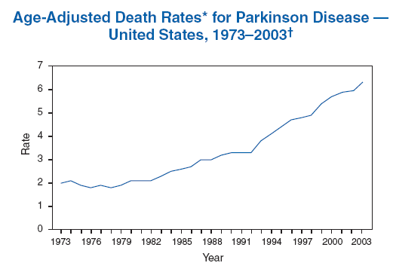
Neurological/Nervous System Diseases(Table 17.1)
Parkinson Diseases
Notes:
http://www.medicinenet.com/parkinsons_disease/page6.htm
http://www.pdf.org/en/parkinson_statistics

Slide 7
Neurological/Nervous System Diseases(Table 17.1)
Cerebral palsy:
Group of non-progressive chronic disorders, causing impairment of controlled movement due to damage to the developing brain (before birth, during birth, or after birth)
Risk Factors: Brain injury during a baby's development in the womb, brain trauma, infections during pregnancy, severe jaundice, breech births, low birth weight, low apgar score, twins , or parents age
Consequences: quality of life, feeding and motor difficulties, social isolation
Age Group: 3-5 years
Intervention: Therapy, medications
Prevalence: The United Cerebral Palsy Association estimates that more than 764,000 Americans have CP
Cost: “Lifetime costs in 2003 dollars, was $11.5 billion for person with cerebral palsy”- CDC
Indirect costs –$9.241 billion(productivity loss due to inability to work; limitation in the amount or type of work; and premature mortality)
Direct medical costs –$1.175 billion(physician visits, prescription medications, in-patient hospital stays, assistive devices, therapies, rehabilitation, and long-term care)
Direct non-medical costs $1.054 billion(special education, home and automobile modifications)
Notes:
http://www.webmd.com/brain/understanding-cerebral-palsy-basic-information?page=2
http://cerebralpalsy.org/

Slide 8
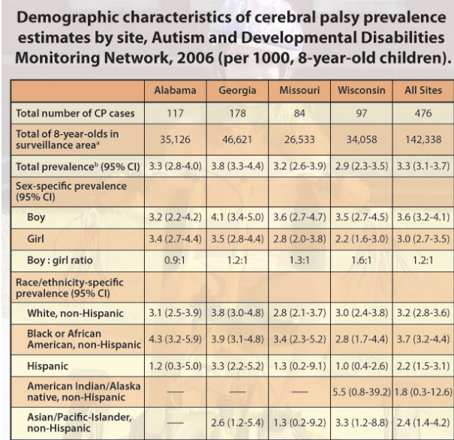
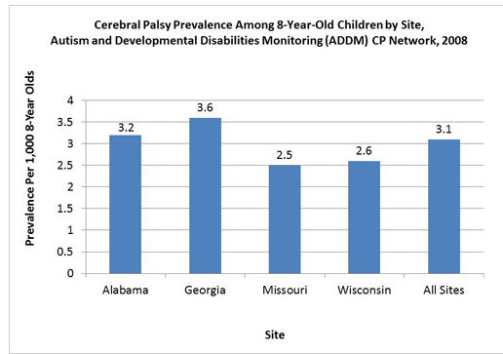
Neurological/Nervous System Diseases(Table 17.1)
Notes:
http://www.webmd.com/brain/understanding-cerebral-palsy-basic-information?page=2
http://cerebralpalsy.org/

Slide 9
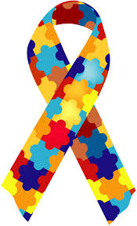
Neurological/Nervous System Diseases(Table 17.1)
Autism spectrum disorders
Autism spectrum disorders (ASDs) -developmental disabilities causing social, communication and behavioral challenges. 3 types: Autistic Disorder, Asperger Syndrome and Pervasive Developmental Disorder
The latest revision of DSM—DSM-5 reorganized the triad into a dyad: diﬃculties in social communication, social interaction, restricted and repetitive behavior, interests, or activities
Cause: Genetic ,environmental factors, advanced paternal or maternal reproductive age
and maybe vaccine?!?
Consequences: social impairment, communication issues, repetitive disorders
High Risk group: Boys face about four to five times higher risk than girls.
Intervention: intensive behavioral therapy, special training for parents and family, measuring and recording each child's progress, etc
Cost: $60 billion annual cost
In 10 years, the annual cost will be $200-400 billion
** Cost of lifelong care can be reduced by 2/3 with early diagnosis and intervention**
Notes:
http://www.cdc.gov/ncbddd/autism/facts
http://www.autism-society.org/about-autism/facts-and-statistics.html
6. Autism Society estimates based on UK study by Jarbrink K, Knapp M, 2001, London School of Economics: "The economic impact on autism in Britain,"Autism, 5 (1): 7-22.html
Autism Society estimate, using Government Accounting Office Report on Autism 2007.
http://www.commed.vcu.edu/Chronic_Disease/neurologic/2014/autism%20update.pdf

Slide 10
Neurological/Nervous System Diseases
Autism spectrum disorders and Vaccines Safety:
Research:
Antigens are substances in vaccines that cause the body’s immune system to produce antibodies to fight disease
-no connection to the development of autism spectrum disorder (ASD) in children with the amount of antigens in all the vaccination in the first 2 years
Study Results:
256 children with ASD compared with 752 children without ASD
The total amount of antigens from vaccines received was the same in both groups
Children with ASD with regression (the loss of developmental skills during the second year of life) did not receive an increased number of vaccine antigens when compared to children without ASD with regression
More vaccination currently BUT decreased amount of antigens than in 1990
Notes:
-The number of vaccine antigens has decreased in recent years
-Although the routine childhood vaccine immunization schedule in 2013 contains more vaccines than the schedule in the late 1990s, the maximum number of vaccine antigens that a child would be exposed to by 2 years of age in 2013 is 315, compared with several thousand in the late 1990s
http://www.cdc.gov/vaccinesafety/Concerns/Autism/antigens.html

Slide 11
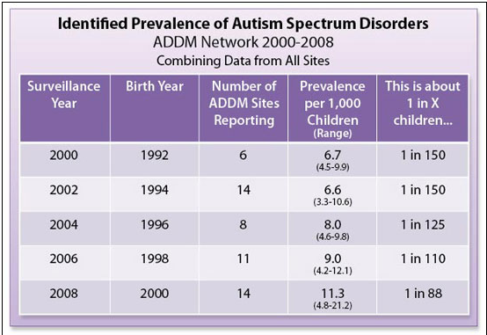
Neurological/Nervous System Diseases
Notes:
-The number of vaccine antigens has decreased in recent years
-Although the routine childhood vaccine immunization schedule in 2013 contains more vaccines than the schedule in the late 1990s, the maximum number of vaccine antigens that a child would be exposed to by 2 years of age in 2013 is 315, compared with several thousand in the late 1990s
http://www.cdc.gov/vaccinesafety/Concerns/Autism/antigens.html

Slide 12
Neurological/Nervous System Diseases(Table 17.1)
ADHD-Attention deficit hyperactivity disorder
ADHD is one of the most common neurodevelopment disorders of childhood
Signs and Symptoms:
daydream a lot
forget or lose things a lot
squirm or fidget
talk too much
Types:
Predominantly Inattentive Presentation
Predominantly Hyperactive-Impulsive Presentation
Combined Presentation
Cause:
Brain injury
Environmental exposures (e.g., lead)
Alcohol and tobacco use during pregnancy
Premature delivery
Low birth weight
Treatment:
medication
behavior therapy

Slide 13
Neurological/Nervous System Diseases(Table 17.1)
Approximately 11% of children 4-17 years of age (6.4 million have been diagnosed with ADHD as of 2011)
Boys (13.2%) were more likely than girls (5.6%) to be diagnosed with ADHD
The percentage of children with an ADHD diagnosis in 2003 was 7.8% to 9.5% in 2007 and to 11.0% in 2011
Economic Cost:
ADHD is estimated to be between $36 and $52 billion, in 2005
Estimated between $12,005 and $17,458 annually per individual
The total excess cost of ADHD in the US in 2000 was $31.6 billion
$1.6 billion was for the treatment of patients
$12.1 billion was for all other health care costs of persons with ADHD
$14.2 billion was for all other health care costs of family members with ADHD
$3.7 billion was for the work loss cost of adults with ADHD and adult family members of persons with ADHD

Slide 14
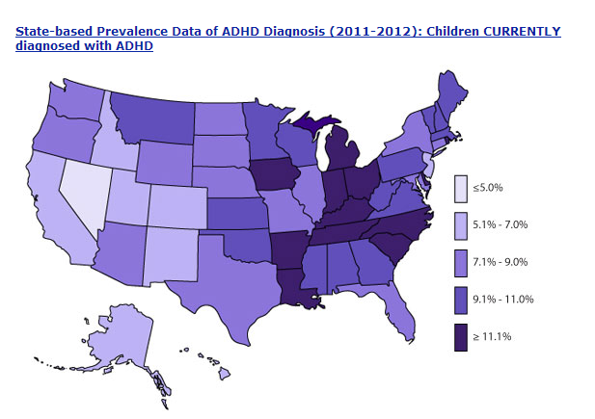
Neurological/Nervous System Diseases(Table 17.1)

Slide 15
Neurological/Nervous System Diseases(Table 17.1)
Dementia
Loss of memory and other mental abilities caused by physical changes in the brain
Group of symptoms which affect areas of thinking and social abilities
Cause:
Damage of nerve cells in the brain, nutritional deficiencies, toxic reactions(drugs/alcohol), head injury, etc
Symptoms :
-Memory Loss
-Difficulty in communication, planning, and organzation
-Personality changes
-Agitation/Anxiety
-Public show of inappropraite behavior
-Paranoia/Hallunication
Notes:
- severely enough to interfere with daily functioning
-Dementia can make you confused and unable to remember people and names. You also may experience changes in personality and social behavior. However, some causes of dementia are treatable and even reversible
http://www.mayoclinic.org/diseases-conditions/seo/basics/causes/con-20034399

Slide 16
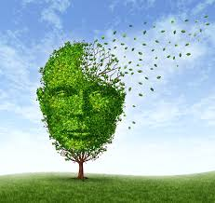
Dementia
Risk Factors:
-Age
-Family History
-Down Syndrome
-Cholesterol
-Diabetes
Risk Factors( can be altered):
-Alcohol use
-Blood Pressure
-Cholesterol
-Depression
-Diabetes
Notes:
http://www.mayoclinic.org/diseases-conditions/seo/basics/risk-factors/con-20034399

Slide 17
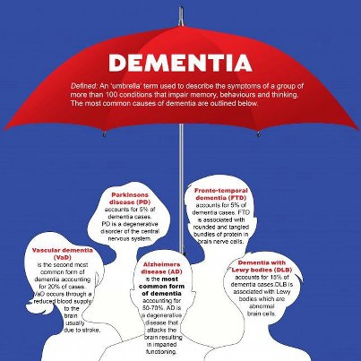
Types of Dementia
Progressive Dementia(worsen over time):
-Alzheimer's disease(50-60% cases)
-Lewy body dementia
-Vascular dementia
Disorders linked to dementia:
-Huntington's disease
-Traumatic brain injury
-HIV associated dementia
Dementia causes that can be reversed:
-Infections and immune disorders
-Nutritional deficiencies
-Reactions to medications
-Tumors
Notes:
http://www.mayoclinic.org/diseases-conditions/seo/basics/causes/con-20034399

Slide 18
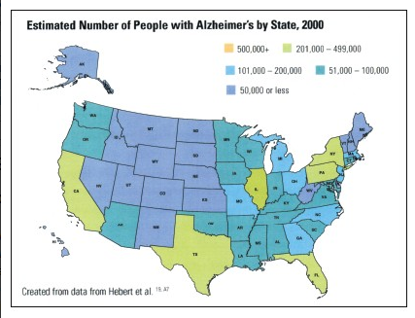
Dementia
Notes:
http://www.mayoclinic.org/diseases-conditions/seo/basics/causes/con-20034399

Slide 19
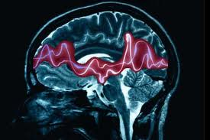
Epilepsy
-Having two or more unprovoked seizures, affecting mental and physical functions ( Epilepsy Foundation)
-Seizures are forces of electrical activity in the brain, lasting from a few seconds to a few minutes
Incidence - Epilepsy:
200,000 new cases of epilepsy are diagnosed each year
highest under the age of 2 and over 65
Males are more likely to develop epilepsy than females
greater in African American and socially disadvantaged
Prevalence - Epilepsy:
nearly 3 million in the United States
increase with age
326,000 children through age 15 have epilepsy
More than 300,000 over the age of 65 have epilepsy
Higher among racial minorities than among Caucasians
Notes:
-One in 10 adults will have a seizure sometime during their life
-They can have many symptoms, from convulsions and loss of consciousness to some that are not always recognized as seizures by the person experiencing them or by health care professionals: blank staring, lip smacking, or jerking movements of arms and legs.
http://www.epilepsyfoundation.org/aboutepilepsy/whatisepilepsy/
http://www.epilepsyfoundation.org/aboutepilepsy/whatisepilepsy/statistics.cfm

Slide 20
Epilepsy
Cause:
Newborns: Brain malformations, lack of oxygen during, low levels of blood sugar, and maternal drug use
Children and Adults: Congenital conditions, genetic factors , progressive brain disease, head trauma
Elderly: Stroke, Alzheimer's disease, head trauma
Genetic: family history, have an increased risk of developing seizures themselves
Treatment: Medication or brain surgery
Age group: age 2 and adults older than age 65
10% of Americans will experience a seizure sometime during their lives
Cost:
$15.5 billion in direct costs (medical) and indirect costs (lost or reduced earnings and productivity) yearly
Notes:
http://www.cdc.gov/chronicdisease/resources/publications/aag/epilepsy.htm

Slide 21
Epilepsy
Is epilepsy an important neurologic disease in the United States?
Epilepsy in Adults and Access to Care — United States, 2010- CDC
-Overall prevalence of Epilepsy are “scant”
-National estimates of epilepsy prevalence using NHIS data have not been reported since 1994
-Limitations:
-Based on self-reported data leading to reporting bias
-Not classified by seizure type, severity,or etiology
Notes:
-One in 10 adults will have a seizure sometime during their life
-They can have many symptoms, from convulsions and loss of consciousness to some that are not always recognized as seizures by the person experiencing them or by health care professionals: blank staring, lip smacking, or jerking movements of arms and legs.
http://www.epilepsyfoundation.org/aboutepilepsy/whatisepilepsy/

Slide 22
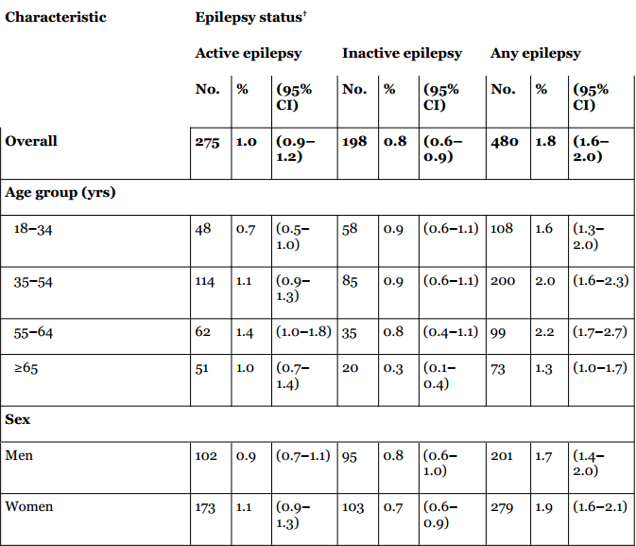
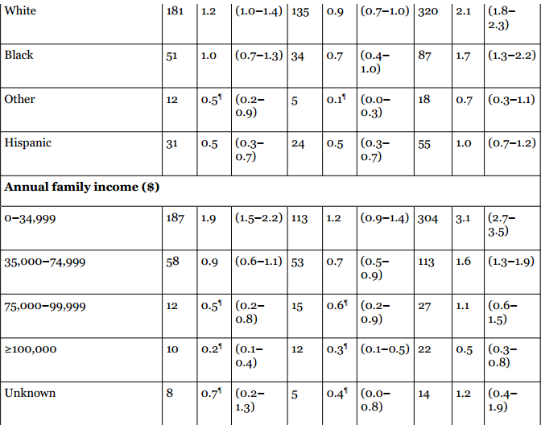
Age-adjusted prevalence of active epilepsy, inactive epilepsy, and any epilepsy, by selected characteristics — National Health Interview Survey, United States, 2010

Slide 23
Epilepsy- Table 1
-Of 27,139 adults surveyed (approximately 4.1 million adults) reported ever being told they had epilepsy
-275 (2.3 million adults) were classified as having active epilepsy
-198 (1.7 million adults) as having inactive epilepsy
-The prevalence of any epilepsy and active epilepsy did not differ significantly by age, sex, or education level
-Those with a history of epilepsy or active epilepsy were significantly more likely to be white or black or live in families at the lowest income level
-Among those living in families with annual incomes of ≤$34,999
- 1.9% had active epilepsy and 3.1% had any epilepsy

Slide 24
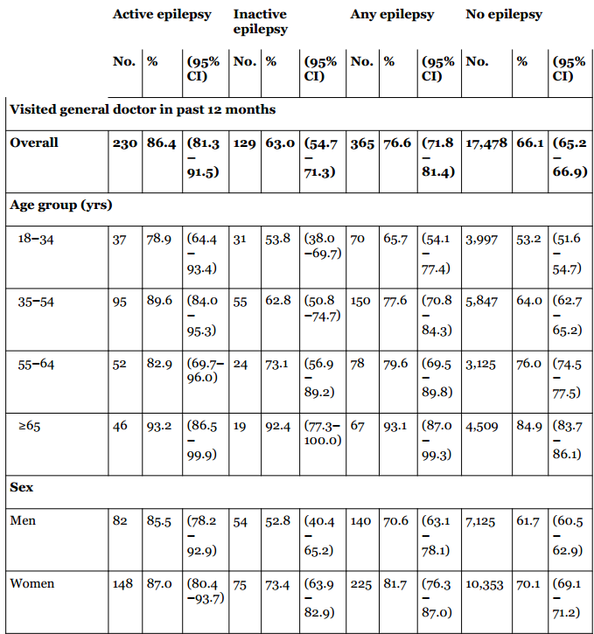
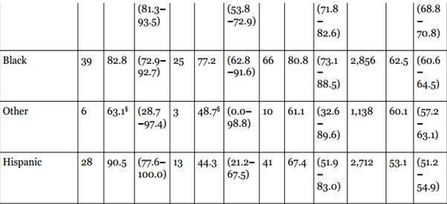
Adjusted percentage of adults who visited a general doctor, neurologist, or epilepsy specialist in the past 12 months, by epilepsy status and selected characteristics — National Health Interview Survey, United States, 2010

Slide 25
Epilepsy- Table 2
-Adults with active epilepsy (86.4%) or any epilepsy (76.6%) had visited a general doctor in the past 12 months than those without epilepsy (66.1%)
-Person aged ≥65 years with any epilepsy (93.1%) saw a general doctor than those aged 18– 34 years with any epilepsy (65.7%)
-Among adults with active epilepsy, 52.8% had visited a neurologist or epilepsy specialist in the past 12 months, as had 33.4% of those with any epilepsy
-The percentage of adults with any epilepsy and active epilepsy who had seen a neurologist or epilepsy specialist in the past 12 months did not differ by age, sex, or race-ethnicity

Slide 26
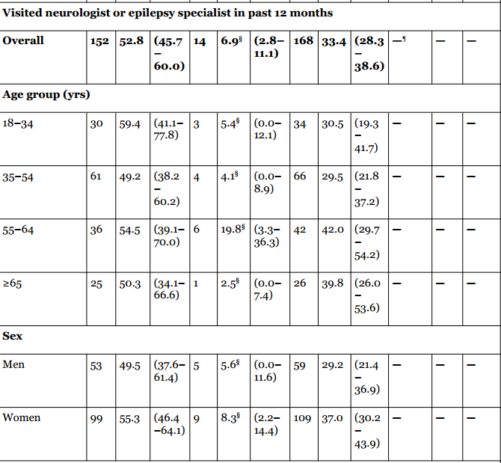
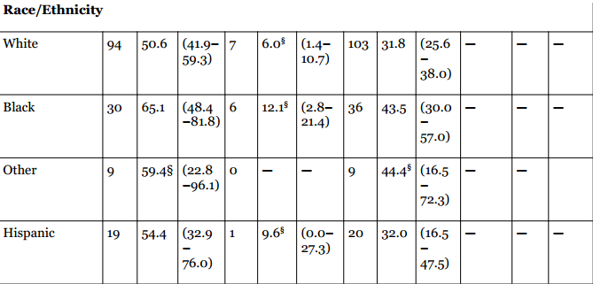
Adjusted percentage of adults who visited a general doctor, neurologist, or epilepsy specialist in the past 12 months, by epilepsy status and selected characteristics — National Health Interview Survey, United States, 2010

Slide 27
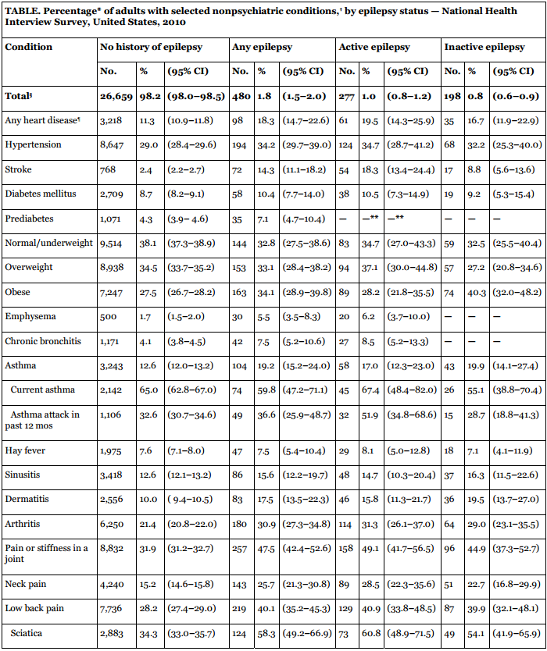
Notes:
http://www.commed.vcu.edu/Chronic_Disease/neurologic/2014/Comorbidity_EpilepsyUS2010.pdf

Slide 28
Epilepsy & Chronic Diseases
Comorbidity in Adults with Epilepsy — United States, 2010
-Higher prevalence of cardiovascular, respiratory, some inflammatory, and other disorders (headache, migraine,etc)
-Cardiovascular and metabolic disorders and their associated risk factors were common among adults with epilepsy
-More adults with any epilepsy (19.2%) and inactive epilepsy (19.9%) had asthma than those without epilepsy (12.6%)adults without epilepsy had a history of dermatitis, arthritis, recent joint pain, and other types of pain including, neck, facial, and low back pain
-Cancer was more common in adults with any epilepsy (11.3%) than adults without epilepsy (8.1%)
-Overall, found that adults with epilepsy reported co-occurring cardiovascular, respiratory, some inflammatory, and other disorders frequently.

Slide 29
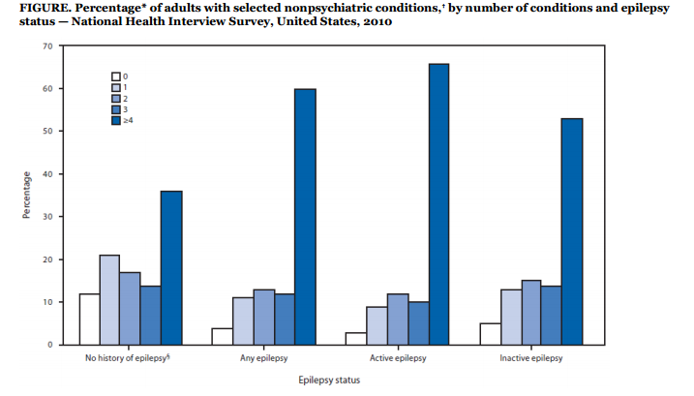
The figure above shows the percentage of adults with selected no psychiatric conditions, by number of conditions
and epilepsy status in the United States in 2010. Adults with epilepsy, especially active epilepsy, were more likely to report four or more medical comorbidities and less likely to report no other comorbidities than adults without epilepsy
Notes:
http://www.commed.vcu.edu/Chronic_Disease/neurologic/2014/Comorbidity_EpilepsyUS2010.pdf

Slide 30
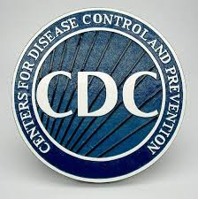
Epilepsy risk in special populations:
Comorbidity in Adults with Epilepsy — United States, 2010
25.8 % of children with mental retardation
13 % of children with cerebral palsy
50%of children with both disabilities
10 % of Alzheimer patients
22 %of stroke patients
8.7%of children of mothers with epilepsy
2.4% of children of fathers with epilepsy
33 %of people who have had a single, unprovoked seizure
Notes:
http://www.epilepsyfoundation.org/aboutepilepsy/whatisepilepsy/statistics.cfm

Slide 31
Alzheimer’s
The most common form of Dementia
Worsen over time, memory loss and other intellectual abilities
Alzheimer's disease prevents certain cells from perform the needed function
Not just a normal part of again
Risk Factors: Age, genetics, family history
Treatment: no cure for Alzheimer's
Medications for memory loss
Treatments for behavioral changes of alzheimer's
Treatments for sleep changes
Specialists:Neurologists.Psychiatrists,Psychologists

Slide 32
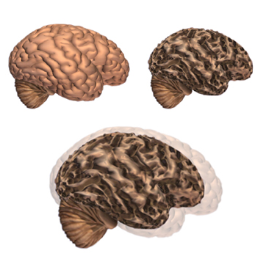
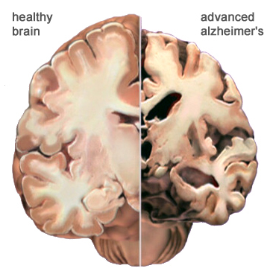
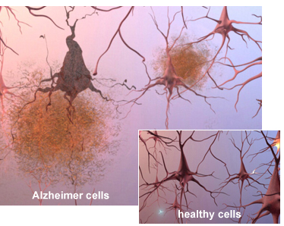
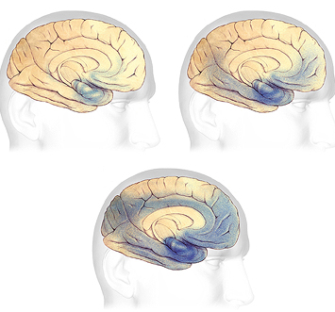

Slide 33
Alzheimer’s-7 Stages:
Stage 1: No impairment
Stage 2: Very mild decline
Stage 3: Mild decline
Stage 4: Moderate decline
Stage 5: Moderately severe decline
Stage 6: Severe decline
Stage 7: Very severe decline

Slide 34
Alzheimer’s?
What Causes Alzheimer’s?-Sue T. Griffin -Amyloid plaques were once thought to be the “smoking gun” for onset but not it proven to this present day
-Finding that inflammation may be the real cause
Scientist at Washington University School of Medicine:
-Mutations alone are not the only factors that a person will develop alzheimer's, many genetic and environmental factors also leading to development
-Mutations will have different effects on person and time of early or late onset, although these labels are not as reliable with more research
-If strong family history is present then screening is highly recommended, along with genes sequencing
-More focus on onset
early onset disease as inherited and late onset as sporadic ,because sporadic cases and
familial occur in both age groups
Notes:
https://www.alz.org/braintour/tangles.asp

Slide 35
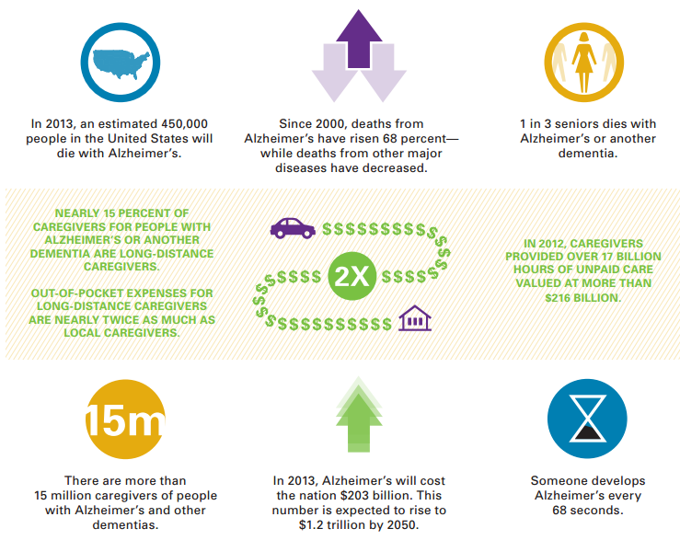
Alzheimer's 2013

Slide 36
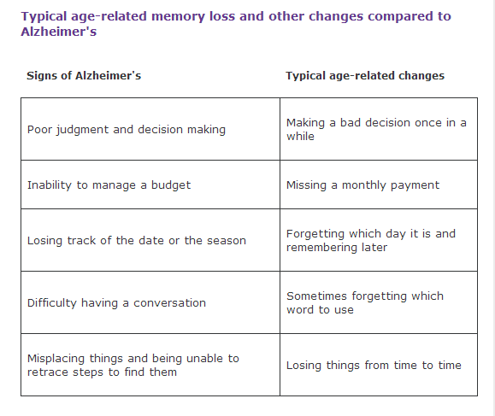
Alzheimer's or Aging?

Slide 37
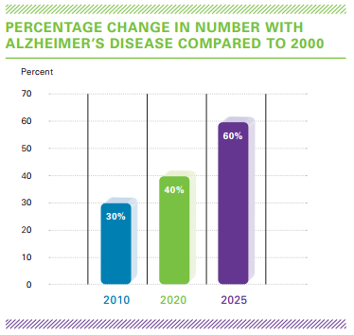
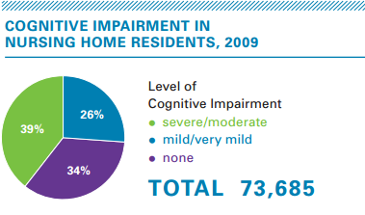
Alzheimer's Facts and Figures- Virginia

Slide 38
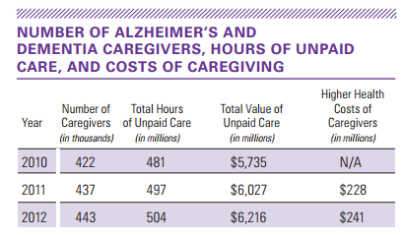
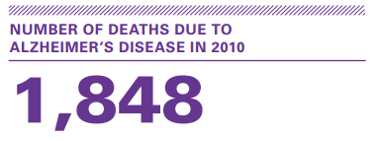
Alzheimer's Facts and Figures- Virginia

Slide 39
Caregiving for Alzheimer's Disease or other Dementia
Leading type of dementia( 50 to 70 percent of dementia cases)
- 5.3 million Americans are living with Alzheimer’s disease, and sixth leading cause of death
-An estimated 25-29% of caregivers of persons age 50 or older provide assistance to someone with a cognitive impairment, a memory problem, or a disorder like Alzheimer’s disease or other dementia (NAC, 2004)
- For Alzheimer’s disease, in 2008 there were an estimated 9.9 million caregivers providing 8.5 billion hours of care valued at $94 Billion (Alzheimer’s Association, 2009)
-The average age of a caregiver to a person with Alzheimer’s disease or other is 48 years old. (Alzheimer’s Association, 2009)
-18% of children 8 to 18 years old provide unpaid care for someone (Alzheimer’s Association, 2009)
-87% of individuals with Alzheimer’s disease are cared for at home by family members (Alzheimer’s Association, 2009)
Notes:
Alzheimer's destroys brain cells, causing problems with memory, thinking and behavior severe enough to affect work, lifelong hobbies or social life.

Slide 40
Public Health Importance in Surveillance of Dementias in New York
Assessing the public health importance of dementias event under surveillance( CDC):
frequency
severity of disease
disparities and inequities
costs
preventability
potential clinical course in absence of intervention
public interest
-1956, New York State established the Alzheimer's Disease and Other Dementias Registry
-Main problem was Data quality with hospital and nursing homes
-New York wanted to seek help in managing medical records and coding dementias and overcome current challenges
Notes:
-Completeness may be undermined when hospitals and nursing homes fail to report data, and hospital charts do not record dementia diagnoses
Dementia is well recorded in nursing home data because care planning requires frequent resident evaluations

Slide 41
Public Health Importance in Surveillance of Dementias in New York
Frequency
-The national mortality rate for Alzheimer's disease is increasing
-The age-adjusted mortality rate in 1995 was 15x the rate in 1979
-Public health practitioners agree that the number of individuals with Alzheimer's disease could triple or quadruple in the next 50
-Alzheimer's or other dementias are at increased risk of death compared
Severity of disease
-Individuals with dementia are 5x more likely to be admitted to a nursing home than others of the same age
-1/4 of individuals with mild Alzheimer's disease progress to severe Alzheimer's within 5 years
-another quarter die in this time period
Disparities and inequities
- African American and Caribbean Hispanic 2x at risk
- In New York, twice as many women over the age of 84 than men being diagnosed

Slide 42
Public Health Importance in Surveillance of Dementias in New York
Costs
-Vary per person but still very high
-Medicaid and Medicare
Preventability
-Medical advance are present yet still a slow progression
-FDA approval needed/clinical trials
Public interest
-Not as advertised as breast cancer or other chronic diseases

Slide 43
Healthy People 2020
-Nearly 60 percent of nursing home residents have Alzheimer's or another dementia
Goal:
-reduce the morbidity and costs associated with
-maintain or enhance the quality of life for, persons with dementia(Alzheimer’s) disease
Emerging Issues in Dementias, Including Alzheimer’s Disease:
Improving the early diagnosis of Alzheimer’s disease and other dementias
Developing interventions to delay or prevent Alzheimer’s disease and other dementias
Finding better ways to manage dementia when other chronic conditions are present
Understanding the influence of lifestyle factors on a person’s risk of cognitive decline and dementia
Notes:
http://www.healthypeople.gov/2020/topicsobjectives2020/overview.aspx?topicId=7

Slide 44
NINDS & Translational Research
“Neuroscience in the New Millennium”
Currently:
Drugs are available for multiple sclerosis, epilepsy, chronic pain, and other diseases
Surgical interventions( tremor and Parkinson’s disease )
Main Goals:
understand how the normal brain and nervous system develop and work
translate basic and clinical discoveries into better ways to prevent and treat neurological disorders
new drugs for diseases and disorders of the nervous system
develop new methods to accurately predict and diagnose
creating new treatments
conducting clinical trials for new treatment regimens
Notes:
http://neurology.stanford.edu/memory/research.html

Slide 45
Translational Research& Commonalities Across Diseases Workshop
The need for a better understanding of cellular and molecular mechanisms across neurodegenerative diseases
Exploring commonalities across diseases may provide a promising approach
Therapeutic approaches based on common mechanisms
Common challenges
Opportunities
Funding
Collaborations and public–private partnerships
Notes:
http://neurology.stanford.edu/memory/research.html

Slide 46
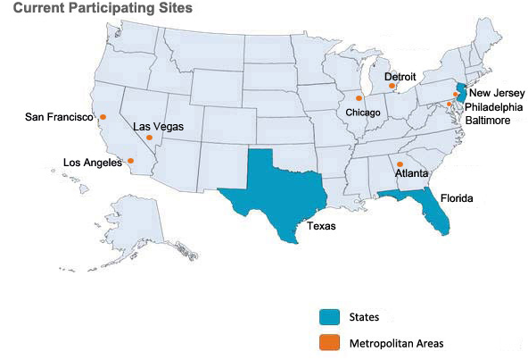
National Amyotrophic Lateral Sclerosis (ALS) Registry
-Progressive disease that attacks the nerve cells that control voluntary movement
-Congressionally mandated registry
-Collects information to help scientists learn more about who gets ALS and its causes
-Currrently unknown causes and cure
Benfits:
Translational Research
Healthcare and policy purpose
Epidemiology

Slide 47
Distinction between Mental health and Neurological Diseases
A mental illness can be only psychological, only neurological, or a combination
A neurological illness would be memory loss as a result of severe head trauma
Mental and neurological conditions are classified in different chapters of diagnostic manuals
Psychiatric disorders should be reclassified as disorders of the (central) nervous system
WHY?
currently the distinction of the mind and of brain is counterproductive for clinicians and patient
Example: In ICD(International Classification of Diseases) Alzheimer’s disease is classified as a mental disorder (F00), while Alzheimer’s disease is classified under neurology (G30)
Overall, illness affects both organs and functions
Promote a biopsychosocial model of illness and avoid misclassification
Notes:
http://www.commed.vcu.edu/Chronic_Disease/neurologic/2013/medicalorMe
disorders of the mind are rooted in dysfunction of the brain
neurological disorders interact strongly with psychological and social factors and often cause psychological symptoms
ntal.pdf

Slide 48
References
-http://www.nlm.nih.gov/medlineplus/neurologicdiseases.html
http://www.who.int/features/qa/55/en/
http://www.medicinenet.com/parkinsons_disease/page6.htm
http://www.medicinenet.com/parkinsons_disease/page6.htm
http://www.pdf.org/en/parkinson_statistics
http://www.webmd.com/brain/understanding-cerebral-palsy-basic-information?page=2
http://cerebralpalsy.org/
http://www.cdc.gov/ncbddd/autism/facts
http://www.autism-society.org/about-autism/facts-and-statistics.html
http://www.commed.vcu.edu/Chronic_Disease/neurologic/2014/autism%20update.pdf

Slide 49
References
http://www.cdc.gov/vaccinesafety/Concerns/Autism/antigens.html
http://www.mayoclinic.org/diseases-conditions/seo/basics/causes/con-20034399
http://www.commed.vcu.edu/Chronic_Disease/neurologic/2013/medicalorMental.pdf
http://neurology.stanford.edu/memory/research.html
https://www.alz.org/braintour/tangles.asp
http://www.epilepsyfoundation.org/aboutepilepsy/whatisepilepsy/statistics.cfm
Autism Society estimates based on UK study by Jarbrink K, Knapp M, 2001, London School of Economics: "The economic impact on autism in Britain,"Autism, 5 (1): 7-22.html
Autism Society estimate, using Government Accounting Office Report on Autism 2007.

