Slide 1


Adult-Onset Disease
The Example of Colon Cancer

Slide 2
Day #3 as Director
When you get to your office this morning, you see that someone has left a copy of HP2020 on your desk, opened to the page describing the new Genomics objectives. The following objective is highlighted: Increase the proportion of persons with newly diagnosed colorectal cancer who receive genetic testing to identify Lynch syndrome (or familial colorectal cancer syndromes). Attached is a post-it note: “What are we going to do about this? Can the Virginia Cancer Registry help?”

Slide 3
What Do You Need To Know and Where Are The Gaps?
What is Lynch syndrome?
How common is it?
What is the screening?
Is it cost-effective?
Is informed consent required?
Can the state registry help?
Are there alternative strategies?

Slide 4
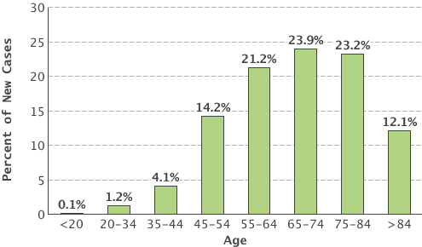
Colon Cancer
Fourth most common cancer in the U.S.
  136,830 estimated new cases (2014)
  Lifetime risk 4.7%

Slide 5
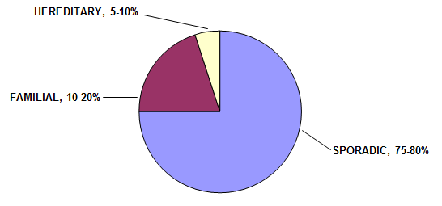
Hereditary Colon Cancer

Slide 6
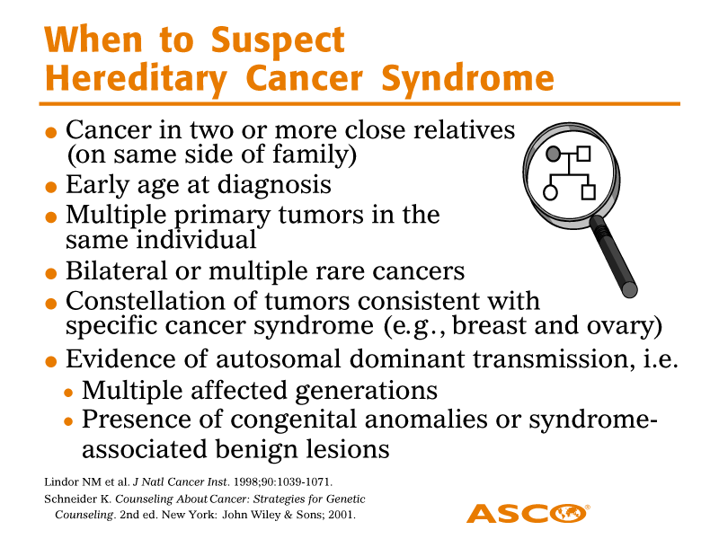

Slide 7
?
d. childbirth
?
d. 70s
3
3
2
d. 74 YO
d. 49 YO
Gastric ca
62 YO
Col Ca dx 44 YO, 61 YO
55 YO
Notes:
Example of a hereditary cancer family that was picked up because of work up in the pathology department.
Anyone know what syndrome this family might have?
Would you recommend any laboratory testing?

Slide 8
How Common Is Lynch Syndrome?
In Virginia, about 3,250 new cases of colorectal cancer are expected yearly.
About 2% of colon cancers are associated with Lynch syndrome
  Recommended screening
    Colonoscopy q 1-2 yrs starting at age 20
    Endometrial and ovarian cancer surveillance/surgery
    Potentially screening for other tumors

Slide 9
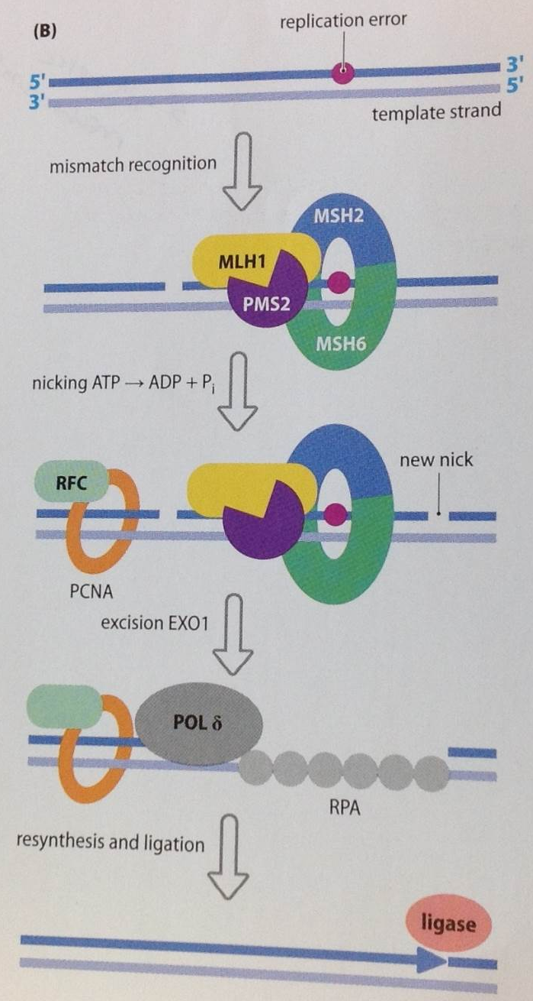
Goodship and Chinnery, 2015
Notes:
So what is the pathology work up for Lynch Syndrome?
Helps to understand the biology of Lynch Syndrome.
Associated with mutations in four genes – MLH1, MSH2, MSH6, and PMS2
Involved in mismatch repair
DNA mismatches are more likely to occur in parts of the genome that include stretches of repeated DNA. Can occur in genes important for colon cancer, like TGF-B, but many different parts of the genome include stretches of DNA repeats; called microsatellites.
MLH1 forms dimer with PMS2; MSH2 forms dimer with MSH6

Slide 10
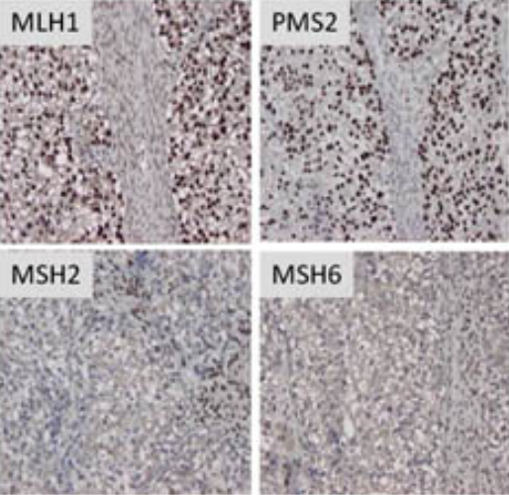
How Can We Screen the Population for Lynch Syndrome?
http://kintalk.org/whats-lynch-syndrome/diagnosing-lynch-syndrome/

Slide 11
Is Lynch Syndrome Screening Cost-Effective?
Relevant factors include:
  IHC/MSI screening typically ~$800
  Screen everyone?
  Cost of confirmatory diagnostic genetic testing
  Downstream savings
    Future cancers for patients
    Prevention of cancers for relatives
    Compliance? Family communication?
IHC as preliminary test may cost <$25,000 per life-year saved compared with no testing (Myundura et al., 2010)

Slide 12

Informed Consent?
http://www.nytimes.com/2009/07/30/health/30chen.html?pagewanted=all&_r=0
Most major centers conducting universal screening do not require consent (Beamer et al., 2012)

Slide 13
Can the State Registry Help?
www.vdh.virginia.gov/ofhs/prevention/cpc/vcr/about.htm
Mandated by the Virginia Code
How is it used?
  Planning cancer control efforts
  Investigate cancer clusters
  Research
Information includes:
  Type of cancer
  Age
  Microsatellite Instability

Slide 14

Lynch Syndrome Screening Network
www.lynchscreening.net
Promotes universal screening of colon and endometrial cancers
Resources
  Public – information brochures
  Clinicians – algorithms
  Epidemiologists - data
http://learningprofessionalnetwork.com/

Slide 15
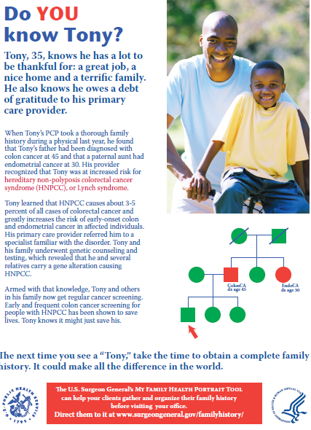

Slide 16
Will Family History Screening Work?
From EGAPP (www.egappreviews.org/recommendations/lynch.htm)
“Family history is an important risk factor for CRC in the general population. Among individuals with newly diagnosed CRC, however, family history is less useful as the first step in identifying Lynch syndrome than strategies involving the analysis of tumor samples (e.g., MSI, IHC).”
Why do you think this is?

Slide 17
Family History as a Public Health Tool
2009 AHRQ report on assessing family history:
  Difficult to assess clinical validity
  Low sensitivity, but high specificity (analytic validity)
  Impact on health behaviors uncertain (clinical utility)
  Not psychologically harmful (ELSI)
  Lots of research to be done

Slide 18
Recall Your Task
When you get to your office this morning, you see that someone has left a copy of HP2020 on your desk, opened to the page describing the new Genomics objectives. The following objective is highlighted: Increase the proportion of persons with newly diagnosed colorectal cancer who receive genetic testing to identify Lynch syndrome (or familial colorectal cancer syndromes). Attached is a post-it note: “What are we going to do about this? Can the Virginia Cancer Registry help?”

Slide 19
What Public Health Genomic Competencies Apply?
Competencies
Apply the basic public health sciences to genomic issues
Identify the role of cultural, social, behavioral, environmental and genetic factors
Participate in the evaluation of program effectiveness, accessibility, cost benefit, cost effectiveness and quality of personal and population-based genomic services in public health
Develop protocols to ensure informed consent

Slide 20

Which essential public health services are relevant?

Slide 22
A Potential Action Plan
Public Health Service:
  Monitor health status to identify and solve community health problems
You talk with leaders in the cancer registry and find out how MSI is currently recorded/used
You request a report of incident colon cancers, ages at diagnosis, and whether MSI screening was performed.
From this, you plan to identify and work with point-of-care centers that are already effectively screening for Lynch syndrome, ultimately to come up with a statewide plan.
You also contact the LSSN for collaborative opportunities

