Slide 1
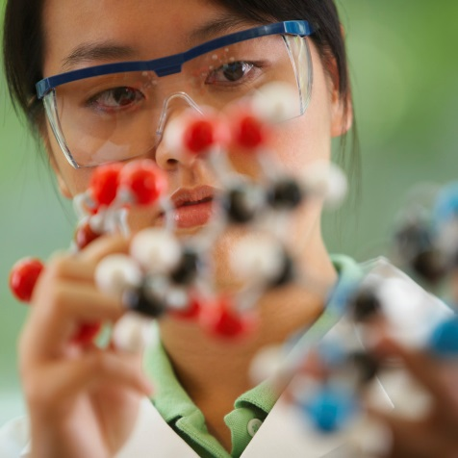

Establish a Statewide Biobank?
EPID 600
Summer, 2016

Slide 2
Day #2
The Board of Medical Assistance Services would like to meet with you about a new Medicaid genetics initiative. They would like to establish a biobank and require all new Medicaid enrollees to contribute a blood sample. Linking their genomic information with Medicaid claims data could provide a treasure trove for epidemiologic research.

Slide 3

Lecture Outline
Define biospecimens and biobanks
Talk about genomics and disease
Discuss ethical concerns about biobanking

Slide 4
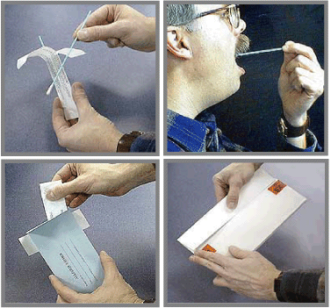
Biospecimens
Biospecimens are samples of your body.
These can be tumor tissue or normal samples like blood, hair, saliva, and urine.

Slide 5

Biobanks
Sometimes called biorepositories
Biobanks are like libraries, but they store biospecimens (samples) instead of books.

Slide 6
Why Do People Donate to Biobanks?
Help research
  When you donate, you help answer today’s questions and tomorrow’s questions.
Help cope with disease
  Many patients feel better knowing they are helping future patients, perhaps someone in their own community.

Slide 7
How Do Biobanks Help Research?
Find drugs that help specific cells
Learn how diseases progress
Group patients based on their genetic makeup
  Develop treatments specific for these genes
  Find out who might be at risk based on inherited genes
Notes:
.

Slide 8
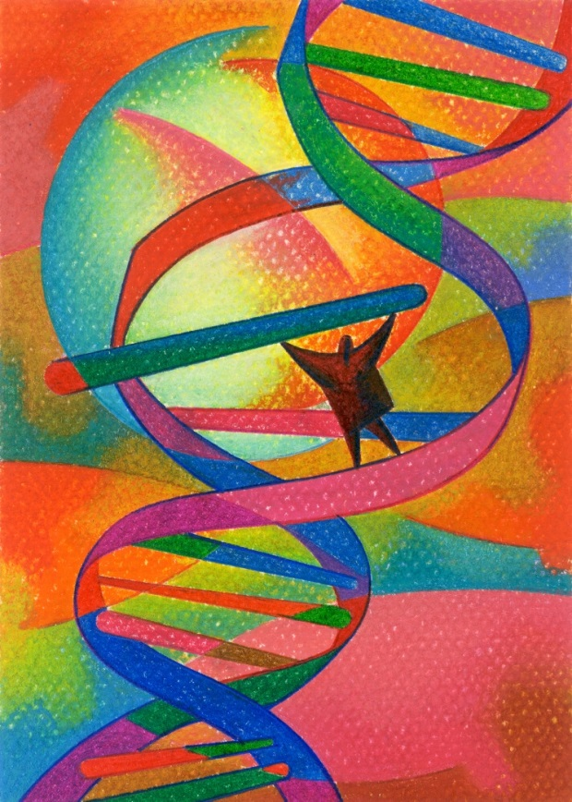
Genes and Disease

Slide 9
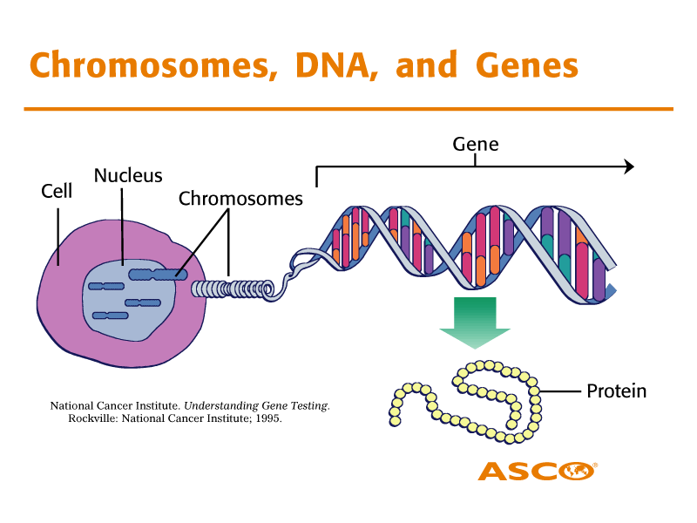
Notes:
In large part, our bodies and the engines that run them are made of proteins. All of these proteins are encoded by genes. Genes are segments of DNA – a molecule – that serves as kind of an instruction book for making proteins. These genes are packaged into structures called chromosomes. We have twenty three pairs of chromosomes. One copy of every pair is inherited from our mothers. The other copy is inherited from our fathers. These chromosomes are stored in the nucleus of every cell.

Slide 10
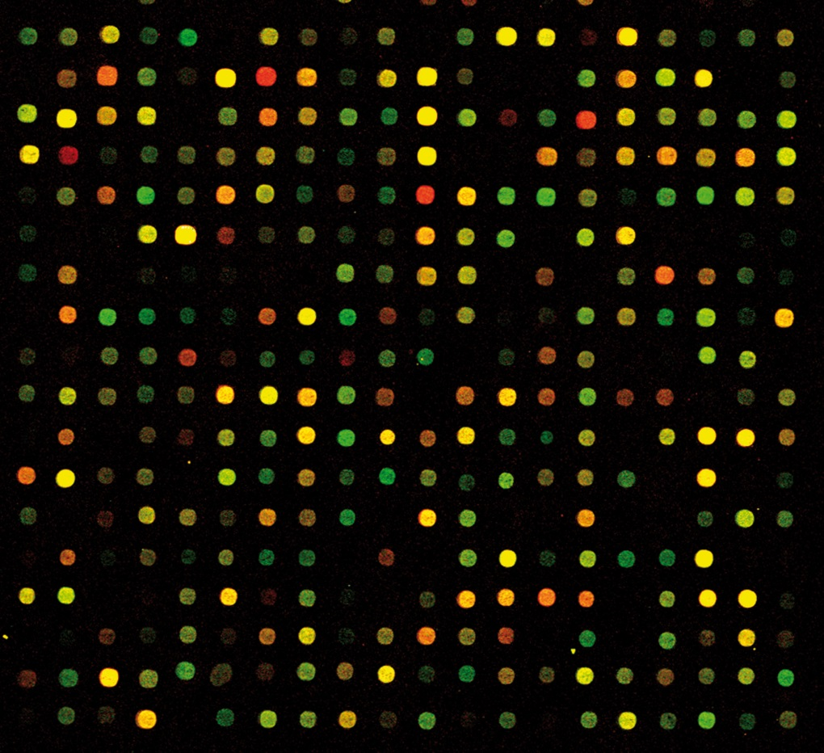
Genomic Expression Studies Could Help Pharmacogenetics

Slide 11
Genome-Wide Association Studies (GWAS)
Beware of spurious findings with big data!
Stadler et al., 2010

Slide 12
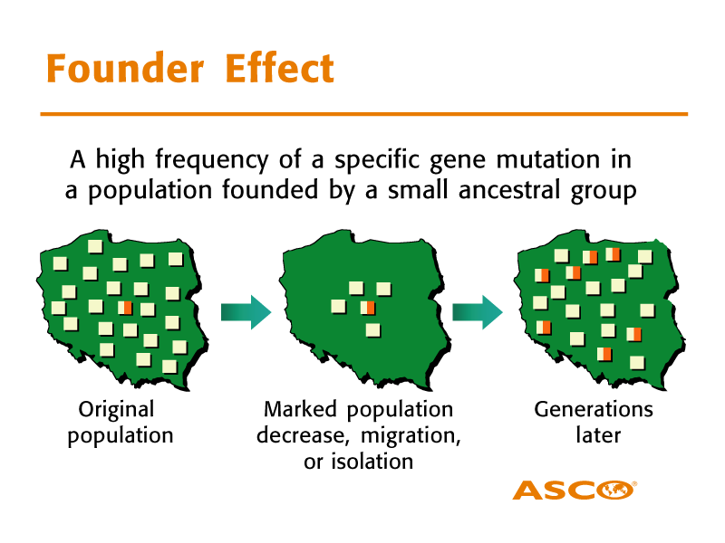
Notes:
Sometimes gene mutations do occur for the first time in a sperm or egg cell – the germline. That person’s children may then have that mutation in all of her/his cells. Consequently, grandchildren and great-grandchildren may inherit the same mutation. In some sense, we are all “clonal expansions” of our ancestors! Since families tended, historically, to live in the same area, scientists have found clusters of the same genetic variation within geographic regions. This means we can track human populations and migration genetically. This also means that when scientists study the genetic makeup of biospecimen collections, they may want to know about ancestry or ethnic background so they can distinguish what genetic variation is important for their research or simply a marker for ancestral relationships.

Slide 13

Ethical Concerns with Biospecimen Collection and Biobanking
What concerns might Medicaid patients have?

Slide 14

Autonomy
What control do I have over access to my tissue?
  Can I decide what type of research?
  Can I decide who can access my tissue?
  Can I retrieve my tissue or ask for it to be destroyed?

Slide 15

Privacy
Who will access my information?
Could I be discriminated for
  Other types of insurance?
  My job?
  A stigmatizing health condition?

Slide 16

Justice
Will scientists make broad claims about others with my genetic background (e.g., ethnicity)?
Will scientists focus on treatment for some, but not others?
Will someone else make money off of my genetic information?

Slide 17

Right To Know (or Not Know)
Will scientists give me information about my personal genetic make-up?
What if I do not want to know my results?

Slide 18
Recall Your Task
The Board of Medical Assistance Services would like to meet with you about a new Medicaid genetics initiative. They would like to establish a biobank and require all new Medicaid enrollees to contribute a blood sample. Linking their genomic information with Medicaid claims data could provide a treasure trove for epidemiologic research.

Slide 19
What Do You Suggest?
Get input from key stakeholders, including current Medicaid patients
Consult NIH Best Practices policies for biobanks (http://biospecimens.cancer.gov/bestpractices/)
  Develop biobank policies regarding confidentiality, access to samples, and permissible studies
  Develop an informed consent process

Slide 20
What Public Health Genomic Competencies Apply?
Competencies
Apply the basic public health sciences, (including behavioral and social sciences, biostatistics, epidemiology, informatics, environmental health) to genomic issues and studies and genetic testing, using the genomic vocabulary to attain the goal of disease prevention
Identify ethical and medical limitations to genetic testing, including uses that don't benefit the individual
Maintain up-to-date knowledge on the development of genetic advances and technologies relevant to his/her specialty or field of expertise and learn the uses of genomics as a tool for achieving public health goals related to his/her field or area of practice
Participate in strategic policy planning and development related to genetic testing or genomic programs
Collaborate with existing and emerging health agencies and organizations, academic, research, private and commercial enterprises, including genomic-related businesses, agencies and organizations and community partnerships to identify and solve genomic-related problems
Participate in the evaluation of program effectiveness, accessibility, cost benefit, cost effectiveness and quality of personal and population-based genomic services in public health
Develop protocols to ensure informed consent and human subject protection in research

