Slide 1
Perinatal Health: A Public Health Approach
Joan Corder-Mabe, RNC, M.S., WHNP
Director, Division of Women’s and Infants’ Health
Virginia Department of Health

Slide 2
Core Functions of Public Health
Assessment
Assurance
Policy

Slide 3
Assessment
Analysis of birth certificate data
• Fetal and Infant Mortality Review
(FIMR)
• Child Fatality Review
• Pregnancy Risk Assessment
Monitoring System (PRAMS)
• Maternal Death Review

Slide 5
Infant Mortality as a Measure of Health
“Infant death is a critical indicator of the health of the population. It reflects the overall state of maternal health as well as the quality and accessibility of primary health care available to pregnant women and infants. Despite steady declines in the 1980’s and 1990’s, the rate of infant mortality in the United States remains one of the highest in the industrialized world.”
Healthy People 2010 Report

Slide 6
“Perhaps the most glaring health failure is our infant mortality
rate.”
-Governor Timothy M. Kaine

Slide 7
Setting a Goal for Reduction of Infant Deaths
Virginia is working toward the goal to reduce its infant death rate to 7.0 per thousand live births by 2009.
This would surpass the Healthy People 2010 goal of reducing the infant mortality rate to 7.2 per thousand.

Slide 8
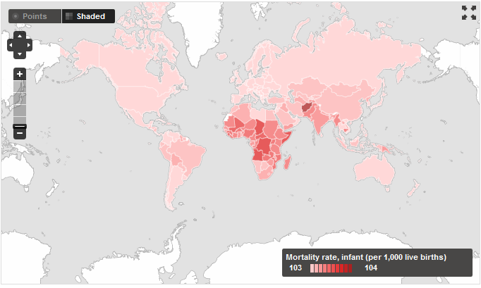
Infant Mortality: The Problem World Rank
World Bank Data - 2007

Slide 9
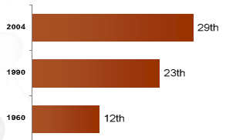
Infant Mortality: The Problem U.S. World Rank

Slide 10
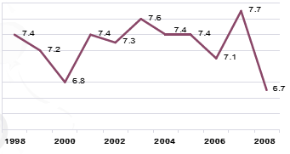
Total Infant Mortality Rates Per 1,000 Births in Virginia

Slide 11
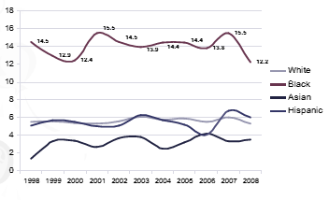
Infant Mortality Rates Per 1,000 Births 1998 By Race/Ethnicity 1998-2008

Slide 12
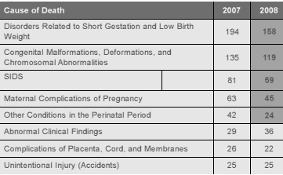
Top Causes of Infant Death, Virginia

Slide 13
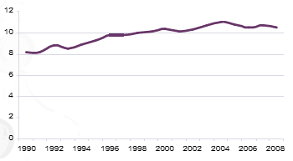
Prematurity Prematurity*- the problem

Slide 14
Prematurity and Late Preterm Births (Associated with brain growth)

Slide 15
Low Birth Weight is associated with multiple factors:
• Medical Risk Factors
- High parity
- Chronic diseases
- Previous Low Birth Weight infants
- Genetic factors
- Multiple gestation
- Poor weight gain
- Infection
- Placental problems
- Premature rupture of membranes
- Fetal anomalies
- Maternal stress

Slide 16
The etiology of preterm labor and premature birth is unknown.
(but there are many theories)

Slide 17
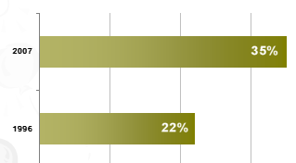
Prematurity and Cesarean Births

Slide 18
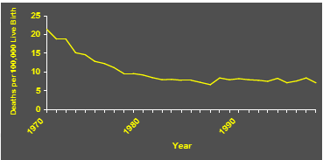
Maternal Mortality Has Not Changed Since 1982

Slide 19
Reasons for reduction in maternal mortality
Sulfa and antibiotic drugs • Decrease infections secondary to illicit abortions
Availability of banked blood
Safer surgical procedures, including Cesarean

Slide 20
The 3 leading causes of natural maternal death in the United States and Virginia
• Hemorrhage, including ectopic pregnancy
• Pregnancy-Induced Hypertension
• Pulmonary Embolism

Slide 21
What can we do?

Slide 22
Case Study
Natisha Jones: 19 year old, G3 Para 1 A1, A.A. woman
Infant died of SUID
5’5” tall and weighs 185 lbs
185% of poverty
Works part-time at Walmart
The boyfriend is unemployed

Slide 23
Prematurity and SIDS
A premature infant less than 37 weeks sleeping prone is 85 times more likely to die of SIDS
A premature infant lying on its side is 40 times more likely to die of SIDS

Slide 24
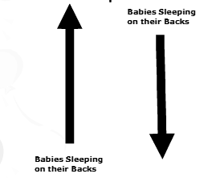
Prematurity: SIDS Rate and Sleep Position

Slide 25
Obesity in Pregnancy
Pregnancy loss
Diabetes and hypertension
Preeclampsia
Indicated Preterm Birth
Operative delivery and complications
Birth injury
Childhood obesity
Anesthesia complications

Slide 26
Fact

Slide 27
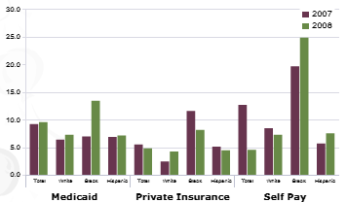
Resident Infant Death Rates by Method of Payment and Race/Ethnicity

Slide 28
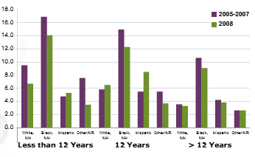
Infant Mortality by Education and Race/Ethnicity

Slide 29
FACT

Slide 30
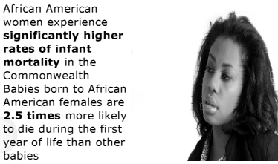
FACT

Slide 31
SMOKING

Slide 32
Prematurity and Smoking
Exposure to smoking is associated with
20% of all low birth weight babies
8% of preterm births
SIDS

Slide 33
Alcohol/Illicit Drugs

Slide 34
Why?

Slide 35
Early prenatal care starting in 1st Trimester is an indicator for access to health care services.

Slide 36
Resource Mothers Program
Lay home visitors who mentor pregnant teenagers
Decrease infant mortality and low weight births
25 contractors enrolling approximately 1100 newly pregnant teens per year in 88 Virginia localities
Early and regular prenatal care, increased healthy behaviors, delay of repeat pregnancy, enrollment in school or employment, and creation of a stable home environment
Staff aim to motivate program participants to stop smoking

Slide 37
Loving Steps/Virginia Healthy Start Program
Goal of reducing infant deaths and improving birth outcomes through early
Case management and health education
Registered nurses provide medical nursing care
Registered dietitians provide medical nutrition therapy services
Resource Mothers (Community Health Workers)
Family, Infant Mortality Reviews

Slide 38
Role Periodontal Disease in Preterm Birth
Inflammation associated breakdown of membranes
Associated with preterm labor and low weight birth
Treatment not harmful
Treatment reduce preterm births

Slide 39
Poor Nutrition

Slide 40
Natisha reported some back pain and not feeling well
• Referred to the local ER
• Admitted for 24 hours
• 20 weeks prenatal visit
• Wants to breastfeed

Slide 41
Breastfeeding: The Benefits
Lower rates of SIDS
Fewer ear infections
Fewer asthma/allergy cases
Less obesity
Less diabetes
Fewer childhood leukemia cases
Fewer infections in premature babies

Slide 42
Promote Breastfeeding
Educate mothers before birth
Provide support from family, friends, healthcare workers, employers, society
Provide safe places to nurse and pump

Slide 43
Interventions That May Reduce Prematurity/Infant Deaths
Education about preterm labor signs and symptoms

Slide 44
34 weeks admitted again for preterm labor
Delivered a 4lb 6oz baby boy
Baby had bradycardia (slow heart rate), apnea and oxygen desaturation

Slide 45
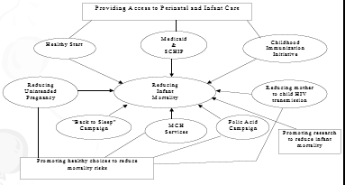
Public Health Approach to Infant Mortality

Slide 46
Safety Net Providers
Prenatal care in local health departments
WIC in local health departments
Community Health Centers
Car seat program

Slide 47
Preconception
Prevention of birth defects
Treatment of chronic conditions
Promotion of healthy lifestyles, (smoking, alcohol)

Slide 48
Regional Perinatal Councils (RPCs)
Regional Perinatal Councils (RPCs) improve the infrastructure through which perinatal health is provided within the Commonwealth.
Conduct Fetal and Infant Mortality Review
Engage communities to address local systems issues

Slide 49
Newborn Screening
Coordinated and comprehensive system consisting of education, blood screening tests, follow-up and referrals, diagnosis, medical and dietary management, and treatment
Updated March, 2010, Virginia now screens for 39 disorders

Slide 50
Setting Standards/Quality of Care
Neonatal Regulations
Screening for domestic violence, perinatal substance use, and perinatal depression
Web-based training on Bright Futures and Perinatal Depression
Provision of culturally competent care

Slide 51
Policy and Planning
Implementation of Codes Regarding Perinatal
Substance Use:
• 54.1-2403.1 of the Code of Virginia Substance Use, Screening in Prenatal Care
• 63.2-1509 of the Code of Virginia Physician referral of Substance Exposed Newborns
• 32.1-127 of the Code of Virginia Hospital Discharge Planning for Substance using Postpartum Women
• 32.1-134.01 of the Code of Virginia Discharge Education on Postpartum Blues, Perinatal Depression, Shaken Baby Syndrome
Interagency Substance Exposed Newborn Workgroup (DMHMRSAS, DSS, DCJ)
Analysis of proposed legislation
Supports Governor’s task forces and commissions

Slide 52
Early and regular use of prenatal care is a strong predictor of positive pregnancy outcomes.

Slide 53
Health Commissioner’s Workgroup on Infant Mortality
Diverse groups represented
Identify evidence-based effective programs
Develop unified message on how everyone can make a difference

Slide 54
Conclusions
Studies of underlying factors that contribute to morbidity and mortality are needed
Review of quality of health care and access to care for all women and infants is needed
Racial/ethnic disparities need to be eliminated
Research to determine effective public health programs to make a difference
Resource and implement programs we know work

