Slide 1


Public Health Surveillance
Diane Woolard, Ph.D., M.P.H.
Division of Surveillance & Investigation
Virginia Department of Health

Slide 2
Objectives of Lecture
Key concepts of surveillance
  Definition
  Uses
  Methods
Public health surveillance systems
Use and evaluation of surveillance systems
Influenza surveillance

Slide 3
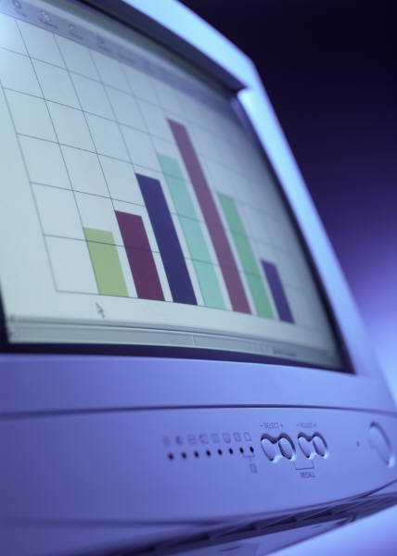
What comes to mind when you hear ‘surveillance’?
Law enforcement agencies
CIA
Routine data collection
Statistics
Trends

Slide 4
Definition of Surveillance
The ongoing systematic collection, analysis, and interpretation of outcome-specific data for use in the planning, implementation, and evaluation of public health practice.
Includes data collection, analysis, and dissemination to those responsible for prevention and control.

Slide 5
What Surveillance Is
Systematic, ongoing…
  Collection
  Analysis
  Interpretation
  Dissemination
…of health outcome data
Health action
investigation
control
prevention

Slide 6
Surveillance History in U.S.
1741 – Rhode Island passed an act requiring tavern keepers to report contagious disease
1850 – Mortality statistics first published by the federal government for the U.S.
1874 – Massachusetts instituted weekly reporting of diseases by physicians
1878 – Public Health Service (PHS)-type organization created to collect morbidity data for use in quarantine for cholera, smallpox, plague, yellow fever.

Slide 7

Surveillance History in U.S.
1901 – All states required disease reporting.
1925 – All states began participating in national morbidity reporting
1935 – First national health survey
1951 – Council of State and Territorial Epidemiologists (CSTE) authorized to determine diseases to be reported to PHS
1961 – Morbidity and Mortality Weekly Report (MMWR) published

Slide 8
Legal Authority for Surveillance
Legal authority for mandatory public health surveillance resides with states
Virginia Code
  32.1-35 – BOH shall promulgate a list of diseases required to be reported.
  32.1-36 – Physicians and laboratories shall report.
  32.1-37 – Medical care facilities, schools and summer camps shall report.

Slide 9
Virginia Code, continued
  32.1-38 – Anyone making a report is immune from liability
  32.1-39 – BOH shall provide for surveillance & investigation.
  32.1-40 – Commissioner or designee can examine medical records
  32.1-41 – Anyone examining records must preserve anonymity of the patient and the practitioner

Slide 10
Purpose of Surveillance
To assess public health status, to define public health priorities, to evaluate programs, and to stimulate research.
  Tells us where the problems are, who is affected, and where the programmatic and prevention activities should be directed.

Slide 11
How can surveillance data be used?
Estimates of a health problem
Natural history of disease
Detection of epidemics
Distribution and spread of a health event
Hypothesis testing
Evaluating control and prevention measures
Monitoring change
Detecting changes in health practice
Facilitate planning

Slide 12
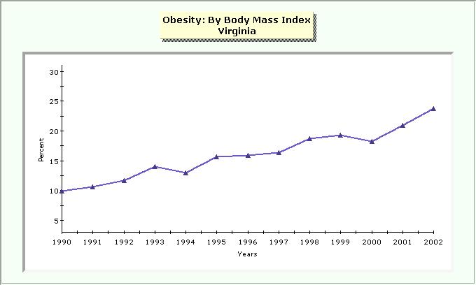
Uses of Surveillance Data
Estimates of a Health Problem
Quantitative estimates of the magnitude of a health problem
  including sudden or long-term changes in trends, patterns

Slide 13
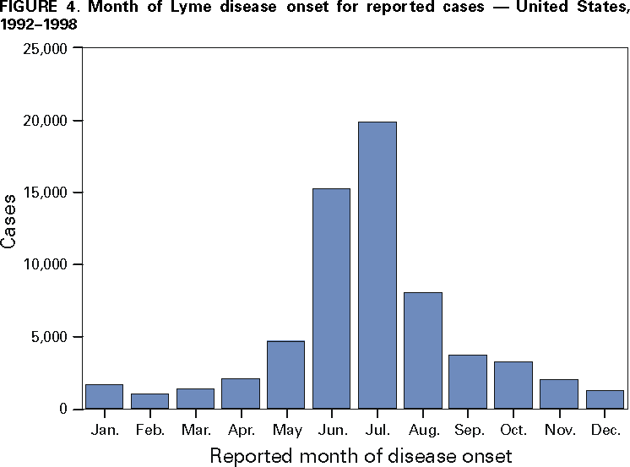
Uses of Surveillance Data
Natural History of Disease
Portrayal of the natural history of disease (clinical spectrum, epidemiology)
Varicella Cases by Month –
Antelope Valley, CA, 1995–2004

Slide 14
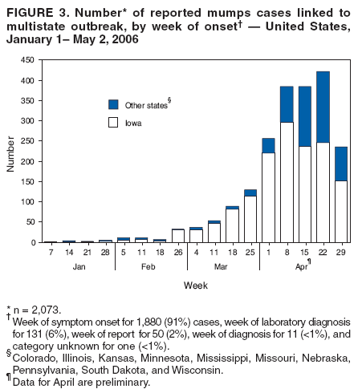
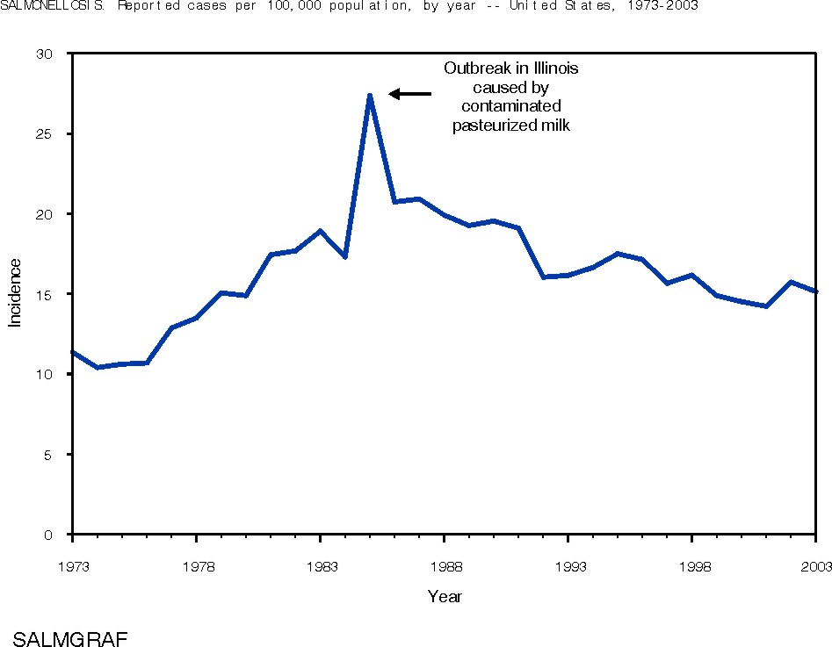
Uses of Surveillance Data
Detection of Epidemics
SALMONELLOSIS
Incidence,* by year
United States, 1973-2003
*Per 100,000 population
Slide from CDC 2003 Annual Summary

Slide 15
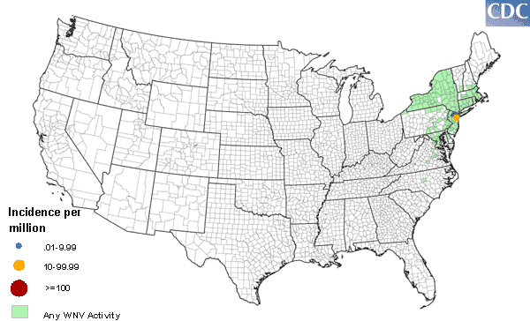
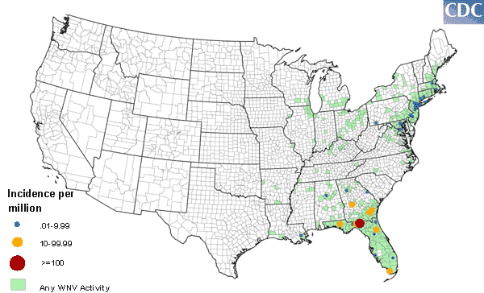
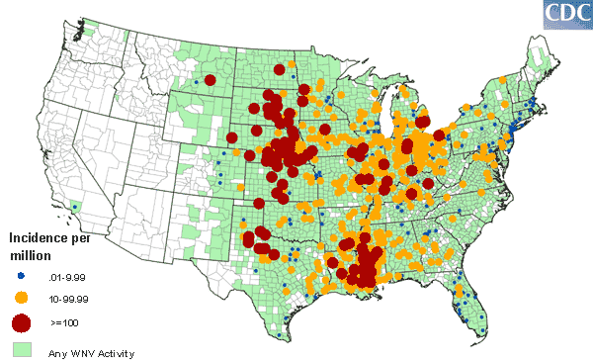
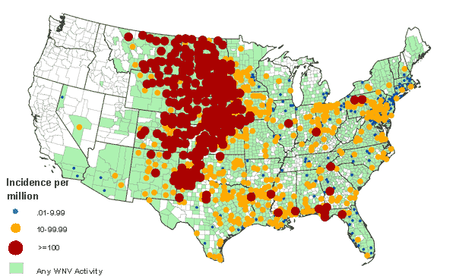
Uses of Surveillance Data
Distribution & Spread of a Health Event
West Nile Virus in the US, 2000-2003
2000
2001
2002
2003

Slide 16
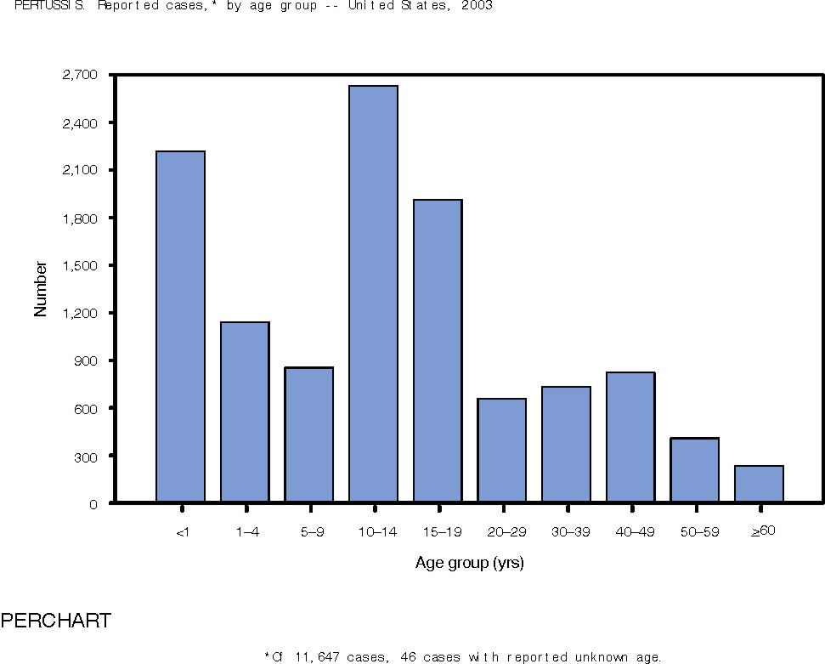
Use of Surveillance Data
Hypothesis Testing
Facilitation of epidemiologic and laboratory research
  Hypothesis testing
PERTUSSIS
Number of reported cases*, by age group
United States, 2003
*Of 11,647 cases, age was reported unknown for 46 (0.4%) cases.
Slide from CDC – 2003 Annual Summary

Slide 17
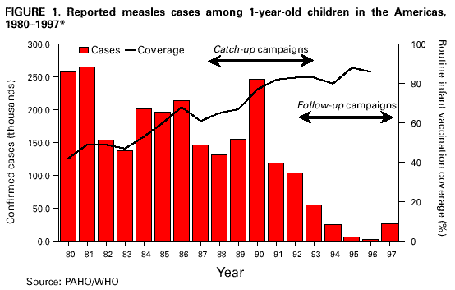
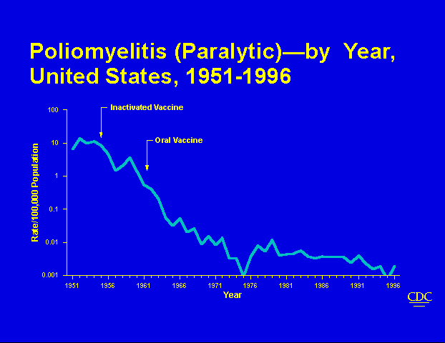
Uses of Surveillance Data
Evaluating control & prevention measures
Effectiveness of vaccine introduction

Slide 18
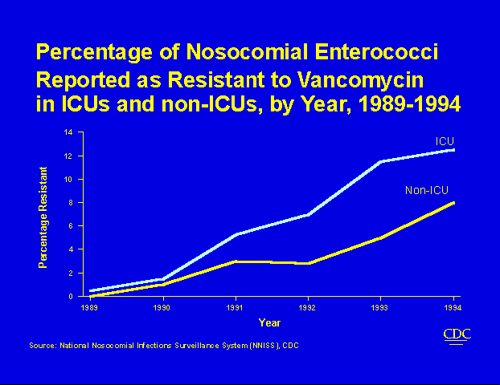
Uses of Surveillance Data
Monitoring changes
Monitoring changes in infectious agents and host factors
National Nosocomial Infections Surveillance System

Slide 19
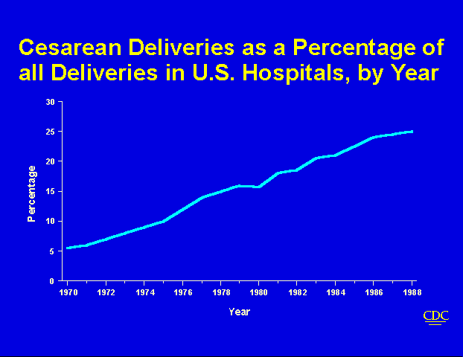
Uses of Surveillance Data
Detecting Changes in Health Practice

Slide 20
Uses of Surveillance Data
Facilitate Planning
Identify target populations in need of health services
  Refugee populations
  Morbidity surveillance in emergency shelters
Identify health topics to be addressed by educational programs and media

Slide 21
Outcomes
Surveillance is outcome oriented
Can measure frequency of an illness or injury, severity of the condition, and impact of the condition.
Number of cases, incidence, prevalence; case fatality, hospitalization rate, mortality, disability; cost.
Orient data by person, place, and time.

Slide 22
Planning a Surveillance System
Establish objectives
Develop case definitions
Determine data source or data collection mechanism
Field test methods
Develop and test analytic approach
Develop dissemination mechanism
Assure use of analysis and interpretation

Slide 23
What Should be Under Surveillance?
Establish priorities based on:
  Frequency (incid., prev., mortality, YPLL)
  Severity (case-fatality, hospitalization rate, disability rate)
  Cost (direct and indirect)
  Preventability
  Communicability
  Public interest
  Will the data be useful for public health action?

Slide 24
Surveillance Methods
Case Definition
Case definition
  Important to clearly define condition
  Ensures same criteria are used by all
  Makes the data more comparable
  Include person, place, time
  May define suspected and confirmed cases
  May include symptoms, lab values, time period, population as appropriate

Slide 25
Case Definition Examples
Weak Definition - Measles
  Any person with a rash and fever, runny nose, or conjunctivitis
Better Definition - Measles
  Any person with a fever >101 F, runny nose, conjunctivitis, red blotchy rash for at least 3 days, and laboratory confirmation of IgM antibodies
Clinical, Probable, Confirmed Case Definitions
Outbreak Case Definition
  Differs from routine surveillance
  Epidemiologically linked

Slide 26
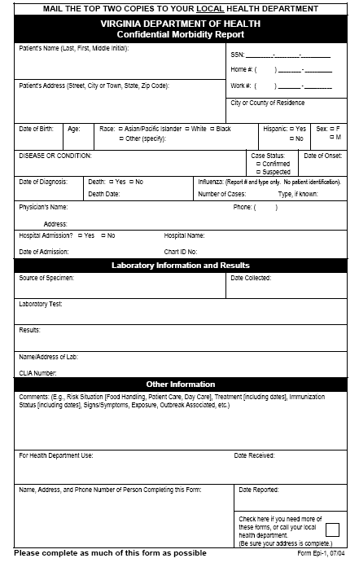

Surveillance Methods
Data Collection
Data collection
  Standardized instruments, field tested
Passive Surveillance
  Providers are responsible for reporting.
  Health dept. waits to receive reports.
  Problem with underreporting
Active Surveillance
  Providers contacted on regular basis to collect information
  More resource intensive
  Used for outbreaks or pilots (e.g., HUS)

Slide 27

Surveillance Methods
Data Analysis
Ongoing review
Descriptive statistics, Multivariate analyses
Automated analyses
Disease | Number of cases
Tuberculosis | 20
Gonorrhea | 320

Slide 28

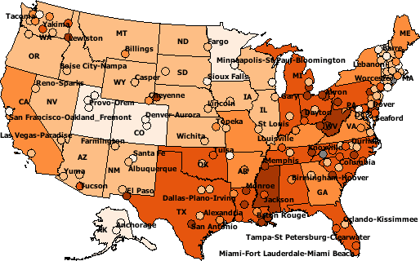

Surveillance Methods
Interpretation and Dissemination
Presentation of data in the form of tables, graphs, maps, etc.
Disseminate data via reports, presentations, internet, etc.

Slide 29
Surveillance Methods Evaluation
Did the system generate needed answers to problems?
Was the information timely?
Was it useful for planners, researchers, etc?
How was the information used?
Was it worth the effort?
What can be done to make it better?
(More on evaluation later).

Slide 30
Cycle of Surveillance
Data Collection
  Pertinent, regular, frequent, timely
Consolidation and Interpretation
  Orderly, descriptive, evaluative, timely
Dissemination
  Prompt, to all who need to know (data providers and action takers)
Action to Control and Prevent
Evaluation

Slide 31
Data Sources
Vital Statistics
Notifiable Diseases
Registries
Sentinel Surveillance
Syndromic Surveillance
Surveys
Administrative Data

Slide 32
Data Sources: Vital Statistics
Live Births
Deaths
Fetal Deaths
Marriages
Divorces
Induced Terminations of Pregnancy
Infant Mortality (link birth and death data)

Slide 33
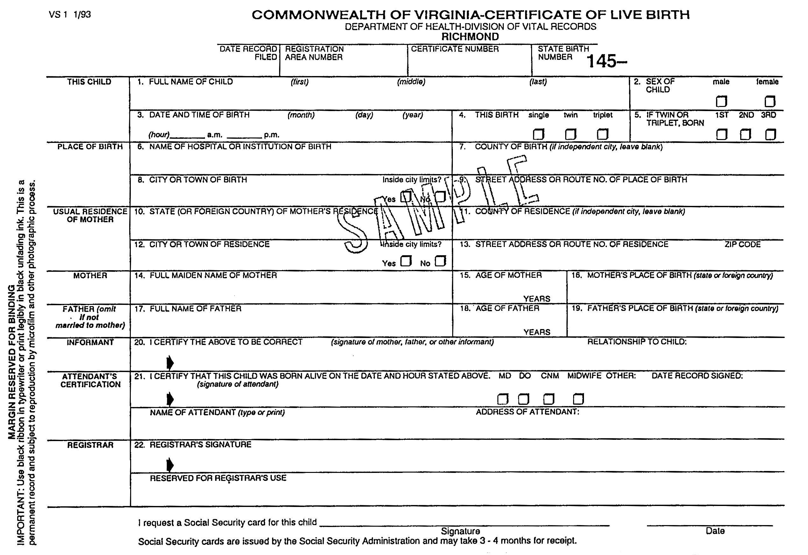
Virginia Birth Certificate

Slide 34
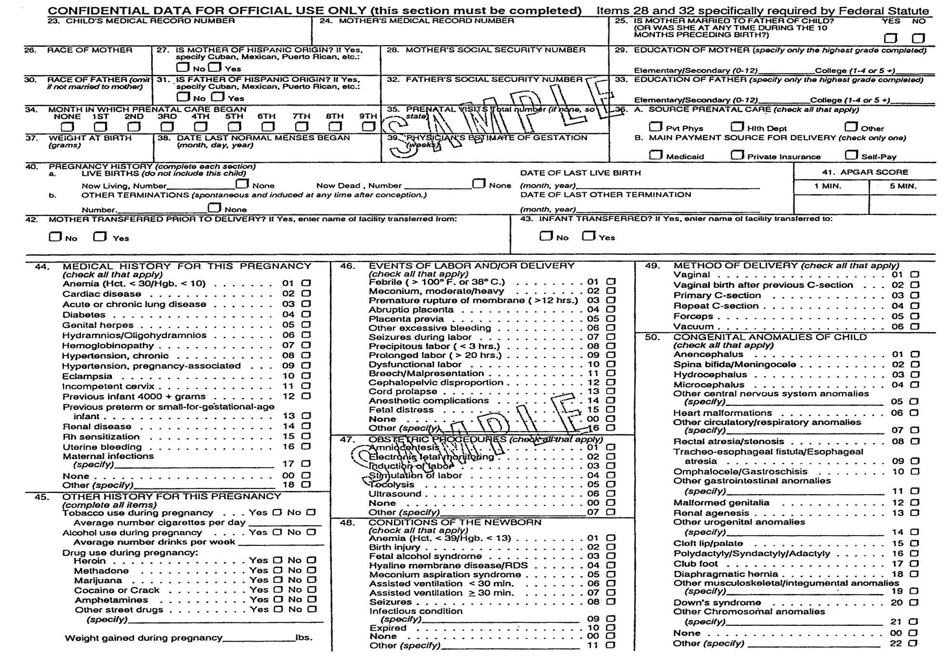
Virginia Birth Certificate

Slide 35
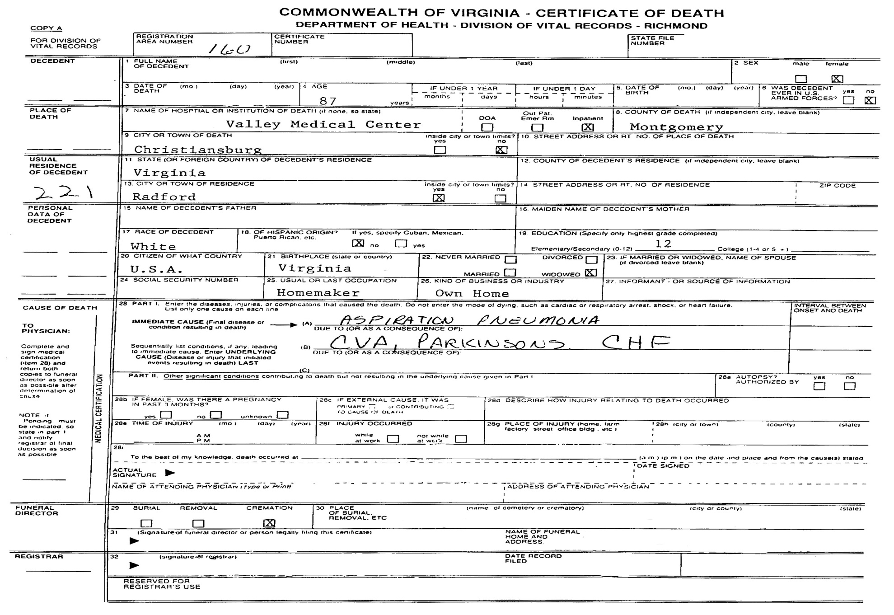
Virginia Death Certificate
SAMPLE

Slide 36
Uses of Vital Statistics Data
Monitoring long-term trends
Identifying differences in health status within racial or other population subgroups
Assessing differences by geographic area
Monitoring deaths that are preventable
Generating hypotheses about causation
Monitoring progress toward improved health of the population; health-planning

Slide 37
Vital Records:
Coding and Calculating
ICD-9 historically, now ICD-10
Infant mortality - need number of live births for denominator in calculating rates
Other death rates - use total population in rate calculations.
Crude and adjusted (standardized) rates used.

Slide 38
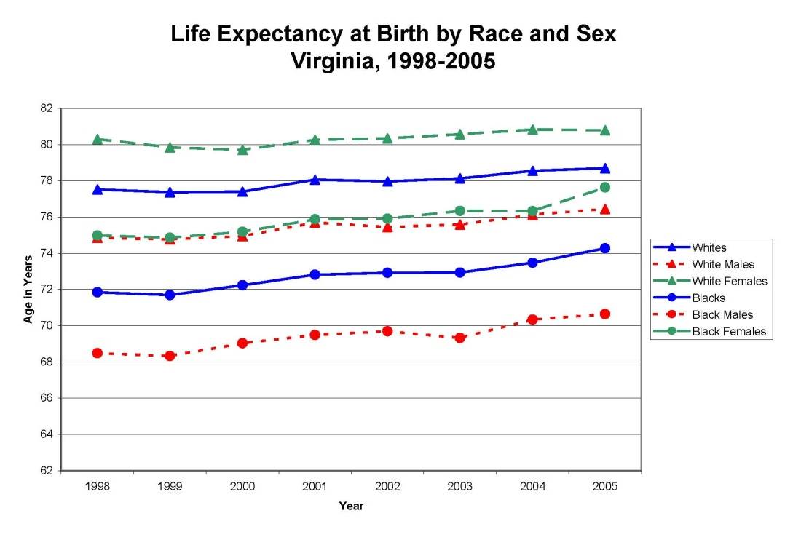
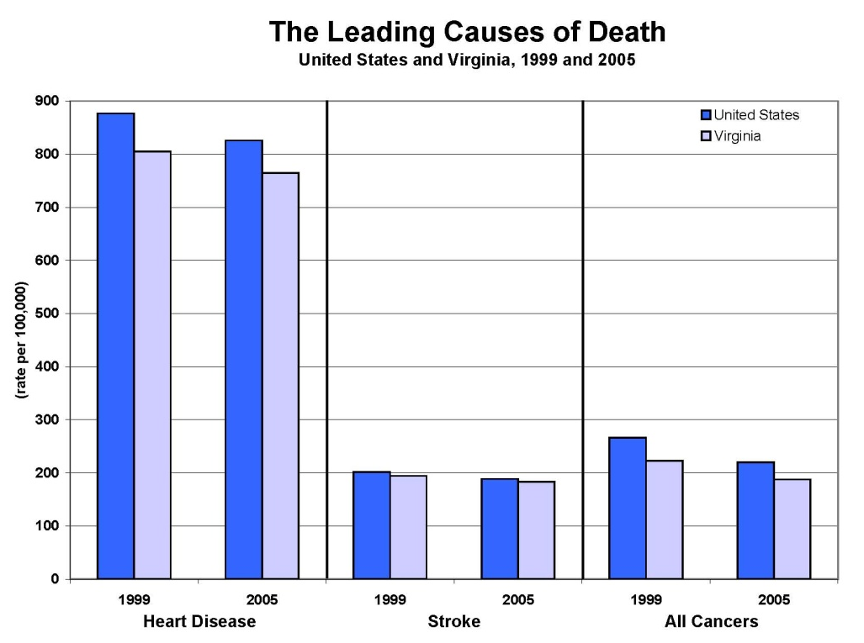
Vital Statistics Data

Slide 39
Quality of Vital Stats Depends on
Care taken by health care providers in ascertaining cause of death and other factors
Accuracy of coding (difficult for injuries)
Relevance of existing codes for the condition being recorded
Accuracy of population estimates
Problems - don’t know onset, can’t see effect of diseases that don’t lead to death

Slide 40
Data Sources: Notifiable Diseases
States decide what is notifiable/reportable
  Based on disease occurrence, potential for outbreaks, public perception of risk, etc.
  CSTE recommendations
  Different processes for generating N.D. list
Weekly (or sometimes rapid) reporting to health departments by physicians, medical care facilities, laboratories.
  States report to CDC

Slide 41
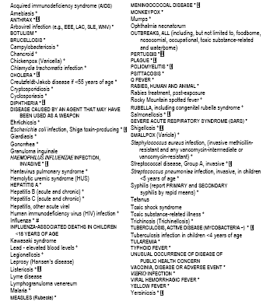
Reportable Disease List
Over 70 reportable diseases/conditions

Slide 42
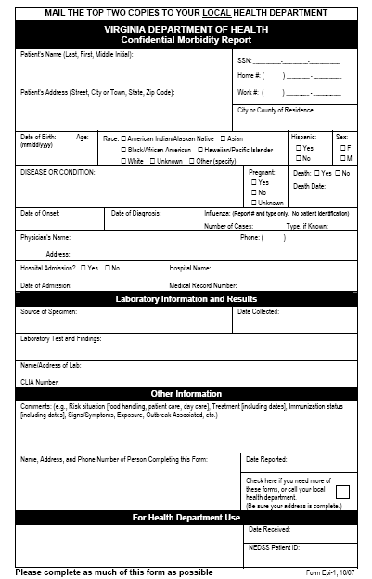
Epi-1 Form

Slide 43
Chain of Communication
Other States
State
Providers
Patients
Public
Regional
Epis
Central Office
Local H.D.
CDC
Other Health Districts
Add this in 2009

Slide 44
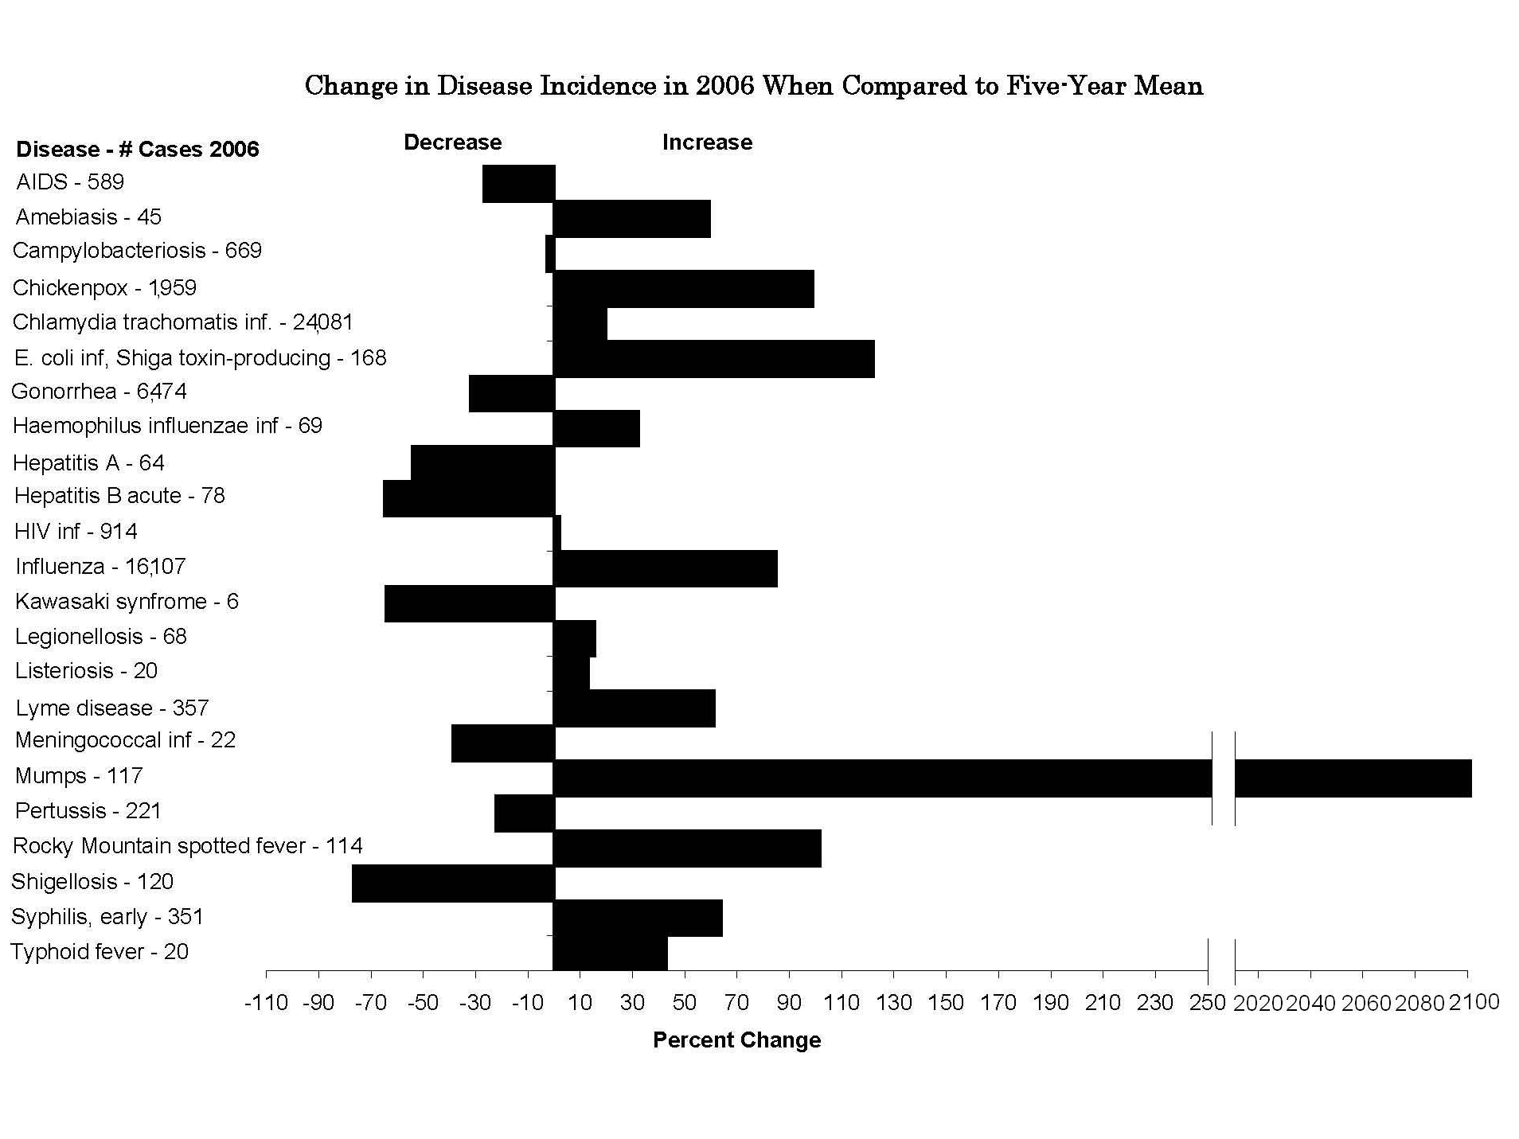

Slide 46
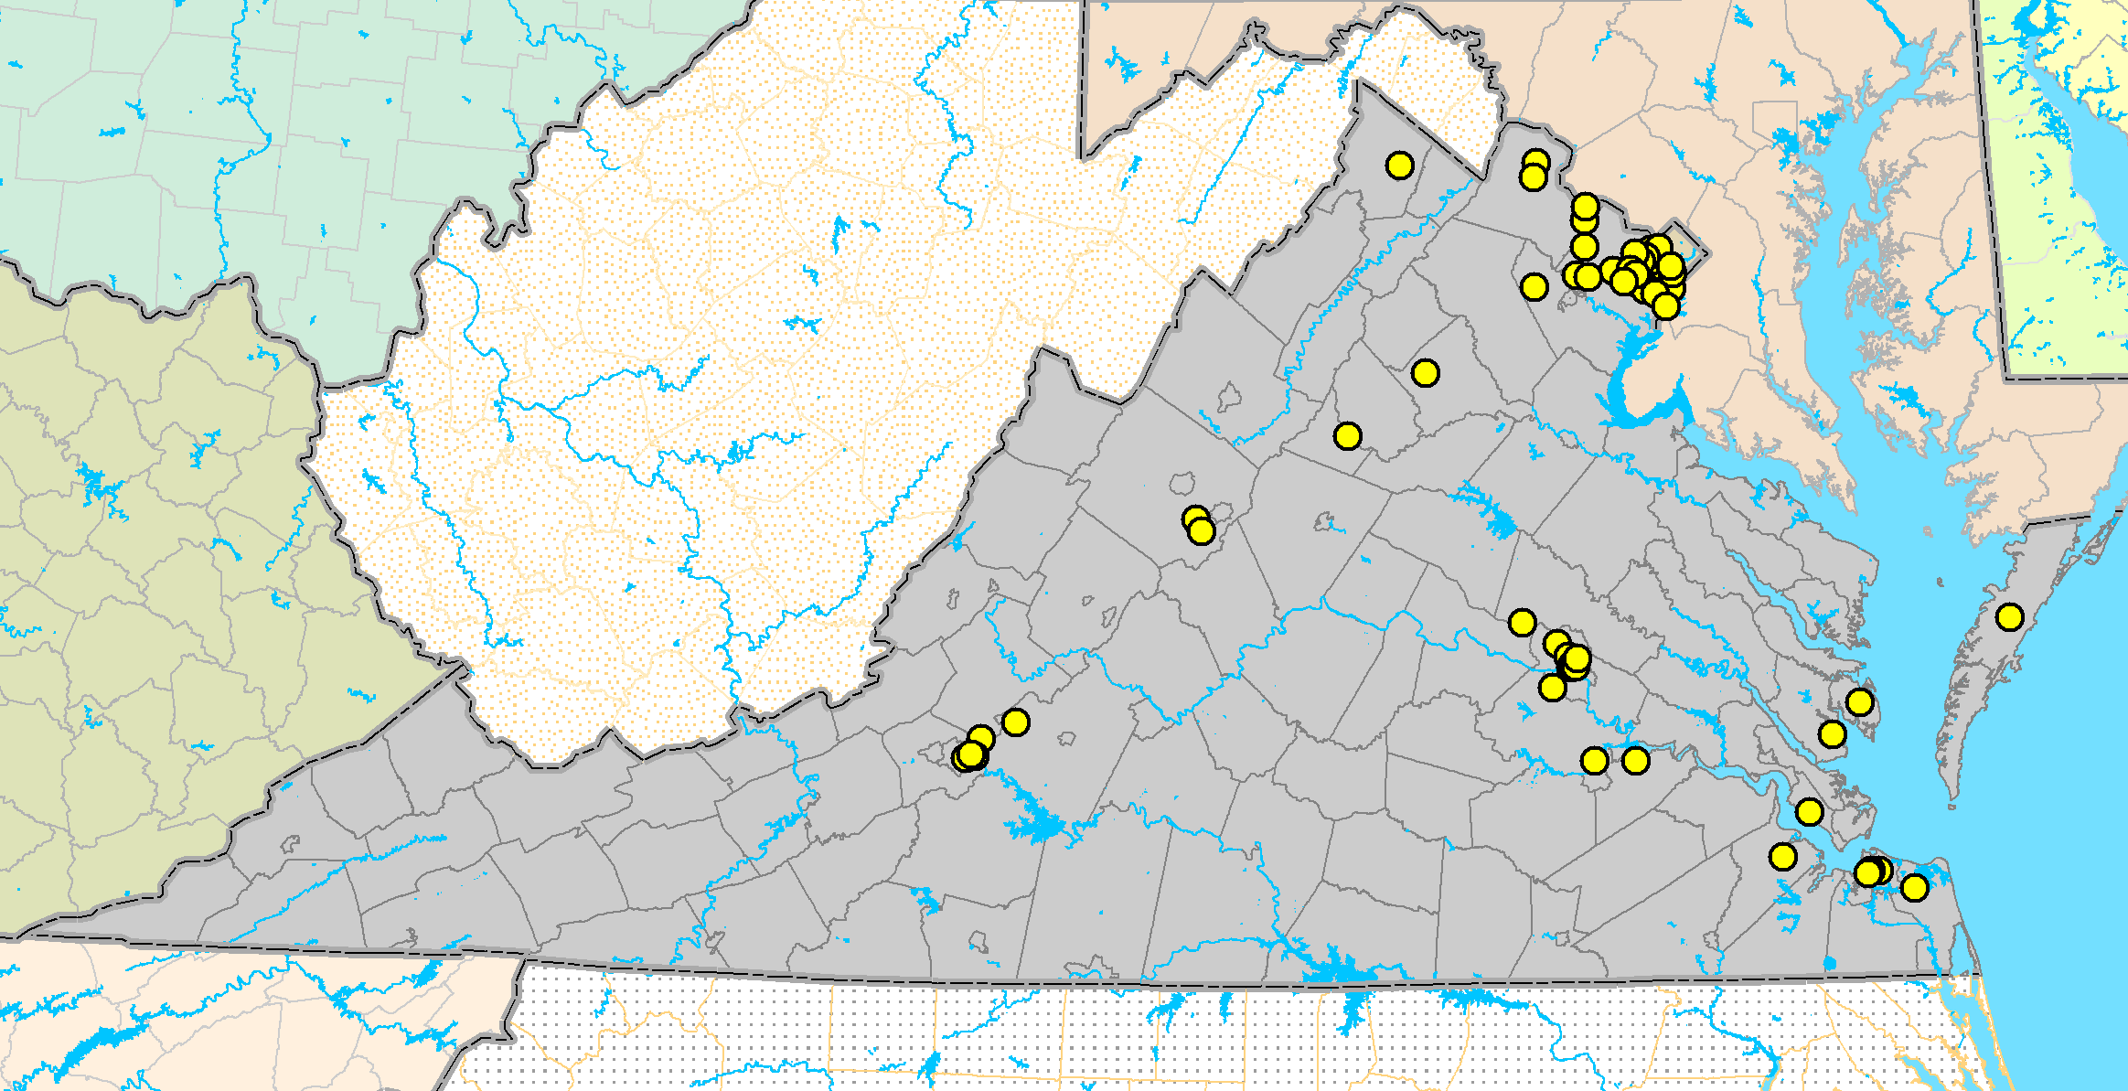
Geographic Distribution of Human Arbovirus Cases Recorded in Virginia since 1975
Human Arbovirus
Infections Since 1975
WNV (67 cases)*
SLE (8 cases)*
LAC (29 cases)*
EEE (5 cases)*
*Number of cases through 9/08
WNV = West Nile virus
LAC = La Crosse encephalitis virus
SLE = St. Louis encephalitis virus
EEE = Eastern equine encephalitis virus

Slide 47
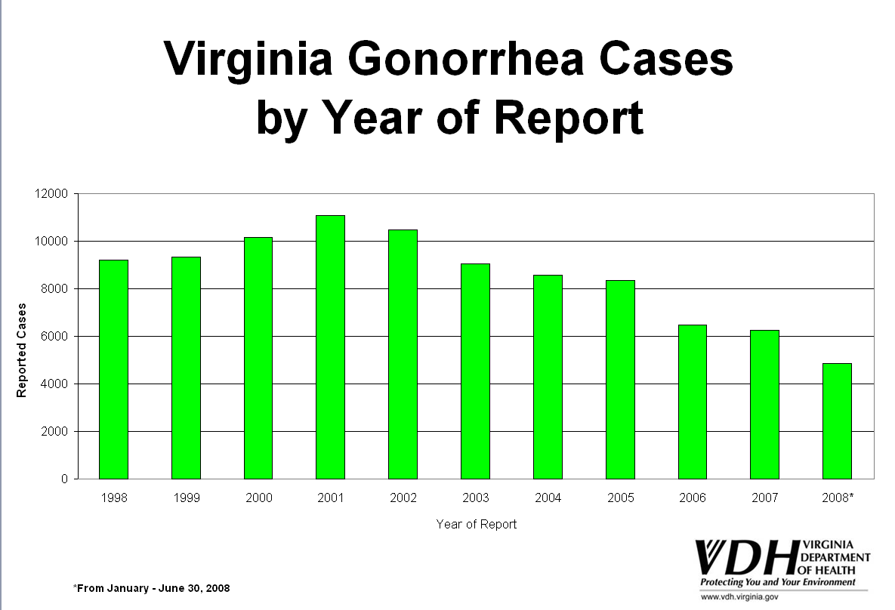
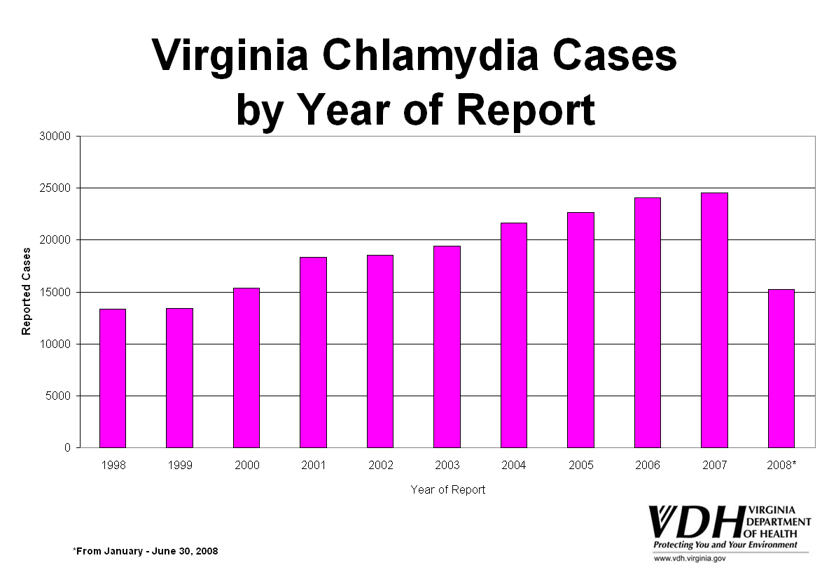
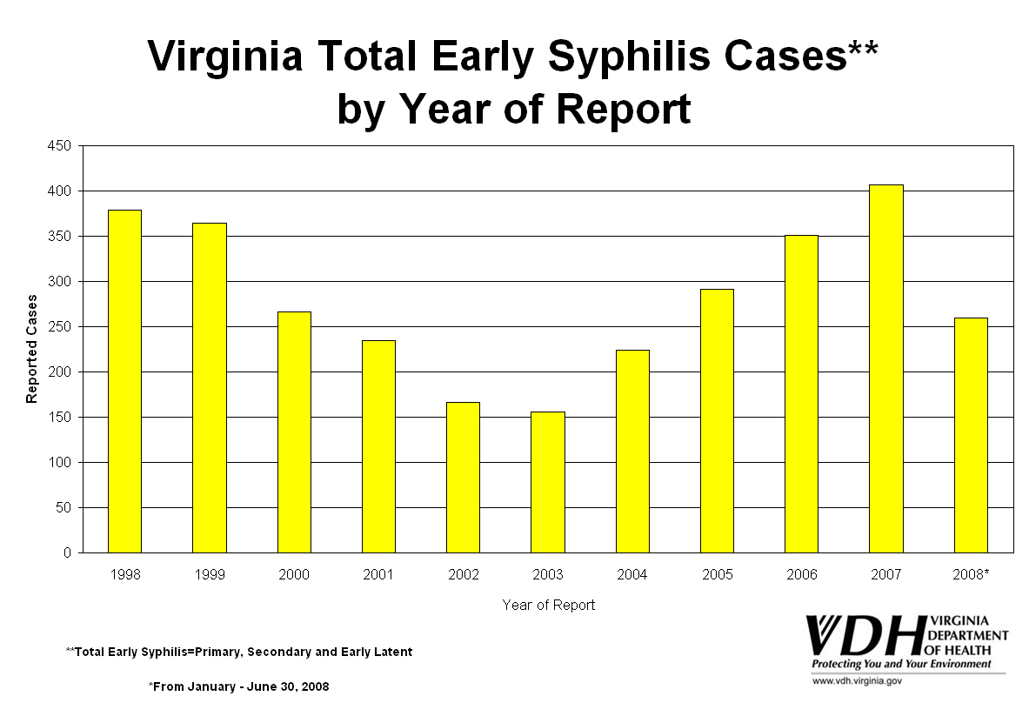
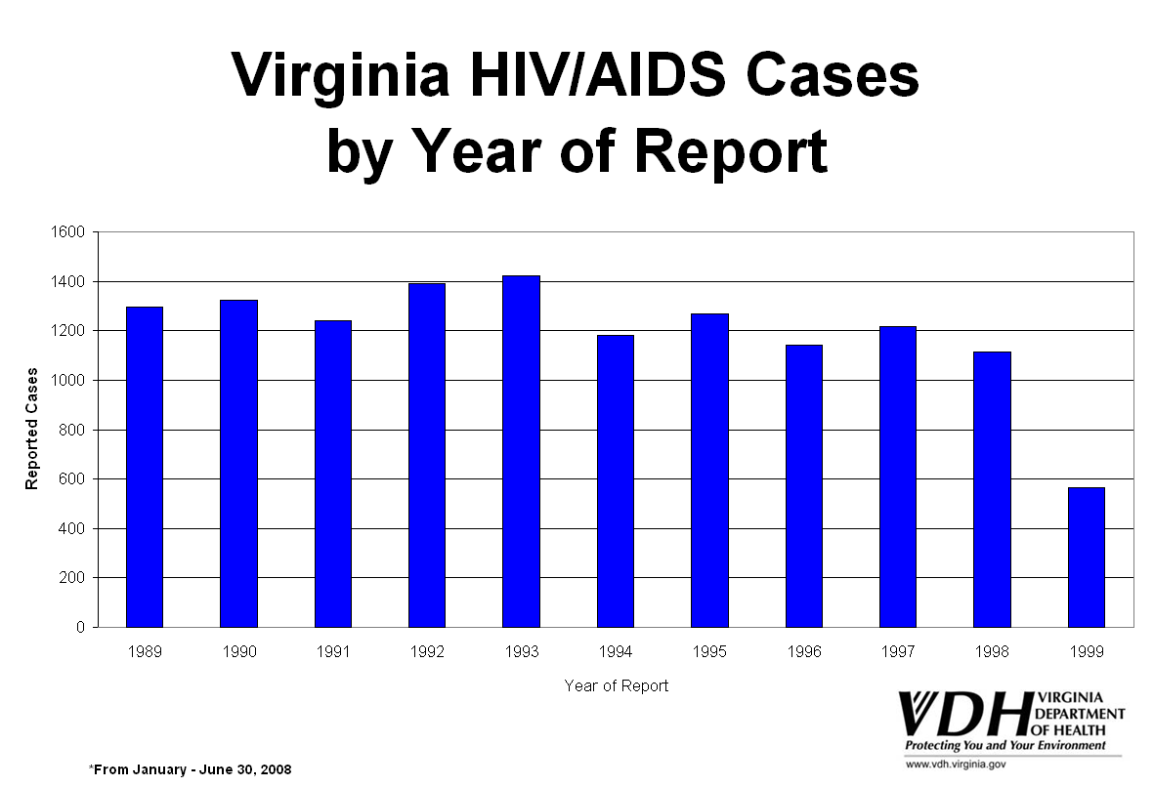
STD and HIV Trends

Slide 48
Limitations of Disease Reporting
Underreporting
  Reporting better for more serious diseases and those for which there is laboratory confirmation
  Need to seek medical consultation to be diagnosed and then reported
Lack of representativeness of reported cases
Inconsistent case definitions

Slide 49
Reasons for Not Reporting
Assume someone else reported.
Did not know reporting was required; don’t have a copy of the reportable disease list.
Do not know how to report; don’t have form or telephone number.
Concern about confidentiality and doctor-patient relationship.
No incentive to report. Time-consuming. Unaware of value.

Slide 50
How to Improve Reporting
Contact physicians in the community
  Tell them the health department is very interested in morbidity reporting
Maintain a reasonable list of reportable diseases
Maximize contact through presentations, mailings, newsletters, media, etc.
Use the data

Slide 51
Nonetheless...
The best system we have for communicable disease morbidity
Information available quickly and from all jurisdictions
Can detect outbreaks / changes in incidence
Allows disease control measures to be implemented

Slide 52
Data Source: Registries
Information from multiple sources is linked for each individual over time.
  Diverse sources of information. E.g., hospitals (sometimes >1), pathology, death certificates.
Used for cancer, congenital anomalies, trauma, etc.
Most are passive but resource intensive.
More lag in data availability due to complexity of data collection process.

Slide 53
Populations Covered by Registries
Hospital-based
Population-based
Exposure registries
  World Trade Center Health Registry
  Three Mile Island

Slide 54
Example: Virginia Cancer Registry
Methods prescribed by ACOS, NAACCR, Virginia regulations, CDC.
Hospital registries are main source of data.
Voluntary reporting, 1970-1989
Mandatory reporting, 1990-present
Demographic, geographic, clinical data
Annual merge with vital records for survival information.

Slide 55
Registry Data

Slide 56
Electronic Surveillance
National Electronic Disease Surveillance System (NEDSS)
  A set of criteria developed by CDC that all public health surveillance systems must meet
  Virginia adopted CDC’s NEDSS Base System
  Supported by EP&R funds

Slide 57
NEDSS
Shared secure web-based disease surveillance database for Virginia
  Eliminates delays in reporting
  Improves communication about cases
  Assists in earlier detection of events
  Provides more data in electronic form for analysis
All Virginia health departments connected by the end of 2006
Includes electronic reporting from laboratories

Slide 58
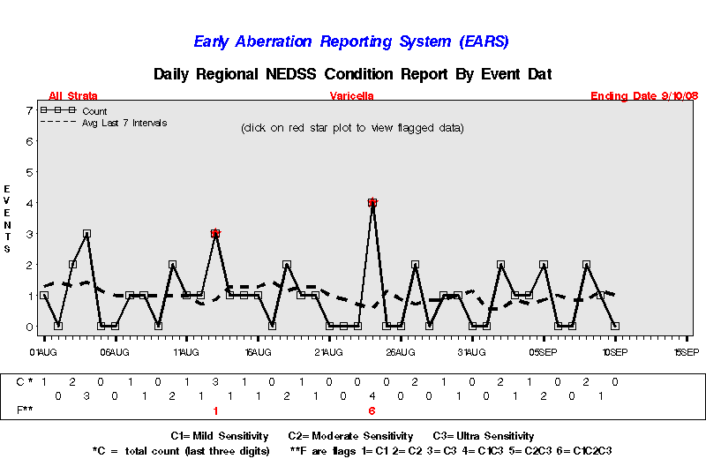
EARS
Early Aberration Reporting System
Daily automated analysis of surveillance data

Slide 59
Data Source: Sentinel Systems
To gather timely public health information in a relatively inexpensive manner.
Cannot derive precise estimates of prevalence or incidence in the population.
Sentinel Health Events
Sentinel Sites
Sentinel Providers

Slide 60
Sentinel Health Events
A condition whose occurrence serves as a warning signal.
Particularly useful for occupational exposures.
Silicosis, occupational asthma, pesticide poisoning, lead poisoning, carpal tunnel syndrome.
Cases trigger intervention activities.

Slide 61
Sentinel Sites or Providers
Surveillance at certain hospitals, clinics, or physician practices.
Sentinel Sites - monitor conditions in subgroups that may be more vulnerable
  E.g., drug clinic, STD clinic, MCH clinic
Sentinel Providers - monitor activity in ambulatory care settings.
  For diseases that are not reportable
  For influenza

Slide 62
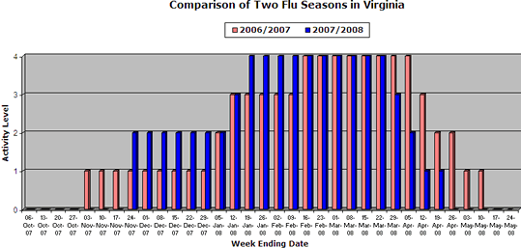
Influenza Activity Monitoring
with Sentinel Surveillance
Sentinel site surveillance for influenza
  Conducted year-round to detect emerging threats
  Used to track flu season - Flu activity level usually elevated Oct/Nov through April/May
  Consider
    chief complaints from EDs
    and Urgent Care Centers,
    positive lab specimens,
    outbreaks.

Slide 63
Syndromic Surveillance
Uses pre-diagnostic indicators to identify emerging health problems
Self medication
Medical care
Diagnosis
Insurance billed
Onset of symptoms
Medical consultation
Laboratory testing
Prescription
filled

Slide 64
Automating Syndromic Surveillance
Began as manual activity just after 9/11/01
Automated in 2004 with ESSENCE
  Electronic Surveillance System for the Early Notification of Community-Based Epidemics (Johns Hopkins University, Applied Physics Laboratory)
Access limited to approved VDH staff
Collaborate with District of Columbia and Maryland to monitor national capital region

Slide 65
ESSENCE
Hospital emergency departments and urgent care centers electronically transmit chief complaints to secure VDH server every day
System also includes:
  Over the counter drug sales
  Military claims
  HMO claims
  School attendance (being added)

Slide 66
Syndromes
Complaints tallied into syndrome categories
  Death
  Sepsis (serious infection)
  Rash
  Respiratory (e.g., cough)
  Gastrointestinal (e.g., diarrhea)
  Unspecified Infection (fever)
  Neurological (e.g., dizziness)
  Other

Slide 67
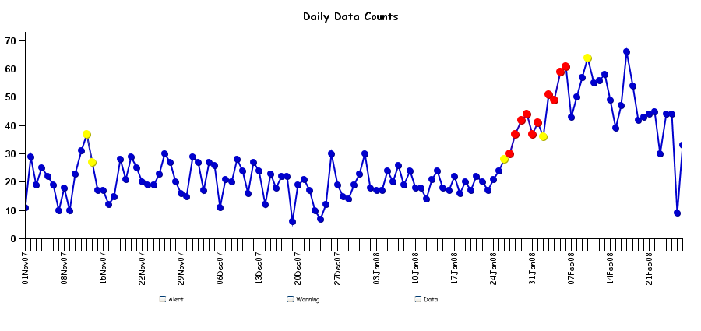
ESSENCE
Automated analyses identify unusual patterns and increases are investigated
Henrico Co - Unspecified Infection

Slide 68
Exposure Detection
U.S. Postal Services’ BioHazard Detection System
  Tests for anthrax in mail sorting area every hour
  Selected Post Offices in Virginia
  Response is collaborative
Homeland Security/DOD BioWatch System
  DC area, including northern Virginia
  Central Virginia around Richmond
  Eastern Virginia around military bases
  Monitors for biologic agents atop buildings

Slide 69
Data Source: Surveys
If done continually or periodically, can monitor risk factors and changes in prevalence over time
Can also assess knowledge, attitudes
People usually queried only once and not monitored on an individual basis after that
From questionnaires, interviews (in person or telephone), or record review

Slide 70
National Surveys – www.cdc.gov/nchs
National Health Interview Survey
  Random selection of households
  In home interview gathering information on all in the household
  Self-reported illnesses, chronic conditions, injuries, impairments, use of health services
  Civilian, non-institutionalized population

Slide 71
National Surveys, continued
National Health and Nutrition Examination Survey (NHANES)
  Prevalence of chronic conditions, distribution of physiologic and anthropomorphic measures, and nutritional status for representative samples of the U.S. population
National Health Care Survey, includes
  National Hospital Discharge Survey
  National Ambulatory Medical Care Survey

Slide 72
BRFSS
Behavioral Risk Factor Surveillance System
  Random digit telephone surveys on non-institutionalized adults’ health behavior and use of prevention services
  Height, weight, physical activity, smoking, alcohol use, seatbelt use, cholesterol screening, mammography, etc.
  Done in most states
  CDC program

Slide 73
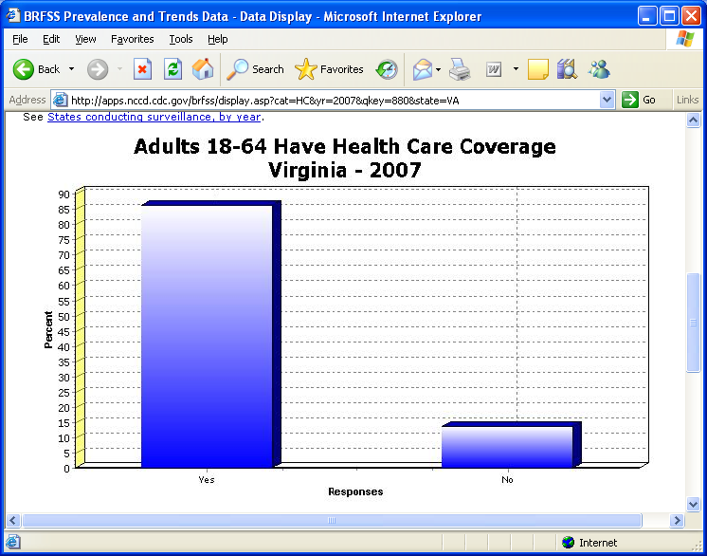
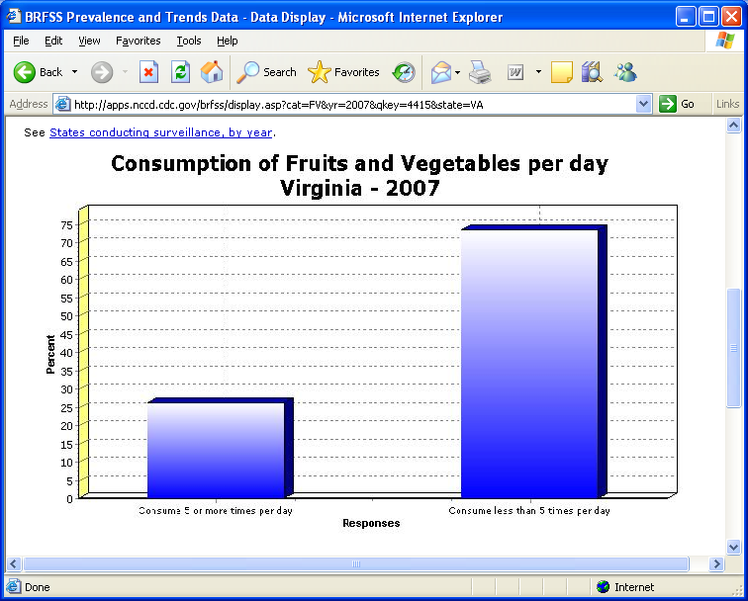
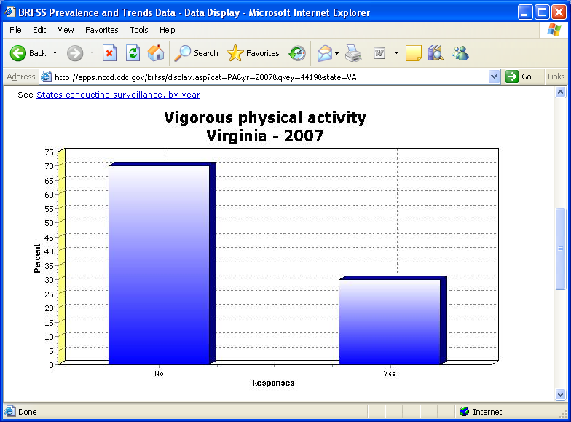
BRFSS Charts

Slide 74
Other Survey Examples
Exit interviews at health facilities
Special studies
  Risk-behavior
Cluster surveys
  Rapid surveillance after emergencies

Slide 75
Data Source
Administrative Data
Routinely collected for other reasons.
E.g., hospital discharge data collected for billing purposes, Medicaid and Medicare data, emergency department data, data collected in managed care organizations.
Virginia Health Information (VHI) – our hospital discharge database

Slide 76
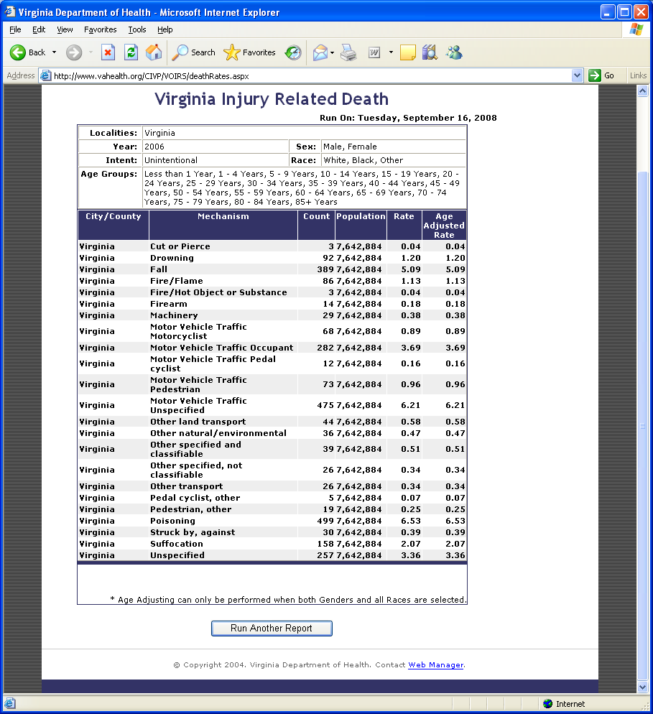
Cause of Injury Death
From Hospital Discharge Data
http://www.vahealth.org/CIVP/VOIRS/

Slide 77
Usefulness of Administrative Data
Depends on:
  What information is computerized
  Standardization of codes for diagnoses, symptoms, procedures, reasons for the visit
  Time between occurrence of health event and availability of data
  Ability to link with other data systems
  Whether supplementary information can be obtained.

Slide 78
Data Sources We Covered
Vital Statistics
Notifiable Diseases
Registries
Sentinel Surveillance
Syndromic Surveillance
Surveys
Administrative Data

Slide 79
Other Important
Surveillance Systems
Injury
Diabetes
Child/Adolescent Hospitalizations
Special temporary systems
Drug safety
Food Safety
Etc. – Public health collects a lot of information on the health of our communities!

Slide 80
Analysis of Surveillance Data
Descriptive epidemiology
  Person, place, time
Incidence and Prevalence
  Rates -- crude, specific, standardized
Trends and seasonality
Geographic clustering (maps)

Slide 81
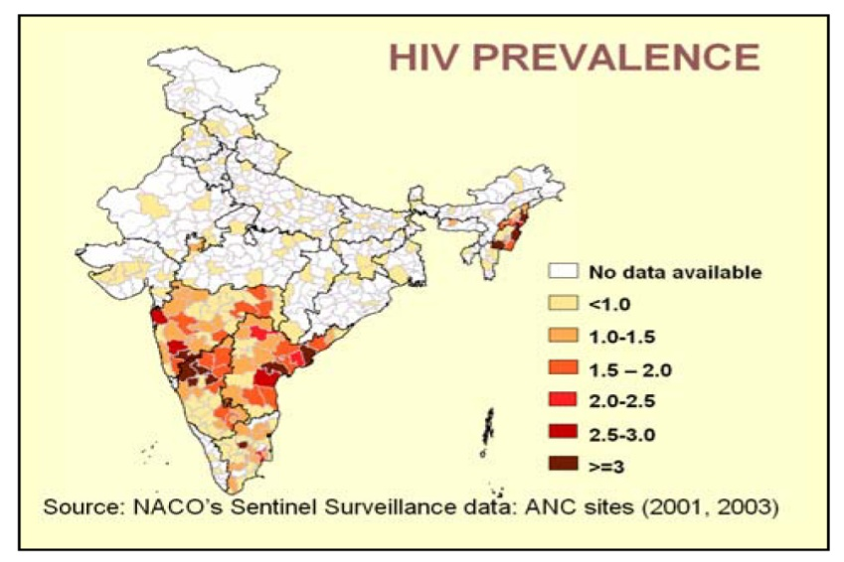
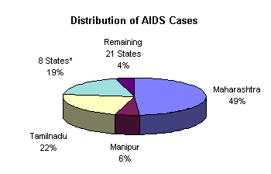
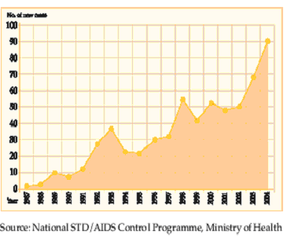
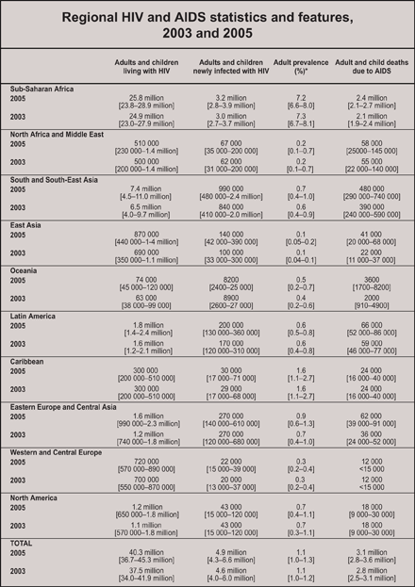
Graphics used to describe data

Slide 82
Interpretation of Surveillance Data
Limitations
  Under-reporting
  Biased reporting
  Inconsistent case definitions
Consider context
  Seasonality
  Recent policy changes

Slide 83
Interpretative Uses of
Surveillance Data
Identifying epidemics
Identifying new syndromes or risk groups
Monitoring trends
Evaluating public policy
Projecting future needs

Slide 84
Data Dissemination
What should be said? To whom? Through what communication medium? How should the message be stated? What effect did the message create?
Determine answers based on the purpose of the system.
SOCO - single overriding communication objective. [What is new? Who is affected? What works best?]

Slide 85



Data Dissemination
MESSAGE
AUDIENCE
CHANNEL

Slide 86
Evaluating Surveillance Systems
System objectives and usefulness
  Actions taken as a result of the data.
  Does the system do what it’s supposed to do?
Operation of the system
  who is reporting? to whom? what information is collected? how is information stored? who analyzes the data? what are the findings? how often are reports disseminated? to whom? etc.
Cost

Slide 87
Evaluation - System Attributes
Simplicity
  Should be as simple as possible and as easy to operate as possible.
Flexibility
  Should be able to adapt to changing needs.
Acceptability
  Willingness of individuals or organizations to participate in the surveillance system. (Judge based on completeness, timeliness, reporting)

Slide 88
Evaluation - System Attributes
Sensitivity
  Proportion of cases detected by the system. Completeness of reporting. Detect epidemics?
  Increased awareness, new diagnostic test, change in surveillance method may impact.
Predictive Value Positive
  Proportion of persons identified as having the disease who actually have it.

Slide 89
Sensitivity/Specificity and Predictive Value +/-

Slide 90
Evaluation - System Attributes
Representativeness
  Do the characteristics of reported events compare favorably with those in the population.
  Is there case ascertainment bias?
  Bias in descriptive information about a reported case?
Timeliness
  Any delay between the steps? (onset, diagnosis, report to public health, disease control actions)

Slide 91
Ethical and Legal Issues Relating to Surveillance
Professional obligations
Protecting confidentiality and privacy
Informed consent
  Mandated activity vs. Research
Maintaining public trust
Right of Access

Slide 92
ILI Surveillance
57 emergency departments and 24 urgent care facilities currently provide chief complaint data that are used to identify visits for influenza-like illness.
Percent of Visits for ILI out of All Visits by Age Group in Virginia
2008-2009 Influenza Season
9.0
0-4
5-24
25-49
50-64
65+
All Ages
8.0
7.0
6.0
5.0
percent of visits for ILI
4.0
3.0
2.0
1.0
0.0
11/1/2008
1/10/2009
2/7/2009
3/7/2009
4/4/2009
5/2/2009
8/8/2009
1/24/2009
2/21/2009
3/21/2009
5/16/2009
6/13/2009
10/4/2008
4/18/2009
5/30/2009
6/27/2009
7/25/2009
10/18/2008
11/15/2008
7/11/2009
8/22/2009
11/29/2008
12/13/2008
12/27/2008
week ending date

Slide 93
Hospitalizations
Of the EDs providing chief complaint data, 40 provide data that identify hospital admissions from the ED.

Slide 94
Deaths
Death certificates that mention flu or pneumonia are tracked by week, locality, age group
Pediatric flu-associated deaths – each case reported and information collected
Insufficient data available to graph
Usually have 2-3 per flu season in Virginia

Slide 95
Outbreaks
Report to public health
  More illness than expected in a group setting
Investigation includes assessment of the situation, recommendations to limit disease spread, and/or laboratory confirmation
Track by area, type of setting, etc.

Slide 96
Passive Reporting
Based on regulatory requirement
Physicians report number of cases of flu diagnosed each week, by type (A or B), if available
Labs report cases confirmed by PCR, culture, or DFA
  Not rapid tests

Slide 97
School Absenteeism
Schools working with health department to send data
Daily enrollment and absences in students and teachers/staff

Slide 98
School Closures
Decisions to close are made in consultation with the health department
Schools have been instructed to enter closures into CDC web site
CDC web site sends message to CDC and VDH

Slide 99
Sentinel Lab Surveillance
Sentinel physicians – one per district (35), test one patient per month
Sentinel EDs – one per district, test one patient per month
Sentinel hospitals – one per region (5), test five inpatients per month
Purpose is surveillance for circulating strains

Slide 101
Weekly Flu Activity Level
None
Sporadic
Local
Regional
Widespread

Slide 102
Contact Information
Diane Woolard, PhD MPH
Director, Division of Surveillance & Investigation
(804) 864-8141
diane.woolard@vdh.virginia.gov
Lesliann Helmus, MS
Surveillance Chief
(804) 864-8141
Lesliann.helmus@
vdh.virginia.gov

