Slide 1

Public Health Surveillance
Diane Woolard, Ph.D., M.P.H.
Division of Surveillance & Investigation
Virginia Department of Health

Slide 2
Objectives of Lecture
Key concepts of surveillance
  Definition
  Uses
  Methods
Public health surveillance systems
Use and evaluation of surveillance systems

Slide 3

What comes to mind when you hear ‘surveillance’?
Law enforcement agencies
CIA
Routine data collection
Statistics
Trends

Slide 4
Definition of Surveillance
The ongoing systematic collection, analysis, and interpretation of outcome-specific data for use in the planning, implementation, and evaluation of public health practice.
Includes data collection, analysis, and dissemination to those responsible for prevention and control.

Slide 5
What Surveillance Is
Systematic, ongoing…
  Collection
  Analysis
  Interpretation
  Dissemination
…of health outcome data
Health action
investigation
control
prevention

Slide 6
Surveillance History in U.S.
1741 – Rhode Island law required tavern keepers to report contagious disease
1850 – National mortality statistics first published by the federal government
1874 – Massachusetts instituted weekly reporting of diseases by physicians
1878 – Public Health Service (PHS)-type organization created to collect morbidity data for use in quarantine for cholera, smallpox, plague, yellow fever

Slide 7

Surveillance History in U.S.
1901 – All states required disease reporting
1925 – All states began participating in national morbidity reporting
1935 – First national health survey
1951 – Council of State and Territorial Epidemiologists (CSTE) authorized to determine diseases to be reported to PHS
1961 – Morbidity and Mortality Weekly Report (MMWR) published

Slide 8
Legal Authority for Surveillance
Legal authority for mandatory public health surveillance resides with states
Virginia Code
  32.1-35 – Board of Health (BOH) shall promulgate a list of diseases required to be reported
  32.1-36 – Physicians and laboratories shall report
  32.1-37 – Medical care facilities, schools and summer camps shall report

Slide 9
Virginia Code, continued
  32.1-38 – Anyone making a report is immune from liability
  32.1-39 – BOH shall provide for surveillance & investigation
  32.1-40 – Commissioner or designee can examine medical records
  32.1-41 – Anyone examining records must preserve anonymity of the patient and the practitioner

Slide 10
Purpose of Surveillance
To assess public health status, to define public health priorities, to evaluate programs, and to stimulate research.
  Tells us where the problems are, who is affected, and where the programmatic and prevention activities should be directed.

Slide 11
How can surveillance data be used?
Estimates of a health problem
Natural history of disease
Detection of epidemics
Distribution and spread of a health event
Hypothesis testing
Evaluating control and prevention measures
Monitoring change
Detecting changes in health practice
Facilitate planning

Slide 12
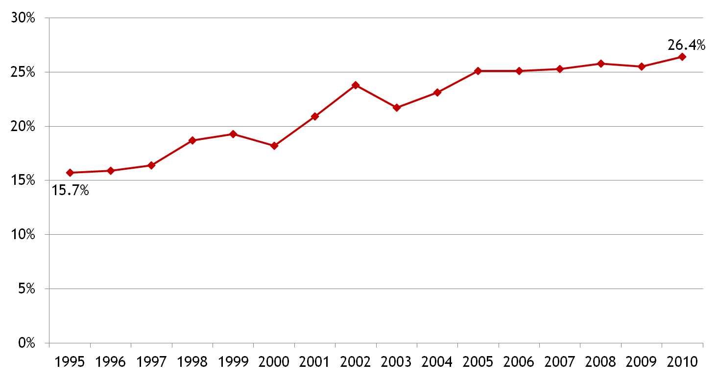
Uses of Surveillance Data:
Estimates of a Health Problem
Quantitative estimates of the magnitude of a health problem
  including sudden or long-term changes in trends, patterns
Percent of Adults Who Are Obese (BMI ≥30), Virginia, 1995-2010
Source: Virginia Behavioral Risk Factor Surveillance System (BRFSS)
Notes:
Graph updated (from Office of Family Health Services)

Slide 13
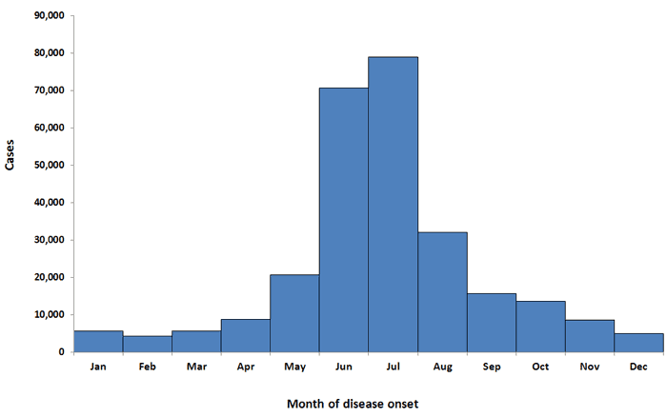
Uses of Surveillance Data:
Natural History of Disease
Portrayal of the natural history of disease (clinical spectrum, epidemiology)
Varicella Cases by Month –
Antelope Valley, CA, 1995–2004
Confirmed Lyme disease cases, by month of disease onset, United States, 2001-2010
Notes:
Lyme graph updated from CDC website – statistics section.

Slide 14
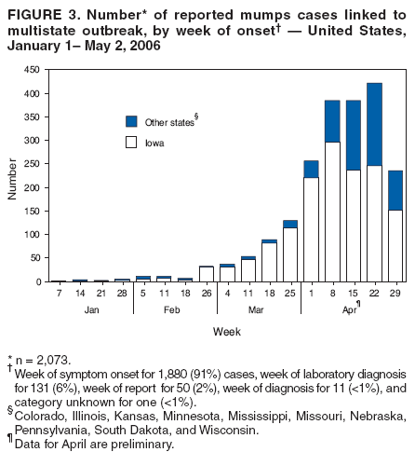
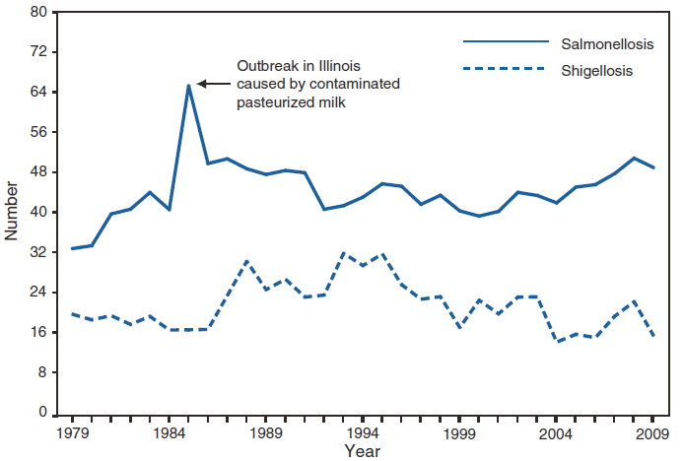
Uses of Surveillance Data:
Detection of Epidemics
SALMONELLOSIS and SHIGELLOSIS
Number* of reported cases, by year
United States, 1979-2009
*In thousands
Slide from CDC 2009 Annual Summary
Notes:
Updated Salm/Shig slide. The reported number of cases of salmonellosis and shigellosis has remained relatively stable during the past 2 decades. During 2009, multistate outbreaks of Salmonella were linked to aquatic frogs and the consumption of alfalfa sprouts, pistachios, and peanut butter.

Slide 15
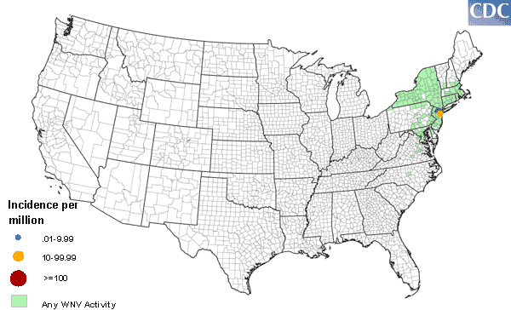
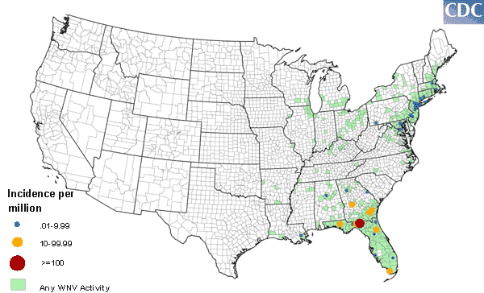
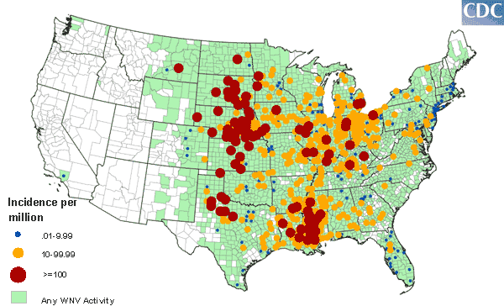
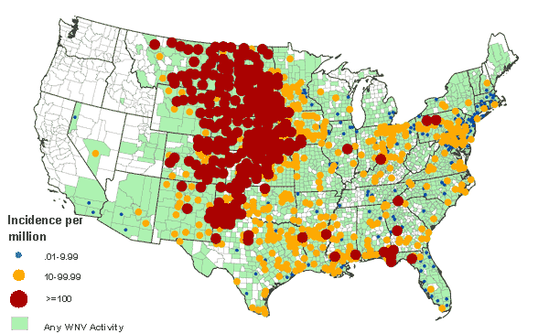
Uses of Surveillance Data:
Distribution & Spread of a Health Event
West Nile Virus in the US, 2000-2003
2000
2001
2002
2003
Notes:
The virus was first introduced in the northeastern US and then very quickly spread across the country in the next three years.

Slide 16
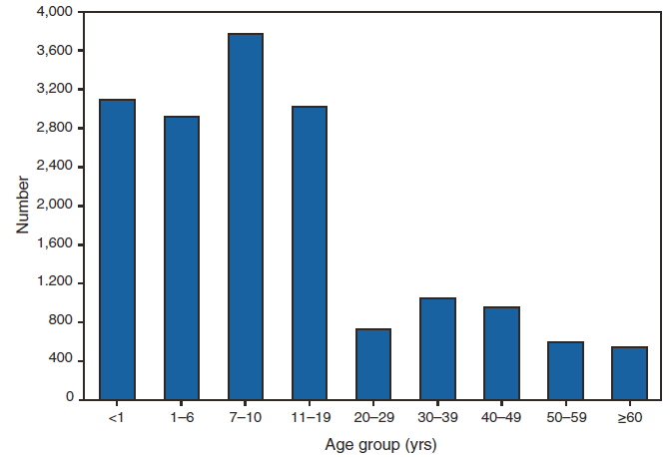
Use of Surveillance Data:
Hypothesis Testing
Facilitation of epidemiologic and laboratory research
  Hypothesis testing
PERTUSSIS
Number of reported cases*, by age group
United States, 2009
*Of 16,858 cases, age was reported unknown for 187 (1.1%) cases.
Slide from CDC – 2009 Annual Summary
Notes:
Updated pertussis slide

Slide 17
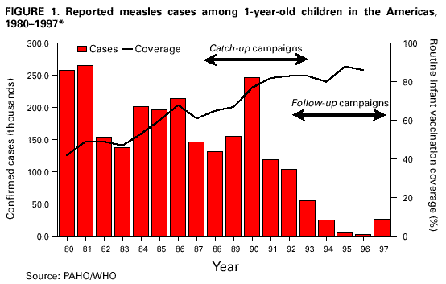
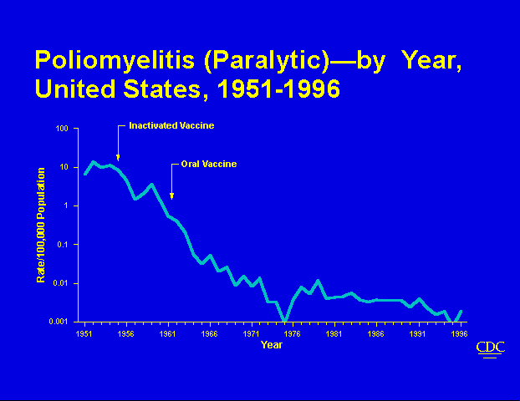
Uses of Surveillance Data:
Evaluating Control & Prevention Measures
Effectiveness of vaccine introduction

Slide 18
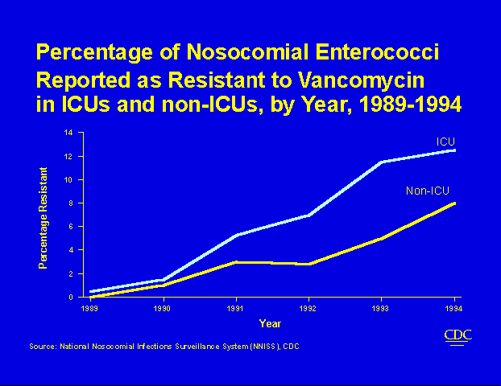
Uses of Surveillance Data:
Monitoring Changes
Monitoring changes in infectious agents and host factors
Notes:
Tried to find an updated slide for VRE or similar one for MRSA but couldn’t…

Slide 19
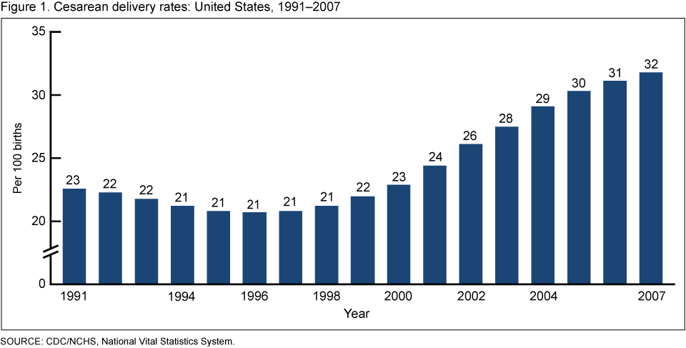
Uses of Surveillance Data:
Detecting Changes in Health Practice
Cesarean delivery rates: United States, 1991-2007
Notes:
Graph has been updated. In 2007, the cesarean rate was the highest ever reported in the United States.
There were 1.4 million cesarean births in 2007, representing approximately one-third of all births in the United States.
Following a decline in the early 1990s, the cesarean rate increased by 53% from 1996 to 2007, from 21% to an all-time high of 32%
The number of cesarean births increased by 71% from 1996 (797,119) to 2007 (1,367,049).

Slide 20
Uses of Surveillance Data:
Facilitate Planning
Identify target populations in need of health services
  Refugee populations
  Morbidity surveillance in emergency shelters
Identify health topics to be addressed by educational programs and media

Slide 21
Outcomes
Surveillance is outcome oriented.
Can measure frequency of an illness or injury (e.g., number of cases, incidence, prevalence)
Can measure severity of the condition (e.g., hospitalization rate, disability, case fatality)
Can measure impact of the condition (e.g., cost)
Orient data by person, place, and time

Slide 22
Planning a Surveillance System
Establish objectives
Develop case definitions
Determine data source or data collection mechanism
Field test methods
Develop and test analytic approach
Develop dissemination mechanism
Assure use of analysis and interpretation

Slide 23
What are Priorities for Surveillance?
Establish priorities based on:
  Frequency (incidence, prevalence, mortality)
  Severity (case-fatality, hospitalization rate, disability rate, years of potential life lost)
  Cost (direct and indirect)
  Preventability
  Communicability
  Public interest
  Will the data be useful for public health action?

Slide 24
Surveillance Methods:
Case Definition
Important to clearly define condition
Ensures same criteria are used by all
Makes the data more comparable
Include person, place, time
May define suspected and confirmed cases
May include symptoms, lab values, time period, population as appropriate

Slide 25
Case Definition Examples
Weak Definition - Measles
  Any person with a rash and fever, runny nose, or conjunctivitis
Better Definition - Measles
  Any person with a fever >101 F, runny nose, conjunctivitis, red blotchy rash for at least 3 days, and laboratory confirmation of IgM antibodies
Clinical, Probable, Confirmed Case Definitions
Outbreak Case Definition
  Differs from routine surveillance
  Epidemiologically linked cases often included

Slide 26
Case Definition Example: Giardiasis
Clinical description
An illness caused by the protozoan Giardia lamblia (aka G. intestinalis or G. duodenalis) and characterized by gastrointestinal symptoms such as diarrhea, abdominal cramps, bloating, weight loss, or malabsorption.
Laboratory criteria for diagnosis
Laboratory-confirmed giardiasis shall be defined as the detection of Giardia organisms, antigen, or DNA in stool, intestinal fluid, tissue samples, biopsy specimens or other biological sample.
Case classification
Confirmed: a case that meets the clinical description and the criteria for laboratory confirmation as described above. When available, molecular characterization (e.g., assemblage designation) should be reported.
Probable: a case that meets the clinical description and that is epidemiologically linked to a confirmed case.
Notes:
2011 case definition

Slide 27
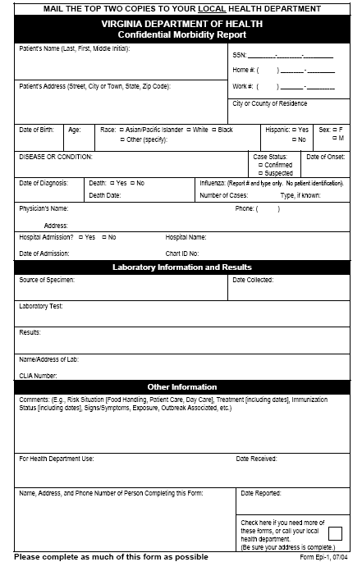

Surveillance Methods:
Data Collection
Data collection
  Standardized instruments, field tested
Passive surveillance*
  Providers are responsible for reporting
  Health dept. waits to receive reports
  Problem with underreporting
Active surveillance*
  Providers contacted on regular basis to collect information
  More resource intensive
  Used for outbreaks or pilot studies
* These are very key concepts

Slide 28
Active Surveillance - Ebola
While most public health surveillance is passive, the Ebola virus disease epidemic in Western Africa in 2014-15 led to active surveillance in the US and elsewhere
From Oct 2014-Dec 2015, the Virginia Department of Health actively monitored 2,239 travelers returning from Ebola-affected countries–calling each 7 days/week for 21 days

Slide 29
Active Surveillance - Zika
Active surveillance is being conducted on women infected with Zika virus during pregnancy
Less active than Ebola surveillance was, this surveillance involves gathering data from the healthcare provider multiple times during pregnancy, at birth, and through the first year of life of the infant to better understand adverse outcomes associated with the virus.

Slide 30

Surveillance Methods:
Data Analysis
Ongoing review
Descriptive statistics, multivariate analyses
Automated analyses
Disease | Number of cases
Tuberculosis | 20
Gonorrhea | 320

Slide 31
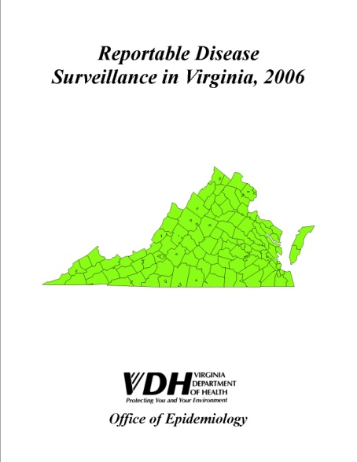

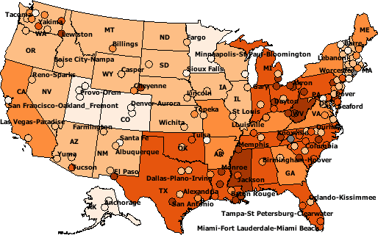
Surveillance Methods:
Interpretation and Dissemination
Presentation of data in the form of tables, graphs, maps, etc.
Disseminate data via reports, presentations, internet, etc.

Slide 32
Surveillance Methods: Evaluation
Did the system generate needed answers to problems?
Was the information timely?
Was it useful for planners, researchers, etc?
How was the information used?
Was it worth the effort?
What can be done to make it better?
(More on evaluation later).

Slide 33
Cycle of Surveillance
Data Collection
  Pertinent, regular, frequent, timely
Consolidation and Interpretation
  Orderly, descriptive, evaluative, timely
Dissemination
  Prompt, to all who need to know (data providers and action takers)
Action to Control and Prevent
Evaluation

Slide 34
Data Sources
Vital Statistics
Notifiable Diseases
Registries
Sentinel Surveillance
Syndromic Surveillance
Surveys
Administrative Data

Slide 35
Data Sources:
Vital Statistics
Live Births
Deaths
Fetal Deaths
Marriages
Divorces
Induced Terminations of Pregnancy
Infant Mortality (link birth and death data)

Slide 36
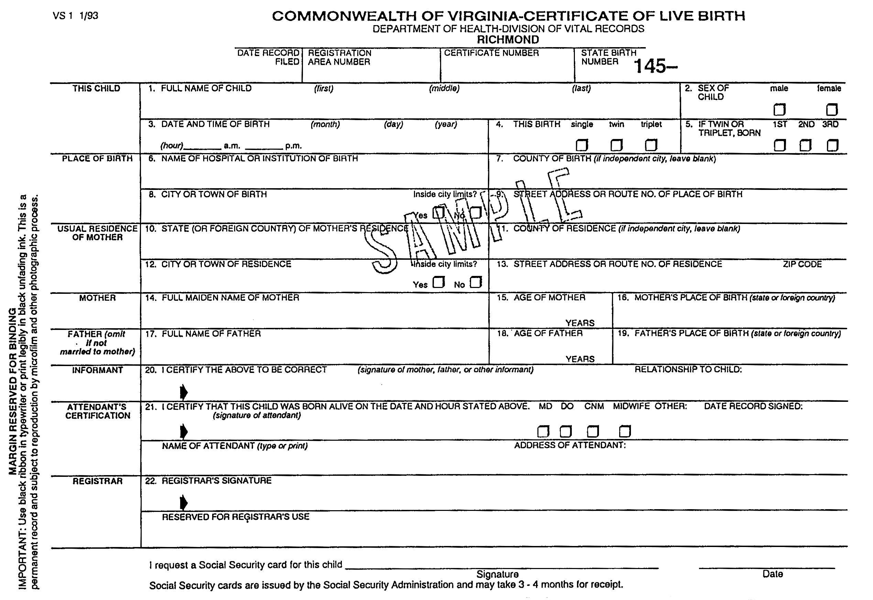
Virginia Birth Certificate

Slide 37
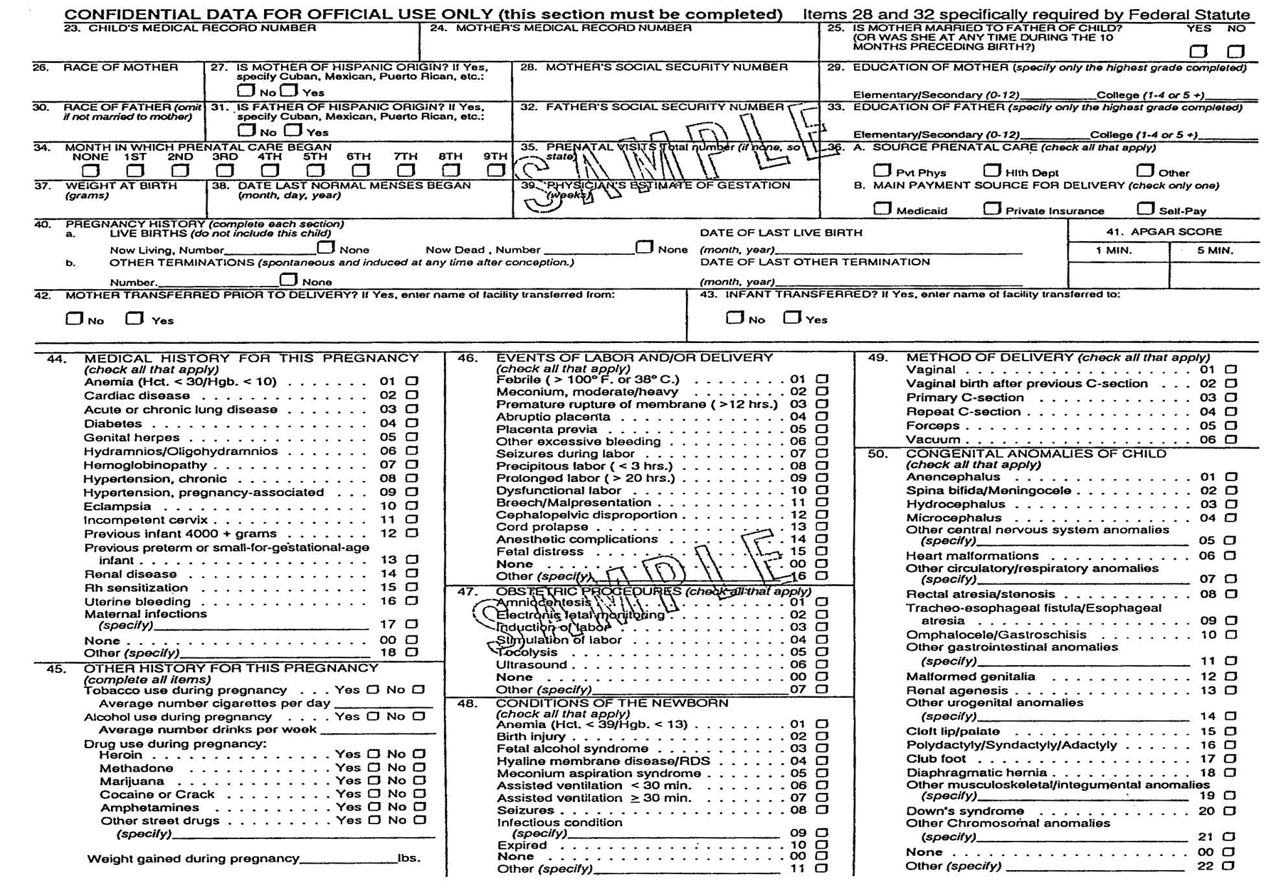
Virginia Birth Certificate
Notes:
Note under Item 50 that Microcephalus is reported on the birth certificate, which is important in 2016, as the risk of that outcome associated with Zika virus infection is of great concern.

Slide 38
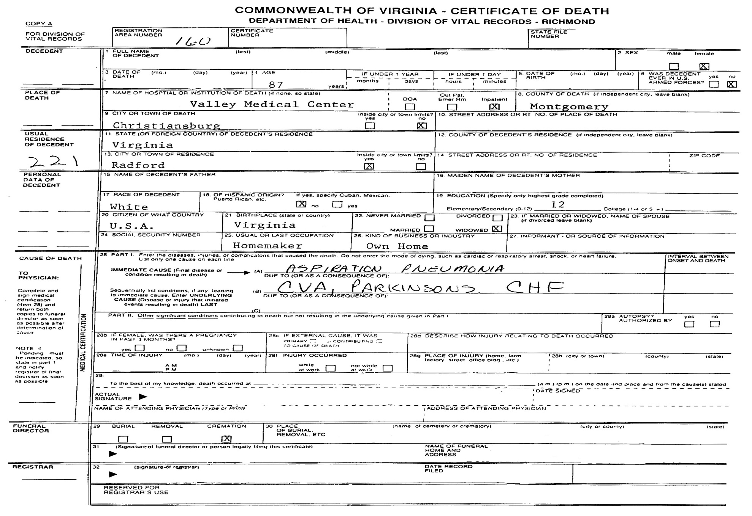
Virginia Death Certificate
SAMPLE
Notes:
The immediate and numerous underlying causes can be noted on the death certificate, but procedures are in place nationwide that are followed to assign one underlying cause of death to each death. Most death statistics are based on the underlying cause.

Slide 39
Uses of Vital Statistics Data
Monitoring long-term trends
Identifying differences in health status within racial or other population subgroups
Assessing differences by geographic area
Monitoring deaths that are preventable
Generating hypotheses about causation
Monitoring progress toward improved health of the population; health-planning

Slide 40
Vital Records:
Coding and Calculating
ICD-9 historically, now ICD-10.
Infant mortality - need number of live births for denominator in calculating rates.
Other death rates - use total population in rate calculations.
Crude and adjusted (standardized) rates used.

Slide 41
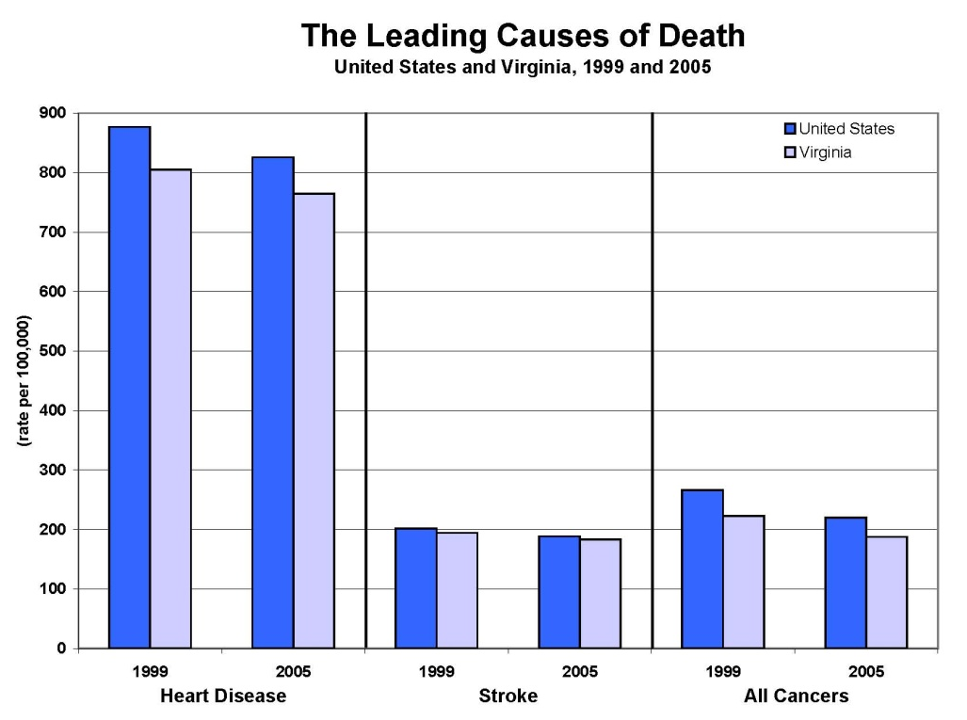
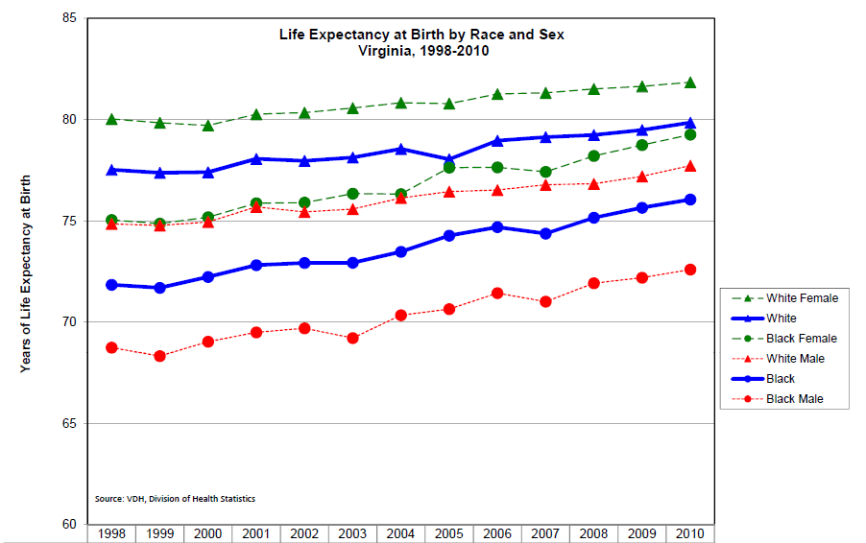
Vital Statistics Data
Notes:
Life expectancy graph has been updated
http://www.vdh.virginia.gov/HealthStats/stats.htm

Slide 42
Quality of Vital Stats Depends on
Care taken by health care providers in ascertaining cause of death and other factors
Accuracy of coding (difficult for injuries)
Relevance of existing codes for the condition being recorded
Accuracy of population estimates
Problems - don’t know onset, can’t see effect of diseases that don’t lead to death

Slide 43
Data Sources:
Notifiable Diseases
States decide what is notifiable/reportable
  Based on disease occurrence, potential for outbreaks, public perception of risk, etc.
  CSTE recommendations
  Different processes for generating N.D. list
Weekly (or sometimes rapid) reporting to health departments by physicians, medical care facilities, laboratories.
  States report to CDC

Slide 44
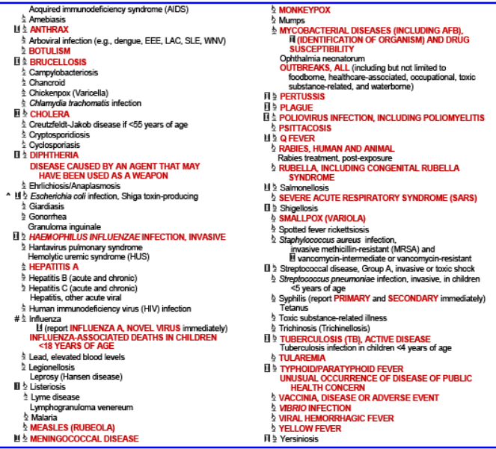
Virginia Reportable Disease List
Over 70 reportable diseases/conditions
Notes:
Reportable disease list updated
Note: Ebola is reportable under the heading of ‘Viral Hemorrhagic Fever’ and Zika is reportable under the heading of ‘Arboviral infection’

Slide 45
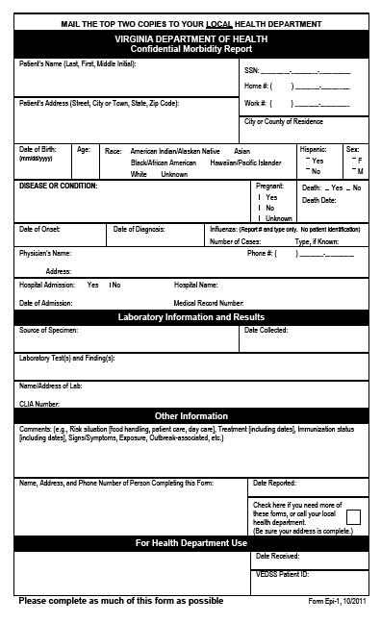
Epi-1 Form
Notes:
Epi-1 updated

Slide 46
Chain of Communication
Other States
State
Physicians
Labs
Hospitals/Medical Care Facilities
Regional
Epis
Central Office
Local H.D.
CDC
Other Health Districts

Slide 47
Electronic Surveillance
National Electronic Disease Surveillance System (NEDSS)
  A set of criteria developed by CDC that all public health surveillance systems must meet
  Virginia adopted CDC’s NEDSS Base System (VEDSS)
  Used to manage statewide reportable disease surveillance data
  Supported by CDC funds

Slide 48
VEDSS
Shared secure web-based disease surveillance database for Virginia
  Eliminates delays in reporting
  Improves communication about cases
  Assists in earlier detection of events
  Provides more data in electronic form for analysis
All Virginia health departments connected by the end of 2006
Includes electronic reporting from laboratories

Slide 49
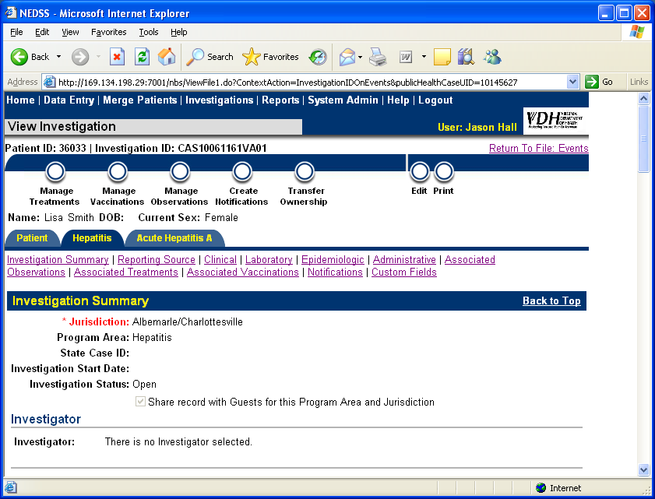
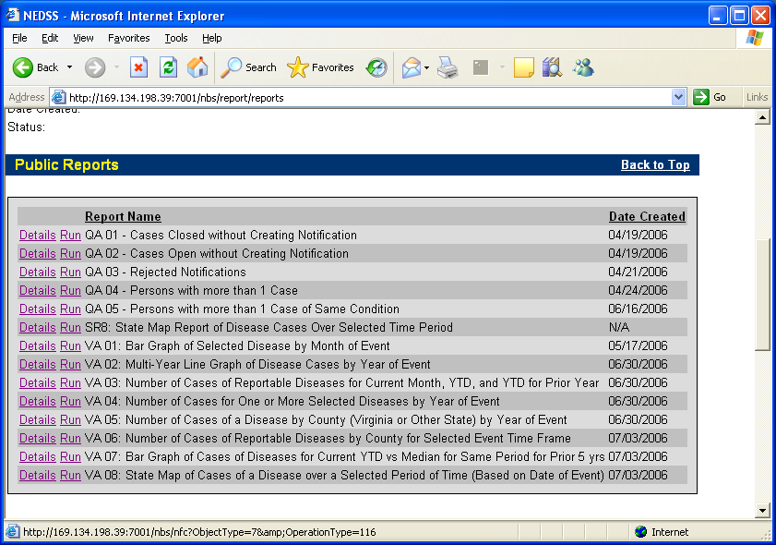
VEDSS Data Entry and Reports

Slide 50
STD Trends Over Time
Notes:
Click here for more current data on Chlamydia in Virginia: http://www.vdh.virginia.gov/Epidemiology/Surveillance/SurveillanceData/AnnualReports/Reports/Diseases%202014/Chlamydia2014.pdf
Click here for more current data on gonorrhea in Virginia: http://www.vdh.virginia.gov/Epidemiology/Surveillance/SurveillanceData/AnnualReports/Reports/Diseases%202014/Gonorrhea2014.pdf
Click here to see data on any reportable disease from the 2014 disease statistics report for Virginia: http://www.vdh.virginia.gov/Epidemiology/Surveillance/SurveillanceData/AnnualReports/Reports/index2014.htm

Slide 51
Elevated Blood Lead Levels in Children by Range of Elevation, Virginia, 2010
Notes:
Updated graph. Used to be three year trend by range of elevation.

Slide 52
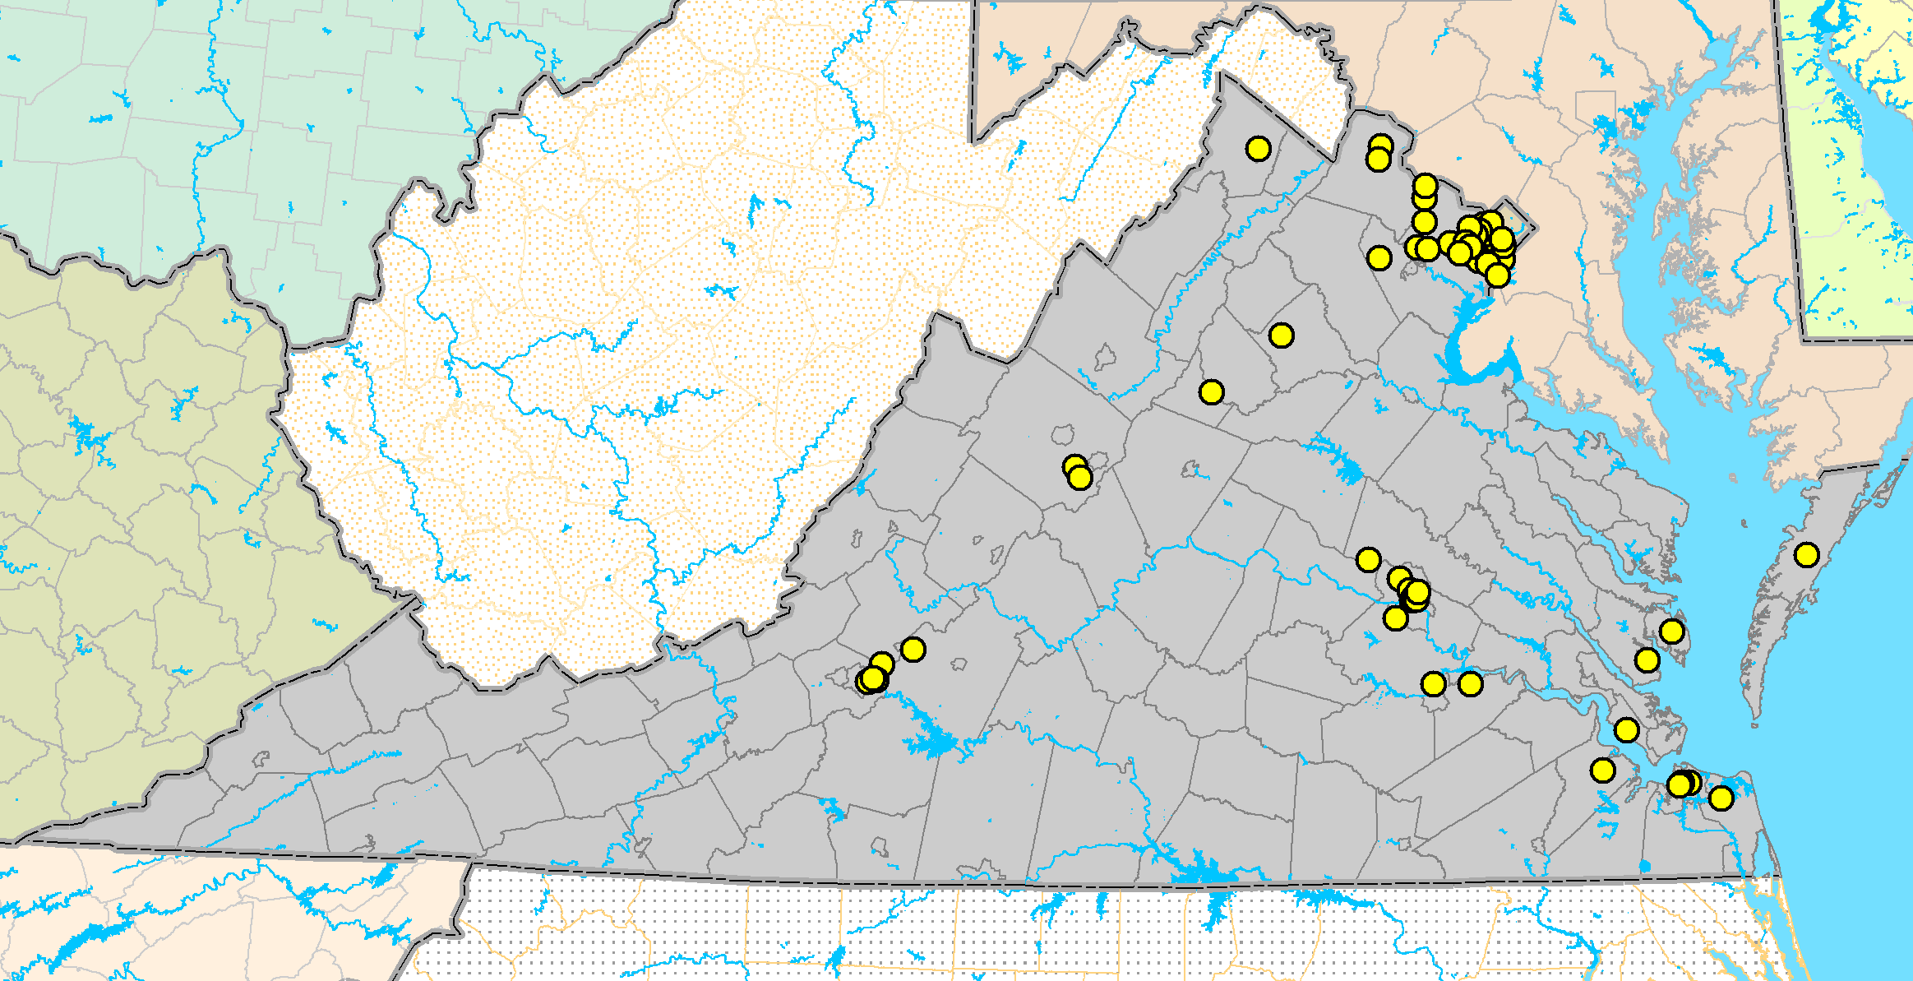
Geographic Distribution of Human Arbovirus Cases Recorded in Virginia since 1975
Human Arbovirus
Infections Since 1975
WNV (67 cases)*
SLE (8 cases)*
LAC (29 cases)*
EEE (5 cases)*
*Number of cases through 9/08
WNV = West Nile virus
LAC = La Crosse encephalitis virus
SLE = St. Louis encephalitis virus
EEE = Eastern equine encephalitis virus
Notes:
Couldn’t find a more recent map

Slide 53
Primary pathogens causing central line-associated bloodstream infections, Virginia, 2010

Slide 54
Limitations of Disease Reporting
Underreporting
  Reporting better for more serious diseases and those for which there is laboratory confirmation
  Need to seek medical consultation to be diagnosed and then reported
Lack of representativeness of reported cases
Inconsistent case definitions

Slide 55
Reasons for Not Reporting
Assume someone else reported.
Do not know reporting was required; don’t have a copy of the reportable disease list.
Do not know how to report; don’t have form or telephone number.
Concern about confidentiality and doctor-patient relationship.
No incentive to report. Time-consuming. Unaware of value.

Slide 56
How to Improve Reporting
Contact physicians in the community.
  Tell them the health department is very interested in morbidity reporting
Maintain a reasonable list of reportable diseases.
Maximize contact through presentations, mailings, newsletters, media, etc.
Use the data.

Slide 57
In Spite of Limitations...
The best system we have for tracking communicable disease morbidity
Information available quickly and from all jurisdictions
Can detect outbreaks / changes in incidence
Allows disease control measures to be implemented

Slide 58
Data Source: Registries
Information from multiple sources is linked for each individual over time.
  Diverse sources of information. E.g., hospitals (sometimes >1), pathology, death certificates.
Used for cancer, congenital anomalies, trauma, etc.
Most are passive but resource intensive.
More lag in data availability due to complexity of data collection process.

Slide 59
Populations Covered by Registries
Hospital-based
Population-based
Exposure registries
  World Trade Center Health Registry
  Three Mile Island

Slide 60
Example: Virginia Cancer Registry
Methods prescribed by ACOS, NAACCR, Virginia regulations, CDC.
Hospital registries are main source of data.
Voluntary reporting, 1970-1989
Mandatory reporting, 1990-present
Demographic, geographic, clinical data
Annual merge with vital records for survival information.

Slide 61
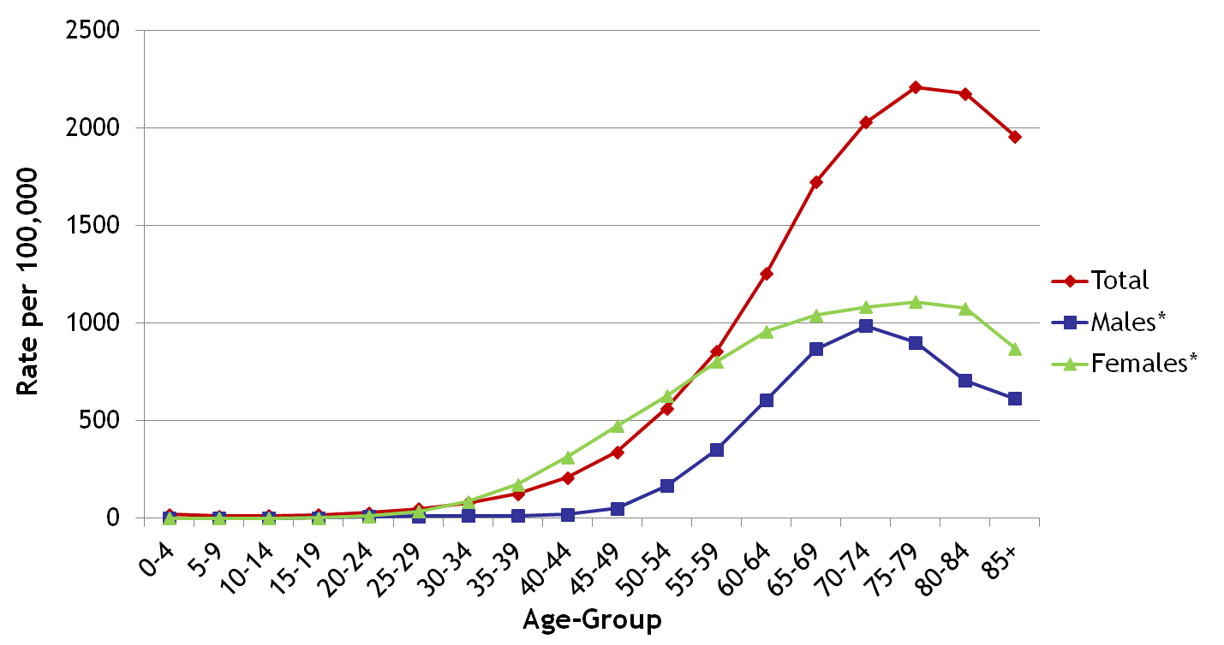
Registry Data
Age-Adjusted Cancer Incidence Rates, All Sites, by Sex and Age, Virginia, 1999-2008
* Incidence rates reflect gender-specific cancers: Males (Prostate and Testis), and Females (Breast, Cervical, Ovarian, and Uterine). Rates are per 100,000 and age-adjusted to the 2000 US Std Population
(19 age groups - Census P25-1130) standard.
Source: Virginia Cancer Registry, May 2012
Notes:
Slide updated from VA Cancer Registry.

Slide 62
Data Source: Sentinel Systems
To gather timely public health information in a relatively inexpensive manner.
Cannot derive precise estimates of prevalence or incidence in the population.
Sentinel health events
Sentinel sites
Sentinel providers

Slide 63
Sentinel Health Events
A condition whose occurrence serves as a warning signal.
Particularly useful for occupational exposures.
Silicosis, occupational asthma, pesticide poisoning, lead poisoning, carpal tunnel syndrome.
Cases trigger intervention activities.

Slide 64
Sentinel Sites or Providers
Surveillance at certain hospitals, clinics, or physician practices.
Sentinel sites - monitor conditions in subgroups that may be more vulnerable
  E.g., drug clinic, STD clinic, MCH clinic
Sentinel providers - monitor activity in ambulatory care settings.
  For diseases that are not reportable
  For influenza…

Slide 65
Flu Surveillance
Visits for influenza-like illness (ILI)
Sentinel Providers / Lab Surveillance
Outbreak Surveillance (and control)
Pediatric Deaths – report to health dept if flu-associated death and age < 18
Weekly Activity Level
Influenza Incidence Surveillance Project

Slide 66
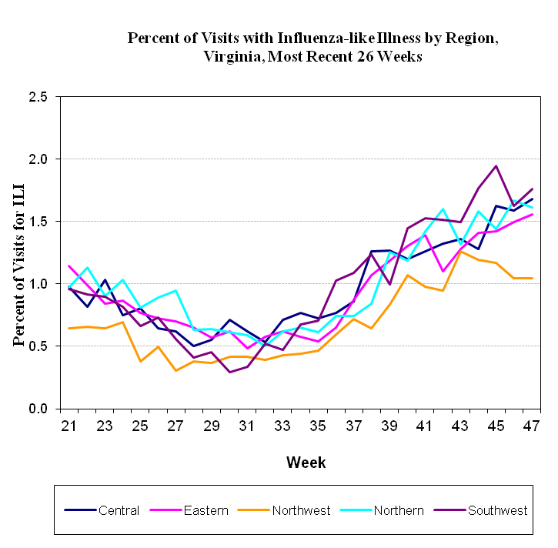
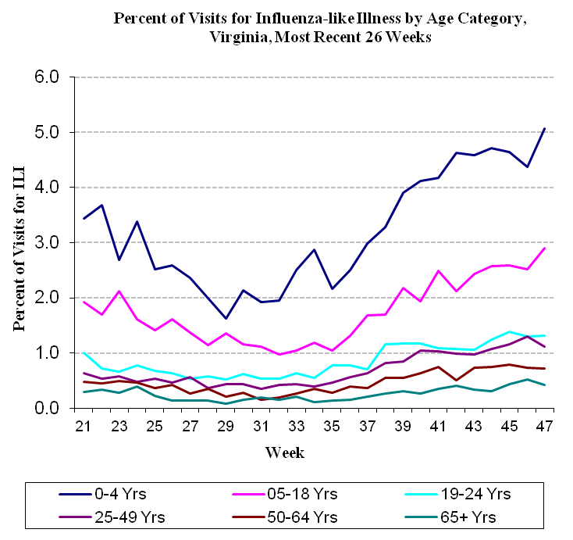
ILI Visits – Reported from ED/Urgent Care

Slide 67
Sentinel Providers/Lab Surveillance
55 sentinel provider sites from 31 health districts
  29 physician offices
  26 ED/urgent care facilities.
Providers submit two specimens per month from patients meeting the ILI case definition to DCLS
  fever with sore throat and/or cough in the absence of another known cause
Confirmatory lab results from other labs also used
Identifies which particular flu viruses are circulating

Slide 68
Flu Outbreak Surveillance
Outbreaks are reported by phone
  Most are from group residential settings
VDH recommends control measures
5-6 specimens collected/outbreak for lab testing
Monitor outbreak to its end
Complete outbreak report form for documentation

Slide 69
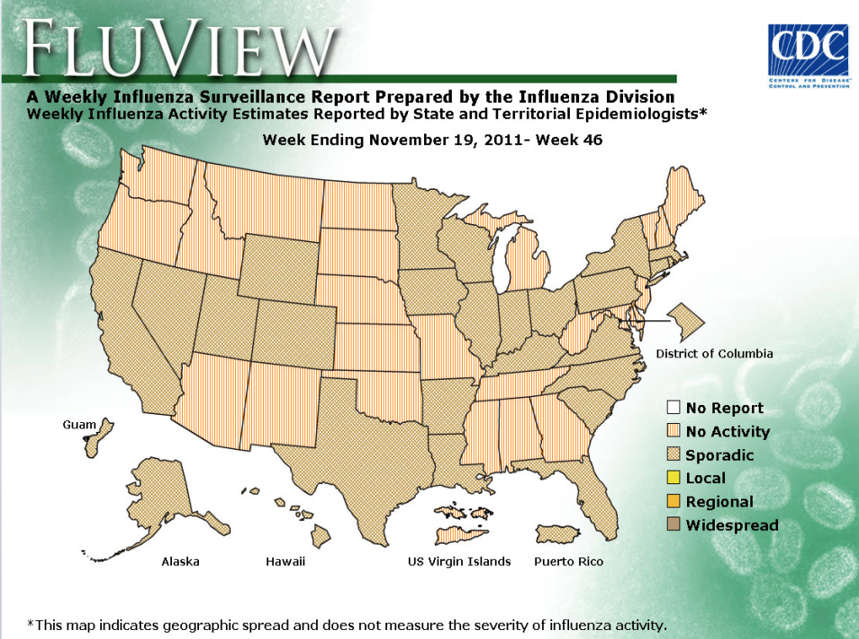
Flu - Weekly Activity Level
Reported to CDC
Shown on weekly State Epidemiologist map
None
Sporadic
Local
Regional
Widespread
Based on ILI visits/region, lab findings, outbreaks

Slide 70
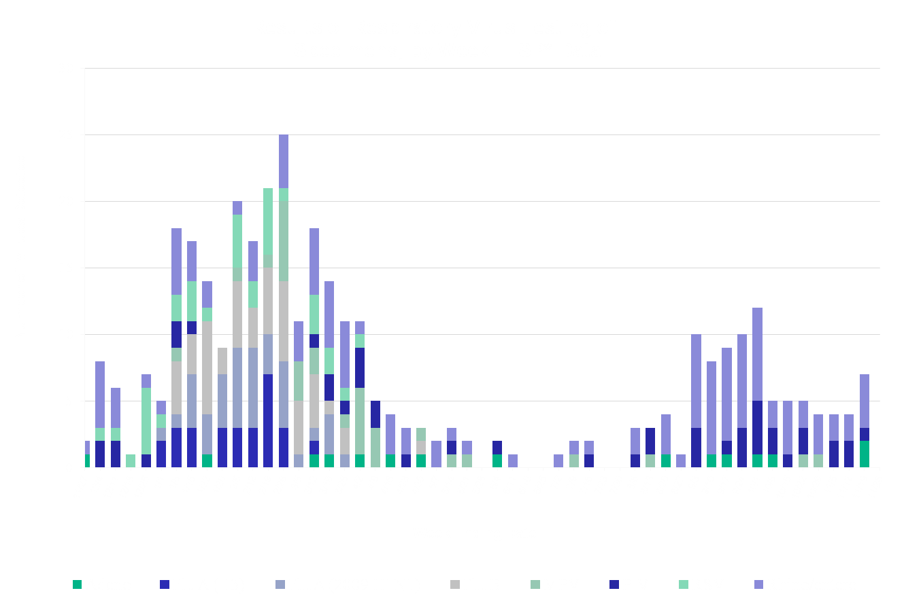
*Influenza Incidence Surveillance Project: Selected providers test a sample of patients who have ILI each week and laboratory tests identify which specific viruses caused the illness.

Slide 71
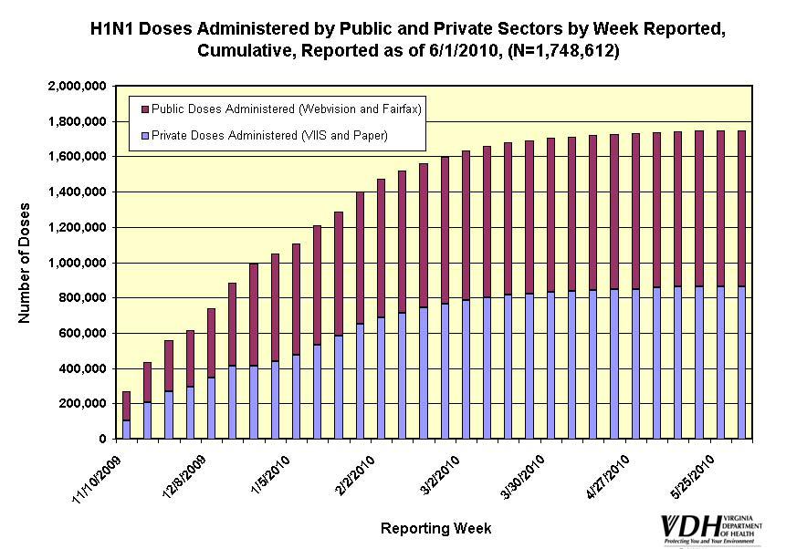
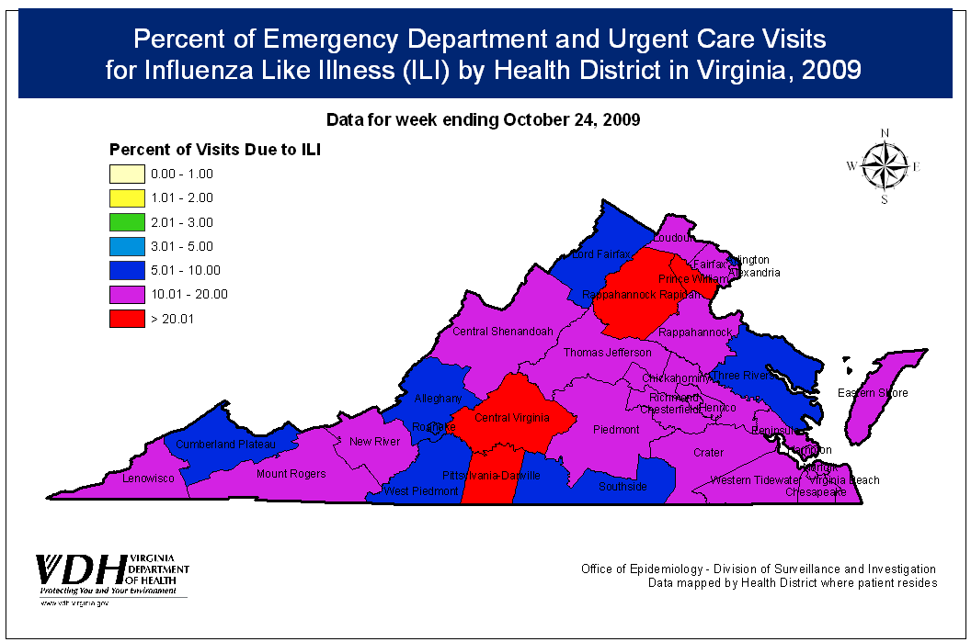
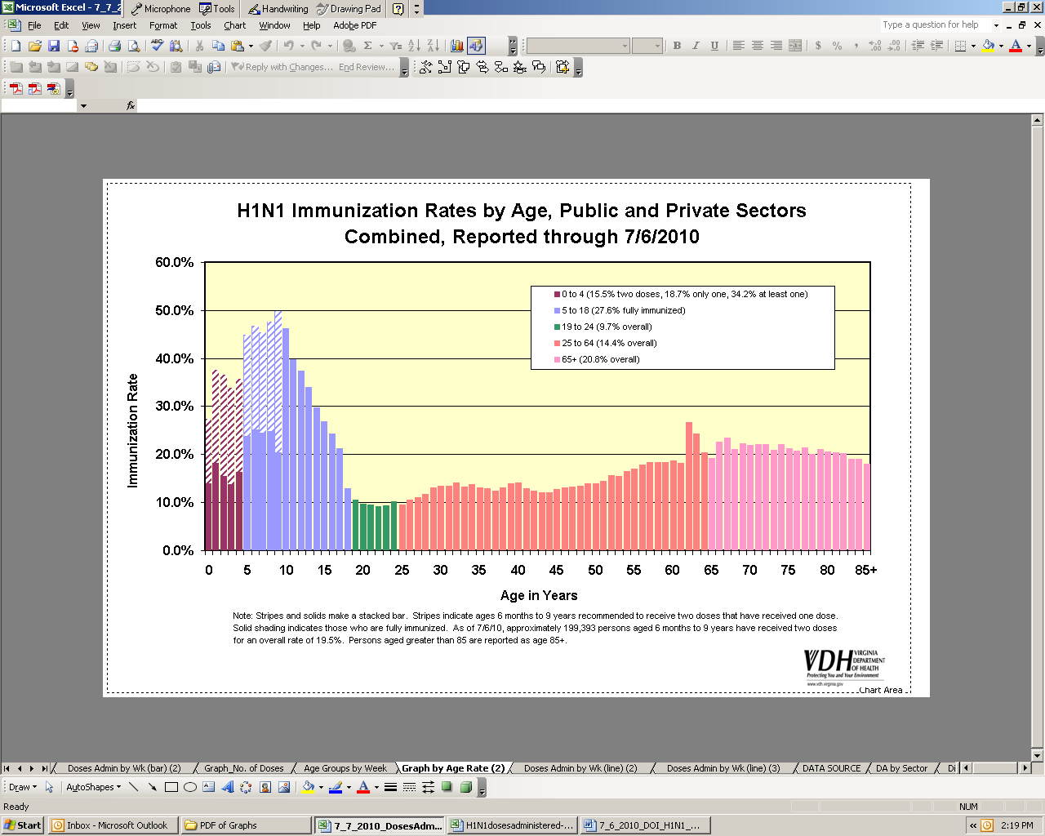
Influenza Dashboard

Slide 72
Syndromic Surveillance
Uses pre-diagnostic indicators to identify emerging health problems
Self medication
Medical care
Diagnosis
Insurance billed
Onset of symptoms
Medical consultation
Laboratory testing
Prescription
filled

Slide 73
Automating Syndromic Surveillance
Began as manual activity just after 9/11/01
Automated in 2004 with ESSENCE
  Electronic Surveillance System for the Early Notification of Community-Based Epidemics (Johns Hopkins University, Applied Physics Laboratory)
Access limited to approved VDH staff
Collaborate with District of Columbia and Maryland to monitor national capital region

Slide 74
ESSENCE
Hospital emergency departments and urgent care centers electronically transmit chief complaints to secure VDH server every day
Receive chief complaints from ~13,000 patient visits each day
System also includes:
  Over-the-counter drug sales
  School attendance

Slide 75
Syndromes
Complaints tallied into syndrome categories
  Death
  Sepsis (serious infection)
  Rash
  Respiratory (e.g., cough)
  Gastrointestinal (e.g., diarrhea)
  Unspecified Infection (fever)
  Neurological (e.g., dizziness)
  Other
Can customize queries to view other outcomes
Notes:
Syndromic surveillance data are good for tracking effects of natural disasters, such as hurricanes, to monitor large-scale public events, such as the Presidential Inauguration, to assess worrisome trends and patterns, such as heroin overdoses, and to identify the start of annual predicted events of public health importance, such as influenza and norovirus seasons.

Slide 76
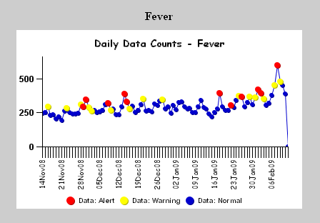
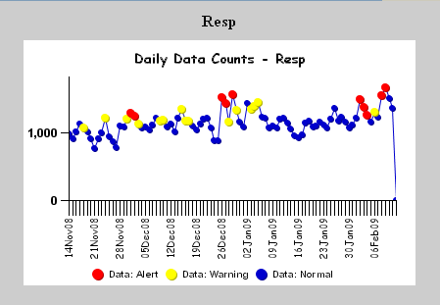
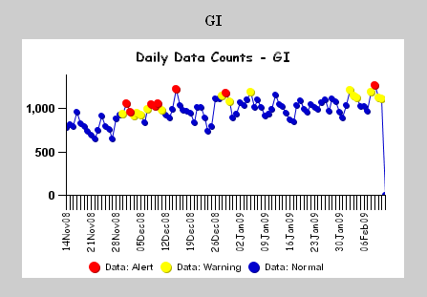
Syndromic Analyses
Automated analyses identify unusual patterns and increases are investigated

Slide 77
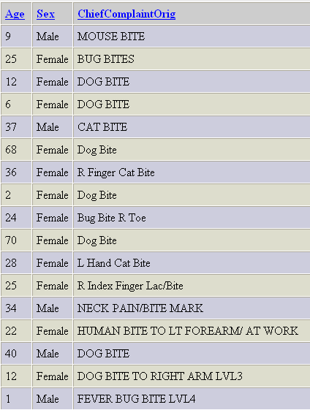
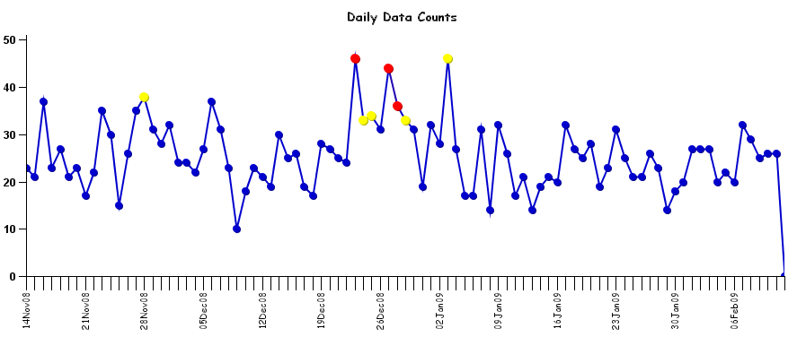
Drill Down Ability
Animal bites

Slide 78
Uses of Syndromic Data
Monitor trends in influenza, gastrointestinal illness
Detect outbreaks or individual cases of disease, especially illnesses with unique symptoms or names (e.g., scombroid poisoning)
Special event surveillance (e.g., Olympic Games, Presidential Inauguration, National Boy Scout Jamboree)
Disaster surveillance (e.g., hurricanes, ice storms, etc.)

Slide 79
Exposure Detection
U.S. Postal Services’ BioHazard Detection System
  Tests for anthrax in mail sorting area every hour
  Selected Post Offices in Virginia
  Response is collaborative
Homeland Security/DOD BioWatch System
  DC area, including northern Virginia
  Central Virginia around Richmond
  Eastern Virginia around military bases
  Monitors for biologic agents atop buildings

Slide 80
Data Source: Surveys
If done continually or periodically, can monitor risk factors and changes in prevalence over time
Can also assess knowledge, attitudes
People usually queried only once and not monitored on an individual basis after that
From questionnaires, interviews (in person or telephone), or record review

Slide 81
National Surveys – www.cdc.gov/nchs
National Health Interview Survey
  Random selection of households
  In-home interview gathering information on all in the household
  Self-reported illnesses, chronic conditions, injuries, impairments, use of health services
  Civilian, non-institutionalized population

Slide 82
National Surveys, continued
National Health and Nutrition Examination Survey (NHANES)
  Prevalence of chronic conditions, distribution of physiologic and anthropomorphic measures, and nutritional status for representative samples of the U.S. population
National Health Care Survey, includes
  National Hospital Discharge Survey
  National Ambulatory Medical Care Survey

Slide 83
BRFSS
Behavioral Risk Factor Surveillance System
  Random digit telephone surveys on non-institutionalized adults’ health behavior and use of prevention services
  Height, weight, physical activity, smoking, alcohol use, seatbelt use, cholesterol screening, mammography, etc.
  Done in most states (including Virginia)
  CDC program

Slide 84
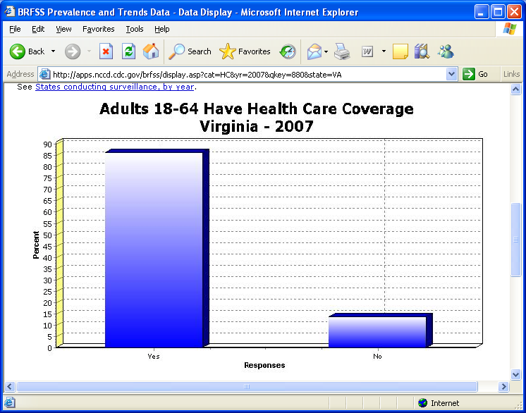
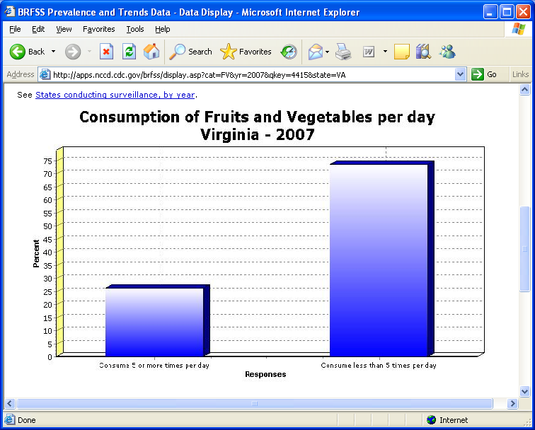
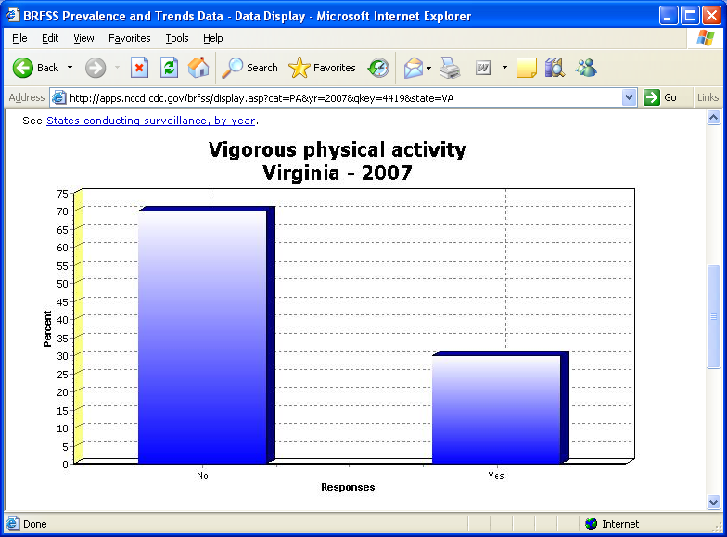
BRFSS Charts

Slide 85
PRAMS
Pregnancy Risk Assessment Monitoring System
  Assesses maternal attitudes and experiences before, during, and shortly after pregnancies that resulted in a live birth.
  In Virginia, about 100 mothers of 2-6 month old infants are randomly selected each month from birth certificate data.
    Eligible mothers are mailed surveys, and phone interviews are conducted if a survey is not returned
  Survey does not represent pregnancies that resulted in induced termination.
Notes:
Began in Virginia in 2007. Data currently available for 2007-2009.
Good source of qualitative data to help target programs to address behaviors. Example: reasons why mom did not breastfeed, barriers to accessing prenatal care, reasons for not using birth control if not trying to get pregnant.

Slide 86
Reasons for Not Using Birth Control Before Pregnancy Among Women Not Trying to Become Pregnant, VA PRAMS, 2008-09
Notes:
27% of all women who had a live birth were not trying to get pregnant but not using birth control to prevent pregnancy
Source: VDH Pregnancy Risk Assessment Monitoring System (PRAMS) 2008-09, compiled by the Division of Policy & Evaluation, Office of Family Health Services

Slide 87
Other Survey Examples
Exit interviews at health facilities
Special studies
  Risk-behavior
Cluster surveys
  Rapid surveillance after emergencies

Slide 88
Data Source:
Administrative Data
Routinely collected for other reasons.
E.g., hospital discharge data collected for billing purposes, Medicaid and Medicare data, emergency department data, data collected by managed care organizations.
Virginia Health Information (VHI) maintains our state’s hospital discharge database.

Slide 89
Causes of Injury Death, Virginia, 2009
From Hospital Discharge Data
Mechanism | Number of Deaths | Population | Rate | Age Adjusted Rate
Cut or Pierce | 61 | 7,882,590 | 0.77 | 0.74
Drowning | 86 | 7,882,590 | 1.09 | 1.06
Fall | 526 | 7,882,590 | 6.67 | 6.82
Fire/Flame | 74 | 7,882,590 | 0.94 | 0.91
Fire/Hot Object or Substance | 1 | 7,882,590 | 0.01 | 0.01
Firearm | 832 | 7,882,590 | 10.55 | 10.31
Machinery | 21 | 7,882,590 | 0.27 | 0.27
Motor Vehicle Traffic Motorcyclist | 75 | 7,882,590 | 0.95 | 0.92
Motor Vehicle Traffic Occupant | 208 | 7,882,590 | 2.64 | 2.6
Motor Vehicle Traffic Pedal cyclist | 4 | 7,882,590 | 0.05 | 0.05
Motor Vehicle Traffic Pedestrian | 73 | 7,882,590 | 0.93 | 0.9
Motor Vehicle Traffic Unspecified | 403 | 7,882,590 | 5.11 | 5.02
Other land transport | 28 | 7,882,590 | 0.36 | 0.35
Other natural/environmental | 38 | 7,882,590 | 0.48 | 0.48
Other specified and classifiable | 45 | 7,882,590 | 0.57 | 0.55
Other specified, not classifiable | 45 | 7,882,590 | 0.57 | 0.55
Other transport | 15 | 7,882,590 | 0.19 | 0.19
Pedal cyclist, other | 6 | 7,882,590 | 0.08 | 0.07
Pedestrian, other | 26 | 7,882,590 | 0.33 | 0.33
Poisoning | 769 | 7,882,590 | 9.76 | 9.59
Struck by, against | 26 | 7,882,590 | 0.33 | 0.31
Suffocation | 391 | 7,882,590 | 4.96 | 4.95
Unspecified | 45 | 7,882,590 | 0.57 | 0.56
TOTAL | 3,798 | 7,882,590 | 48.18 | 47.56
http://www.vahealth.org/Injury/voirs/reports/DeathRates.aspx
Notes:
Slide has been updated.
Rates are per 100,000 population. Age-adjusted rates are adjusted to the US Census 2000 population, and are only for comparison with other sources of death data standardized to the same population.

Slide 90
Usefulness of Administrative Data
Depends on:
  What information is computerized
  Standardization of codes for diagnoses, symptoms, procedures, reasons for the visit
  Time between occurrence of health event and availability of data
  Ability to link with other data systems
  Whether supplementary information can be obtained

Slide 91
Data Sources We Covered
Vital Statistics
Notifiable Diseases
Registries
Sentinel Surveillance
Syndromic Surveillance
Surveys
Administrative Data

Slide 92
Other Important
Surveillance Systems
Injury
Diabetes
Child/Adolescent Hospitalizations
Special temporary systems
Drug safety
Food safety
Etc. – Public health collects a lot of information on the health of our communities!

Slide 93
Analysis of Surveillance Data
Line list of cases – include demographic and clinical info, risk factors, lab results, etc
Descriptive epidemiology
  Person: age, race/ethnicity, sex
  Place: county, district, state
  Time: day, month, year – onset vs. reported
Incidence and prevalence
  Rates -- crude, specific, standardized
Trends and seasonality
Geographic clustering (maps)

Slide 94
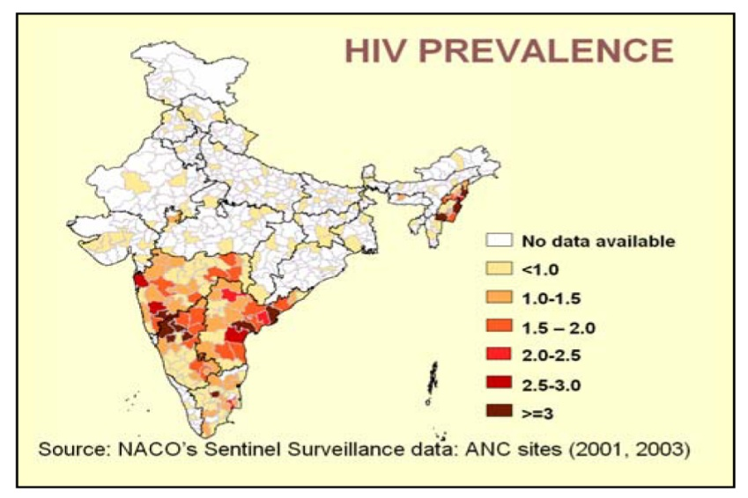
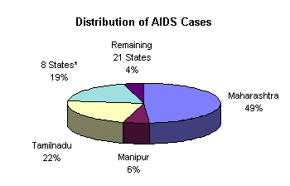
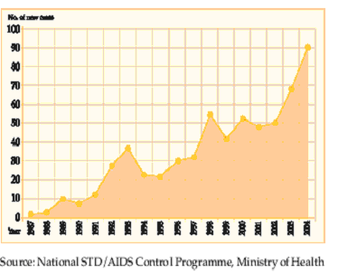
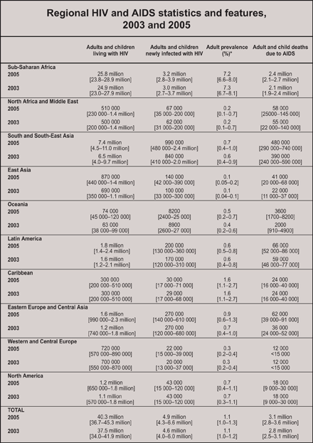
Graphics Used to Describe Data

Slide 95
Interpretation of Surveillance Data
Limitations
  Under-reporting
  Biased reporting
  Inconsistent case definitions
Consider context
  Seasonality
  Recent policy changes or interventions

Slide 96
Interpretative Uses of
Surveillance Data
Identifying epidemics
Identifying new syndromes or risk groups
Monitoring trends
Evaluating public policy
Projecting future needs

Slide 97
Data Dissemination
What should be said? To whom? Through what communication medium? How should the message be stated? What effect did the message create?
Determine answers based on the purpose of the system.
SOCO - single overriding communication objective. [What is new? Who is affected? What works best?]

Slide 98



Data Dissemination
MESSAGE
AUDIENCE
CHANNEL

Slide 99
Evaluating Surveillance Systems
System objectives and usefulness
  Actions taken as a result of the data.
  Does the system do what it’s supposed to do?
Operation of the system
  Who is reporting? To whom? What information is collected? How is information stored? Who analyzes the data? What are the findings? How often are reports disseminated? to whom?
Cost

Slide 100
Evaluation - System Attributes
Simplicity
  Should be as simple as possible and as easy to operate as possible.
Flexibility
  Should be able to adapt to changing needs.
Acceptability
  Willingness of individuals or organizations to participate in the surveillance system. (Judge based on completeness, timeliness, reporting)

Slide 101
Evaluation - System Attributes
Sensitivity
  Proportion of cases detected by the system. Completeness of reporting. Detect epidemics?
  Increased awareness, new diagnostic test, change in surveillance method may impact.
Predictive Value Positive
  Proportion of persons identified as having the disease who actually have it.

Slide 102
Sensitivity/Specificity and Predictive Value +/- (PVP/PVN)

Slide 103
Evaluation - System Attributes
Representativeness
  Do the characteristics of reported events compare favorably with those in the population.
  Is there case ascertainment bias?
  Bias in descriptive information about a reported case?
Timeliness
  Any delay between the steps? (onset, diagnosis, report to public health, disease control actions)
CDC Guidelines for Evaluating Public Health Surveillance Systems: http://www.cdc.gov/mmwr/preview/mmwrhtml/rr5013a1.htm

Slide 104
Ethical and Legal Issues Relating to Surveillance
Professional obligations
Protecting confidentiality and privacy
Informed consent
  Mandated activity vs. research
Maintaining public trust
Right of Access

Slide 105
Conclusion
Surveillance provides information on the health of the community
Public health relies on information from medical care providers and takes prevention-oriented actions based on information received
Surveillance involves taking information in, analyzing & interpreting it, and disseminating it to those who need it

Slide 106
Contact Information
Diane Woolard, PhD, MPH
Director, Division of Surveillance & Investigation
(804) 864-8141
Diane.Woolard@vdh.virginia.gov

