Slide 1
Zoonoses and Public Health
Julia Murphy, DVM, MS, DACVPM
State Public Health Veterinarian
Division of Environmental Epidemiology
Office of Epidemiology

Slide 2
Zoonosis
An infection or infestation shared in nature by humans and other animals
Stedman’s Medical Dictionary,
27th Edition
Notes:
Zoonontic diseases are those that are shared in nature by humans and other animals.

Slide 3
Zoonotic Skew
~60% of the 1709 known human pathogens are zoonotic
~75% of 156 emerging human pathogens zoonotic
Emerging pathogens 3 times more likely to be zoonotic.
Taylor & Woodhouse, ICEID 2000
Notes:
Approximately 60 percent of all known human pathogens are considered zoonotic and ¾ of emerging pathogens are considered zoonotic.

Slide 4
Zoonotic Agents of Concern
CDC has categorized biological agents of concern
All but one Category A agent is zoonotic:
Viral Hemorrhagic Fevers
Plague Tularemia Anthrax
Smallpox Botulism
Notes:
The Centers for Disease Control and Prevention has identified certain pathogens that are of particular concern as bioterrorst weapons. All but one (smallpox) is a zoonotic pathogen. For more information about bioterrorism diseases and agents, visit
http://www.bt.cdc.gov/agent/agentlist-category.asp

Slide 5
Zoonotic transmission
Possible routes:
Fecal-Oral
Inhalation
Direct Contact
Vector-borne
Notes:
People may be exposed to zoonotic disease by one of a number of routes: fecal-oral, inhalation, direct contact or vector-borne.

Slide 6
Fecal-oral transmission
Salmonella Ancylostoma
Campylobacter Toxoplasma
E. coli O157:H7 Listeria
Giardia Trichinella
Cryptosporidia Toxocara
Food safety threats = Category B Agents
Notes:
Zoonotic diseases that people may be exposed to via the fecal oral route are seen here. Most food safety threats are characterized by the CDC as Category B bioterrorism agents.

Slide 7
Salmonella
Frequently reported in Virginia (>1000 cases/year)
~42,000 human cases reported to CDC/yr
Over 1 million human cases suspected in US/yr
~2000 serotypes cause disease
Certain Salmonella bacteria are normal fecal flora in animals
Notes:
Salmonellosis is an infection with bacteria called Salmonella. For over 100 years, it has been know that Salmonella can cause illness. Every year, approximately 42,000 confirmed cases of salmonellosis are reported in the United States. Because many milder cases are not diagnosed or reported, the actual number of infections may be many times greater. There are many different kinds or serotypes of Salmonella bacteria some of which are normal fecal flora in some animals. Salmonella serotype Typhimurium and Salmonella serotype Enteritidis are the most common serotypes in the United States.

Slide 8
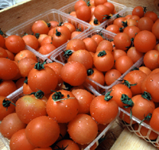
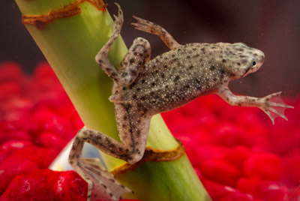
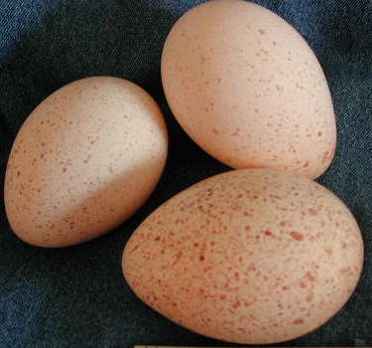
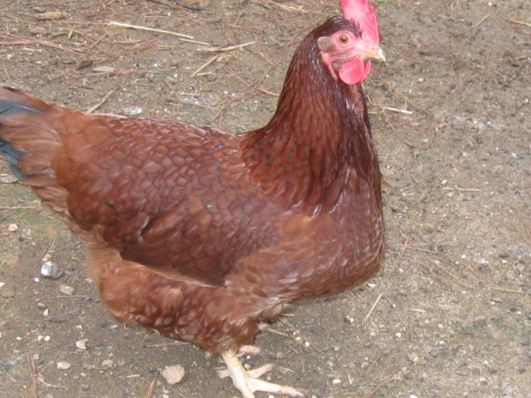
Salmonella
Most commonly transmitted to people via contaminated food
Common foods include meat, poultry, and dairy
Wide reservoir in animals and environment
Notes:
Salmonella is found in many places in the environment as well as in animals especially poultry and swine. The foods that are commonly associated with Salmonella infection are raw meats, poultry and dairy products, but many different foods have been associated with human illness. Poultry is considered a principle reservoir of Salmonella.
Salmonella live in the intestinal tracts of humans and other animals, including birds. Salmonella are usually transmitted to humans by eating foods contaminated with animal feces. Contaminated foods usually look and smell normal and are often of animal origin, such as beef, poultry, milk, or eggs, but all foods, including vegetables may become contaminated. Many raw foods of animal origin are frequently contaminated, but fortunately, thorough cooking kills Salmonella. Food may also become contaminated by the unwashed hands of an infected food handler, who is not being particularly diligent about hand hygiene.
Even though chicken and eggs are most frequently thought of when it comes to foods associated with Salmonella it’s important to remember that any food can become contaminated. One of the largest outbreaks of Salmonella occurred in 1985 and was associated with milk when raw milk containing S. typhimurium contaminated already pasteurized milk. Thousands of people in six states were affected including over 1500 culture confirmed cases.

Slide 9
Salmonella: Human
Incubation 12-72 hours
Vomiting, stomach cramps, diarrhea
15-20 bacteria to infect
Mostly self limiting
Very young, elderly and immunocompromised people most likely to be more severely affected
Notes:
A person becomes infected if he consumes food contaminated with fecal material containing Salmonella or the bacteria is introduced into his mouth in some other way. This bacteria is mainly spread through what is called the “fecal-oral” route. Its infective dose is rather low and it only takes 15-20 bacteria to cause illness. Most persons infected with Salmonella develop diarrhea, fever, and abdominal cramps 12 to 72 hours after infection. The illness usually lasts 4 to 7 days, and most persons recover without treatment. However, in some persons, the diarrhea may be so severe that the patient needs to be hospitalized. In these patients, the Salmonella infection may spread from the intestines to the blood stream, and then to other body sites and can cause death unless the person is treated promptly with antibiotics. The elderly, infants, and those with impaired immune systems are more likely to have a severe illness, but most Salmonella infections are self limiting, so most people recover on their own without any professional, medical intervention. As with many illnesses, the very young, elderly and immunocompromised are more likely to be severely affected by infection.

Slide 10
Salmonella Outbreaks: Human
2000-09 in Virginia
Range 3-11/year
Some multistate
Common serotypes: enteritidis, typhimurium, newport
Various foods associated with illness
Notes:
In Virginia, it is not unusual for the health department to report several Salmonella outbreaks per year and also participate in CDC led multistate outbreaks of Salmonella. Foods associated with illness in outbreaks Virginia has investigated have included eggs, poultry, cheese and spinach. More information about Salmonella outbreaks in Virginia can be found at http://www.vdh.virginia.gov/Epidemiology/Surveillance/SurveillanceData/.

Slide 11
Salmonella Outbreaks: Human
Typically, CDC often investigates multiple multistate outbreaks per year
Foods involved have included: eggs, tomatoes, beef, chicken, peppers, cantaloupe, peanut butter
Animals as risk factors for illness have included chicks, ducklings and small turtles
Notes:
The CDC often investigates multiple multistate Salmonella outbreaks in people every year. Through the years, illness from Salmonella has been linked to a number of different foods including eggs, chicken, beef, cantaloupe, peanut butter and tomatoes. Contact with certain live animals has also been linked to illness and these include chicks, ducklings and small pet turtles.

Slide 12
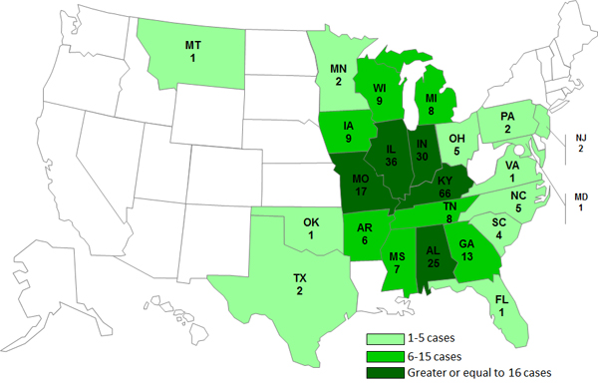
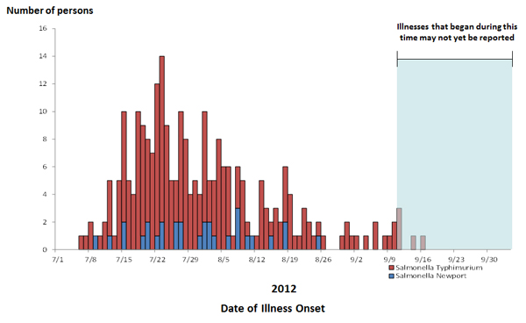
Human Salmonella outbreaks, US
Multistate Outbreak of Salmonella Typhimurium and Salmonella Newport Infections Linked to Cantaloupe, 2012
Notes:
An example of a multistate investigation of a Salmonella outbreak associated with food, specifically cantaloupe, is featured here. More information about this outbreak and selected outbreak highlights can be found in the text and the link below.
http://www.cdc.gov/salmonella/typhimurium-cantaloupe-08-12/index.html, posted October 2012
Outbreak highlights: A total of 261 persons infected with the outbreak strains of Salmonella Typhimurium (228 persons) and Salmonella Newport (33 persons) were reported from 24 states. 94 ill persons were hospitalized. Three deaths were reported in Kentucky. Collaborative investigation efforts of state, local, and federal public health and regulatory agencies indicated that cantaloupe originating from Chamberlain Farms Produce, Inc. of Owensville, Indiana, was the source of this outbreak.

Slide 13
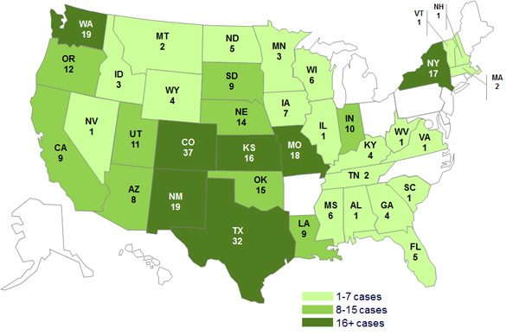
Human Salmonella outbreaks, US
Multistate Outbreak of Human Salmonella Typhimurium Infections Linked to Live Poultry in Backyard Flocks, 2013
Notes:
An example of a multistate investigation of a Salmonella outbreak associated with live animals is featured here. More information about this outbreak and selected outbreak highlights can be found in the text and the link below.
Posted at http://www.cdc.gov/salmonella/typhimurium-live-poultry-04-13/index.html and dated August 19, 2013
Outbreak highlights:
A total of 316 persons infected with the outbreak strain of Salmonella Typhimurium have been reported from 37 states.
Among 199 ill persons with available information, 51 (26%) have been hospitalized.
59% of ill persons are children 10 years of age or younger.
81% of ill people reported contact with live poultry in the week before their illness began.
97% of ill persons reported purchasing live poultry from agricultural feed stores.
A total of 113 locations of feed stores representing 33 feed store companies were identified.
Traceback investigations have identified 18 mail-order hatcheries that supplied poultry to these feed stores.
Epidemiologic, laboratory, and traceback findings have linked this outbreak of human Salmonella Typhimurium infections to contact with chicks, ducklings, and other live baby poultry sourced from Privett Hatchery in Portales, NM.

Slide 14
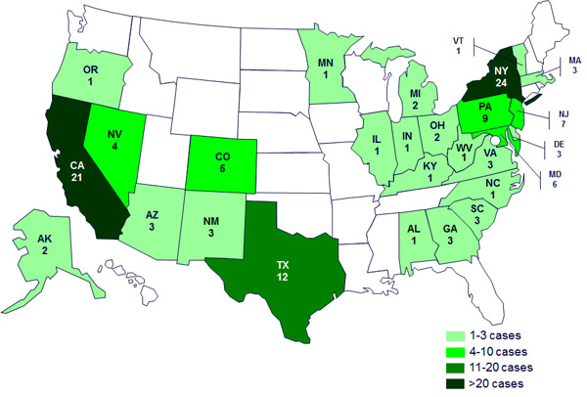
Human Salmonella Outbreaks, US
Human Salmonella Infections Linked to Small Turtles, 2012
Notes:
CDC posting at http://www.cdc.gov/salmonella/small-turtles-03-12/index.html as of May 2012.
A total of 124 persons infected with outbreak strains of Salmonella Sandiego, Salmonella Pomona, and Salmonella Poona have been reported from 27 states.
The number of ill persons identified in each state is as follows: Alaska (2), Alabama (1), Arizona (3), California (21), Colorado (5), Delaware (3), Georgia (3), Illinois (1), Indiana (1), Kentucky (1), Massachusetts (3), Maryland (6), Michigan (2), Minnesota (1), Nevada (4), New Jersey (7), New Mexico (3), New York (24), North Carolina (1), Ohio (2), Oregon (1), Pennsylvania (9), South Carolina (3), Texas (12), Virginia (3), Vermont (1), and West Virginia (1).
19 ill persons have been hospitalized, and no deaths have been reported.
67% of ill persons are children 10 years of age or younger.
Two new multistate outbreaks linked to small turtles have been identified since the prior update on April 5, 2012. Overall, 5 multistate outbreaks of human Salmonella infection are linked with exposure to small turtles.
Results of the epidemiologic and environmental investigations indicate exposure to turtles or their environments (e.g., water from a turtle habitat) is the cause of these outbreaks.
75% of ill persons reported exposure to turtles prior to their illness.
Small turtles (shell length less than 4 inches) were reported by 93% of cases with turtle exposure. Forty-three percent of ill persons with small turtles reported purchasing the turtles from street vendors.
Small turtles are a well-known source of human Salmonella infections, especially among young children. Because of this risk, the Food and Drug Administration has banned the sale and distribution of these turtles as pets since 1975. Turtles with a shell length of less than 4 inches in size should not be purchased as pets or given as gifts.

Slide 15
Salmonella: Animals
Has been described as normal flora and clinical disease
Cattle, sheep, pigs and horses may have mild or severe disease including diarrhea, fever, abdominal pain, abortion
Disease in dogs and cats is often subclinical, but diarrhea, fever, septicemia can occur
Pet reptiles and amphibians should be considered carriers
Chicks and ducklings should be considered carriers
Notes:
In animals, Salmonella has been described both as normal gut flora, but has also been described as causing clinical illness. Cattle, sheep, pigs and horses may have mild or severe disease and clinical signs including diarrhea, fever, abdominal pain and abortion. Disease in dogs and cats is often subclinical, but can manifest itself in diarrhea, fever and septicemia. Pet reptiles, chicks and ducklings are not often ill with Salmonella and should be considered carriers of Salmonella. The environments in which these animals are kept should be considered possible sources of Salmonella infections.

Slide 16
Salmonella-Prevention: Foods
Avoid temperature abuse and cross contamination
Avoid consumption of raw meats and raw dairy
Wash produce thoroughly
Hand washing
Notes:
Ways a person can avoid becoming ill with Salmonella are by using good practices associated with handling and cooking food. Best practices include:
washing your hands, cutting boards, utensils, and countertops routinely through cooking. The importance of good handwashing practices to help avoid this and other illness cannot be overemphasized.
Separating raw meat, poultry, and seafood separate from ready-to-eat foods.
Using a food thermometer to ensure that foods are cooked to a safe internal temperature: 145°F for whole meats (allowing the meat to rest for 3 minutes before carving or consuming), 160°F for ground meats, and 165°F for all poultry.
Keeping your refrigerator below 40°F and refrigerate food that will spoil.
Avoiding preparing food for others if you have diarrhea or vomiting.
Avoiding consumption of raw meats and raw dairy products
And being especially careful when preparing food for children, pregnant woman, those in poor health, and older adults.

Slide 17
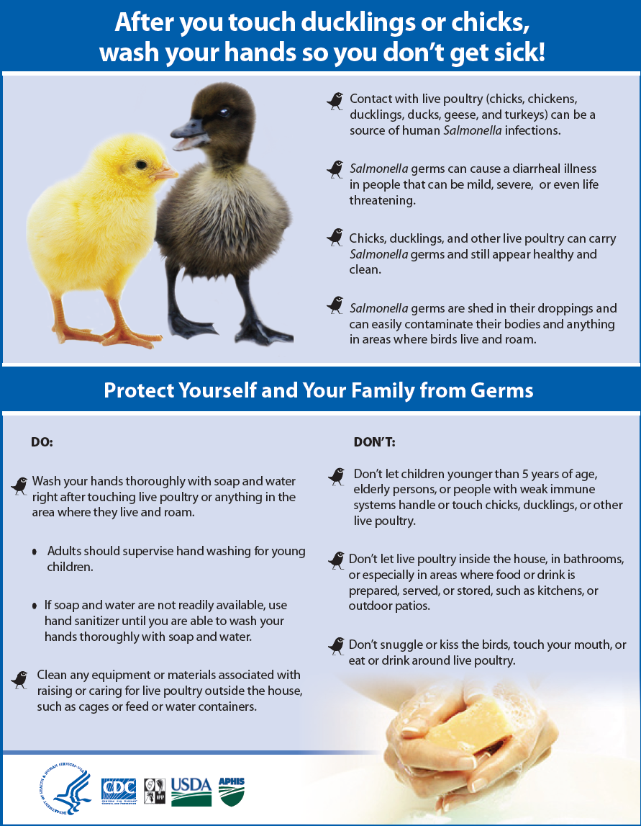
Salmonella Prevention: Animal contact
Pet reptiles and amphibians and their environments
Chicks and ducklings and their environments
Pets fed a raw meat diet
Animals clinically ill with Salmonella
Notes:
Other ways people can avoid becoming ill with Salmonella is using good practices when handling and working around animals. For instance, good barrier precautions and hygiene are important whenever handling pet reptiles, amphibians, chicks and ducklings and working in or cleaning the environments where these animals are housed. In addition, animals fed a raw meat diet are more likely to shed Salmonella and, of course, animals clinically ill with Salmonella are likely to be shedding the organism. In addition, it is important to keep in mind that stressful situations, like animals being kept in shelters or in unfamiliar surroundings may be more likely to become clinically ill with Salmonella and so animal health responders may be more likely to be exposed. In each case, good barrier and hygiene precautions (again, particularly hand washing) are very important to decrease the likelihood of human illness.

Slide 18
Salmonella Prevention
People at increased risk of infection should avoid contact with reptiles and amphibians and associated items
Reptiles and amphibians should not be allowed in households with children <5 years old or immunocompromised people
Do not let children <5 years old, elderly persons or immunocompromised people touch chicks, ducklings or other live poultry
Good hand and equipment hygiene
Good hygiene around animals with diarrhea
Notes:
Additional infection control measures recommended to decrease the likelihood of human infection with Salmonella include:
People at increased risk of infection should avoid contact with reptiles and amphibians and associated items.
Reptiles and amphibians should not be allowed in households with children <5 years old or immunocompromised people.
Do not let children <5 years old, elderly persons or immunocompromised people touch chicks, ducklings or other live poultry.
Maintain good hand and equipment hygiene and good hygiene around animals with diarrhea.

Slide 19
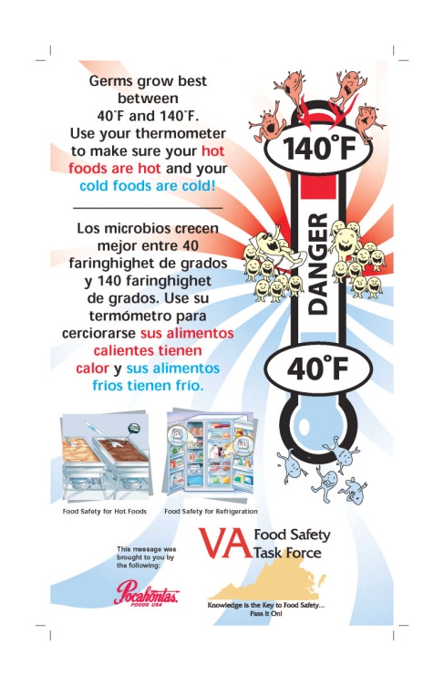
Salmonella resources
www.cdc.gov/salmonella/
www.fda.gov/Food/FoodborneIllnessContaminants/default.htm
Links to FDA’s “Bad Bug Book”
www.fsis.usda.gov/wps/portal/fsis/topics/food-safety-education
Notes:
For more information about Salmonella visit these websites.

Slide 20
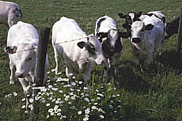
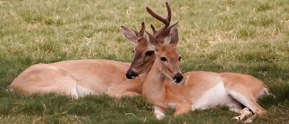
Shiga toxin producing E. coli (STEC)
E. coli bacteria area found in intestines of all animals and humans
E. coli O157:H7 is an STEC that is more likely than others to cause severe illness
Cattle recognized as the most important source of O157:H7 and it has been isolated from deer
Notes:
Escherichia coli (E. coli) bacteria normally live in the intestines of people and animals. Most E. coli are harmless and actually are an important part of a healthy human intestinal tract. However, some E. coli are pathogenic, meaning they can cause illness, either diarrhea or illness outside of the intestinal tract. The types of E. coli that can cause diarrhea can be transmitted through contaminated water or food, or through contact with animals or persons.
E. coli consists of a diverse group of bacteria. Pathogenic E. coli strains are categorized into pathotypes. Six pathotypes are associated with diarrhea and collectively are referred to as diarrheagenic E. coli.
Shiga toxin-producing E. coli (STEC)—STEC may also be referred to as Verocytotoxin-producing E. coli (VTEC) or enterohemorrhagic E. coli (EHEC). This pathotype is the one most commonly heard about in the news in association with foodborne outbreaks. Other types of E. coli can also produce illness in people.
STEC live in the guts of ruminant animals, including cattle, goats, sheep, deer, and elk. The major source for human illnesses is cattle. STEC that cause human illness generally do not make animals sick.

Slide 21
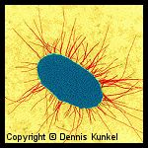
STEC: Human
Reportable in VA since 1999
~150 cases reported/year in VA
CDC estimates 265,000 cases/year
Notes:
STEC has been reportable in Virginia since 1999. About 150 cases per year are reported in VA and the CDC estimates that about 265, 000 human cases occur each year nationwide.

Slide 22
STEC: Human
Incubation 3-4 days
Diarrhea
Severe stomach cramps
Potential kidney failure
Hemolytic uremic syndrome
Notes:
The route of infection is fecal-oral and the incubation period ranges from 3-4 days. Once a person becomes sick, the illness typically takes about a week to resolve. Stomach cramps and bloody diarrhea are common features of this infection. While most of these infections will resolve on their own, some of them, can result in more serious complications such as kidney failure. Can be self limiting if immunocompromised.
Around 5–10% of those who are diagnosed with STEC infection develop a potentially life-threatening complication known as hemolytic uremic syndrome (HUS). HUS is believed to develop when STEC enters into circulation through the inflamed bowel wall, releasing a specific chemical system known as shiga-like toxin (SLT). SLT, and probably other chemical mediators, attach to receptors on the inside surface of blood vessel cells (endothelial cells). Some organs appear more susceptible than others to the damage caused by these toxins, possibly due to the presence of increased numbers of toxin-receptors. These organs include the kidney, pancreas, and brain. Thrombocytopenia and formation of renal thrombi are characteristic of HUS, suggesting that platelet activation is involved in its pathogenesis. Thrombocytopenia caused by platelet consumption in thrombi is a major manifestation of hemolytic uremic syndrome (HUS) associated with Shiga toxin (Stx) producing Escherichia coli.
HUS was first described in 1955, and is now recognized as the most common cause of kidney failure in childhood. E. coli O157: H7 is responsible for the majority of the cases of HUS that develop in North America.

Slide 23
STEC Outbreaks in Virginia: Human
Occasional outbreaks
Improperly cooked ground beef often associated with illness
Notes:
Virginia has investigated occasional outbreaks (usually no more than one per year) of E. coli. It is not unusual that outbreaks are associated with improperly cooked ground beef.

Slide 24
E. Coli O157:H7 in the news, 2007
WASHINGTON (Reuters) - U.S. food safety inspectors said Tuesday they will expand tests and recall infected meat more rapidly to combat E. coli contamination of meat products after the largest American manufacturer of hamburger patties went out of business this month. The U.S. Agriculture Department's Food Safety and Inspection Service said in a briefing the number of E. coli recalls climbed to 15 so far in 2007 compared to the five cases reported in all of 2005.
Notes:
The Topps case was the most serious of 16 recalls in 2007 involving E. coli contaminated beef. That was a sharp increase from 2005 and 2006. More information about this outbreak and recall can be found at http://www.cdc.gov/ecoli/outbreaks.html

Slide 25
Human STEC outbreaks, US
Lebanon Bologna, 2011
Hazelnuts, 2011
Romaine Lettuce, 2011
Cheese, 2010
Raw Cookie Dough, 2009
Notes:
Other foods can also be associated with STEC. Additional information about all of these outbreaks can be found at http://www.cdc.gov/ecoli/outbreaks.html

Slide 26
STEC: Animals
Cattle are probably the most important source of E. coli O157:H7
Often commensal in adult cattle
Young calves can become clinically ill
Illness in other animals has also been reported
Notes:
E coli O157: H7 can be found as normal flora in adult cattle. When it does cause illness in this species, it usually affects calves and causes diarrhea, which can be bloody, and dehydration. Infection with this organism has also been reported in pigs, dogs and horses.

Slide 27
E. Coli-Prevention
Avoid cross contamination
Thoroughly cooking all foods
Avoid consumption of raw meats and raw dairy
Wash produce thoroughly
Hand washing
Notes:
Never eat rare or undercooked ground beef. Cook to 160 degrees F or until the meat color is brown or gray.
Do not drink unpasteurized milk or cider.
Always wash any raw fruits or vegetables before eating.
Always carefully wash hands before and after preparing foods.
Always refrigerate meat products. Never leave raw meats at room temperature.
Make sure children wash their hands carefully, especially after using the toilet or handling animals.
Always wash hands with soap and warm water after using the toilet or changing diapers.
Persons with diarrhea should not use public swimming facilities.
Clean and disinfect diapering areas, toilets/potty chairs, toys, etc. at least daily and when soiled

Slide 28
E. Coli resources
www.cdc.gov/Features/EcoliInfection/
www.foodsafety.gov/
www.vdh.virginia.gov/Epidemiology/
Surveillance/
Notes:
For more information about E. coli, visit these websites.

Slide 29
Inhalation Transmission
Psittacosis
Histoplasmosis
Hantavirus
Coxiella burnetii (Q Fever)
Tuberculosis
Notes:
Examples of zoonotic pathogens that may cause illness in people via inhalation are listed here.

Slide 30
Psittacosis: Human
Caused by Chlamydophila psittaci
Exposure to pet birds
Rarely reported in VA
<50 cases reported/year in US
Notes:
Psittacosis, also known as parrot fever and ornithosis, is a bacterial infection of humans. It is caused by Chlamydophila psittaci, formerly known as Chlamydia psittaci. In general, human cases occur after exposure to infected pet birds, usually cockatiels, parakeets, parrots, and macaws. Infected birds shed the bacteria through feces and nasal discharges, and humans become infected from exposure to these materials.
Very few human cases occur in Virginia every year. From 2005 through 2009, 66 human cases of psittacosis were reported to the Centers for Disease Control and Prevention (CDC). In general, these cases occur after exposure to infected pet birds, usually cockatiels, parakeets, parrots, and macaws.

Slide 31
Psittacosis: Human
Inhaled from desiccated droppings/secretions, dust from feathers
Incubation 1-2 weeks
Fever, headache, rash, chills
Person to person spread not proven
Notes:
The disease resulting from C. psittaci infection in humans is called psittacosis. Most infections are typically acquired from exposure to psittacine birds, although transmission has also been documented from poultry and free-ranging birds including doves, pigeons, birds of prey and shore birds. Human infection with C. psittaci usually occurs when a person inhales organisms that have been aerosolized from dried feces or respiratory tract secretions of infected birds. Other means of exposure include mouth-to-beak contact and handling of infected birds’ plumage and tissues.
The onset of illness typically follows an incubation period of 5 to 14 days, but longer periods have been reported. The severity of the disease ranges from a mild, non-specific illness to a systemic illness with severe pneumonia. Before antimicrobial agents were available, 15% to 20% of humans with C. psittaci infection died; however, mortality has been extremely rare since the advent of antibiotics. Humans with symptomatic infections typically have an abrupt onset of fever, chills, headache, malaise, and myalgia. A nonproductive cough is usually present and can be accompanied by breathing difficulty and/or chest tightness. Person-to-person transmission has been suggested but not proven.

Slide 32
Psittacosis Investigation
Infection in people is uncommon
Infection in birds is much more common
Often report in a bird prompts public health follow up with bird owners or aviaries
Notes:
Infection in birds is more common than in people and so it is typically a report of infection in a bird that triggers public health follow up.

Slide 33
Psittacosis: Animals
Birds shed intermittently in feces and respiratory secretions
Often no signs in
infected birds
Stress initiates
shedding/illness
Notes:
C. psittaci is excreted in the feces and nasal discharges of infected birds. The organism is environmentally labile but can remain infectious for over a month if protected by organic debris (e.g., litter and feces). Some infected birds can appear healthy and shed the organism intermittently. Shedding can be exacerbated by stress factors, including reproductive activities, rearing of young, relocation, shipping, crowding, and chilling.
In birds, C. psittaci illness is referred to as avian chlamydiosis . The usual incubation period of C. psittaci ranges from 3 days to several weeks. However, active disease can appear with no identifiable exposure or risk factor. Signs of avian chlamydiosis are non-specific and include lethargy, anorexia and ruffled feathers. Other signs include serous or mucopurulent ocular or nasal discharge, conjunctivitis, diarrhea and excretion of green to yellow-green urates. Severely affected birds may become anorectic and produce sparse, dark green droppings, followed by emaciation, dehydration, and death. Whether the bird has acute or chronic signs of illness or dies, depends on the species of bird, virulence of the strain, infectious dose, stress factors, age, and extent of treatment or prophylaxis.

Slide 34
Psittacosis-Prevention
Diagnose and treat sick birds
Clean bird cages regularly
Use of protective clothing and equipment when working with birds
Notes:
Controlling the disease in the bird population helps reduce the risk for people. However, birds that seem healthy can shed the bacteria and new birds may reintroduce the bacteria, so prevention depends on properly designed and managed facilities that raise and sell birds and the use of protective clothing, including wearing masks or respirators, and gloves by those working with birds. Sick birds should be diagnosed and treated. If they are sold while they are being treated, the new owner should be informed and be sure that treatment is completed. Bird cages should be cleaned regularly with disinfectants (alcohol, Lysol, or bleach solution) and the contents of the cage should be disposed of properly.

Slide 35
Psittacosis resources
Compendium of Measures To Control Chlamydophila psittaci Infection Among Humans (Psittacosis) and Pet Birds (Avian Chlamydiosis), 2010
available at www.nasphv.org
www.cdc.gov/ncidod/dbmd/diseaseinfo/psittacosis_t.htm
Notes:
Additional information about psittacosis can be found via the resources on this slide.

Slide 36
Q Fever
Caused by Coxiella burnetii
Primary reservoirs are cattle, sheep and goats
Very hardy in the environment
Animal reservoirs typically remain well and shed the bacteria in birthing fluids, placenta, milk, urine and feces
Notes:
Q fever is a worldwide disease with acute and chronic stages caused by the bacteria Coxiella burnetii. Infected animals such as sheep, goats, and cattle are the main source of infection for human beings although a variety of species may be infected. Humans are exposed to the bacterium via contact with the fluids of infected animals such as birth products, urine, milk, and feces; with the highest bacterial load being shed in the birth products (placenta, fetus, amniotic fluid) making them the highest risk material. During birthing the organisms are shed in high numbers within the amniotic fluids and the placenta. The organism is extremely hardy and resistant to heat, drying, and many common disinfectants which enable the bacteria to survive for long periods in the environment. Infection of humans usually occurs by inhalation of these organisms from air that contains airborne barnyard dust contaminated by dried placental material, birth fluids, and excreta of infected animals. Other modes of transmission to humans, including tick bites, ingestion of unpasteurized milk or dairy products, and human to human transmission, are rare. Humans are often very susceptible to the disease, and very few organisms may be required to cause infection.

Slide 37
Q Fever: Human
~2 cases are reported/year in Virginia
Cases are more commonly reported from western states and the CDC reports between 150-200 human cases/year
Annual reported incidence (per million population) for Q Fever in the United States for 2010, CDC
Notes:
Very few cases of Q Fever in people are reported in Virginia each year. The CDC reports between 150 and 200 people with Q Fever annually. Cases of Q fever are most frequently reported from western and plains states where ranching and rearing of cattle are common. In other states, areas where sheep, goat, and cattle ranching are locally practiced may demonstrate increased incidence. Seven states (California, Colorado, Illinois, Kentucky, Missouri, Tennessee, and Texas) have accounted for more than half (52%) of all cases since human Q fever became notifiable. Cases of Q fever are reported less frequently in the eastern United States. Sporadic reports of cases may result from patients involved in animal research work and from patient travel to other states.

Slide 38
Q Fever: Human
Incubation 2-3 weeks
Typical exposure is occupational
birth assistance, exposure to birth materials
Flu-like symptoms most common
Complications like pneumonia and chronic illness may occur
Notes:
Q fever can cause acute or chronic illness in humans, who usually acquire infection after contact with infected animals or exposure to contaminated environments. The acute symptoms caused by infection with Coxiella burnetii usually develop within 2-3 weeks of exposure, although as many as half of humans infected with C. burnetii do not show symptoms. In the United States, Q fever outbreaks have resulted mainly from occupational exposure involving veterinarians, meat processing plant workers, sheep and dairy workers, livestock farmers, and researchers at facilities housing sheep. The primary mode of transmission to humans is through inhalation of pathogen-contaminated dust / aerosols or contact with infected birth products. Acute illness symptoms often include high fever, severe headache, myalgia, and non productive cough. Although most persons with acute Q fever infection recover, others may experience serious illness with complications that may include pneumonia, granulomatous hepatitis, myocarditis and central nervous system complications.
The frequency of reported cases of Q fever increases with age and is highest among males, which may reflect occupational risks for exposure among livestock handlers. A past history of heart valve defects, endocarditis, or valvular implants may increase the risk of chronic infection and severe disease outcome. Infection is also more common in patients with compromised immune systems (such as may occur through cancer treatments, advanced human immunodeficiency virus (HIV) infection, prior organ transplants, or some medications). Individuals who reside or spend time near ranches and livestock rearing facilities are at increased risk for infection.

Slide 39
Q Fever Outbreaks: Human
Q Fever outbreak in the Netherlands
Ongoing since 2007
Over 3500 human cases
Mass vaccination of goats and sheep
Culling of goat herds
The large numbers of human cases thought to be due to proximity to aborting small ruminants
Notes:
The 2007–2009 human Q fever epidemic in The Netherlands attracted attention due to its magnitude and duration. The current epidemic and the historical background of Q fever in The Netherlands are reviewed according to national and international publications. Seroprevalence studies suggest that Q fever was endemic in The Netherlands several decades before the disease was diagnosed in dairy goats and dairy sheep. This was in 2005 and the increase in humans started in 2007. Q fever abortions were registered on 30 dairy goat and dairy sheep farms between 2005 and 2009. A total of 3523 human cases were notified between 2007 and 2009. Proximity to aborting small ruminants and high numbers of susceptible humans are probably the main causes of the human Q fever outbreak in The Netherlands.

Slide 40
Q Fever: Animals
Primary reservoirs (cattle, sheep and goats) are typically asymptomatic
When clinical illness is seen, abortion is the typical manifestation in these species
Studies in cats would indicate adverse reproductive events in this species as well
Notes:
Coxiella burnetii infection in livestock species is generally asymptomatic. Goats and sheep are the species in which abortions, stillbirths, and early neonatal mortality have been most frequently documented. Abortion in cattle due to C. burnetii infection has been reported, and more research is needed to determine the organism’s role in infertility, metritis and endometritis. Coxiella burnetii can cause adverse pregnancy outcomes in cats, and contact with infected cats has been associated with human infection.

Slide 41
Q Fever: Prevention
Prevention methods include barrier precautions during birth assistance to avoid contamination broken skin or mucous membranes
Proper cleaning of stalls, removal of bedding, removal of birthing materials
Proper handling of laboratory samples
Notes:
Prevention and control efforts should be directed primarily toward the groups who work in environments where infection is more likely including: veterinarians, meat processing plant workers, sheep and dairy workers, livestock farmers, and researchers at facilities housing sheep.
The following measures represent some of the measures that should be used to prevent and control of Q fever:
Educate the public on sources of infection.
Appropriately dispose of placenta, birth products, fetal membranes, and aborted fetuses at facilities housing sheep and goats.
Restrict access to barns and laboratories used in housing potentially infected animals.
Use only pasteurized milk and milk products.
Use appropriate procedures for bagging, autoclaving, and washing of laboratory clothing.
Counsel persons at highest risk for developing chronic Q fever, especially persons with pre-existing cardiac valvular disease or individuals with vascular grafts.

Slide 42
Q Fever resources
www.cdc.gov/qfever/
Diagnosis and Management of Q Fever: US, 2013
www.cdc.gov/mmwr/preview/mmwrhtml/rr6203a1.htm
Roest, et al. The Q fever epidemic in The Netherlands : history, onset, response and reflection. Epidemiol. Infect. (2011), 139, 1-12.
Prevention and Control of Coxiella burnetii Infection among Humans and Animals: Guidance for a Coordinated Public Health and Animal Health Response, 2013
Available at www.nasphv.org
Notes:
More information about Q Fever as well as a history of Q Fever in the Netherlands via these resources.

Slide 43
Direct Contact Transmission
Leptospirosis
Tularemia
Brucellosis
Monkeypox
Methicillin-resistant Staphylococcus Aureus (MRSA)

Slide 44
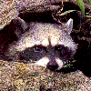
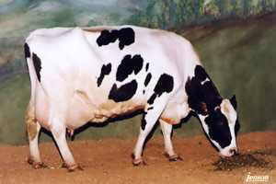
Leptospirosis
Caused by spiral shaped bacteria (leptospires)
Over 200 serovars have been described
Wild and domestic animals are reservoirs; serovars vary with species of animal
Notes:
Leptospirosis is a bacterial disease that affects humans and animals. It is caused by bacteria of the genus Leptospira. There a number of different serovars or serotypes of this bacteria and a number of animals can act as both reservoirs of those serovars and also become ill with those serovars. Leptospires are most commonly spread through the urine of infected animals, which can get into water or soil and can survive there for weeks to months. These organisms can be very hardy in the environment and they survive particularly well in stagnant slow moving water and in places where ambient temperatures range from 32-77 degrees Fahrenheit. So it’s not unusual for leptospires to be present in stock ponds or slow moving streams particularly in warmer environments and many animals including a number of wild animal species such as raccoons, opossums skunks and rodents contribute to the environmental level of this bacteria.

Slide 45
Leptospirosis: Human
Not a reportable disease in Virginia
100-200 cases identified each year in the US
Considered to be the most widespread zoonotic disease in the world
Notes:
Leptospirosis is not a reportable disease in Virginia, but approximately 100-200 cases are identified annually in the United States. About 50% of cases occur in Hawaii.
Although incidence in the United States is relatively low, leptospirosis is considered to be the most widespread zoonotic disease in the world.

Slide 46
Leptospirosis
Direct and indirect
Contact with urine, infected tissues, bite wounds
Contact with contaminated water sources, food, bedding
Contact with mucous membranes and/or abraded/scratched/water-softened skin
Notes:
The bacteria that causes leptospirosis are typically spread through the urine of infected animals, which can get into water or soil and can survive there for weeks to months. Humans and animals can become infected through contact with this contaminated urine (or other body fluids, except saliva), water, or soil. The bacteria can enter the body through skin or mucous membranes (eyes, nose, or mouth), especially if the skin is broken from a cut or scratch. Drinking contaminated water can also cause infection. Infected wild and domestic animals may continue to excrete the bacteria into the environment continuously or every once in a while for a few months up to several years.

Slide 47
Leptospirosis: Human
Severity of illness can vary
Initial symptoms often flu-like and usually begin 10 days after exposure (range 2-30)
Can cause renal disease and coagulopathy
Person to person transmission rare
Antibiotic prophylaxis typically not recommended
Notes:
In humans, leptospirosis can cause a wide range of symptoms, including: high fever, headache, chills, muscle aches, vomiting, jaundice (yellow skin and eyes), red eyes, abdominal pain, diarrhea and rash. Many of these symptoms can be mistaken for other diseases. In addition, some infected persons may have no symptoms at all. The time between a person's exposure to a contaminated source and becoming sick is 2 days to 4 weeks. Illness usually begins abruptly with fever and other symptoms. Leptospirosis may occur in two phases: after the first phase (with fever, chills, headache, muscle aches, vomiting, or diarrhea) the patient may recover for a time but become ill again.
If a second phase occurs, it is more severe; the person may have kidney or liver failure or meningitis. This phase is also called Weil's disease. The illness lasts from a few days to 3 weeks or longer. Without treatment, recovery may take several months.
Person to person transmission of leptospirosis is rare and antibiotic prophylaxis for people who have been exposed is typically not recommended

Slide 48
Leptospirosis outbreaks: Human
Largest outbreak in the US occurred in 1998
Outbreak among triathletes in IL and WS
775 people exposed and 90 people were either confirmed with or suspected of having illness
Outbreaks in the US have also been documented in association with infected dogs
Notes:
The largest recorded U.S. outbreak occurred in 1998, when 775 people were exposed to the disease. Of these, 90 people were either confirmed with or suspected of having Lepto. More information about this outbreak can be found at http://www.cdc.gov/mmwr/preview/mmwrhtml/00054395.htm. Outbreaks in the US have also been documented in association with infected dogs.

Slide 49
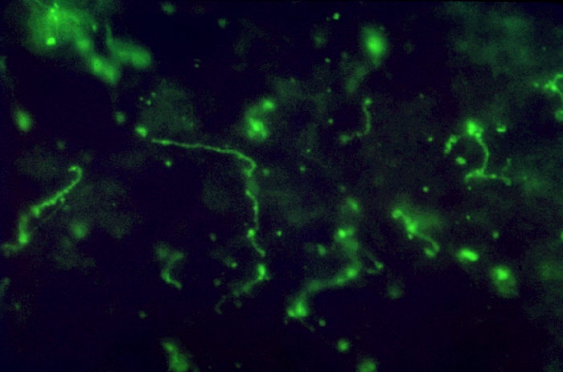
Leptospirosis: Animals
Wide variety of clinical signs or asymptomatic
Depends on species, immunity, age, stage of gestation, serovar
Renal disease
Liver disease
Coagulopathy
Abortion/infertility
Decreased milk production
Notes:
There can be a wide variety of clinical signs that accompany leptospirosis illness in animals and some animals may not become ill at all. For instance, clinical signs are usually mild or not apparent in cats, however dogs (depending on the serovar they are infected with) can experience vomiting, jaundice, rapid breathing, lethargy, diarrhea. Cattle can experience reproductive disorders like abortion and renal disease.

Slide 50
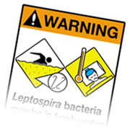
Leptospirosis: Human
Most human illness caused by occupational or recreational exposures
Infected wildlife
Infected domestic animals
Contaminated recreational water
Notes:
Leptospirosis occurs worldwide, but is most common in temperate or tropical climates. It is an occupational hazard for many people who work outdoors or with animals, such as veterinarians, animal caretakers and farmers. The disease has also been associated with swimming, wading, kayaking, and rafting in contaminated lakes and rivers. As such, it is a recreational hazard for campers or those who participate in outdoor sports. The risk is likely greater for those who participate in these activities in tropical or temperate climates.

Slide 51
Leptospirosis: Prevention
Avoid contact with urine, other fluids of sick animals
Good barrier precautions: gloves, face protection, hand washing
Isolate infected animals if possible
Vaccinate livestock and pets
Avoid water with potential contamination
Control rodents
Notes:
To prevent infection with leptospirosis, it is best to avoid direct contact with the urine or other body fluids of sick animals by using good barrier precautions like gloves and or face protection to avoid fluids like urine splashing into your eyes, nose or mouth. Isolate sick animals from well animals if possible and vaccinating livestock and pets are also good practices to decrease the likelihood that animals will be infected. In addition, good rodent control and avoiding potentially contaminated water are also helpful in preventing illness.

Slide 52
Leptospirosis resources
www.cdc.gov/leptospirosis/
Levett, P. Leptospirosis. Clin. Microbiol. Rev. 2001, 14(2):296.
Notes:
More information about leptospirosis can be found via these resources.

Slide 53
Methicillin-resistant Staphylococcus Aureus (MRSA)
Staph. aureus very common in people
30% of people colonized at any time; transient
MRSA first described in 1968 and increasingly important cause of human healthcare associated infections since then
Emergence of community associated MRSA (CA-MRSA) in 1990s
<2% of general public colonized with MRSA
Notes:
Staphylococcus Aureus is a very common bacteria that is commonly found on the skin of people without causing any harm, in fact at any given time Staph. aureus can be cultured from the nasal passages of about 30% of people. Methicillin-resistant Staphylococcus Aureus (MRSA) is a type of staph bacteria that is resistant to certain antibiotics called beta-lactams. These antibiotics include methicillin and other more common antibiotics such as oxacillin, penicillin, and amoxicillin. MRSA was first described in 1968 and continues to be an important cause of hospital associated infections. In addition, for about the last 20 years, certain strains of MRSA have been increasingly recognized as a common cause of community acquired skin and soft tissue infections. Just like Staph. Aureus, MRSA can be found on healthy individuals and its thought that about 2% of the general public may be colonized. Those who work in healthcare professions like veterinarians are more likely to be colonized than members of the general public. So, people can be colonized with either Staph aureus or Methicillin reistant Staph aureus without having any active infection or illness as a result.

Slide 54
MRSA: Human
Transmission by direct contact
Skin and Soft Tissue Infections predominate (especially in CA-MRSA)
Other documented infections include UTIs, sinusitis, pneumonia and surgical site infections
Notes:
MRSA infections, as with most Staph. aureus infections, are usually spread by having contact with someone’s skin infection or personal items they have used, like towels, bandages, or razors that touched their infected skin. These infections are most likely to be spread in places where people are in close contact with others—for instance, schools and locker rooms where athletes might share razors or towels. In healthcare settings, MRSA is typically spread from patient to patient on unclean hands of healthcare personnel or through the improper use or reuse of equipment. Mostly, MRSA causes skin and soft tissue infections (particularly those MRSA infections that are community acquired), but other documents infections caused by MRSA include urinary tract infections, sinusitis, pneumonia and surgical site infections.

Slide 55
MRSA: Human
Invasive cases have been reportable in Virginia since 2007
1000-1500 cases/yr reported
Estimated that ~90,000 invasive MRSA cases occur per year in US
Notes:
Invasive cases of MRSA (those typically more serious cases of illness that affect normally sterile sites like bloodstream, bone and central nervous system) have been reportable in Virginia since 2007. In that time, between 1000-1500 cases have been reported each year. It is estimated that 90,000 such case occur each year in the US.

Slide 56
MRSA outbreaks: Human
MRSA among players on a high school football team, 2007, Morbidity and Mortality Weekly Report (MMWR)
MRSA Skin Infections from an Elephant Calf, 2008 MMWR
Severe MRSA Community-Acquired Pneumonia Associated with Influenza, December 2006--January 2007, MMWR
Reports accessed via www.cdc.gov/mmwr/
Notes:
Outbreaks of both skin and more invasive MRSA infections have been documented. For more information about the outbreaks featured on this slide and others visit www.cdc.gov/mmwr/.

Slide 57
MRSA: Animals
First described in 1972 (bovine)
Has been reported in many animals
Dogs, cats, horses, pigs and others
Sporadic reports in 1990s
Notes:
While Staph. aureus is considered to be predominantly a human pathogen, it can be found in many animal species. Just like in people, Staph. aureus may be found in animals that are otherwise healthy. MRSA as an infection was first described in animals in 1972 (specifically in a cow with a MRSA infection as a cause of mastitis) and since then there have been many individual reports of MRSA infections in animals. These reports were originally sporadic, but in recent years, the number of reports has increased. Again, like in people, sometimes MRSA can be isolated from an animal that is otherwise healthy or it may be the cause of illness or infection.

Slide 58
MRSA: Animals
Later reports of larger numbers of infections and suggestions of interspecies transmission
Types of infections similar to humans
Skin and soft tissue, surgical site
Transmission by direct contact
Direction unclear
Notes:
Again, until recently reports of MRSA in animals were uncommon, but that seems to be changing. There is also suggestion of interspecies transmission, but the direction of transmission is often unclear. (In other words, it can be difficult to tell if an animal exposed a person to MRSA or vice versa.) It is not unusual to find the same strain of MRSA in animals and the people those animals have contact with. Just like in people, when animals do have infections associated with MRSA, they are typically skin and soft tissue infections.

Slide 59
MRSA: Animals
Colonization rate can vary with species
Canine and felines studies report 0-4% with some reporting slightly higher
Equine studies report 0-11%
Adult bovine studies, <1%
Swine studies, 0-100%
Colonization often transient
Notes:
Reported colonization rates vary with the species. Often pets of people who are colonized or infected with MRSA will be colonized with the same strain of MRSA as their owners. Studies in companion animals and equine would indicate that colonization is often transient and MRSA may last for only a few weeks in some species.

Slide 60
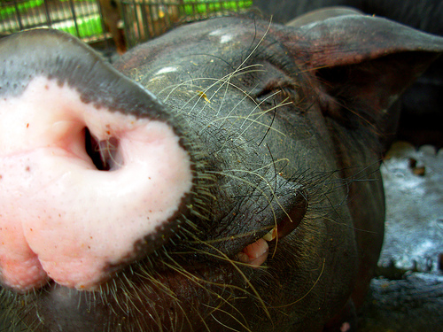
MRSA: Animals
Sporadic reports of MRSA mastitis in cattle
Most reports related to colonized swine with clinical infections reported only rarely
Notes:
There have been sporadic reports of MRSA in cattle. The main food producing animal in which MRSA has been documented consistently is swine. While it is not unusual for both pigs and people who work with pigs to be colonized with the same strain of MRSA, clinical infections in pigs have been reported only rarely.

Slide 61
MRSA: Prevention
Keep cuts/scrapes clean and covered
Avoid contact with wound drainage
Injury prevention
Prompt attention to skin infections
Clean hands and shower regularly, particularly after skin to skin contact and contact with shared environmental surfaces
Notes:
Since MRSA is spread by direct contact and the kinds of infections people typically develop are skin and soft tissue infections, people can avoid becoming infected by keeping any cuts and scrapes on their skin covered, avoiding direct and indirect contact with wound drainage, avoiding injuries (especially ones that would lead to a break in skin integrity), attending promptly to skin infections and keeping your skin clean by showering regularly and good hand hygiene.

Slide 62
MRSA: Prevention
Consider screening pets if infection is persistent within a household
No evidence that decolonization of animals is effective
Treatment options for colonized pets not well defined and may not be necessary
Notes:
From an infection control standpoint, routine screening of veterinary patients is rarely needed and should only be undertaken after careful consideration. The main situation in which screening a pet may be helpful is where there are recurrent infections in people in a household despite the use of good hygiene practices. While animals with MRSA infections should be treated, attempts to decolonize animals using antibiotics or other treatments is currently not recommended.

Slide 63
MRSA resources
www.cdc.gov/mrsa/
Hadler JL. Trends in Invasive MRSA, Connecticut, USA, 2001-2010. Emerg. Inf. Dis., 2012 Jun;18(6):917-24.
Tattevin, P. Concurrent Epidemics of Skin and Soft Tissue Infection and Bloodstream Infection due to MRSA. Clin. Infect. Dis., 2012 Jun 5.
www.wormsandgermsblog.com/
Notes:
Some resources for additional information about MRSA, can be found here.

Slide 64
Vector-Borne Transmission
Arboviral encephalitis
Examples: West Nile virus (WNV) Eastern equine encephalitis (EEE)
Rocky Mountain spotted fever
Lyme disease
Ehrlichiosis
Notes:
People can become infected with zoonotic disease via vectors such as mosquitoes and ticks. Included here are some examples of such vector-borne diseases.

Slide 65
West Nile Virus
Mosquito-borne
1999- First identified in US
2002- First identified in VA
Reported human cases in US have ranged from 712-9862/year since 2002
Reported human cases in VA have ranged from 0-29/year since 2002
Notes:
In 1999, West Nile virus (WNV) was first documented in the United States during an outbreak of meningitis and encephalitis in NYC. Since its introduction, it became established throughout much of the United States, and has spread into Canada and Mexico.
WNV is a mosquito-borne disease that is spread by the bite of an infected mosquito.

Slide 66
Notes:
West Nile virus is almost always spread to humans, birds and other animals through the bite of an infected mosquito. The virus is maintained in nature by bird reservoir hosts. A mosquito becomes infected by biting a bird that is carrying the virus. People and other animals are incidental hosts. West Nile virus is not spread from person to person. Although uncommon,
WNV may be transmitted by blood products via transfusion or transplanted organs from infected donors or by cuts or punctures with contaminated scalpels or needles and, more rarely, through inhalation or ingestion of dust or particles from infected bird feces.

Slide 67
West Nile Virus “Iceberg”
<1% CNS
Disease
~20%
“West Nile Fever”
~80%
Asymptomatic
Notes:
An estimated 80% of people infected with the virus show no symptoms. About 1 in 5 people who are infected will develop a fever with other symptoms such as headache, body aches, joint pains, vomiting, diarrhea, or rash. Most people with this type of West Nile virus disease recover completely, but fatigue and weakness can last for weeks or months. Less than 1% of people who are infected will develop a serious neurologic illness such as encephalitis or meningitis (inflammation of the brain or surrounding tissues). The symptoms of neurologic illness can include headache, high fever, neck stiffness, disorientation, coma, tremors, seizures, or paralysis. People with certain medical conditions, such as cancer, diabetes, hypertension and kidney disease are also at greater risk for serious illness. Recovery from severe disease may take several weeks or months. Some of the neurologic effects may be permanent. About 10 percent of people who develop neurologic infection due to West Nile virus will die.

Slide 68
West Nile Virus: Animals
Most cases in incidental hosts been documented in horses
Encephalitis is the most common manifestation
Treatment is supportive care
Vaccine for horses is available
Notes:
WNV infection has been documented in the U.S. primarily in wild birds, humans and horses, but a few cases have also occurred in other species such as sheep, bats, squirrels, chipmunks, raccoons, skunks, rabbits, cats, and dogs. Horses manifest illness mostly by developing encephalitis which leads to a loss of coordination, lack of interest in their surroundings and loss of appetite and can cause the horse to go down and be unable to get up without help. Even though the disease is called West Nile Fever, affected horses may not develop a noticeable fever although some will. Treatment consists of supportive therapy to prevent the animal from injuring themselves and nurse them through the 2-3 weeks of the disease. A WNV vaccine for horses is available.

Slide 69
WNV-Prevention
Long, loose, light clothing
Repellants – e.g., DEET, picaridin, IR3535
Screens on windows
Avoid environments/times of day when mosquitoes biting
Notes:
How to protect yourself from mosquitoes that bite:
Wear long, loose and light-colored clothing.
Use insect repellent products that contain active ingredients which have been registered with the U.S. Environmental Protection Agency (EPA) for use as repellents applied to skin and clothing such as DEET, picaridin and IR3535
Follow label instructions when using insect repellents.
Eliminate standing water and avoid environments and times of day when mosquitoes will likely be biting

Slide 70
WNV-Prevention
Mosquito Control
Eliminate breeding sites
proper drainage
remove or turn over water containers
change bird baths weekly
Larvicide
Adulticide – aerial spraying after hurricanes sometimes employed
Notes:
The best defense against WNV is to protect yourself from biting mosquitoes and to eliminate mosquito breeding areas.
How to eliminate mosquito breeding areas:
Turn over or remove containers in your yard where rainwater collects, such as potted plant trays, buckets, or toys.
Empty bird baths once a week.
Remove old tires from your yard.
Clean roof gutters and downspout screens.
Eliminate standing water on flat roofs, boats, and tarps.
Clear obstructions in ditches so they flow and drain. Fill in puddles with soil, or a mixture of sand and gravel, or dig drainage ditches to drain puddles.
If puddles or ditches cannot be drained or filled in, treat standing water with mosquito larvicide's (dunks or granules) that can be purchased at any hardware store.

Slide 71
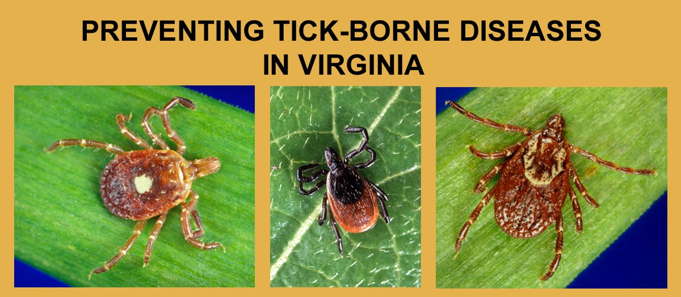
Lyme Disease
Tick-borne diseases (TBD) are the most commonly reported vector-borne disease in people in Virginia and Lyme disease is the most commonly reported TBD
Lone Star Tick
Blacklegged Tick
American Dog Tick
Notes:
There are three different tick species that commonly bite people in Virginia.
By far, the most common tick to bite people in Virginia is the lone star tick. All three tick species can transmit various diseases, but only one species, the blacklegged tick (a.k.a. deer tick, latin name Ixodes scapularis) transmits Lyme disease. *It is the only human biting tick in Virginia that has black legs.*

Slide 72
Lyme Disease Transmission – Two Year Cycle
Notes:
The blacklegged tick has a two year life cycle.
In the spring, adult blacklegged ticks lay eggs. By mid summer, larval ticks hatch from eggs and are infected with the Lyme disease agent by feeding on infected white-footed mice which are typically found in forest environments.
In the 2nd spring & summer, the previous season’s larvae become nymphs. Nymphs feed on rodents, dogs, cats & people. Infected nymphs transmit Lyme disease to people primarily during the spring and early summer, but transmission can occur from early spring to late summer. In the 2nd fall & winter, infected nymphs become infected adults. Adult ticks feed mostly on deer & use deer blood to nourish a batch of eggs. Infected adult ticks can sometimes bite people or pets and transmit Lyme disease.

Slide 73
Blacklegged Ticks
1/16
Inch (fractions)
Notes:
Adult blacklegged ticks feed almost exclusively on deer and they seldom bite people. Therefore, it is the tiny nymph stage tick that causes the most Lyme disease transmission to people. The nymph stage blacklegged tick is typically about 1/16 of an inch in length which is about the size of a pin head and has dark legs and a dark spot on its back behind the head.
The blacklegged nymph must be ATTACHED (and feeding) for at least 36 hours to transmit the Lyme disease agent. Lyme disease infection rates measured in Virginia’s ticks have ranged from < 1% up to 40%. The Lyme disease agent resides in the tick's mid-gut, and during a blood meal on a warm host, the warmth of the host and the presence of ingested blood causes the bacteria to reactivate, multiply, pass through the gut wall into the tick's hemolymph, and infect the tick's salivary glands. Infection of the salivary glands allows the Lyme disease agent to be transmitted to the tick's host. This process takes about 36 hours.

Slide 74
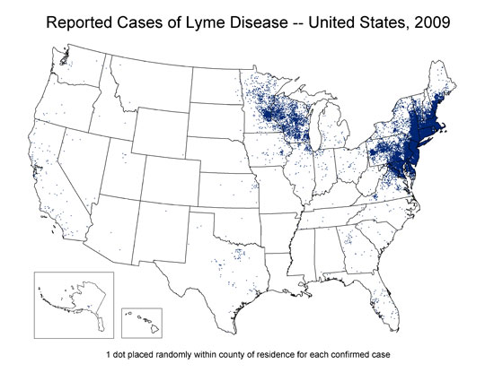
Notes:
Depicted here is the geographic incidence of human Lyme disease in the United States. Zones of human Lyme disease activity have expanded from where they initially occurred in the Northeastern and North Central United States. Currently, apprximatley 30,000 cases of Lyme disease are reported in people each year in the US. Virginia is now on the front line of this expansion.

Slide 75
Lyme Disease Incidence in Virginia, 1990 - 2010
Notes:
Since 2000, Virginia has seen a steady increase in its annual number of newly identified Lyme disease cases. In 2007, Lyme disease increased dramatically and has remained high since that time. Virginia’s recent increase in Lyme disease incidence has coincided with a progressive geographic spread of activity southward and westward from northern regions of the state.
In 2010, 1,245 new Lyme disease cases were reported to Virginia Department of Health. This is an estimated 30% increase over what was counted in 2009. The increased case rate in 2010 can be attributed to multiple factors including the improved Lyme disease reporting practices by Virginia’s healthcare providers.

Slide 76
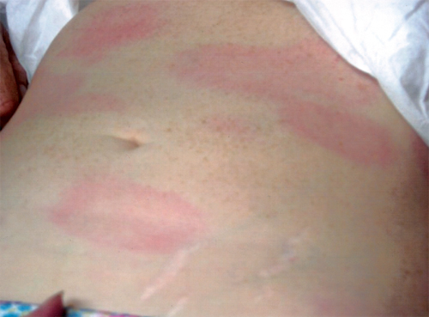
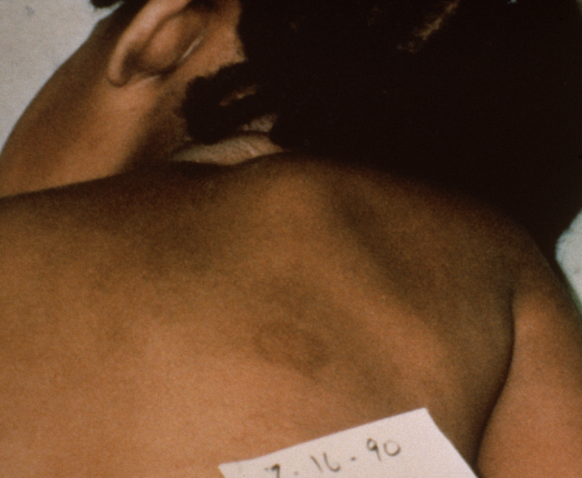
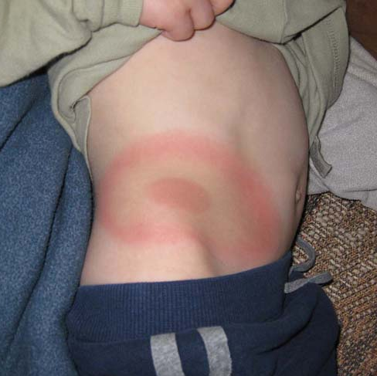
Lyme Disease: Human
Bull’s Eye rash
Fatigue
Fever
Joint or muscle aches
Headache
Swollen glands
Notes:
Learning the early signs of Lyme disease facilitates its recognition, treatment, and cure. The most recognizable early sign of Lyme disease is the erythema migrans rash, also known as the EM rash or bull’s-eye rash. Most people infected with Lyme disease will develop an EM rash. EM rashes cause little or no sensation or pain, so if the EM rash is on a person’s back side, it may go unnoticed. Recognizing these symptoms early is important in order that treatment early on in the course of illness can be initiated in order to try an avoid some of the more severe manifestations of disease like cranial nerve inflammation or atrioventricular block.
As depicted in the image in the lower left hand corner, the EM rash presents as darker colored rings on African Americans or persons with darker skin color. Other early signs of Lyme disease may include: fatigue, fever, headache, joint or muscle aches, and swollen glands. Multiple EM rashes (as shown in the top left) may appear as the early localized infection begins to disseminate.

Slide 77
Lyme Disease: Animals
Dogs may develop illness that includes lameness, fever, anorexia, myalgia and lethargy
Cats may develop arthritis (rare)
Horses may develop illness, but disease in this species is poorly understood at this time
Notes:
Other than humans, dogs are the animal that is most likely to manifest clinical signs of Lyme disease. There have been rare reports in cats. Horses may develop illness, however, this disease in that species is poorly understood at this point.

Slide 78
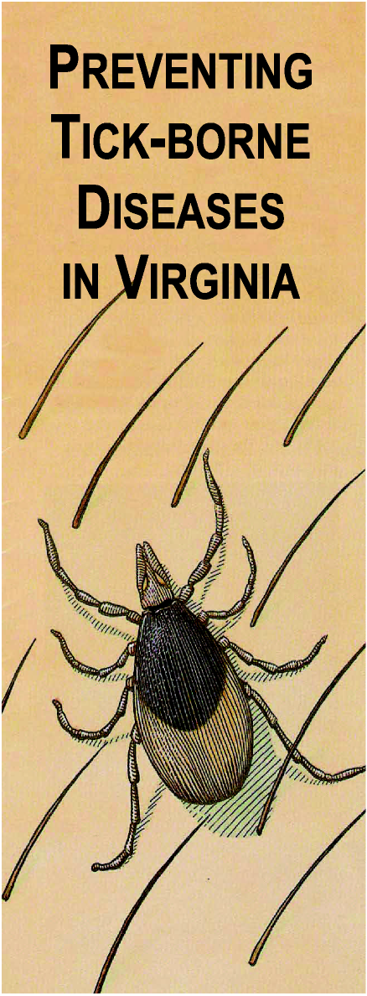
Lyme Disease: Prevention
1. Recognize tick habitats
2. Dress appropriately
3. Use repellents
4. Do tick checks
5. Remove ticks
Notes:
Because it is not currently economically or technically possible to all eliminate tick or deer populations in Virginia, VDH must work to prevent Lyme disease through educational outreach.
The best currently available method for preventing infection with B. burgdorferi and other tick transmitted pathogens is to avoid exposure to vector ticks. If exposure to ticks is unavoidable, measures recommended to reduce the risk of infection include: the use of both protective clothing and tick repellents, checking the entire body for ticks daily, prompt removal of attached ticks before transmission of disease agents can occur, and knowledge of the early signs of Lyme disease and other tick-borne diseases.

Slide 79
1. Recognize Tick Habitats
Notes:
Blacklegged ticks are forest creatures. They are not normally found in open fields. Recognize tick habitats and task the appropriate precautions when entering into a tick habitat. Tick habitats include leaf litter areas in shady forest environments; tall weeds, grass, brush and leaf litter along forest trails and forest margins; and wood piles, rock piles, and stone walls that provide cover for rodents and ticks.

Slide 80
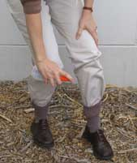
2. Dress Appropriately
Light colors
Tucked and buttoned
Prompt clothing removal
Launder with hot water and high heat
Notes:
Appropriate dress includes wearing light colored clothing. Dark colored blacklegged ticks are easier to spot and remove from light colored clothing.
Tuck pants legs into socks and shirts into pants. Ticks typically get on a person’s feet first and crawl up the leg. If pants are tucked into socks, the ticks will be forced to crawl up the outside of the pants where they can be seen and removed. If a shirt is tucked into pants, the ticks will have limited access to skin on the belly, back, or chest. Button shirt and long sleeves to prevent easy access to the body and arms by ticks.
It is important to remove clothing immediately upon return from a tick habitat to prevent carrying ticks around the house. Also, clothing worn outdoors should be laundered in hot water and dried on high heat. This step will kill any ticks that remain on clothing.

Slide 81
3. Use Insect Repellents
Notes:
There are a variety of different repellent products for use on skin, and a variety of repellent active ingredients that are known as effective in repelling ticks. Those active ingredients include DEET, Picaridin, IR3535, 2-Undecanone, and oil of lemon eucalyptus. Different products may contain one or another active ingredient, so it is necessary to look on the active ingredients section of the repellent label to chose a repellent with your preferred active ingredient.
For treatment of clothing, socks and shoes, use Permethrin. Clothing repellents containing Permethrin may last up through 6-7 laundry cycles and do not stain clothes. Permethrin should not be used on skin. Ticks usually access the feet initially; therefore, treating shoes and socks will repel most ticks.
It is important to follow label instructions on any repellent package, and exercise particular care when applying repellents to children. Repellents should not be applied to skin under clothing.

Slide 82
4. Do a Tick Check
Take a bath or shower
Use mirror if needed
Pay special attention to children
Notes:
On returning from potential tick habitats it is important to promptly take a bath or shower and wash with soap and hot water. Request assistance from a spouse or friend to check self for ticks, or use a full length mirror and/or a hand mirror.
It is important to thoroughly examine children after they have been in tick habitats. The sooner ticks are found and removed, the less likely they are to transmit disease. Blacklegged ticks require a minimum of 36 hours attachment before Lyme disease transmission may occur.

Slide 83
5. Remove Ticks Promptly
Use pointed tweezers to grasp the tick by the head; do not squeeze its body!
Pull slowly and steadily until the tick releases; do not jerk or twist the tick.
Notes:
It is important to remove ticks promptly. Careful tick removal reduces the chance of disease transmission.
Use pointed tweezers to grasp the tick by the head. Do not squeeze the tick’s body. Removal must be done carefully to prevent tick from regurgitating into the wound. Pull slowly and steadily until the tick releases. Do not jerk or twist the tick out as this may cause tick mouthparts to break off and remain in the wound.
We recommend saving the tick in a jar of alcohol so it can be properly identified. VDH central office in Richmond can assist with identifying the tick if needed. A “Tick Identification Chart” can also be obtained on the VDH website to help identify the tick species.

Slide 84
Vector-borne disease resources
www.cdc.gov/ncezid/dvbd/
www.cdc.gov/lyme/
www.vdh.virginia.gov/epidemiology/DEE/Vectorborne/
Notes:
Resources for additional information about vectorborne diseases can be found at these websites.

Slide 85
Zoonotic Disease References
www.cdc.gov
www.cdc.gov/healthypets/health_prof.htm
www.cdc.gov/healthypets/extra_risk.htm
www.vdh.virginia.gov
www.vdh.virginia.gov/Epidemiology/DEE/
Notes:
Additional information about zoonotic diseases can be found via these websites.

Slide 86
Zoonotic Disease References
Control of Communicable Diseases Manual
Available through the American Public Health Association (www.aphabookstore.org)
Zoonoses and Communicable Diseases Common to Man and Animals, 3rd edition
www.paho.org
Notes:
Additional information about zoonotic diseases can be found via these resources

Slide 87
Zoonotic Disease References
www.nasphv.org
Animal Contact Compendia
Animal Rabies Compendium
Psittacosis Compendium
Veterinary Standard Precautions Compendium
Model Infection Control Plan for Veterinary Practices (MS Word)
Notes:
Additional information about zoonotic diseases can be found via these resources.

Slide 88
Zoonotic Disease References
www.cfsph.iastate.edu/
Iowa State Center for Food Safety and Public Health
www.avma.org
Public Health section
Notes:
Additional information about zoonotic diseases can be found via these websites.

Slide 89
Questions?

