Slide 1
The Nature of Translational Science
EPID 691, Spring 2012
Epidemiology of Chronic Disease
Nancy L. McCain, RN, DSN, FAAN

Slide 2
NIH Roadmap http://commonfund.nih.gov/aboutroadmap.aspx
The NIH Roadmap for Medical Research was launched in September, 2004, to address roadblocks to research and to transform the way biomedical research is conducted by overcoming specific hurdles or filling defined knowledge gaps. Roadmap programs span all areas of health and disease research and boundaries of NIH Institutes and Centers (ICs).
Roadmap Themes:
New Pathways to Discovery
Research Teams of the Future
Re-engineering the Clinical Research Enterprise→ Clinical and Translational Science Awards (CTSA)

Slide 3
“The key to achieving this vision is the ability to ensure that the rapid and fundamental advances in biomedical and behavioral sciences will be translated into patient-oriented research and then further applied to real-world practice” (Zerhouni, 2007, p. 127).
This process is defined as Translational Research.

Slide 4
What exactly is translational research?
For many, means the “bench-to-bedside” enterprise of “harnessing knowledge from basic sciences to produce new drugs, devices, and treatment options for patients.
In this interface between basic science and clinical medicine, goal is the production of a promising new treatment that can be used clinically or commercialized.
“For others—especially health services researchers and public health investigators whose studies focus on health care and health as the primary outcome—translational research refers to translating research into practice…
ensuring that new treatments and research knowledge actually reach the patients or populations for whom they are intended and are implemented correctly” (p. 211).
Woolf, S.H. (2008). The meaning of translational research and why it matters. JAMA, 299, 211-213.

Slide 5
www.iths.org
Translational research involves moving knowledge gained from the basic sciences to its application in clinical and community settings.
Summarized as "bench-to-bedside" and "bedside-to-community" research.
Translational research encompasses a bidirectional continuum of phases of translation, or "T-phases.“
ITHS model of 5 phases, adapted from Khoury et al. (2007):
T₀ is characterized by the identification of opportunities and
approaches to health problems.
T₁ seeks to move basic discovery into a candidate health application.
T₂ assesses the value of application for health practice leading to the development of evidence-based guidelines.
T₃ attempts to move evidence-based guidelines into health practice, through delivery, dissemination, and diffusion research.
T₄ seeks to evaluate the “real world” health outcomes of population
health practice.

Slide 6
Translational Research Cycle
Institute of Translational Health Sciences
University of Washington CTSA

Slide 7
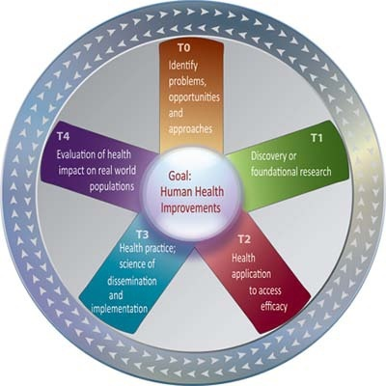
https://www.iths.org/about/translational
to assess
ITHS Wheel of Translational Research
The 5 phases of translational research do not necessary move along a linear trajectory; they often interact with each other through the entire spectrum and in no particular order.

Slide 8
Khoury et al. (2007). The continuum of translation research in genomic medicine: How can we accelerate the appropriate integration of human genomic discoveries into health care and disease prevention? Genetics in Medicine, 9, 665-674.
Research Phase | Definition | Type of Research | Examples
T₀ | Identification of opportunities and approaches to health problem. | Basic research question | Are there specific gene mutations associated with breast cancer?
T₁ | Discovery of candidate health application | Phase I and II clinical trials; observational studies | Is there an association between BRCA mutations and breast cancer?
T₂ | Health application to evidence-based practice guidelines | Phase III clinical trials; observational studies; evidence synthesis and guidelines development | What is the positive predictive value of BRCA mutations in at-risk women?
T₃ | Practice guidelines to health practices | Dissemination research; implementation research; diffusion research Phase IV clinical trials | What proportion of women who meet the family history criteria are tested for BRCA and what are the barriers to testing?
T₄ | Practice to population health impact | Outcomes research (includes many disciplines); population monitoring of morbidity, mortality, benefits, and risks studies | Does BRCA testing in asymptomatic women reduce breast cancer incidence or improve outcomes?

Slide 9
Khoury et al., 2007, p. 667:
Fig. 1. The continuum of translation research in genomic medicine. HuGE, human genome epidemiology; ACCE, analytic validity, clinical validity, clinical utility, ethical, legal, and social issues.

Slide 10
“Renewed calls for enhancing the ‘translation’ research enterprise have recently emerged from the National Institutes of Health as part of the Roadmap initiative, as well as from the clinical, academic, and public health sectors. Nearly all of these proposals highlight the role of multidisciplinary research through enhanced collaboration among researchers in the basic sciences, clinical medicine, and public health” (Khoury et al., 2007, p. 666).
Notes:
Many basic scientists believe that translation research means taking new discoveries from the laboratory to develop applications (primarily drugs) for study in human clinical trials. Conversely, public health agencies tend to view translation research as focusing on building the evidence base for integration of applications into practice and demonstrating health impact at the population level. To distinguish these phases on the translation research spectrum, some investigators refer to them as “Type 1” (translation of basic research into clinical application) and “Type 2” (clinical application to evidence-based practice guidelines). Recently, Westfall et al. proposed that the evaluation of interventions in practice can be called “Type 3 translation research.” To adapt this framework to research translation in genomics, we prefer the use of the term “phase,” rather than “type,” and we have added a phase 4 to represent the population-level evaluation of health outcomes (p. 666).

Slide 11
NCI, President’s Cancer Panel Annual Report, 2004-2005

Slide 13
Francis Collins, describing the goals and functions of NCATS,
“the National Center for Advancing Translational Sciences (NCATS), a new entity [established Dec 2011] currently being shaped by the U.S. National Institutes of Health (NIH) to reengineer the process of developing diagnostics, devices, and therapeutics….
“the time is right to take a comprehensive, systematic, and creative approach to revolutionizing the science of translation” (Collins, 2011, p. 1).

Slide 14
“The translation of basic biological discoveries into clinical applications that improve human health is an intricate process that involves a series of complex steps:
the discovery of basic information about the pathogenesis of a disease;
an assessment of whether that information has the potential to lead to a clinical advance;
development of candidate diagnostics, devices, or therapeutics;
optimization of the candidates in preclinical settings;
regulatory assessment of the data to determine the potential for human use;
testing in human clinical trials; application for approval for widespread clinical use; and, ultimately,
the assessment of approved diagnostics, devices, and therapeutics during widespread use in real-world settings.”
(Collins, 2011, p. 1)

Slide 15
Khoury et al., 2011 :
“Translational research is guided by knowledge synthesis and evidence-based recommendations …. Traditionally, research investments are heavily concentrated in discovery (T0) and the first phase of translation (T1 or bench to bedside). The outcomes of discovery and early translational research are promising tests, drugs, and other interventions (e.g., policy or environmental) that need to be evaluated for their validity and utility in clinical and population settings.>>

Slide 16
To fulfill the promise of these applications to improve health, a robust "post-bedside“ translational research agenda is needed to evaluate the efficacy of the new applications leading up to evidence-based recommendations and policies for their use (T2), to conduct implementation and dissemination science to move discoveries into practice and control programs (T3), and to assess effectiveness, cost-effectiveness, and outcomes at the population level (T4). >>

Slide 17
To achieve a post-bedside translational research agenda, population sciences are crucial. Population sciences encompass multiple disciplines, including among others, epidemiology, behavioral, social and communication sciences, implementation and dissemination research, health services and comparative effectiveness and outcomes research, and regulatory science. (p. 2106)

Slide 18
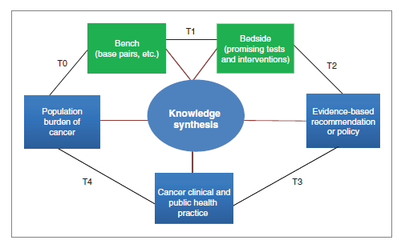
Khoury, M.J., Clauser, S.B., Freedman, A.N., Gillanders, E.M., Glasgow, R.E., Klein, W.M.P., & Schully, S.D. (2011). Population sciences, translational research, and the opportunities and challenges for genomics to reduce the burden of cancer in the 21st century .Cancer Epidemiology, Biomarkers & Prevention, 20, 2105-2114.

Slide 19
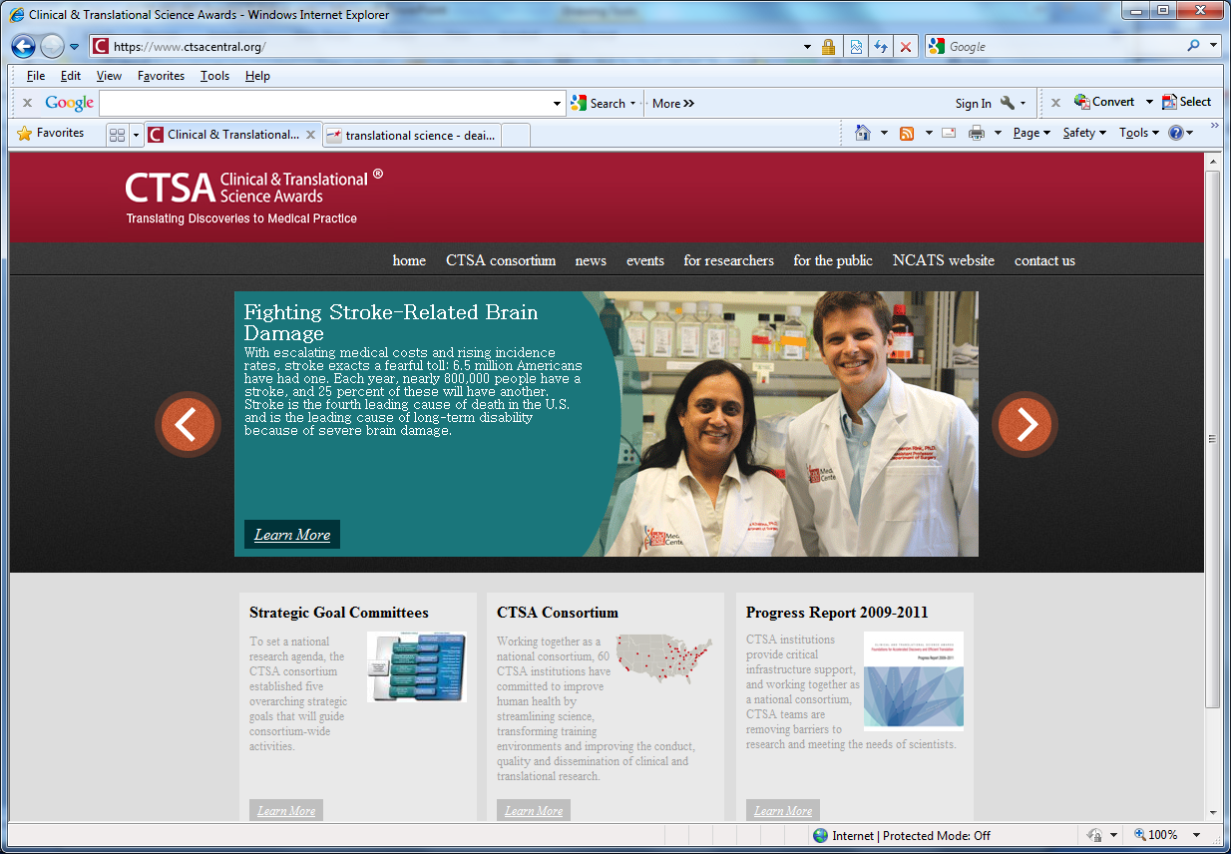

Slide 20
https://www.ctsacentral.org/ctsa-progress-report-2009-2011

Slide 21
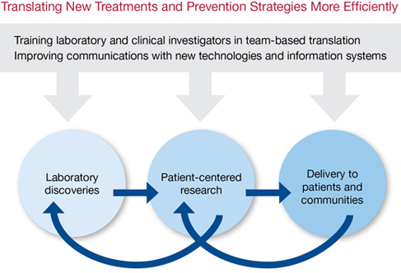
CTSA-funded institutions aim to accelerate scientific discovery along the entire biomedical research continuum, from basic science to patient studies to clinical practice, using an integrated approach. Information sharing at each stage of the process ensures that researchers are meeting community health needs, and that progress in the clinic, in turn, informs the work in the laboratory.

Slide 22
A Shared Focus for the CTSA Consortium
CTSA-supported institutions, working both individually and as a consortium, have focused efforts in the following areas:
Accelerating laboratory discoveries into early clinical studies and trials
Improving the efficiency of patient-centered research
Training new generations of laboratory and clinical investigators to work as interdisciplinary teams
Fostering collaborations and partnerships
Engaging communities in defining health care needs and in receiving the benefits of research
Supporting resources and networking tools for sharing data

