Slide 1
Cancer Epidemiology
Kara P. Wiseman, MPH, Phd
Tobacco Control Research Branch
Division of Cancer Control and Population Sciences

Slide 2
Outline
What is cancer
Cancer statistics
Cancer disparities
Cancer prevention and early detection
Cancer survivorship
Cancer research

Slide 3
What is Cancer

Slide 4
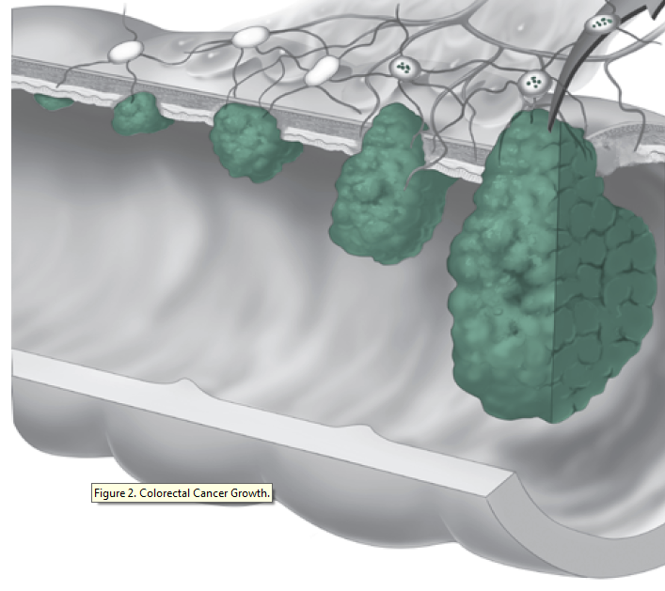
What is cancer?
Disease where abnormal cells divide without control and are able to invade other tissues
1,685,210 new cases expected in 2016
2nd leading cause of death in the US
Cancer arises from malfunctions in genes that control cell growth and division
  Mutations develop over a lifetime

Slide 5

Who is at risk?
Anyone can develop cancer
  Risk increases with age
  86% of all cancers diagnosed in people ≥50 years of age
Approximately 14.5 million Americans with a history of cancer were alive on Jan 1, 2014

Slide 6
Cancer statistics

Slide 7
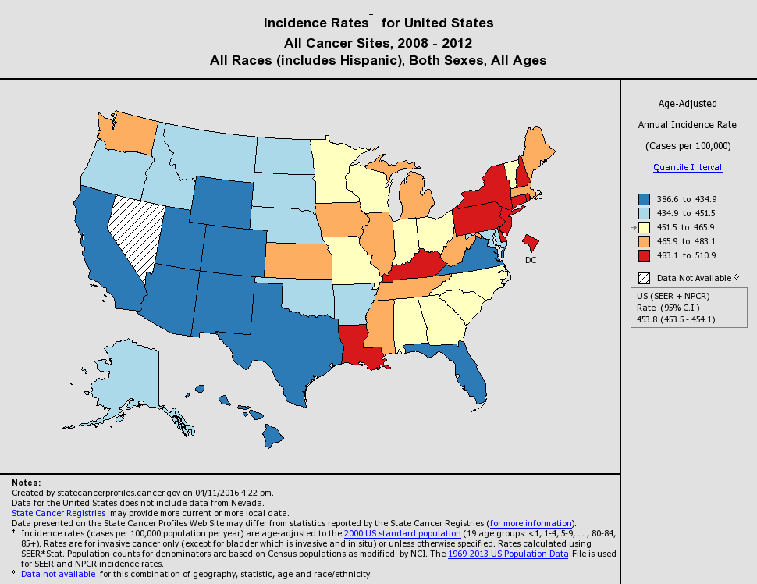
Where do cancer statistics come from?
Surveillance, Epidemiology, and End Results (SEER) Program
  Data collection started in 1973 for 7 states
  Now ~ 30% of the US population
National Program of Cancer Registries (NPCR)
  Established in 1992 to cover 10 states that did not have a cancer registry
  Now supports cancer registries in 45 states + DC and territories

Slide 8
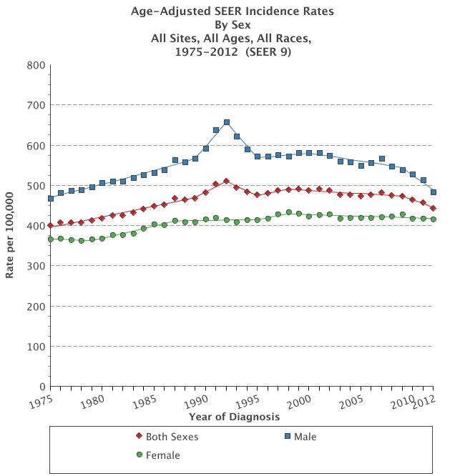
Cancer Incidence
  Number of new cases among population at risk
  Expressed as number of cases per 100,000 people at risk

Slide 9
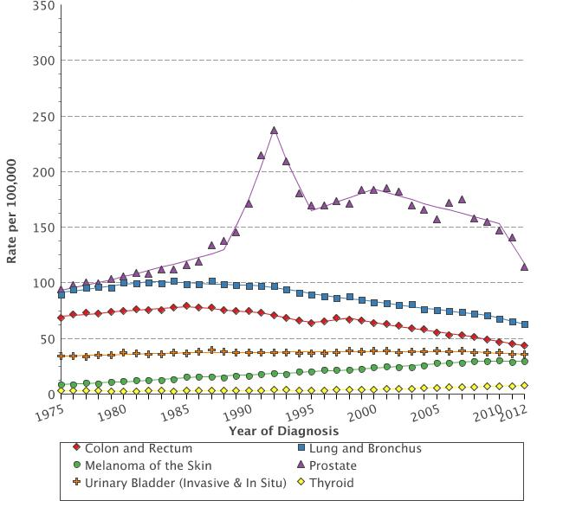
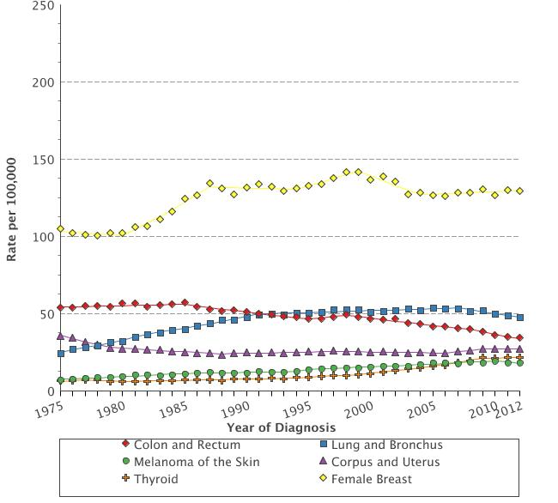
Age-adjusted incidence by cancer site 1975-2012
Male
Female

Slide 10
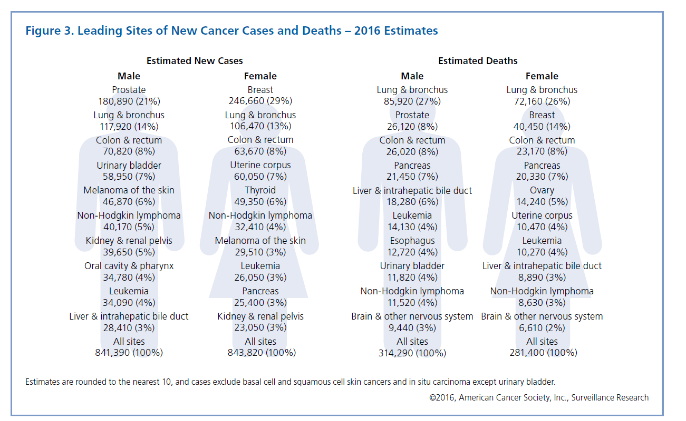
Leading sites of new cancer cases – 2016 estimates
Estimates rounded to nearest 10. Excludes basal cell and squamous cell skin cancers and in situ carcinoma except urinary bladder.

Slide 11
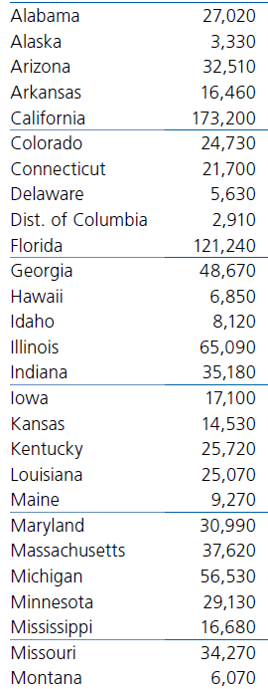
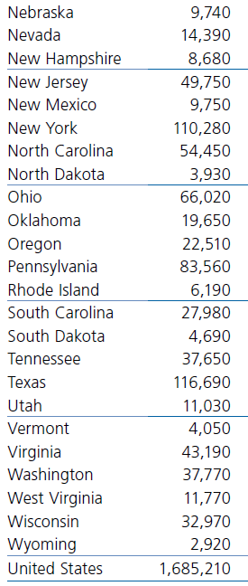
Estimated new cancer cases by state, 2016

Slide 12
Cancer prevalence
Who has cancer right now out of everyone in the population
  Includes people who are living with cancer
  Incidence and survival impact specific cancer prevalence
Incidence
Prevalence
Survival

Slide 13
Estimated numbers of survivors for the 10 most prevalent cancer
Males | Females
Prostate - 2,975,970 (43%) | Breast - 3,131,440 (41%)
Colon & rectum - 621,430 (9%) | Uterine corpus - 624,890 (8%)
Melanoma - 516,570 (8%) | Colon & rectum - 624,340 (8%)
Urinary bladder - 455,520 (7%) | Melanoma - 528,860 (7%)
Non-Hodgkin lymphoma - 297,820 (4%) | Thyroid - 470,020 (6%)
Testis - 244,110 (4%) | Non-Hodgkin lymphoma - 272,000 (4%)
Kidney - 229,790 (3%) | Cervix - 244,180 (3%)
Lung and bronchus - 196,580 (3%) | Lung and bronchus - 233,510 (3%)
Oral cavity and pharynx - 194,140 (3%) | Ovary - 199,900 (3%)
Leukemia - 177,940 (3%) | Kidney - 159,280 (2%)

Slide 14
Stage of diagnosis
Stage 0
- Carcinoma in situ
Stage 1
- Localized
Stage 2
- Regional early locally advanced
Stage 3
- Regional late locally advanced
Stage 4
- Distant
More localized = better chance of benefiting from treatment
Rates of late-stage (distant) cancers are tracked to monitor the impact of cancer screening.
  More cancers detected at early stages should = fewer detected at late stages
Clinicians use TNM staging
  Tumor (T), lymph node involvement (N), metastases (M)

Slide 15
Stage distribution SEER 2000 by cancer site

Slide 16
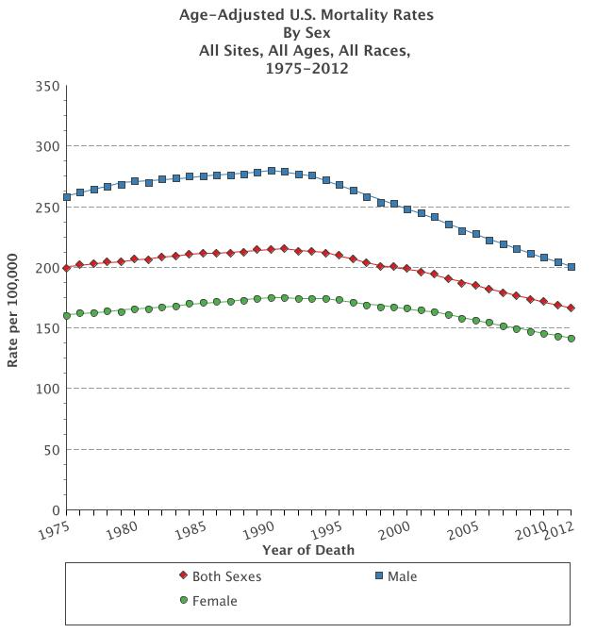
Cancer mortality
Number of deaths caused by cancer in a specified population
Expressed as number of deaths per 100,000 people

Slide 17
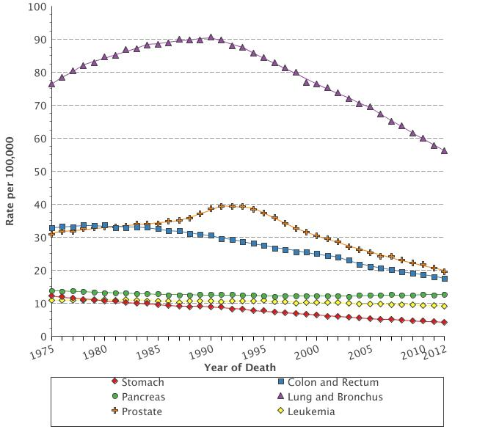
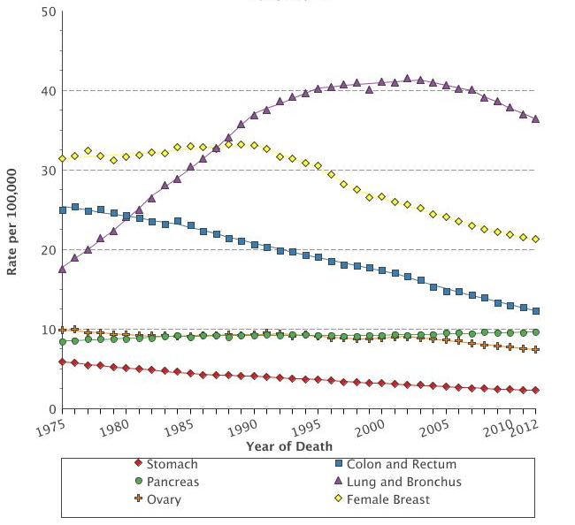
Age-adjusted U.S. mortality rates by cancer site, 1975-2012
Male
Female

Slide 18
Leading sites of cancer deaths – 2016 estimates
Estimates rounded to nearest 10. Excludes basal cell and squamous cell skin cancers and in situ carcinoma except urinary bladder.

Slide 19
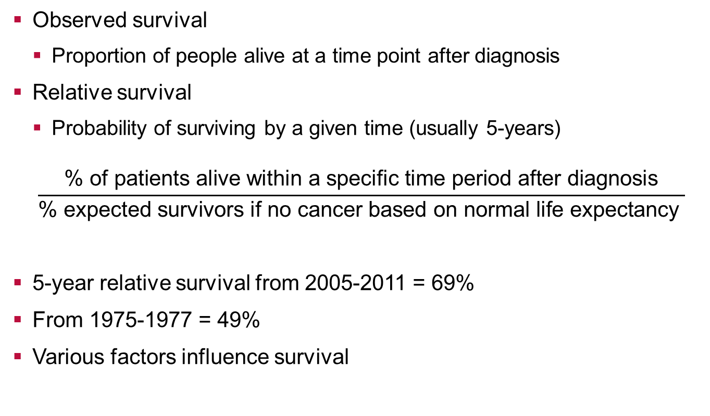
Cancer survival
Observed survival
  Proportion of people alive at a time point after diagnosis
Relative survival
  Probability of surviving by a given time (usually 5-years)
$$\frac{\text{\%} \text{of} \text{patients} \text{alive} \text{within} \text{a} \text{specific} \text{time} \text{period} \text{after} \text{diagnosis}}{\text{\% }\text{expected} \text{survivors} \text{if} \text{no} \text{cancer} \text{based} \text{on} \text{normal} \text{life} \text{expectancy} }$$
5-year relative survival from 2005-2011 = 69%
From 1975-1977 = 49%
Various factors influence survival

Slide 20
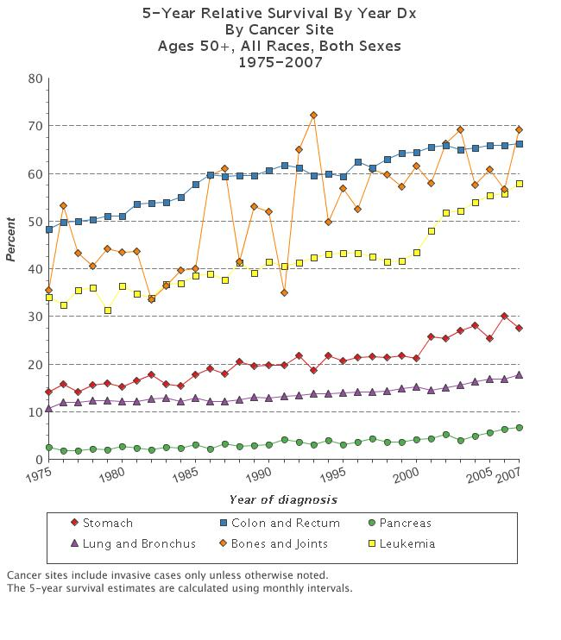
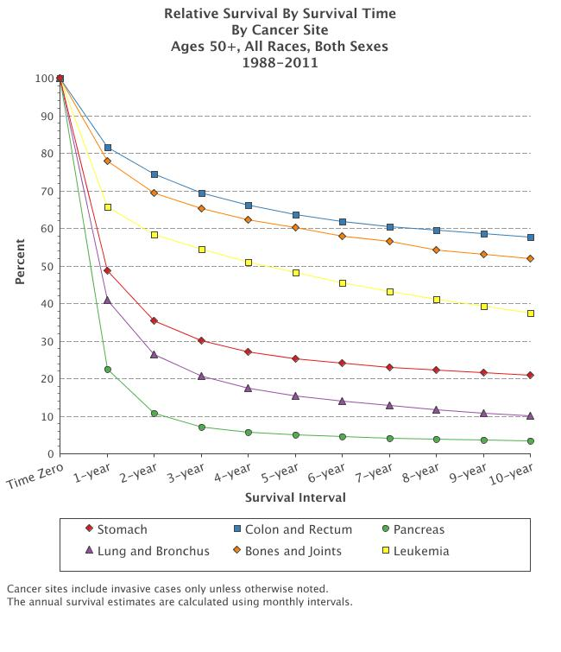
Survival graphs

Slide 21
Relative survival by stage (2005-2011)

Slide 22
Cancer disparities

Slide 23
Cancer Incidence, 1973-2012 by race and gender

Slide 24
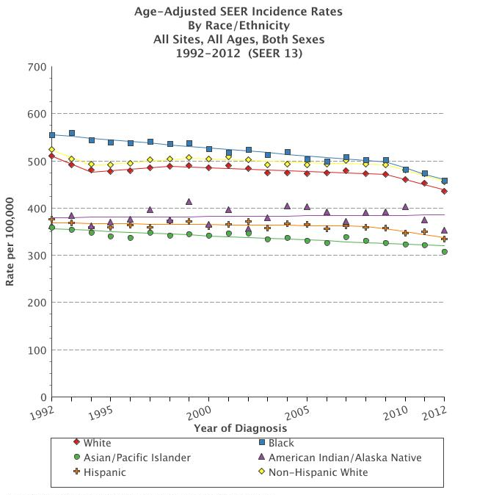
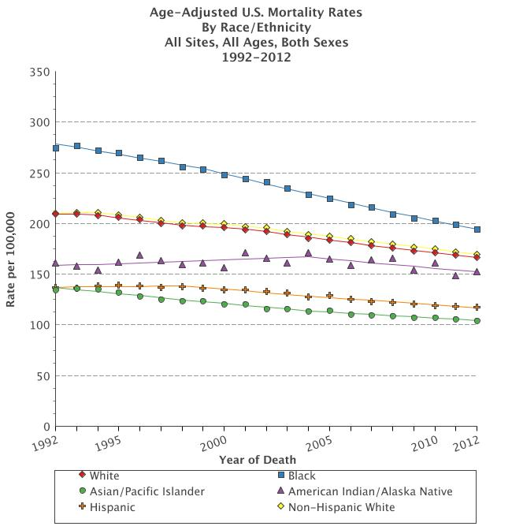
Incidence and mortality by race

Slide 25
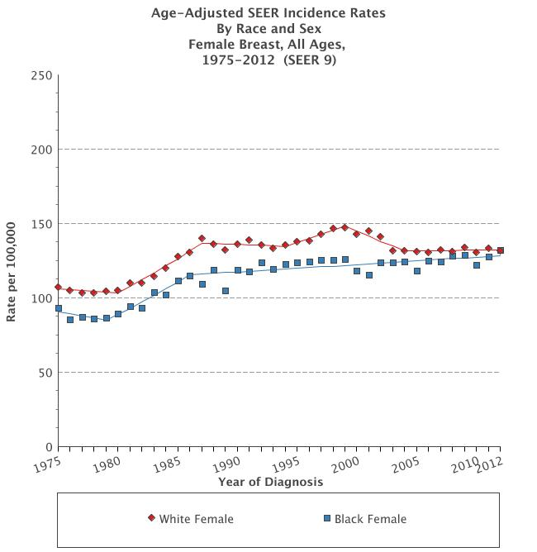
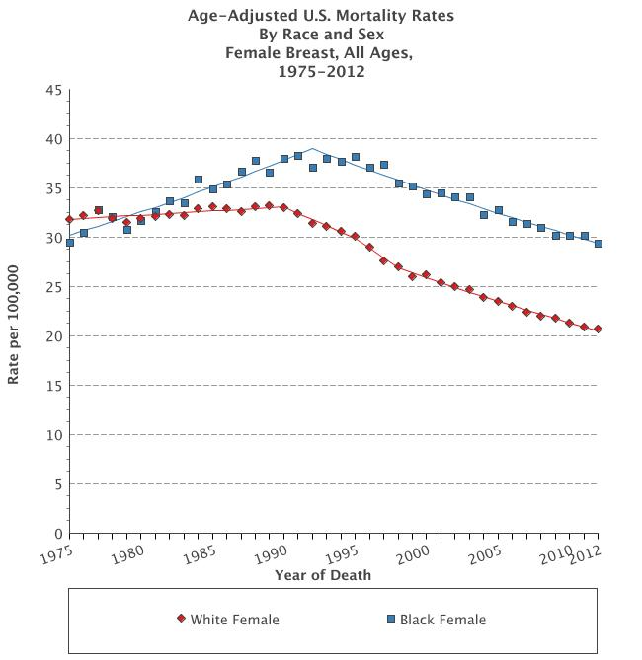
Breast cancer incidence and mortality by race

Slide 26
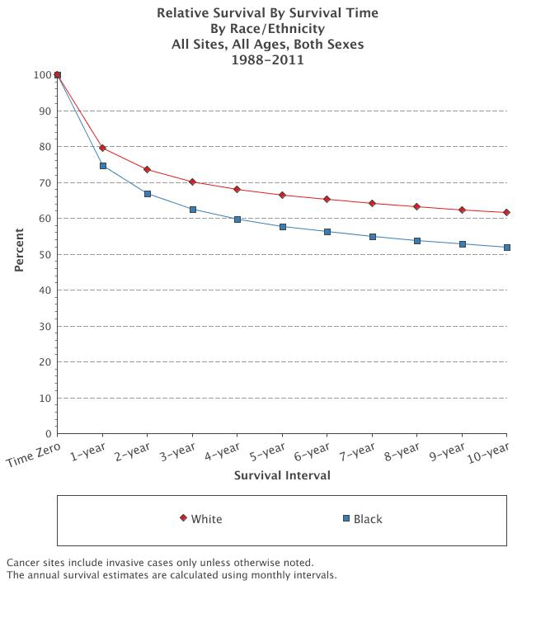

Slide 27
Stage of diagnosis

Slide 28
Cancer health disparities
Health disparities are differences in incidence, mortality, burden of disease, prevention, or treatment in specific groups.
Causes of health disparities - complex interaction of factors
  Social
  Cultural
  Economic
  Environmental
  Health care-related
Groups to identify/examine cancer health disparities
  Race/ethnicity
  Socioeconomic status
  Geographic region
  Gender

Slide 29
Race/ethnicity
Obstacles to receiving healthcare services
  Including cancer prevention, early detection and good quality cancer treatment
Poverty
  Percent living below the poverty line
    28% African Americans
    25% Hispanics
    10% non-Hispanic whites
Discrimination
Cultural/inherited factors
Social factors
Behaviors
Genetics

Slide 30
Socioeconomic status (SES)
People with lower SES have disproportionately higher cancer death rates than those with higher SES, regardless of demographic factors such as race/ethnicity.
  Cancer mortality rates for men with ≤ high school education is ~ 3 times higher than those with a college degree, regardless of race

Slide 31
Geography

Slide 32
Cancer prevention and early detection

Slide 33
Cancer prevention
Non-modifiable risk factors
  Age
  Inherited genetic mutations
    BRCA 1 and BRCA2
Modifiable risk factors
  Exercise
  Diet
  Smoking

Slide 34
Primary prevention
Chemoprevention
Behaviors
Prophylactic surgery
Screening
Preclinical phase
Clinical phase
Disease onset
Symptoms
Dx
Begin treatment

Slide 35
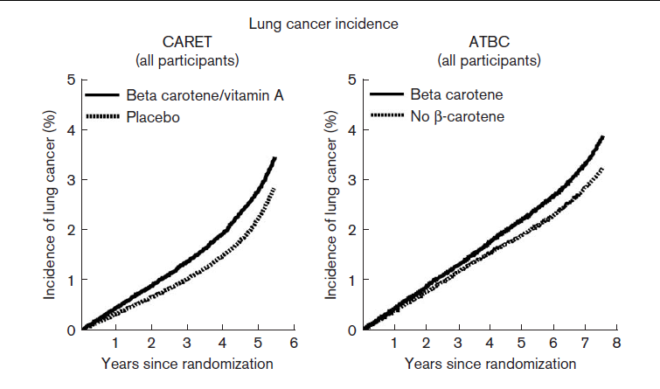
Chemoprevention
The use of drugs, vitamins, or other agents to try to reduce the risk of, or delay the development or recurrence of cancer
Beta-carotene for lung cancer
USPSTF just recommend aspirin for colorectal cancer in adults 50-59

Slide 36

Smoking
1/3 of all cancers caused by tobacco smoking and environmental tobacco smoke exposure
Smoking rates are higher in:
  Low SES groups
  People with mental health illness
Problems with cessation
  Nicotine is addictive
  Tobacco marketing

Slide 37
Secondary prevention - early detection
Finding cancer at an earlier stage when it is easier to treat
Biomarkers
Screening
Preclinical phase
Clinical phase
Disease onset
Symptoms
Dx
Begin treatment

Slide 38
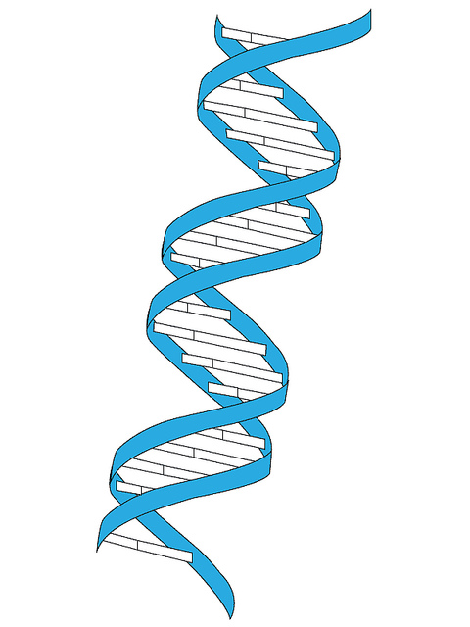
Biomarkers
Molecule found in blood, other body fluids, or tissues that is a sign of a normal or abnormal process, or of a condition or disease,
Proteins
  PSA
Genetic
  Circulating cancer cell DNA
Collection of different molecules

Slide 39
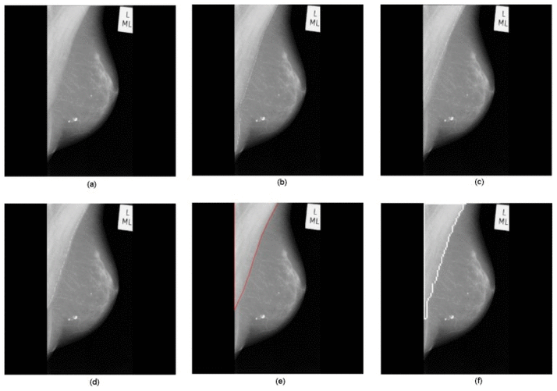
Screening
Mammogram
Colorectal cancer screening
Lung cancer screening
Overdiagnosis?!

Slide 40
Cancer survivorship

Slide 41
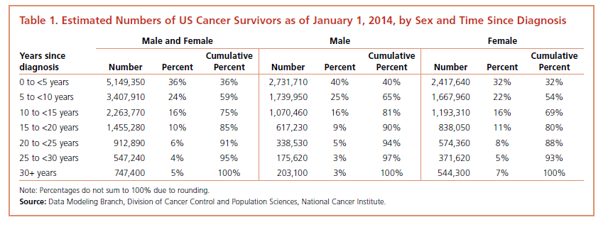
Cancer survivorship
Definition varies
  Survivor from time of diagnosis?
  Survivor after completing treatment?
  Survivor after surviving 5 years after treatment?
14.5 million cancer survivors in the US in 2014
~ 19 million estimated for 2024

Slide 42
Post treatment follow-up care
Monitoring after completion of cancer treatment
  Late-effects
  Long-term effects
Evidence-based guidelines for post-treatment care exist
  National Comprehensive Care Network (NCCN)
  American Society of Clinical Oncology (ASCO)
  Provider responsible for follow-up is not explicitly stated
Specialist vs. primary care follow-up care
  Specialist is traditional source of care
  Breast cancer: Two RCTs of oncology vs. primary care follow-up showed similar outcomes

Slide 43
Cancer research

Slide 44
