Slide 1
Tobacco Control
February 6, 2017
J. Randy Koch, Ph.D.
Alison Breland, Ph.D.
VCU Center for the Study of Tobacco Products

Slide 2
Health Consequences
In the US: over 480,000 people die from tobacco related diseases each year
  Globally, nearly 6 million annually
What’s in tobacco that is so harmful?
  Nicotine
  Carbon monoxide or CO (when burned)
  Carcinogens (e.g., tobacco-specific nitrosamines, PAHs)
Morbidity and mortality caused by CO and carcinogens
Smoked tobacco use increases risk of:
  coronary heart disease by 2 to 4 times
  stroke by 2 times
  Lung cancer by 13-23 times (women and men)
  chronic obstructive lung diseases (such as emphysema) by 10 times
Notes:
http://www.cdc.gov/tobacco/data_statistics/fact_sheets/health_effects/tobacco_related_mortality/
http://www.who.int/mediacentre/factsheets/fs339/en/
Carbon monoxide causes heart disease by decreasing oxygen to heart
tobacco-specific nitrosamines—created during the curing and processing of tobacco (therefore, present in different forms of tobacco)
43 known carcinogens in cigarette smoke
Risk data all from CDC website

Slide 3
Tobacco Dependence/Withdrawal
Effects of tobacco: mild euphoria, reduced stress, increased energy, and appetite suppression
Dependence likely caused by nicotine
Symptoms of withdrawal generally start within 2 - 3 hours after the last tobacco use, and peaks about 2 - 3 days later
  Intense craving for tobacco
  Anxiety, restlessness, impatience
  Difficulty concentrating
  Drowsiness or trouble sleeping, as well as bad dreams and nightmares
  Headaches
  Increased appetite and weight gain
  Irritability or depression
Notes:
Like any other drug, the withdrawal symptoms make it difficult to quit
Aversive withdrawal syndrome can maintain tobacco use and thus, exposure to harmful smoke constituent

Slide 4
Global Sources of
Epidemiological Data
Lack of standardized data on a global level
Global Tobacco Surveillance System—1999+
  Collaborative effort among WHO, United States Centers for Disease Control and Prevention, and the Canadian Public Health Association
  Surveys
    Global Youth Tobacco Survey (GYTS)
    Global School Personnel Survey (GSPS)
    Global Health Professions Student Survey (GHPSS)
    Global Adult Tobacco Survey (GATS)
Notes:
Standardized system for collecting Epi data on tobacco
GYTS— 140 countries plus territories
School-Based survey
Youth ages 13 to 15
different years for different countries
http://www.cdc.gov/mmwr/preview/mmwrhtml/ss5701a1.htm
GATS — Only 14 countries have implemented (Not US or Czech) and 8 more plan to conduct in 2011
Household survey
Ages 15+

Slide 5
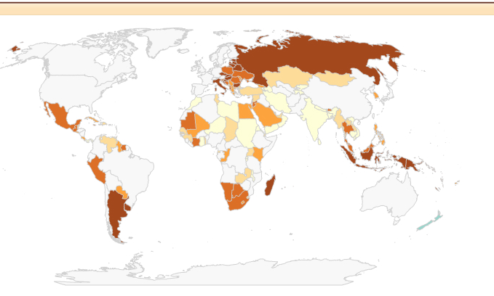

GYTS: Current Cigarette Smokers

Slide 6
Epidemiology: US rates
Currently, about 15% of US adults smoke cigarettes
Rates higher if you include any tobacco product (21% used a tobacco product every day or some days; 2013-14 data)
Notes:
https://www.cdc.gov/mmwr/volumes/65/wr/mm6544a2.htm (2005 – 2015 data)
The 2009 National Health Interview Survey and the 2010 Behavioral Risk Factor Surveillance System were used to estimate national and state adult smoking prevalence, respectively. Cigarette smokers were defined as adults aged ≥18 years who reported having smoked ≥100 cigarettes in their lifetime and now smoke every day or some days.
https://www.cdc.gov/mmwr/volumes/65/wr/mm6527a1.htm (2013 data) 21% used a tobacco product every day or some days
National Youth Tobacco Survey (NYTS), For each substance, current use was defined as use on at least 1 of the past 30 days. 2009 data.
Current use of any tobacco product among youth
8.2% of middle school students and
23.9% of high school students

Slide 7
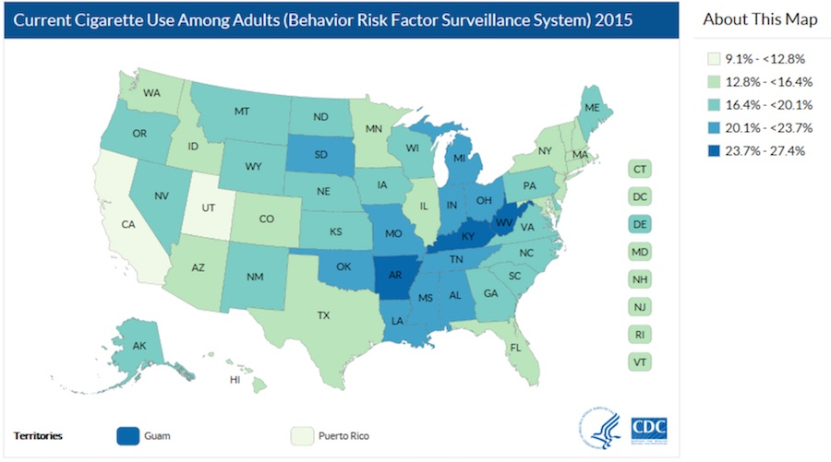
Adult smoking prevalence by state
Notes:
https://www.cdc.gov/tobacco/data_statistics/fact_sheets/adult_data/cig_smoking/index.htm#national
http://www.taxadmin.org/assets/docs/Research/Rates/cigarette.pdf
(2016 data) Low cigarette taxes: Virginia, West Virginia, North Dakota, North Carolina, Missouri is 17 cents a pack.
High taxes: New York (4.35) Rhode island (3.75), Connecticut (3.65)
Not as strong smoke free laws: Alaska, Texas, MO, MS, AL, KY, SC, NC, VA: http://www.lung.org/our-initiatives/tobacco/reports-resources/sotc/state-grades/state-rankings/smokefree-air-laws.html

Slide 8
Epidemiology: US rates (adults, cigarettes only)
Gender
  17% men
  13.6% of women
Race
  21.9% of American Indians/Alaska Natives
  20.2% of whites (non-Hispanic)
  16.7% of blacks (non-Hispanic)
  10.1% of Hispanics
Socio-economic status
  26.1% of adults who live below the poverty level
  13.9% of adults who live at or above the poverty level
Notes:
Source: CDC 2015
http://www.cdc.gov/tobacco/data_statistics/fact_sheets/adult_data/cig_smoking/index.htm#national
Also see reductions in tobacco use by education (more education = less tobacco use)
41.9% of adults with a GED diploma
24.7% of adults with 12 years or less of education (no diploma)
23.1% of adults with a high school diploma
9.1% of adults with an undergraduate college degree
5.9% of adults with a postgraduate college degree
Disproportionate rates of tobacco-related disease among ethnic and racial minorities in the US.

Slide 9
Epidemiology: US rates (adults, cigarettes only)
Adults with mental illness
  36% of adults with mental illness are smokers
Adults with substance use disorders: ~80%
Adults with MH or SUD account for 40% of all cigarettes smoked in the US
Notes:
http://www.cdc.gov/media/dpk/2013/dpk-vs-adult-smoking-mental-illness.html

Slide 10
Epidemiology: US rates for youth
Current use of cigarettes among youth:
  2.3% of middle school students
  9.3% of high school students
Rates higher if you include any tobacco product
  7.4% of middle school students
  25.3% of high school students
Most adult smokers (80%) began smoking before age 18
Notes:
CIGARETTE use rates keep going down, but ALL tobacco going up (more ECIGs and hookah use).
https://www.cdc.gov/tobacco/data_statistics/fact_sheets/adult_data/cig_smoking/index.htm#national
National Health Interview Survey and the Behavioral Risk Factor Surveillance System were used to estimate national and state adult smoking prevalence, respectively. Cigarette smokers were defined as adults aged ≥18 years who reported having smoked ≥100 cigarettes in their lifetime and now smoke every day or some days.
National Youth Tobacco Survey (NYTS), For each substance, current use was defined as use on at least 1 of the past 30 days. 2009 data.

Slide 11
Types of Tobacco Products (US)
Cigarettes
Cigars
Pipes
Smokeless tobacco (“dip”, “chew” or “snus”)
Waterpipe (hookah)
E-cigarettes (not actually tobacco, although are regulated as tobacco)
Notes:
Can’t sell clove cigarettes any longer in US. BUT you can sell flavored “little cigars”

Slide 12
Cigarettes
Modern cigarette developed in the early 1800s
At the start of the 20th century, less than 0.5% of the population smoked
Consumption peaked in the US in 1965: ~50% of men and 33% of women smoked
Smoking and Health: Report of the Advisory Committee to the Surgeon General (1964)
Start to see changes to cigarettes: “light” “filtered”; health claims
Notes:
Prior to 1800s, cigarettes were more like small cigars
Started becoming popular in the 1850s in English speaking countries

Slide 13
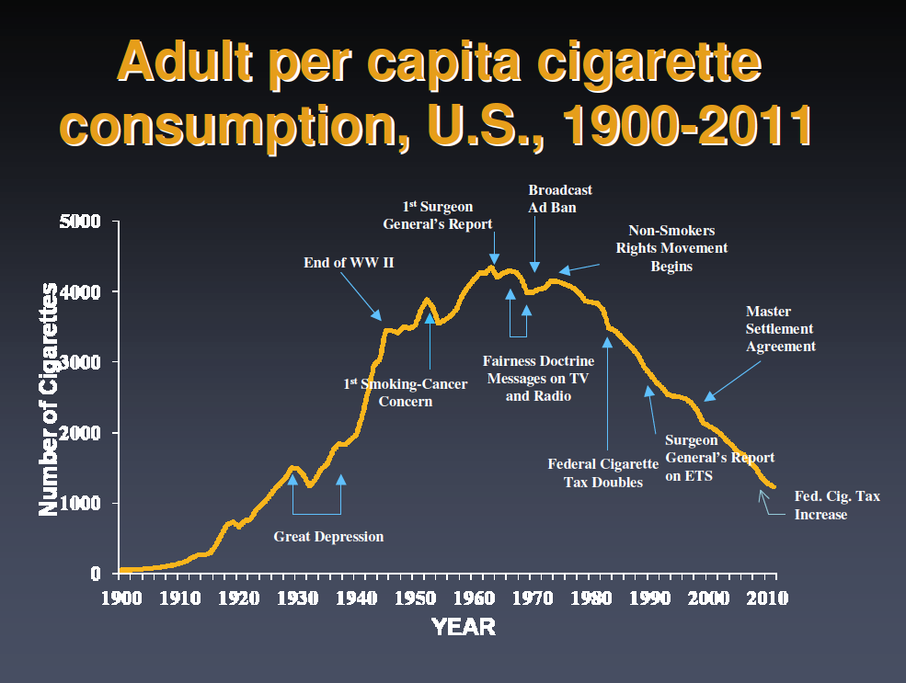
FDA Regulation of
tobacco products
Source: United States Department of Agriculture; Centers for Disease Control and Prevention; Alcohol and Tobacco Tax and Trade Bureau
Notes:
Slide from Caroline Cobb, who got it from David Abrams
Source: United States Department of Agriculture; Centers for Disease Control and Prevention; Alcohol and Tobacco Tax and
Trade Bureau
Advertising contributed to climb in smoking rates.

Slide 14
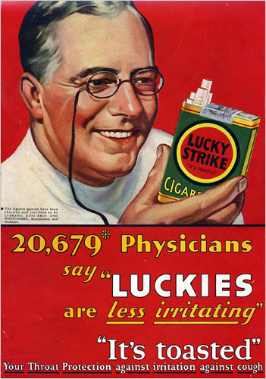
Cigarettes
1930
Notes:
1930.

Slide 15
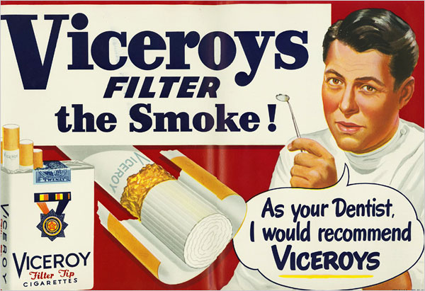
Cigarettes
1949
Notes:
1949.

Slide 16
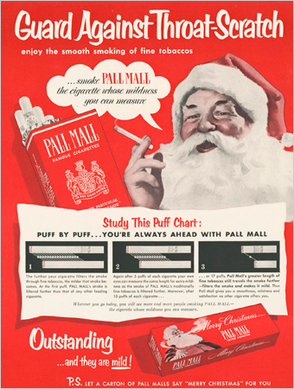
Cigarettes
1951
Notes:
1951.

Slide 17
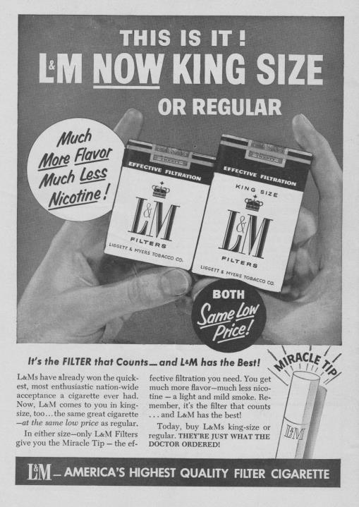
1954

Slide 18
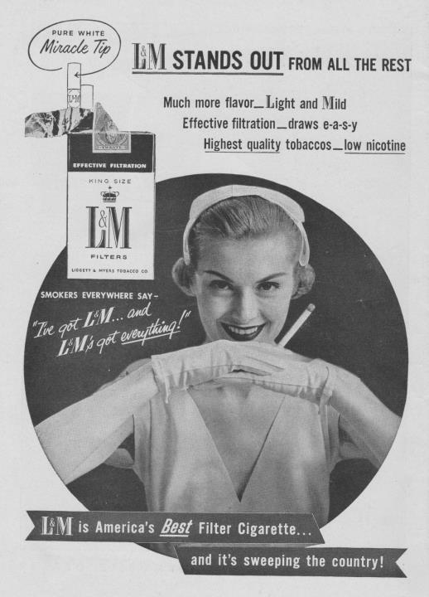
1955

Slide 19
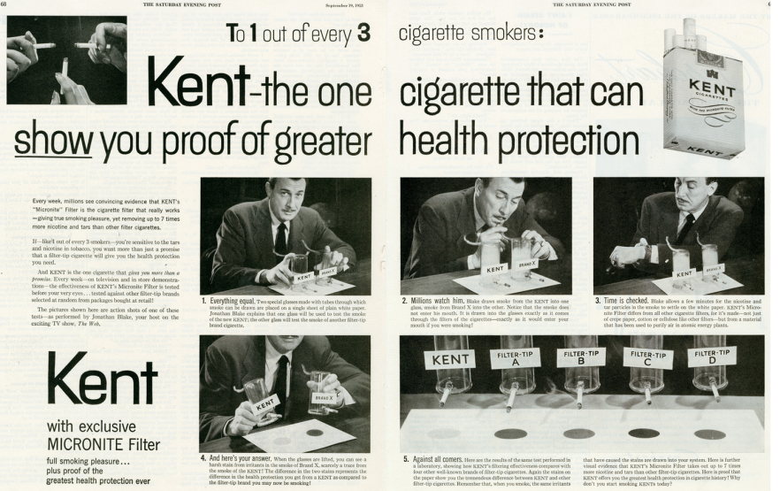
Types of Tobacco Products
Notes:
Filter had asbestos—1955.

Slide 20
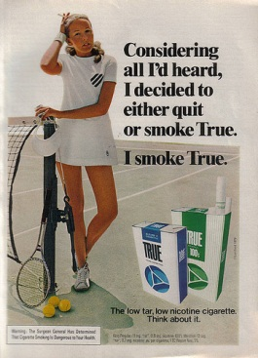
Cigarettes
1976
Notes:
Concern is that people continued to smoke instead of quitting. 1976.

Slide 21
Cigarettes
“Patients who are unable to stop cigarette smoking should be assisted to reduce their smoke exposure by smoking low-tar and low nicotine cigarettes . . .” (Harrison’s Internal Medicine 9th Ed., 1980, p. 941).
Smokers believe “light” and “ultra light” cigarettes decrease health risks of smoking (Kozlowski, Goldberg, et al., 1998; Giovino et al., 1996).
Smokers switch to low yield cigarettes instead of quitting (Giovino et al., 1996).

Slide 22
Cigarettes
Changes increased sales without harm reduction
“The weight of the evidence indicates that lower-tar and nicotine yield cigarettes have not reduced the risk of disease proportional to their FTC yields” (IOM, 2001).
Past modifications did not alter exposure: changing puff topography, covering vent holes
New FDA regulation has eliminated the use of “light,” “low” and “mild”
Notes:
Important to keep in mind what happened in the past, when thinking about new tobacco products emerging on the market.

Slide 23
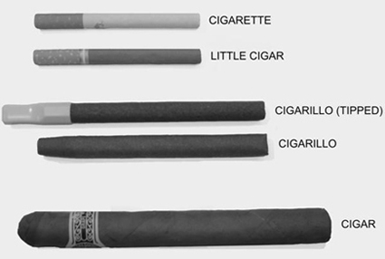
Types of Tobacco Products
Cigars
  5.0% of US adults use (>1 in past 30 days)
  8.2% of high school students
  1.9% of middle school students
http://www.smokefree.gov/tob-cigarillo.aspx
Notes:
http://www.cdc.gov/tobacco/data_statistics/fact_sheets/tobacco_industry/cigars/

Slide 24
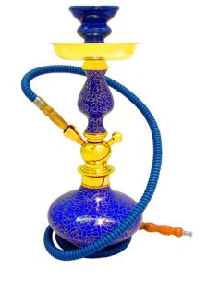
Types of Tobacco Products
Pipes
Waterpipe, or hookah
  Past year use among high school students: 21% (has been increasing)
  Past 30 day use among
  HS students: 5.4%
  CO exposure is much higher than cigarettes (Eissenberg et al., 2011)
  200 puffs/hour vs ~20 puffs for one cigarette (CDC)
Notes:
https://www.cdc.gov/mmwr/preview/mmwrhtml/mm6245a2.htm
https://www.cdc.gov/tobacco/data_statistics/fact_sheets/tobacco_industry/hookahs/index.htm
Kreteks are clove-flavored, bidis = rolled tobacco in a tendu leaf, sometimes flavored
SAMHSA NSDUH (2010 data) is citation for data about cigars (at least 1 in past 30 days)
http://www.cdc.gov/tobacco/data_statistics/fact_sheets/tobacco_industry/hookahs/
MTF: http://www.monitoringthefuture.org/pubs/monographs/mtf-overview2013.pdf
Smoking Tobacco Using a Hookah. The past year
prevalence rate in 2013 was 21.4% for hookah
smoking (up significantly from 17.1% in 2010 and
18.3% in 2012). Only about 14% of the 12th-grade
students in 2013 indicated use on more than two
occasions during the past 12 months, which suggests
that a considerable amount of hookah use is light or
experimental. Both genders use hookahs in about
equal proportions: 22% of males and 21% of females
in 2013.

Slide 25
Types of Tobacco Products
Smokeless tobacco
  “Dip”, “Chew” (e.g., Skoal, Wintergreen)
  Snus (Swedish)
  Marlboro snus, Camel snus
  Camel orbs, sticks, dissolvable strips
  Verve disc
Health effects? In Sweden, low rates of lung cancer, but effects in US not known

Slide 26
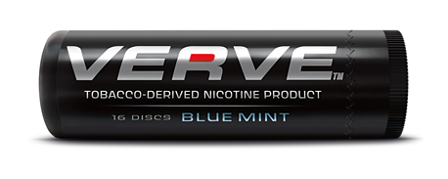
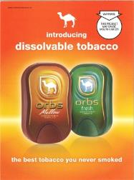

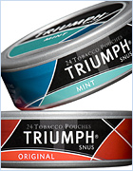
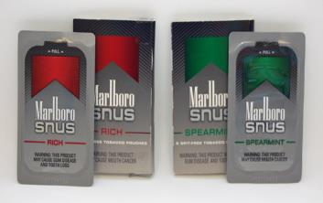
dissolvable tobacco
snus

Slide 27
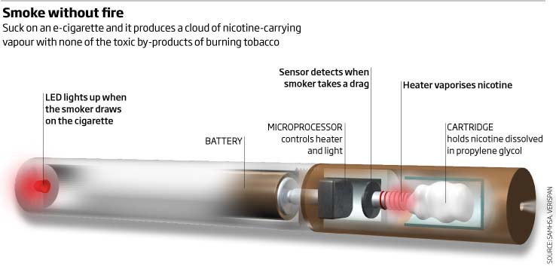
Electronic Cigarettes

Slide 28
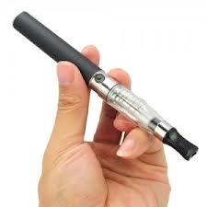
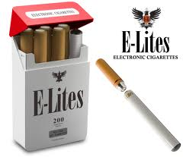

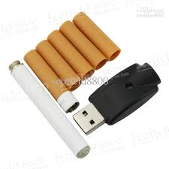
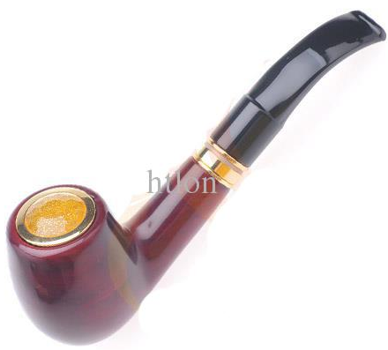
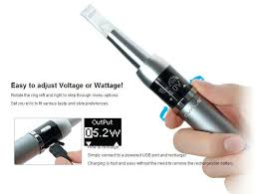
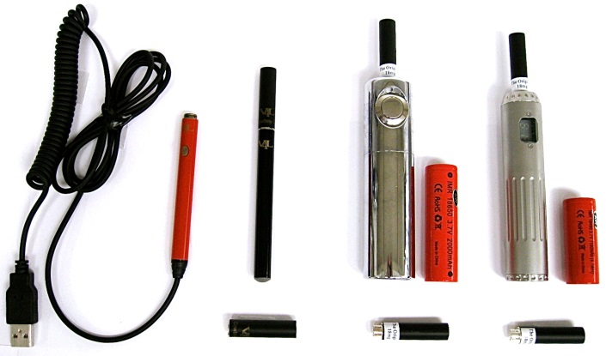
Electronic Cigarettes

Slide 29
From Breland et al., (in press), Annals of the NY Academy of Sciences
Notes:
29

Slide 30
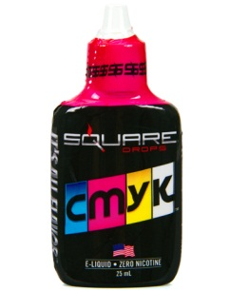
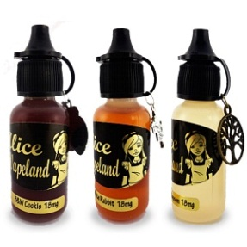
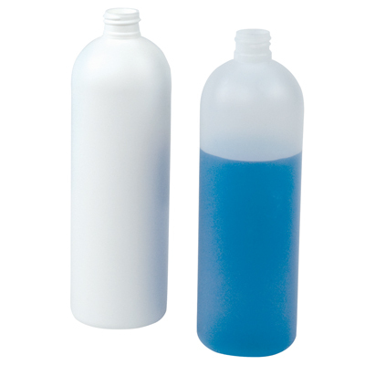
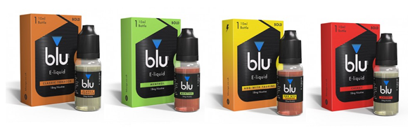
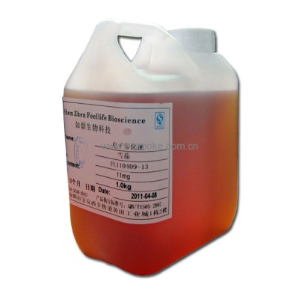

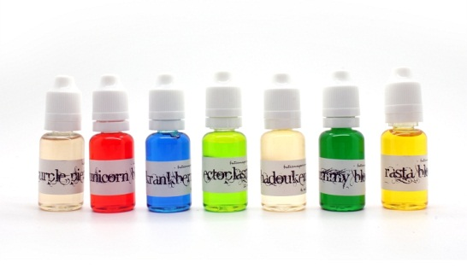
Electronic Cigarettes
E-liquids
Base | Propylene Glycol, Vegetable Glycerin
Flavors | Various tobacco, fruit, and other flavors Other flavors include: chocolate, caramel, amaretto, popcorn, etc.
Nicotine | 0-36 mg/mL +
Other | Water, additives Additives include: sweeteners: stevia, sucralose, ethyl maltol; sour additives: maltic acid, acetic acid, lemon or lime juice; ethyl alcohol; menthol; pyrazines?

Slide 31
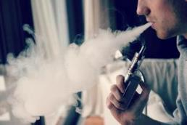
Who uses ECIGs?
Adults
  In 2010, 0.3% of adults used ECIGs (about 727,000 people)
  In 2014, 3.7% of adults used ECIGs (almost 9 million people)
Adolescents
  In 2011, 1.5% of high school students used ECIGs (about 250,000 high school students)
  In 2015, 16% of high school students used ECIGs (about 2.5 million high school students)
More common among current/former cigarette smokers, but some adult and adolescent ECIG users have never smoked cigarettes.

Slide 32
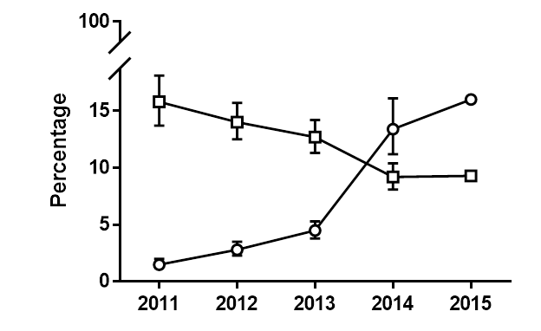
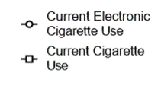
Cigarette and Electronic Cigarette Use among High School Students
Notes:
http://www.washingtonpost.com/news/to-your-health/wp/2015/04/16/high-school-middle-school-kids-now-use-more-e-cigs-than-tobacco-cdc/?tid=HP_more?tid=HP_more
Note decline in cigarette smoking has slowed down/stopped as ECIG use has increased in popularity, and we don’t know what that means yet.

Slide 33
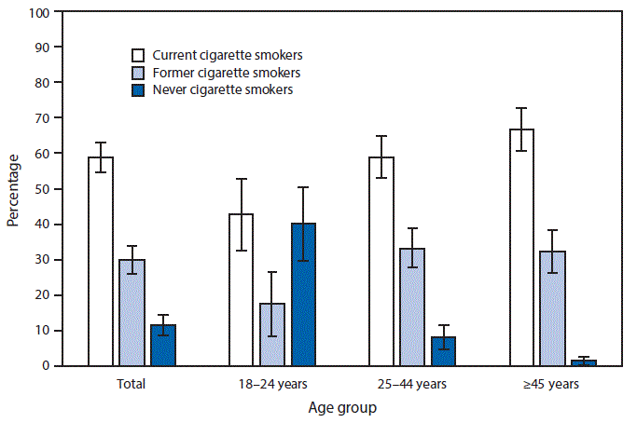
E-cigarettes: rates of use
National Health Interview Survey, 2015, ECIG use = “every day or some days”
Notes:
https://www.cdc.gov/mmwr/volumes/65/wr/mm6542a7.htm?s_cid=mm6542a7_e

Slide 34
E-cigarettes
Health effects of e-cigarettes mostly unknown
  Short term vs long-term
Concerns about:
  Nicotine delivery
  Toxicant delivery
Currently little evidence to show that e-cigarettes are effective quit aids
VCU’s Center for the Study of Tobacco Products currently studying e-cigarettes

Slide 35
E-cigarettes: Promise or Peril?
Promising! “If governments, parliaments, regulation agencies, and experts are able to restrain their yearning to restrict access to e-cigarettes, these products are likely to represent a revolution in public health.” Etter, 2013.
Perilous! “Urged on by myopic health professionals who seem to have lost any population health focus they might have had, this may become one of the biggest blunders of modern public health.” Chapman, 2013.
Middle ground. “… [our responses to ECIGs] will provide the greatest public health benefit when they are proportional, based on evidence, and incorporate a rational appraisal of likely risks and benefits.” Hajek et al., 2014.

Slide 36
Summary
Overall, tobacco use has been going down in the US (by small amounts in recent years)
Use of other products is increasing
Hard to determine long-term impact of new products
Major concern—Will people switch to new “safer” products rather than quit? Or become dual users?
How will youth be affected?
Notes:
Virginia students reported a modest increase from 2003 to 2005 to 2007 in the rate currently using
smokeless or chewing tobacco (from 3% to 5% to 6%). In 2009 the rate dropped slightly to the 2005 rate of
5%. The rate of students who reported that they currently use cigars or cigarillos rose slightly from 7% in 2007
to 9% in 2009. In 2009, 13% of all students reported that they were currently smoking Black and Milds brand
cigarillos. Current use of bidis dropped slightly from 4% in 2007 to 3% in 2009. Three percent (3%) of
students reported that they currently smoked tobacco in a pipe in 2009, down very slightly from 4% in 2007. In
2007 students were asked about their current use of a water pipe, while in 2009 wording was changed to
hookah. The rate reporting current use of a water pipe in 2007 was 5%, while 7% reported that they had used a
hookah in the past 30 days on the 2009 survey. Finally, 5% of students reported that they had used SNUS in
the past 30 days (Figure 9).

Slide 37
Smoking cessation
~70% of smokers say they want to quit
45% make quit attempts
Relapse rates are high
Tobacco produces dependence: very difficult to quit
Tobacco is as addictive as heroin or cocaine
Notes:
CDC, 2002 National Health Interview Survey (70% figure)
CDC, 2009 National Health Interview Survey (45% figure)

Slide 38

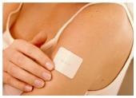
Smoking cessation
Medications to quit can increase likelihood of success
  Nicotine replacement therapy (nicotine patch, gum, inhaler, lozenge, nasal spray)
  Non-nicotine medications:
    buproprion (Zyban/Wellbutrin)
    varenicline (Chantix)
1-800 QUIT-NOW (counseling)
Websites
Emerging trend: technology
Notes:
People twice as likely to quit successfully if they use NRT

Slide 39
Estimated abstinence rates—
Behavioral therapies
Treatment | Abstinence rate (%)
No counseling/behavioral therapy | 11.2
Relaxation/breathing | 10.8
Cigarette fading | 11.8
Social support | 14.4-16.2
Practical counseling | 16.2
Source: Treating Tobacco Use and Dependence: 2008 Update (Clinical Practice Guideline, Fiore et al., 2008)
Notes:
The column labeled “Estimated abstinence rate” shows the abstinence
percentages for the two treatment conditions. For instance, the reference
condition (minimal or no counseling) in the analyzed data set was associated
with an abstinence rate of 10.5 percent. Consistent with the odds ratio
data reviewed above, proactive telephone counseling produced modest
increases in abstinence rates (15.5%).
Is ~ abstinence at 6 months, but not every study was exactly 6 months.
Practical counseling = problem solving/skill building
More counseling (in minutes) = better!

Slide 40
Estimated abstinence rates—
Medications
Treatment | Abstinence rate (%)
Placebo | 13.8
Chantix | 33.2
High dose nicotine patch (more than 25 mg) | 26.5
Wellbutrin (Zyban, bupropion) | 24.2
Nicotine patch 6-14 weeks | 23.4
Nicotine gum | 19.0
Long term patch + ad lib gum or spray | 36.5
Patch + Wellbutrin | 28.9
Patch + antidepressants (Paxil, Effexor) | 24.3
Notes:
People twice as likely to quit successfully if they use NRT
Counseling + medication = best; more than 8 sessions of counseling + medication = 33% abstinent
Long term = more than 14 weeks

Slide 41
Questions?

Slide 42
Prevention
Notes:
Much of the focus is on adolescents
NSDUH (2012) – 88% of adult daily smokers started by the age of 18

Slide 43
Risk and Protective Factors
Effective prevention programs are based on reducing risk factors and/or enhancing protective factors
Related to age, gender, race, and environment
  A need for preventive interventions tailored to specific populations and settings
Most risk and protective factors related to a broad array of youth problems, but some are unique
Additive effect—goal is to affect the balance of risk and protective factors
Notes:
43
Age: younger children more influenced by family/parents and older more influenced by peers
RACE: same factors, but different weight. Conflicting findings thus far (one study (Corona et al.) found family and community not related for AA youth when controlling for other variables, yet others have found that family is most important)

Slide 44
Risk and Protective Factors Domains
Individual
Family
Peer
School
Community
Notes:
44
May vary by race and ethnicity, age, etc.

Slide 45
Risk and Protective Factors
Individual Risk Factors
  Psychiatric disorders
  Novelty/sensation seeking
  Positive attitudes towards substance use
  High antisocial behavior
Individual Protective Factors
  Ambitious life goals
  High religiosity

Slide 46
Risk and Protective Factors
Family Risk Factors
  Family conflict
  Family history of antisocial behavior
  Family attitudes favorable to substance use
Family Protective Factors
  Parental nonsmoking
  Parental advice not to smoke
  Parental monitoring
  Strong family bonds
Notes:
Parental Advice—very important
Parental monitoring
Do you know where your child is and who he is with

Slide 47
Risk and Protective Factors
Peer Risk Factors
  Peer tobacco use
Community risk factors
  Exposure to tobacco advertising
  Perceived availability of tobacco
School Risk Factors
  Low school connectedness
  Low academic achievement
  School misbehavior

Slide 48
Types of Prevention Strategies
School-based programs
Family-based programs
Media campaigns
Reducing youth access
Excise Taxes
Notes:
Community-based programs
Evidence of Effectiveness from several countries
Restrictions on advertising
Clean indoor air laws

Slide 49
School-Based Prevention Programs
Schools are most common setting for tobacco use prevention programs
  Provide relatively easy access to youth
  Can address other concerns of interest to schools
  Can be integrated into school curriculum
Notes:
Thomas RE, McLellan J, Perera R.
School-based programmes for preventing smoking.
Cochrane Database of Systematic Reviews 2013, Issue 4. Art. No.: CD001293.
DOI: 10.1002/14651858.CD001293.pub3.

Slide 50
School-Based Prevention—What Works?
Systematic Review Thomas et al., 2013 (Cochrane Collaboration)
  Social competence (e.g., problem solving, decision making, self-control, self-esteem)
  Social competence plus social influence (resistance skills)
  Booster sessions
  Information only (normative education) is not effective
Notes:
Thomas RE, McLellan J, Perera R.
School-based programmes for preventing smoking.
Cochrane Database of Systematic Reviews 2013, Issue 4. Art. No.: CD001293.
DOI: 10.1002/14651858.CD001293.pub3.
Based on 49 RCTs, pure prevention cohorts (youth who had never smoked) showed a significant effect at longest follow-up, with an average 12% reduction in starting smoking compared to the control groups. However, no overall effect was detected at one year or less. The combined social competence and social influences interventions showed a significant effect at one year and at longest follow-up. Studies that deployed a social influences programme showed no overall effect at any time point; multimodal interventions and those with an information-only approach were similarly ineffective.
Think of a flu vaccine
Wears off
Exposed to new risk factors
Other reviews have found the following to be effective:
norms education
media literacy
academic competency skills

Slide 51
School-Based Prevention—What Works?
Other reviews have found these to be effective:
  Academic Competence
  Normative Education
  Media Literacy

Slide 52
Life Skills Training
Gilbert Botvin and colleagues, Cornell University
Separate programs specifically tailored to elementary, middle and high school youth.
Focus on:
  Drug resistance skills and information
  Self-management skills
  General social skills
Interactive program using facilitated discussion, role playing, and small group activities
Notes:
52
Information:
Smoking myths and realities
Self-Management
Decision making
Media influences/cigarette advertising
Coping with anxiety
Coping with anger
Resolving conflict
Social Skills
giving and receiving compliments
Overcoming shyness
Assertiveness
Communication skills
Personal Self-Management Skills
Students develop strategies for making healthy decisions, reducing stress, and managing anger, increasing self-esteem.
General Social Skills
Students strengthen their communication skills and learn how to build healthy relationships.
Drug Resistance Skills
Students understand the consequences of substance use, risk-taking, and the influences of the media.

Slide 53
Adjusted Substance Use Means at One-Year Follow-up
 | LST |  | Control Group
 | Mean | SE | Mean | SE | X² | df | P
Smoking | 1.79 | .08 | 2.13 | .09 | 6.4 | 1 | .006
Drinking | 1.82 | .08 | 2.11 | .08 | 5.8 | 1 | .008
Marijuana | 1.69 | .10 | 1.87 | .11 | 1.3 | 1 | .126
N= 802 Griffin et al., 2003
Notes:
Smoking scale combined frequency and quantity
Significant differences found even at 6 years followup

Slide 54
Family-Based Prevention Programs
Parents are a major influence on youth behavior, especially on children
Most common approaches focus on enhancing parenting skills
  Age appropriate expectations
  Consistent and appropriate discipline
  Monitoring of child activities/friends
Notes:
Parental monitoring = knowing where they are and who they are with

Slide 55
Family-Based Prevention—What Works?
Systematic Review Thomas et al., 2015 (Cochrane Collaboration)
  Reduce the number of adolescents who tried smoking by between 16 and 32%
  Typically address family functioning--encouraging authoritative parenting (showing strong interest in and care for the adolescent, often with rule setting).
  Evidence is strongest for high intensity programs
Notes:
Nine trials provided data to compare a family tobacco intervention to no intervention on future smoking behaviour for those who did not smoke at the start of the study. The results showed a significant benefit of family-based interventions over the control comparison on preventing experimentation with or taking up regular smoking. Our estimate suggested that family interventions could reduce the number of adolescents who tried smoking at all by between 16 and 32%.
Two trials provided data to compare a combined family plus school intervention to a school intervention and also favoured the family-based intervention. The estimate suggested that the addition of a family intervention might reduce the onset of smoking by between 4 and 25%. We could not include data from a further five trials.
Our interpretation is that the common feature of the effective interventions was encouraging authoritative parenting (which is usually defined as showing strong interest in and care for the adolescent, often with rule setting). This is different from authoritarian parenting (do as I say) or neglectful or unsupervised parenting.
There is moderate quality evidence to suggest that family-based interventions can have a positive effect on preventing children and adolescents from starting to smoke. There were more studies of high intensity programmes compared to a control group receiving no intervention, than there were for other compairsons. The evidence is therefore strongest for high intensity programmes used independently of school interventions. Programmes typically addressed family functioning, and were introduced when children were between 11 and 14 years old. Based on this moderate quality evidence a family intervention might reduce uptake or experimentation with smoking by between 16 and 32%. However, these findings should be interpreted cautiously because effect estimates could not include data from all studies. Our interpretation is that the common feature of the effective high intensity interventions was encouraging authoritative parenting (which is usually defined as showing strong interest in and care for the adolescent, often with rule setting). This is different from authoritarian parenting (do as I say) or neglectful or unsupervised parenting.

Slide 56
Family-Based Prevention—What Works?
Other reviews have shown:
  Strengthen family bonding and positive relationships
  Improve parenting skills
  Helping families to develop and enforce rules about substance use
  Providing parents information about drugs and their effects on development

Slide 57
Strengthening Families Program
Richard Spoth and colleagues, Iowa State University
Target Population: Youth 10 to 14 years old (also available for younger children)
Seven sessions
Parents and youth meet separately for first hour and then together for second hour
Parent sessions
  Skills-building focused on establishing rules, limits, and consequences while expressing love; communication with youth; handling stress; using community resources
  Uses videos demonstrating parenting skills, with role playing, discussion and skill building activities
Notes:
57
A major revision of the SFP developed by Karol Kumpfer et al. at University of Utah

Slide 58
SFP (cont’d)
Youth sessions
  Youth skill-building focuses on following rules, peer pressure resistance, handling stress, and problem-solving
  Group discussions, group skill practice, and social bonding activities
Family sessions
  Games and projects to increase family bonding, build positive communication skills, plan family activities, and facilitate learning to solve problems together
Booster program 3 to 12 months after completing initial program—Four sessions

Slide 59
Intervention–Control Differences in Time to Initiation Rates: 6 Year Follow-up
Spoth et al., 2004
Outcome | Initiation Proportion | Estimated time in months from pretest
 |  | SFP | Control | Difference
Lifetime alcohol use .40 |  | 38.2 | 25.3 | 12.9
Lifetime alcohol use without parental permission .40 |  | 46.8 | 34.4 | 12.4*
Lifetime drunkenness .35 |  | 58.6 | 45.3 | 13.3*
Lifetime cigarette use .30 |  | 54.9 | 30.8 | 24.1*
Lifetime marijuana use .10 |  | 63.7 | 48.6 | 15.1
Notes:
59
Pretest at 6th grade and post test at 12th grade
Shows program delayed use by over 2 years when compared to the control group

Slide 60
Mass Media Interventions
Systematic review by Brinn et al., 2010 (Cochrane Collaboration)
  There is some evidence that mass media can prevent the uptake of smoking in young people, however the evidence is not strong and contains a number of methodological flaws.
  Effective media campaigns:
    Based on good market research
    Identify and tailor message to specific groups (market segmentation)
    Last longer and more intensive
    Use multiple media (TV, radio, newspapers)
Notes:
Virginia Example:
Preppy
Hip Hop
Hipsters (music and art)

Slide 61





Virginia “Y Campaign”
Notes:
Available on You Tube
Promote cultural change within the “peer crowd” of every Virginia teen to ensure that living tobacco-free is perceived as a socially desirable and celebrated lifestyle choice, no matter which peer crowd a youth identifies with. - See more at: http://http://www.vfhy.org/tobacco/marketing-campaigns/advertising
The only way to eliminate a young person’s desire to use tobacco is to make it uncool. But that’s easier said than done. Changing cultural norms among young people requires penetrating their peer crowd in an authentic manner. To do this, VFHY first has to identify and understand the most common peer crowds in Virginia and determine which of these niche youth cultures are most likely to use tobacco products.
Peer Crowd:
Groups of youth who share a combination of fashion, music, language, culture, mannerisms, media consumption habits and other behaviors to define their social identity and differentiate themselves from other groups of youth.
With the help of its contractors Rescue Social Change Group and Market Decisions Health Care Research, VFHY has collected ongoing data on the most common peer crowds in Virginia. Five peer crowds are present in nearly every high school and each has a different tobacco use rate.
See more at: http://www.vfhy.org/tobacco/marketing-campaigns/culture-change#sthash.NY75DXj6.dpuf
Changing the norms within each of these peer crowds requires strategies that are tailored to the unique images, language and media that define their culture. Using Rescue Social Change Group’s Social Branding model, VFHY reaches these high-risk teens in their own social venues to associate being tobacco-free with the situations where tobacco use is most likely to occur. In addition, Social Branding campaigns recruit influencers from each peer crowd and train them on tobacco control facts and messages, creating change agents within each high-risk culture. VFHY has begun this strategy with the Alternative peer crowd, which has the highest chew tobacco rate, and the Hip Hop peer crowd, which has the highest smoking rate. SYKE and 2UP2DOWN target the Alternative and Hip Hop peer crowds, respectively, by hosting youth events, conducting social media campaigns, sending direct mail and training influencers. Collectively, these strategies strive to create change from within each peer crowd, reducing the pressure for current and future teens within that peer crowd to use tobacco products. - See more at: http://www.vfhy.org/tobacco/marketing-campaigns/culture-change#sthash.NY75DXj6.dpuf
Preppy
Mainstream
Alternative
Hip Hop
- Country

Slide 62
Reducing Youth Access
Primary focus on preventing illegal sales to minors
  Retailer education
  Active enforcement
Systematic review by Stead, 2008 (Cochrane Collaboration)
  Active enforcement more effective in reducing sales to minors
  Little evidence of impact on perceived availability of tobacco products or on prevalence of youth smoking (only three controlled trials)

Slide 63
Reducing Youth Access—Synar Amendment
Enacted in 1992
Required States to enact and enforce laws prohibiting the sale or distribution of tobacco products to those under 18 years old
  Required random, unannounced inspections of retail outlets and reporting of results
  “False buys”
  Established targets for “violation rates”
  Failure to meet targets could result in loss of funds—up to 40% of SAPT Block Grant
Notes:
Requires use of a valid sampling frame
Ensure sampling population includes 80% of all outlets
Sample size ensures at least 95% confidence interval
90% completion rate or better
Targeted compliance rates increased each year—Now 20% for all states (as of 2003)
Have not traditionally pulled back funds—usually require state to use own funds to increase compliance

Slide 64
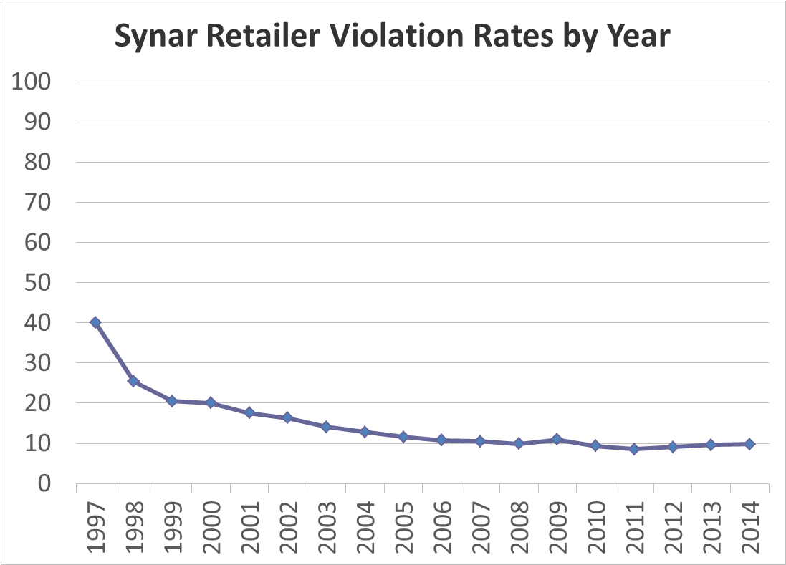
Notes:
1997 = 40.1%
2011 = 8.5%
2012 = 9.1%
2013 = 9.6% --
2014 = 9.8% -- uptick in violations over past 3 years
Reasons Why:
1. Budget cuts resulting in less enforcement
2. States have expanded types of tobacco products included (e.g. smokeless) and retailers are more likely to sell non-cigarette products to youth
3. In 2013 Dept. of Labor ruled that employing 15 year olds violated the Fair Labor Standards Act and retailers are more likely to sell to older youth
In 2014, Range from 0% in Nevada to 24.1% in Oregon. Va = 9.7%
Results:
Decline in youth reporting retail outlets as primary source of tobacco products (38.7% in 1995 to 18.1% in 2013)
No strong evidence for decreasing use, but some evidence that it reduces use if below 10% RVR

Slide 65
State Tobacco Excise Taxes
Create a financial disincentive to use tobacco
Based on known relationship between price and sales
  Elasticity of demand (E_{d} ) is percentage change in sales as a result of percentage change in price
Generally, youth are more price sensitive
  Less disposable income
  Less addicted
Notes:
Hypothesized to prevent people from starting and to reduce amount of smoking
Lance et al. (2000). Investing in youth tobacco control: a review of smoking prevention and control strategies. Tobacco Control.
IDAS (2008). Health impact of tobacco price changes in Virginia.
Adults Ed = -.40 to -.70 (IARC, 2011)
Less research on youth
Illegal product for youth
Youth Ed = -.9 to -1.5
10% increase in tobacco prices will reduce consumption by 4% by adults
Relationship between price and sales (demand) complicated by role of addiction
African and Hispanic youth more price sensitive
When excise taxes go up, tobacco companies reduce price
International Agency for Research on Cancer, 2011. http://www.iarc.fr/en/publications/pdfs-online/prev/handbook14/index.php. Cited at: CDC. http://www.cdc.gov/mmwr/preview/mmwrhtml/mm6313a1.htm?s_cid=mm6313a1_e

Slide 66
Excise Taxes (cont’d)
“Policies that affect the price of tobacco products are the single most effective means of decreasing tobacco use, especially among youth and young adults.” (CDC, 1998)
Tobacco companies often respond by decreasing wholesale price

Slide 67
Notes:
The highest combined state-local tax rate is $6.16 in Chicago, IL, with New York City second at $5.85 per pack.
Federal tax is $1.01/pack
Impact of differential taxes on smuggling
Campaign for Tobacco-Free Kids, January 31, 2017-----Figures are effective for April 1, 2017

Slide 68
Family Smoking Prevention and Tobacco Control Act
Notes:
Enacted June 22, 2009
Gave regulatory authority over tobacco products to the Food and Drug Administration
Center for Tobacco Products

Slide 69
Regulatory Authority
Oversight over the Manufacture, Distribution and Marketing of Tobacco Products by the FDA
  Combustible cigarettes
  Cigarette tobacco
  Roll-your-own tobacco
  Smokeless tobacco

Slide 70
Major Goals of the FSPTCA
Prevent youth from starting to use tobacco
Help consumers better understand the risks
Prohibit false and misleading product claims
Prevent new tobacco products unless a manufacturer demonstrates that the products meet the relevant public health standard

Slide 71
FSPTCA: Key Requirements
Restricts cigarettes and smokeless tobacco retail sales to youth
  Require proof of age to purchase tobacco products
  Require face-to-face sales, with some exemptions for vending machines and self-service displays in adult-only facilities
  Ban the sale of packages of fewer than 20 cigarettes

Slide 72
FSPTCA: Key Requirements
Restricts tobacco product advertising and marketing to youth
  Limit color and design of packaging and advertisements, including audio-visual advertisements (pending litigation)
  Ban tobacco product sponsorship of sporting or entertainment events under the brand name of cigarettes or smokeless tobacco
  Ban free samples of cigarettes and brand-name non-tobacco promotional items

Slide 73
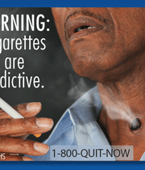
FSPTCA: Key Requirements
Prohibits “reduced harm” claims including “light,” “low,” or “mild,” without an FDA order to allow marketing
Requires bigger, more prominent warning labels for cigarettes and smokeless tobacco products
  However…
Notes:
June 22, 2011 FDA proposed graphic warning labels
Following the issuance of these warnings, tobacco companies filed two lawsuits challenging them, leading to two federal appellate court
rulings. On August 24, 2012, The U.S. Court of Appeals for the D.C. Circuit struck down the specific warnings proposed by the
FDA. However, the U.S. Court of Appeals for the Sixth Circuit upheld the law’s underlying requirement for
graphic warnings, finding that the warnings "are reasonably related to the government's interest in
preventing consumer deception and are therefore constitutional."
The U.S. Supreme Court declined to hear a tobacco industry appeal of the Sixth Circuit ruling, preserving the FDA's authority to develop new
graphic warnings.
The FDA stated in March 2013 that it would begin developing new warnings, but over 3.5 years later it
has yet to act.

Slide 74
FSPTCA: Key Requirements
Tobacco industry must disclose research on the health, toxicological, behavioral, or physiologic effects of tobacco use
Tobacco industry must disclose information on ingredients and constituents and must notify FDA of any changes

Slide 75
Limits on FDA Authority
FDA cannot:
  Ban certain specified classes of tobacco products
  Require the reduction of nicotine yields to zero
  Require prescriptions to purchase tobacco products
  Ban face-to-face tobacco sales in any particular category of retail outlet

Slide 76
Deeming Rule
Tobacco Products Not Covered by 2009 Act
  Electronic Nicotine Delivery Systems (e.g., E-Cigs)
  Cigars
  Pipe and waterpipe tobacco
  Gels
  Disolvables
May 5, 2016 the FDA issued regulations for these products using their “deeming” authority—Effective Aug. 8, 2016
Notes:
Does not include treatments, e.g., NRTs
FSPTCA gave the FDA power to regulate additional tobacco products through “deeming” them through rulemaking.
Extends existing requirements, most importantly, restricts sales of E-Cigs to those 18 and older and review of ingredients
New requirements:
1. It requires health warnings on roll-your-own tobacco, cigarette tobacco, and certain newly regulated tobacco products
2. Bans free samples for all products (not just cigarettes).
3. Manufacturers of newly regulated tobacco products that were not on the market as of February 15, 2007, will have to show that products meet the applicable public health standard set by the law. And those manufacturers will have to receive marketing authorization from the FDA.
Many lawsuits:
Especially E-cigs and premium cigar industry
1. Concerns about bans on free samples (free speech)
2. Claim that E-cigs are not a tobacco product because they do not contain tobacco (FDA confirmed that e-liquids made from synthetic nicotine are not covered)
3. ENDS should be treated differently than combustible cigs because they are safer—violates enforcement authority
4. No rationale for including ENDS apparatus (batteries, tanks, etc.)

Slide 77
Tobacco Centers of
Regulatory Science
Research centers funded by the FDA to “provide the scientific evidence needed to better inform FDA’s regulatory authorities”
The FDA has funded 14 centers, including VCU

Slide 78
Center for the Study of
Tobacco Products at VCU
$18.1 million
Thomas Eissenberg, Director
Develop and test a model for evaluating modified risk tobacco products (MRTPs)
  Using e-cigarettes as the exemplar, but which can be applied to many other forms of MRTPs
Notes:
14 Centers
In many ways, it reflects the goals of the VYTP/VFHY (i.e., multi-disciplinary and multi-university collaborations)

Slide 79
Major Research Questions
Are e-cigarettes truly safer?
  Toxicant exposure
  Abuse liability
  Short- and long-term health effects
Why do people use e-cigarettes and what are the perceived effects?
Notes:
Major debate surrounding modified risk tobacco products and a key regulatory issue – note issue related to ECIGS and Swedish Snus

Slide 80
Regulation of Electronic Cigarettes—A Raging Debate
Anti Strict Regulation (harm reduction)
  Less harmful alternative to combustible cigs
  Will facilitate smoking cessation
    Will save many lives
    Technology will improve along with effectiveness—don’t stifle innovation
Pro Strict Regulation (abstinence)
  Long-term health effects are unknown
  Negative effects of nicotine on adolescent brain
  Big increase in adolescent use
  Not strong evidence of effectiveness for cessation
Notes:
Highly controversial
Harm reduction vs. Prevention/abstinence
Also pits youth advocates against those who perceive current danger for adults
“Thread moving needle”
Can we promote as a smoking cessation devise for adults while preventing adolescent use
“The FDA believes that this new technology has both potential benefits and risks. If certain products, such as e-cigarettes, have reduced toxicity compared to conventional cigarettes; encourage current smokers to switch completely; and/or are not widely used by youth, they may have the potential to reduce disease and death. But if any product prompts young people to become addicted to nicotine, reduces a person’s interest in quitting cigarettes, and/or leads to long-term usage with other tobacco products, the public health impact could be negative.”

Slide 81
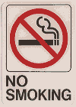
Thank you
And, thank you for not smoking!

