Slide 1
The Epidemiology of Arthritis
EPID 624- Epidemiology of Chronic Disease

Slide 2
Overview
General Information
  History
  Definition
  Epidemiology
    Age
    Race
    Sex
    Income
    Education
    Cost
Pathophysiologies of Specific Arthritides
  Osteoarthritis
  Post-Traumatic Arthritis
  Rheumatoid Arthritis
  Gout
  Osteoporosis
  Juvenile Idiopathic Arthritis
Intervention and Research
  Primary, Secondary, and Tertiary
  Current Research
  Future Areas of Research

Slide 3
Part I: General Information

Slide 4
History
Referenced in texts as far back as 4500 BC
Native American skeletal remains from 5000 to 500 BC were examined and found to have evidence of RA
William Musgrave complied De Arthritide Symptomatica, which first described the symptoms of RA
Dr. Alfred Baring Garrod coined the phase “Rheumatoid Arthritis” in 1859
http://www.dailyrepublic.com/news/locallifestylecolumns/rheumatoid-arthritis-more-than-a-joint-disease/
http://www.news-medical.net/health/Arthritis-History.aspx

Slide 5
Definition: Arthritis
“While the word arthritis is used by clinicians to specifically mean inflammation of the joints, it is used in public health to refer more generally to more than 100 rheumatic diseases and conditions that affect joints, the tissues that surround the joint, and other connective tissue. The pattern, severity, and location of symptoms can vary depending on the type of disease. Typically, rheumatic conditions are characterized by pain and stiffness in or around one or more joints. The symptoms can develop gradually or suddenly. Certain rheumatic conditions can also involve the immune system and other internal organs of the body.”
-CDC, 2015

Slide 6
Activity Limitation
“There is no single definition for "disability," and many programs and surveys use different definitions based on program needs and available data. Also, the same underlying cause of a disability can affect different people in different ways. It is important to remember that all people can be healthy and live well with or without a disability.”
-CDC, 2016
Arthritis-Attributed Limitations
  Work
  Activity
  Social Participation

Slide 7
Prevalence
21.6% of U.S population (46.4 million people) in 2003
  22.7% of U.S. population (52.5 million people) in 2010
  Projected to be 25% of U.S. (67 million) by 2030
8.8% of U.S. population reported to have both arthritis and “arthritis-attributed activity limitation” in 2003
  9.8% (22.7 million people) of U.S. population now report to be activity limited due to arthritis
  37% of those with arthritis in 2030 will report of having their activity limited due to the disease
Chronic Epidemiology Disease and Control (2010)
http://www.cdc.gov/arthritis/data_statistics/index.htm

Slide 8
Mortality
Rose from 5,537 in 1979 to 9,367 in 1998
Death rate increased from 2.75 per 100,000 in 1979 to 3.51 per 100,000 in 1998
80% of deaths from Arthritis were due to:
  Diffuse connective tissue diseases (34%)
  Other specified rheumatic conditions (23%)
  Rheumatoid Arthritis (22%)
http://www.cdc.gov/arthritis/data_statistics/arthritis-related-stats.htm

Slide 9
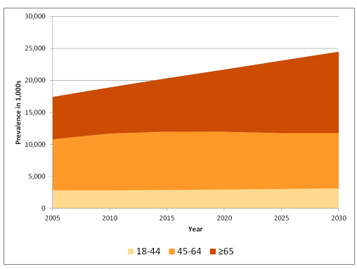
http://www.cdc.gov/arthritis/data_statistics/disabilities-limitations.htm
Prevalence in Arthritis, (NHIS 2005-2030)

Slide 10
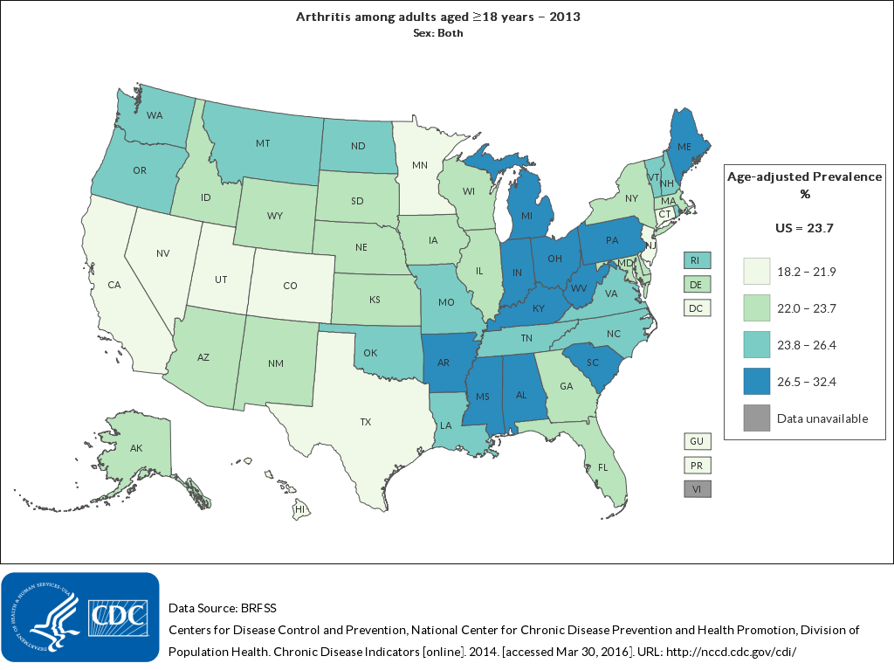
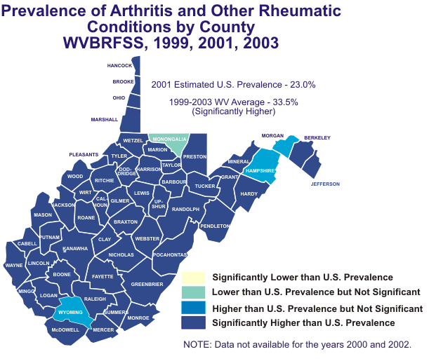
http://nccd.cdc.gov/CDI/rdPage.aspx?rdReport=DPH_CDI.IndicatorMap&islCategory=ART&islIndicator=ART1_1&rdShowModes=ShowBody%2CScreen&go=GO
Prevalence by State, BRFSS 2013
Prevalence by County in West Virginia, WVBRFSS 1999-2003
http://www.wvdhhr.org/bph/hsc/pubs/briefs/014/default.htm

Slide 11
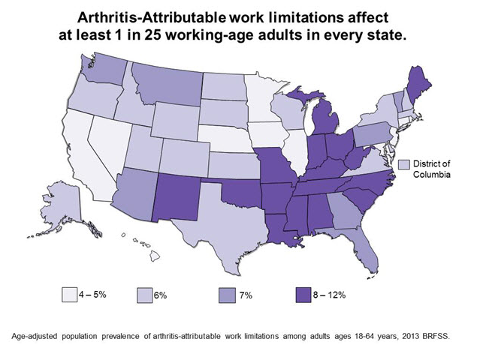
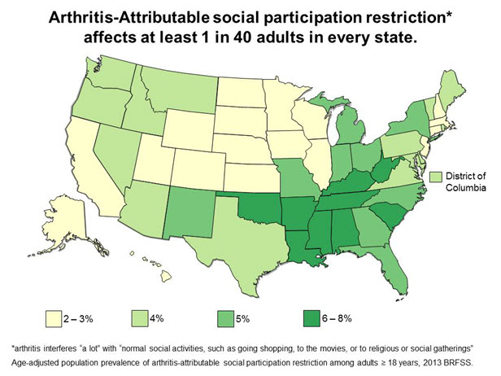
http://www.cdc.gov/arthritis/data_statistics/disabilities-limitations.htm
Work Limitations due to Arthritis, Adults 18-64, BRFSS 2013
Social Participation Restriction, BRFSS 2013

Slide 12
High Risk Groups
Elderly
Racial and Ethnic Minorities
Females
High Risk Occupations
  Construction Workers
  Professional Athletes
  Textile Workers
  Teachers
  Dancers
Chronic Disease Epidemiology and Control (2010)
http://www.everydayhealth.com/arthritis-pictures/9-worst-jobs-for-your-joints.aspx#08

Slide 13
Age
Risk of developing arthritis increases with age
50% of those 65 and older said that had doctor-diagnosed arthritis
(NHIS 2003-2005)
Chronic Disease Epidemiology and Control (2010)

Slide 14
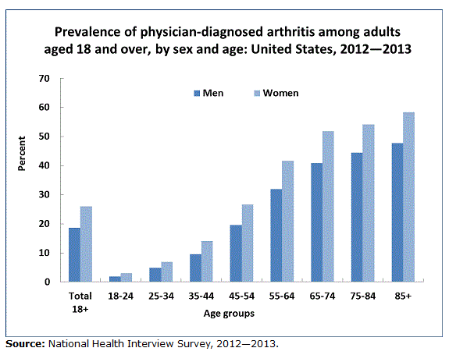
http://www.cdc.gov/nchs/data/factsheets/factsheet_arthritis.html
Prevalence by Age, NHIS 2012-2013

Slide 15
Race
Whites are the least likely to have limitations due to Arthritis
Non-Hispanic Blacks and Hispanics are the most likely to be affected
Hispanic Subgroups
  People from the Cuban subgroup were the most likely to say that their activity was limited by arthritis, but the least likely to say their work was limited
  Mexicans and Puerto Ricans were the most affected by both
http://www.cdc.gov/arthritis/data_statistics/disabilities-limitations.htm

Slide 16
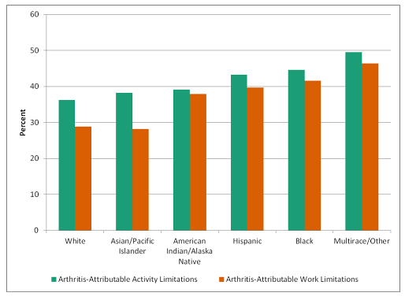
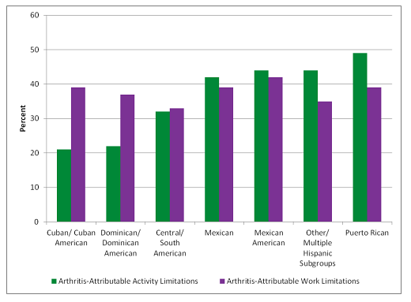
http://www.cdc.gov/arthritis/data_statistics/disabilities-limitations.htm
Activity Limitations due to Arthritis by Race (NHIS, 2002-2006)
Activity Limitations due to Arthritis by Hispanic Subgroup (NHIS, 2002-2006)

Slide 17
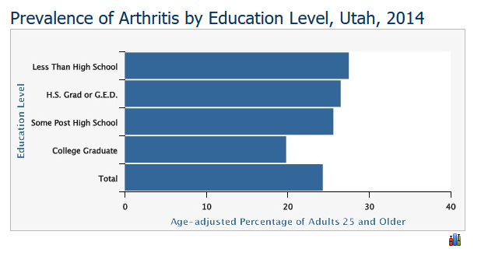
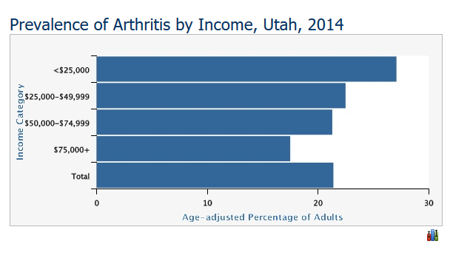
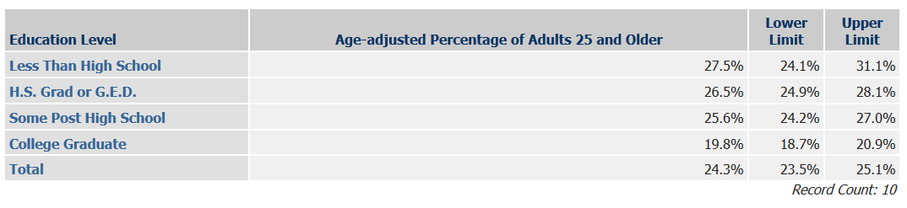
Prevalence by Education and Income in Utah, BRFSS, 2014
https://ibis.health.utah.gov/indicator/complete_profile/ArthPrev.html

Slide 18
Causes
Obesity
Injury and Trauma
Repetitive joint use
Physical inactivity
Genetics
Chronic Disease Epidemiology and Control (2010)

Slide 19
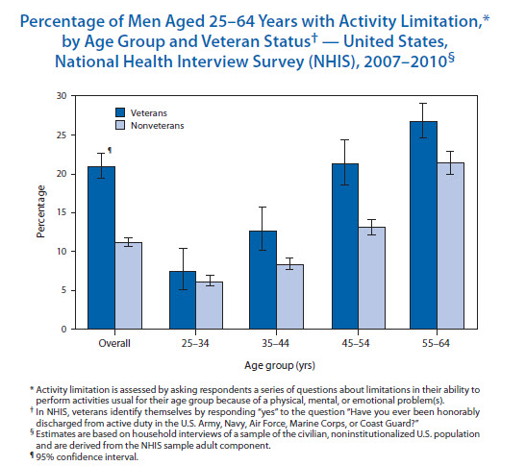
Percentage of Men with Activity Limitation, NHIS 2007-2010
http://www.commed.vcu.edu/Chronic_Disease/syllabus/Osteo.html

Slide 20
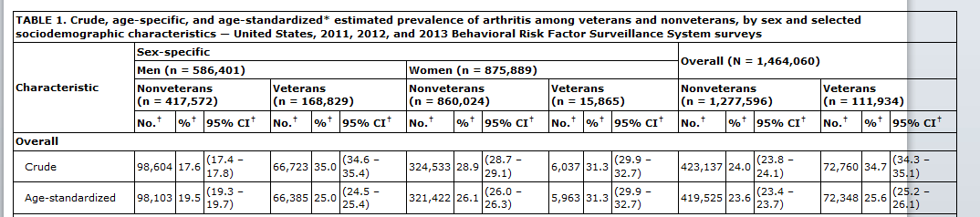
Prevalence of Arthritis ,by Veteran Status and Gender (BRFSS 2011)
http://www.cdc.gov/mmwr/preview/mmwrhtml/mm6344a4.htm?s_cid=mm6344a4_e

Slide 21
Comorbidities
Heart Disease
Asthma/ COPD
Diabetes
Stroke
http://www.cdc.gov/arthritis/data_statistics/comorbidities.htm

Slide 22
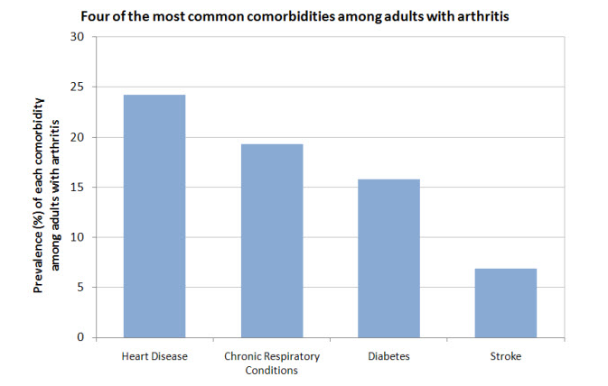
http://www.cdc.gov/arthritis/data_statistics/comorbidities.htm
Four Most Common Comorbidities for people with Arthritis, NHIS 2007

Slide 23
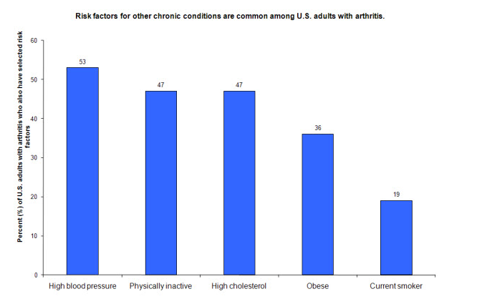
Risk Factors for U.S. adults with arthritis (NHIS 2007)
http://www.cdc.gov/arthritis/data_statistics/comorbidities.htm

Slide 24
Costs and Hospitalization
Hospitalizations
  80.6 million physical visits
  760,000 hospitalizations
Costs
Approximately $128 billion (1.2% of all GDP) in 2003
  $80.8 billion in direct costs (hospitalizations)
  $47 billion in indirect costs (lost earnings)
  Increased by 24% between 1997 and 2003
  WV- highest percent of GDP (2.6%)
Chronic Disease Epidemiology and Control (2010)
http://www.cdc.gov/arthritis/data_statistics/cost.htm

Slide 25
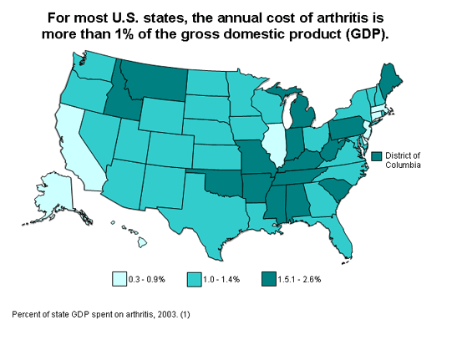
http://www.cdc.gov/arthritis/data_statistics/cost.htm
State Specific Gross Domestic Product, MMWR 2007

Slide 26
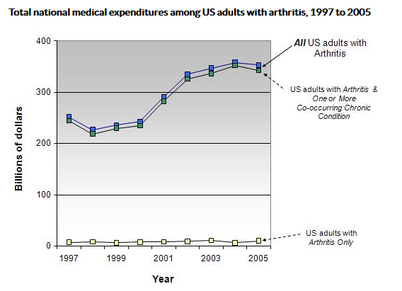
http://www.cdc.gov/arthritis/data_statistics/cost.htm
National Medical Expenditures among adults with arthritis, MEPS 1997-2005

Slide 27
Part II: The Arthritides

Slide 28
The Arthrithides
Osteoarthritis
Rheumatoid Arthritis
Post-Traumatic Arthritis
Gout
Osteoporosis
Juvenile Idiopathic Arthritis

Slide 29
Osteoarthritis

Slide 30
Pathophysiology
Protective Cartilage at the end of bone is worn down over time
Main areas of OA are the knees, hips, hands, and spine
Symptoms include:
  Pain
  Tenderness
  Stiffness
  Loss of feeling
  Grating Sensation
  Bone Spurs

Slide 31
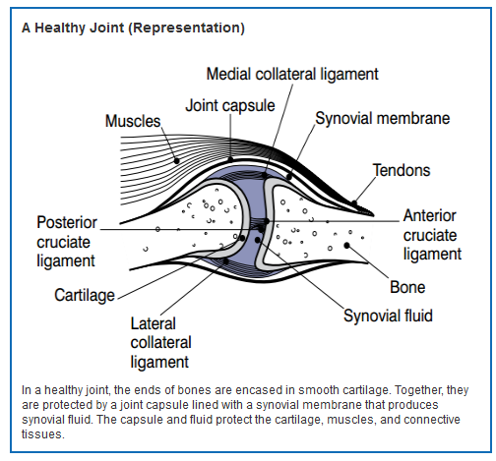
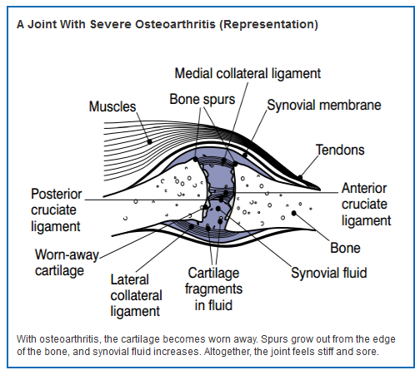
http://www.niams.nih.gov/Health_Info/Osteoarthritis/default.asp

Slide 32
Prevalence
Most common form of arthritis
Complied from NHANES I, NHANES III, and NHES
33.3% of those had OA of at least one site
Site Specific OA
  22% of adults 24-75 years of age had Radiographic Foot OA
  33% of adults 24-75 years of age had Radiographic Hand OA
  8% of adults 60+ years of age had Symptomatic Hand OA
  37% of adults 60+ years of age had Radiographic Knee OA
  12% of adults 24-75 years of age had Symptomatic Foot OA
Chronic Disease Epidemiology and Control (2010)

Slide 33
Mortality, Hospitalizations, and Cost
Mortality
  Accounts for 6% of all arthritis related deaths
  Average is 0.2 to 0.3 deaths per 100,000
  500 deaths per year
  Very likely to be underestimated
Hospitalization
  Accounts for 47.4% of all arthritis hospitalizations
  35% of those hospitalizations were for knee and hip joint replacements
  Knee replacements grew by 217% (203.6 to 645.1 per 100,000)
Non-Hispanic blacks and lower income patients have lower rates of knee and hip replacements, but higher rates of mortality
Cost
  Knee replacement- $28.5 billion
  Hip replacement - $13.7 billion
http://www.cdc.gov/arthritis/basics/osteoarthritis.htm

Slide 34
Demographics
Age
  Increases in both prevalence and severity as one gets older
Sex
  More prevalent among men then women 45 and under, but more prevalent among women then men 54 and older
Race
  Knee OA more common in blacks than whites, Hip OA quite rare in Asian populations
Location
  More prominent in the Southeastern U.S.
Chronic Disease Epidemiology and Control (2010)

Slide 35
Risk Factors
Joint Trauma
Obesity
Repetitive Joint Usage
Muscle Weakness
Nutritional Deficiency
Chronic Disease Epidemiology and Control (2010)

Slide 36
High Risk Groups
Genetic Predisposition
  Herberden’s and Bouchard’s syndrome
Congenital or developmental disease
  Congenital Hip subluxation
Previous Inflammatory Joint Disease
Metabolic Disorder
  Hyperthyroidism
Chronic Disease Epidemiology and Control (2010)

Slide 37
Post-Traumatic Arthritis

Slide 38
Definition and Pathophysiology
Wearing down of a joint that has been involved in a injury
May not appear until 10-15 years after the injury
Symptoms include:
  Joint Pain
  Swelling
  Fluid Accumulation
  Bone Spurs
Most likely to involve the knees and hips
https://my.clevelandclinic.org/health/diseases_conditions/hic_Arthritis/hic-post-traumatic-arthritis

Slide 39
Epidemiology, Causes, and Cost
Affect 5.6 million adults in the U.S. (12%)
10-15% of those with OA actually have PTA
Causes:
  Playing contact sports
  Physical Labor
  Vehicular Accidents
  Past joint surgery
Estimated to cost about $3.06 billion dollars
http://www.everydayhealth.com/news/when-old-injuries-come-back-to-haunt-you/
http://www.hedleyortho.com/post-traumatic-arthritis/
http://www.ncbi.nlm.nih.gov/pubmed/17106388

Slide 40
Rheumatoid Arthritis

Slide 41
Pathophysiology
Chronic Inflammatory Disease that affects the joints
Autoimmune disease (Macrophages is the main effector)
Inflamed Synovial Tissue invades and damages cartilage
Symptoms:
  Stiffness
  Swelling
  Pain
Mainly affects small joints (hands), wrists, elbows, and ankles
Can be monocyclic, polycyclic, or progressive
Chronic Disease Epidemiology and Control (2010)
http://www.hopkinsarthritis.org/arthritis-info/rheumatoid-arthritis/ra-pathophysiology-2/

Slide 42
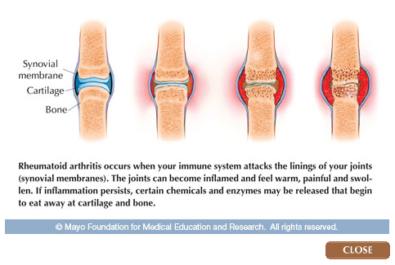
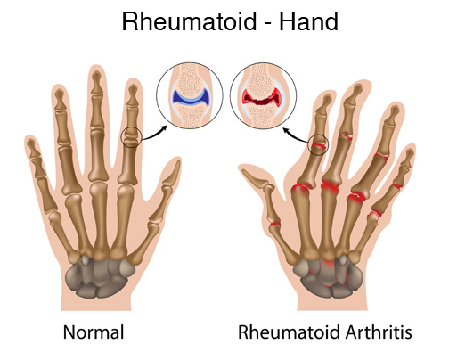
https://www.docresponse.com/diagnoses/orthopedics/rheumatoid-arthritis/
http://healthletter.mayoclinic.com/content/preview.cfm/n/288/t/Rheumatoid

Slide 43
Prevalence, Incidence, and Mortality
Estimated by the Rochester Epidemiology Project
Prevalence
  0.4-1.3% population worldwide
  0.6% (1.5 million people) in US
  2% for adults 60 and over
Incidence
  41 per 100,000 people are diagnosed with RA annually in U.S.
Mortality
22% of all arthritis deaths are due to RA
Associated with respiratory and gastrointestinal disorders
http://www.cdc.gov/arthritis/basics/rheumatoid.htm
Chronic Disease Epidemiology and Control (2010)

Slide 44
Risk Factors
Smoking
  Strongest modifiable risk factor for RA
Genetics
  60% of risk
  HLA-DR chain the MHC II
    DRB1*0401 and DRB1*0404
Age
  Onset is usually in adults 60+
Race
  No difference between blacks and whites
  Difference between Asians and whites
Sex
2 to 3 times higher in women than men
Chronic Disease Epidemiology and Control (2010)

Slide 45
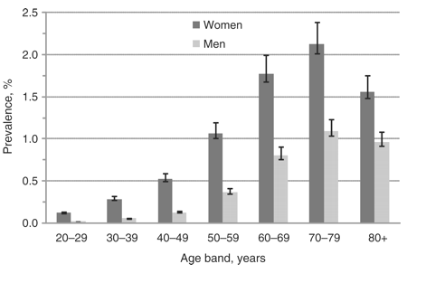
Prevalence by Age and Sex in Southern Sweden, 2008
http://rheumatology.oxfordjournals.org/content/49/8/1563/F1.expansion.html

Slide 46
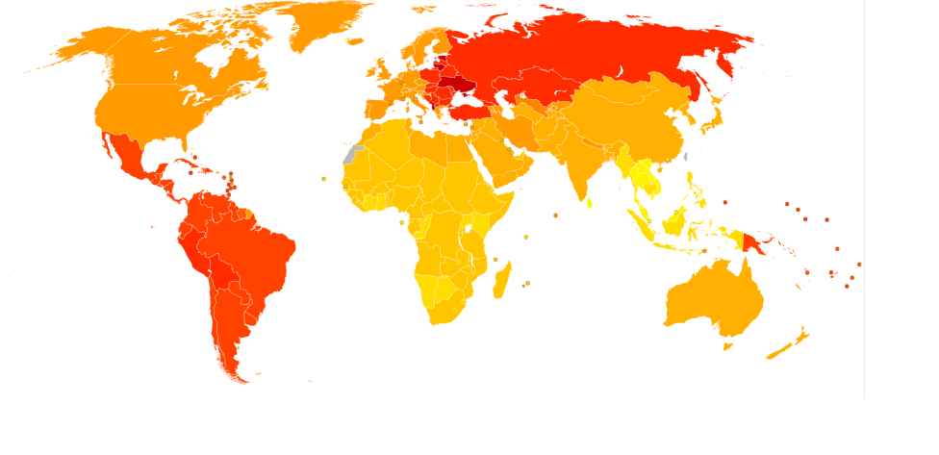
Age-Standardized DALY rates for RA by Country ,WHO 2004
https://commons.wikimedia.org/wiki/File:Rheumatoid_arthritis_world_map_-_DALY_-_WHO2004.svg
Yellow- Red (40-140) per 100,000

Slide 47
Gout

Slide 48
Pathophysiology
Metabolic disorder
Inflammation due to Monosodium Uric crystals being deposited in the synovial fluid
Associated with Hyperuricemia
  Serum urate levels about 6.8 mg/dL
Initially produces acute, episodic flairs that progress to chronic arthritis
Chronic Disease Epidemiology and Control (201)
http://www.commed.vcu.edu/Chronic_Disease/arthritis/CMEGoout.pdf

Slide 49
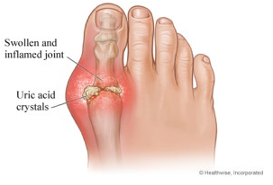
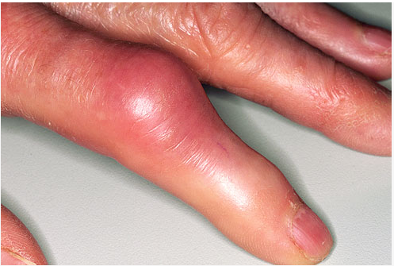
http://www.eatingformylife.com/gout/
http://www.webmd.com/arthritis/ss/slideshow-gout

Slide 50
Prevalence, Incidence, and Mortality
Prevalence
  3.9% of U.S. population (8.3 million people) have gout (NHANES 2007-2008)
  Grew by 1.2 percentage points over 2 decades
Incidence
  Increased from 45.0 per 100,000 in 1977-1978 to 63.3 per 100,000 in 1995-1996
Mortality
  Rare, but associated with increased risk for CVD
http://www.cdc.gov/arthritis/basics/gout.html

Slide 51
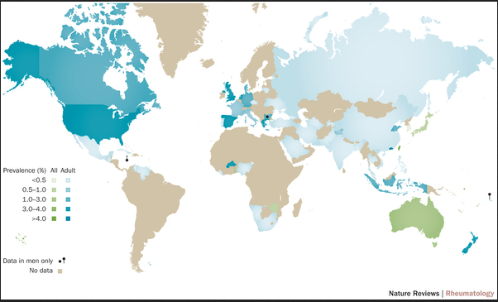
Prevalence of Gout by Country
http://www.nature.com/nrrheum/journal/v11/n11/images_article/nrrheum.2015.91-f1.jpg

Slide 52
Attributes
Age
  Risk increases with age
Sex
  Affects 3 males for every 1 female
Race
  More common among blacks than whites

Slide 53
Risk Factors and Costs
Family History
  Genetic Polymorphisms and rare X-linked inborn errors
Obesity
Alcohol Consumption
Meat and Seafood Consumption
Occupation and environmental lead exposure
Cost of Gout is approximately $31.6 billion dollars (MEPS 2011)
Chronic Disease Epidemiology and Control (2010)
http://www.commed.vcu.edu/Chronic_Disease/arthritis/CMEGoout.pdf
http://www.cdc.gov/arthritis/basics/gout.html

Slide 54
Osteoporosis

Slide 55
Definition and Pathophysiology
Definition
  Having a Bone Mass Density (BMD) of more than 2.5 standard deviations below the mean of a normal young white woman (g/A)
Clinical Manifestations
  Fractures of the spine, hip, wrists or other areas
Chronic Disease Epidemiology and Control (2010)

Slide 56
Prevalence, Incidence and Costs
Prevalence
  Affects 54 million people in the U.S. and 200 million people around the world
Incidence
  9 million new cases annually
Costs
  $17.9 billion dollars per year (DHHS 2002)
Chronic Disease Epidemiology and Control (2010)
http://www.iofbonehealth.org/facts-statistics#category-14
http://nof.org/

Slide 57
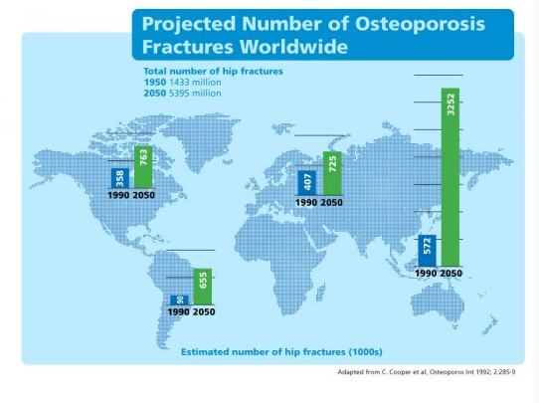
Number of Fractures due to Osteoporosis Worldwide
http://www.iofbonehealth.org/epidemiology

Slide 58
Risk Factors
Genetic Factors
  85% of risk
  Allelic variations of the Vitamin D, estrogen, and Type I collagen receptors are associated with higher risk
Physical inactivity
Low Body Weight
Smoking
Alcohol Consumption
Aging
Chronic Disease Epidemiology and Control (2010)

Slide 59
Attributes
Age
  BMD decreases at a rate of 0.5-1% per year beginning at age 40
Sex
  More prevalent in women than men, with an even higher risk after menopause
Race
  BMD lowest in Asians and Whites, but hip fractures more common in whites than Asians
Chronic Disease Epidemiology and Control (2010)

Slide 60
Juvenile Idiopathic Arthritis

Slide 61
Definition and Pathophysiology
Most common of the Juvenile Arthritis diseases
Autoimmune disease (Neutrophils are main effector cell)
Symptoms include
  Fatigue
  Decrease physical activity
  Sleep problems
  Swelling at joints
http://www.arthritis.org/about-arthritis/types/juvenile-idiopathic-arthritis-jia/symptoms.php

Slide 62
Prevalence, Incidence, Attributes
Prevalence
  100,000 children in the U.S have JIA
Incidence
  13.9 per 100,000 children annually
Attributes
  Sex
    One study found that it was more prevalent in girls than boys by a 2 to 1 margin
  Race
    Less common in African-American and Asian populations compared to Caucasian populations
http://www.uptodate.com/contents/juvenile-idiopathic-arthritis-epidemiology-and-immunopathogenesis
http://ped-rheum.biomedcentral.com/articles/10.1186/s12969-015-0030-z

Slide 63
Part III: Intervention and Research

Slide 64
Primary Prevention- Individual
Osteoarthritis
  Avoid joint trauma (Also applicable to PTA)
  Preventing Obesity
  Modifying occupational joint stress
Gout
  Weight Reduction
  Dietary Changes
  Moderation/Elimination of alcohol
Osteoporosis
  Adequate intake of Vitamin D and Calcium during childhood
  Smoking cessation (Also applicable to RA)
  Hormone Therapy (Post-Menopause)
  “Fall-proofing” living areas
Chronic Disease Epidemiology and Control (2010)

Slide 65
Secondary Intervention- Individual
Osteoarthritis
  X-rays and radiographs in older patients
Gout
  Treating those with asymptomatic hyperuricemia
Osteoporosis
  BMD testing recommended for women 65+ and men 75+
  Earlier if there is a prior history of fractures
Chronic Disease Epidemiology and Control (2010)

Slide 66
Tertiary Intervention- Individual
Pharmalogical
  NSAIDS
  Corticosteroids
  TNF/ IFN-1 blockers
  Anti-catabolic/anabolic drugs
Non-pharmalogical
  Physical Therapy
  Support Groups
  Public Health Nursing Services
  Surgery
Chronic Disease Epidemiology and Control (2010)

Slide 67
Community Intervention

Slide 68


Surveillance
CDC uses 2 surveys to collect data of Arthritis and other rheumatic conditions (AORC)
National Health Interview Survey (NHIS)
  Monitors the health of the non-institutionalized U.S
  Has a Core questionnaire and supplement questions
  Scheduled to be redesigned in 2018
Behavioral Risk Factor Surveillance System (BRFSS)
  Collects data on health- related risk behaviors
  Used for building health-promotion activities
http://www.cdc.gov/nchs/nhis/about_nhis.htm
http://www.cdc.gov/brfss/about/index.htm

Slide 69

National Arthritis Action Plan (NAAP)
Developed by CDC in 1999
Three objectives:
  “To establish a solid scientific base of knowledge
  on the prevention of arthritis and related disability.”
  Increase awareness of arthritis and its impact
  Implement programs to prevent arthritis
http://www.cdc.gov/arthritis/temp/pilots-201208/pilot1/online/arthritis-challenge/05-PublicHealth/keydocuments.htm

Slide 70

OA Agenda
Developed in 2010 by the CDC
Three goals it set to accomplish within
3 to 5 years
  Ensure the availability of evidence-based intervention
  strategies for OA
  Establish supportive policies
  Start research to better understand OA
http://www.cdc.gov/arthritis/temp/pilots-201208/pilot1/online/arthritis-challenge/05-PublicHealth/keydocuments.htm

Slide 71



Examples of Community Outreach
Fit and Strong!
EnhanceFitness
Active Living Every Day
Walk With Ease
Buenos días, artritis
National Arthritis Month (May)
Arthritis Foundation Aquatic Program
Arthritis Foundation Exercise Program
Fitness &Exercise for people with Arthritis
http://www.cdc.gov/arthritis/interventions/index.htm

Slide 72
Research Funding
NIH reports that $214 million dollars for FY 2015 on Arthritis Research, down from $258 million for FY 2012
  Diabetes- $1.01 billion
  Asthma-COPD- $ 378 million
  CVD- $1.99 billion
https://report.nih.gov/categorical_spending.aspx

Slide 73
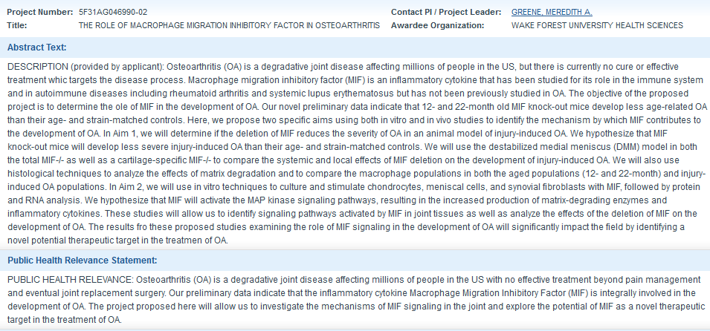
Cost: $43,120 https://projectreporter.nih.gov/project_info_description.cfm?aid=8762225&icde=0
Macrophage Inhibitory Factor and OA

Slide 74
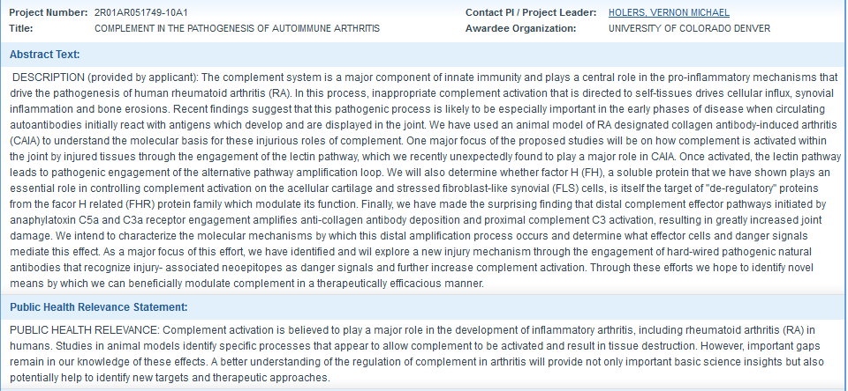
Cost: $341,550 https://projectreporter.nih.gov/project_info_description.cfm?projectnumber=2R01AR051749-10A1
Complement and RA

Slide 75
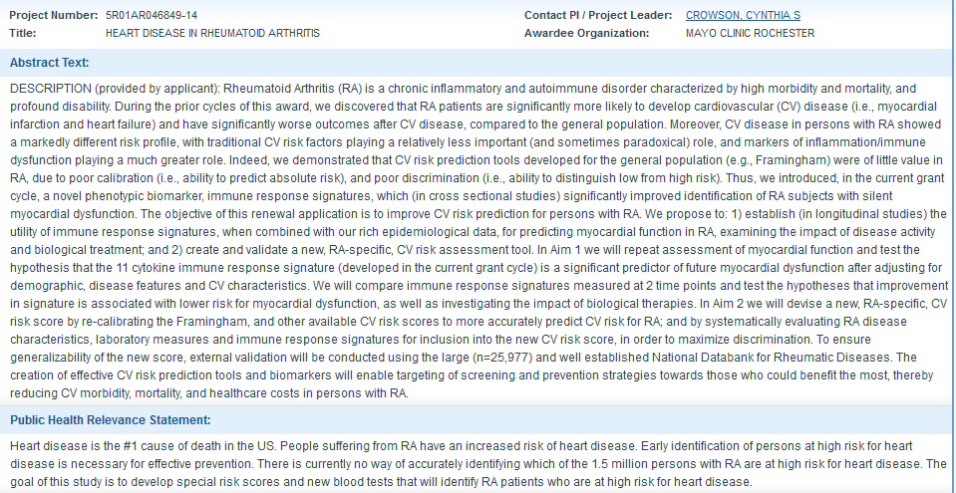
Cost: $667,898 https://projectreporter.nih.gov/project_info_description.cfm?projectnumber=5R01AR046849-14
Heart Disease and RA

Slide 76
Areas of Future Research
  Arthritis National Research Foundation
    Osteoarthritis Study: “Missing Link” to Repairing Joint Cartilage by Dr. Denis Evseensko
      Stem Cells may be used to replace worn-down articular cartilage
    Enzyme Study May Lead to New OA Treatment by Dr. Nidhi Bhutani
      Targeting gene expression may be new way to treat OA
  National Osteoporosis Foundation
    Identifying a High Bone Mass gene
    Excessive bone remodeling
http://www.curearthritis.org/osteoarthritis-research/
http://nof.org/files/nof/public/content/file/7790/upload/1350.pdf

Slide 77
Questions? Comments? Concerns?

