Slide 1
Genetics and Genomics in Public Health: Challenges and Opportunities for Smoking Research and Application
Elizabeth Prom-Wormley, MPH, PhD
Division of Epidemiology, Department of Family Medicine and Population Health
Virginia Institute for Psychiatric and Behavioral Genetics
Virginia Commonwealth University

Slide 2
Lecture Objectives
Understand the implications of genetic and environmental factors for health promotion and disease prevention.
Evaluate the accessibility, effectiveness, and quality of individual and population-based genetic services.
Understand the complexity of communicating genetic risk information.
Identify the ethical, legal, and social issues in applying genetic information in clinical and research settings.

Slide 3
What is Public Health Genetics/Genomics?
How do we all fit together?
Notes:
Genetics- diseases due to a single gene. Genomics- Study of the information gained from the human genome on the etiology of disease and application to populations
Priorities in PHG are (1) develop and maintain large-scale databases with genetic information, (2) development of evidence base for genomic applications to health promotion and disease prevention and (3) develop a workforce with training in the field of genomics

Slide 4
One Public Health Genomics Framework
Intervention Stage | Public Health Intervention | Public Health Genomics Intervention
Primary | Healthy populations to prevent illness | Risk (susceptibility) assessment
Secondary | Early detection, testing, hazard surveillance | Risk assessment of high risk groups/newborns
Tertiary | Treating those with illness | Assisting those affected with treatment options
Research
Discoveries
T1
Intervention Testing
T2
T3
Evidence-Based Recommendations
Organizational & Community
Utilization
T4
Population Health Outcomes

Slide 5
Disease/Outcome Etiology
Psychiatry/Psychology
Physiology/Biology
Neuroscience
Genetics
Pharmacology
Clinician Training/Development
Genetic Counseling
Health Education/Promotion
Genetic Epidemiology
Genetic/Environmental Risk Factors
Pharmaceutical Development
Data Collection/Evaluation
Biostatistics
Bioinformatics
Epidemiology
Statistical Genetics
Ethical/Legal/Social/Policy

Slide 6
Public Health Genomics Framework
Research
Discoveries
T1
Intervention Testing
T0
Knowledge Synthesis
Stakeholder Engagement
T2
Population Health Outcomes
Evidence-Based Recommendations
T3
T4
Organizational & Community
Utilization
Modified from Khoury et al, 2007
Notes:
Integrating basic, behavioral, organizational, clinical & population science research

Slide 7
Smoking Remains a Significant Public Health Issue
Mental Health
Genetic
CVD
Smoking Related Behaviors
Respiratory Illnesses
Cancers
Environment
Pre-Term Labor/Birth

Slide 8
Epidemiology of Cigarette Use
SUCCESS
Decrease in prevalence of cigarette use
  42.4% to 19.3% in ADULTS
Since 2002, the number of former smokers exceeds the number of current smokers
CHALLENGES
Less decline in smoking rates among (US) adolescents
Expected to be top preventable cause of death worldwide by 2030
New nicotine products on the market
Notes:
Decrease 1965-2000
Adult-focused
Across the world, 1 in 4 adults is a current smoker
Still one of the most significant sources of morbidity and death worldwide
Treatment cost for tobacco-related illness = $167 Billion/year

Slide 9
Genetics to the Rescue?
Environment
DNA
mRNA
Protein
Biological
System
Smoking
Behaviors
Post-Translational
Modification
miRNA
siRNA
RNAi
Epigenetics
Methylation
Acetylation
Telomere length
Treatment
Medication
Diet
Exercise
Interpersonal
Interactions
Parents
Peers
Spouse
Children
Notes:
Systems level processes
Pathways of risk common to multiple outcomes
Interplay between environmental exposure and system modification

Slide 10
Public Health Genomics Framework
Scientific Discoveries
Identifying Genetic and Environmental Contributions to Mental Health Outcomes
  Smoking Initiation/Early smoking
Utility of Biological Markers to Identify Specific Psychiatric Risk Factors
  Chronic Smoking and Brain Structure/Nicotine Dependence

Slide 11
Genetic Epidemiology Study Designs
Twin/Family Studies
  Estimate genetic/environmental influences
Linkage Studies
  Identify locations in the human genome
Association Studies
  Candidate Gene Association
  Genome-Wide Association
  Gene-environment Interaction
  Gene-gene interaction (epistasis)
Epigenetic Studies
  Methylation
  Telomere length
Literature-Based Meta-Analysis
Consortia-Based Mega-Analysis

Slide 12
How Much do Genetic and Environmental Effects Influence Smoking-Related Behaviors?

Slide 13
Genetic Epidemiology of Cigarette Use
Nicotine Dependence is highly heritable
  h² = 30-75%
Smoking persistence
  h² = 50-60%
Smoking Initiation less heritable
  h² = 30-60%
  May differ in males and females
  Unclear how & whether heritability changes across adolescent development

Slide 14
The Developmental Genetic Epidemiology of Smoking Study

Slide 15
Study Aims
Identify developmental trends in smoking initiation in late adolescence/early adulthood
Determine the extent to which genetic and environmental effects play a role in the development of smoking initiation

Slide 16
Study Population and Measures
88,436 individuals across 15 different studies
46,932 complete and incomplete twin pairs
Age Range = 8-94
  Adolescence- Adulthood (Ages 12-59)
Smoking initiation
R- 2.15.2 (“Trick or Treat”) and OpenMx

Slide 17
Study Name | Age Range | N | Study Design | Lifetime Smoking
ABD | 8-32 | 2785 | Prospective Cohort (PC)- 6 Waves | Have you ever smoked ?
MN | 8-32 | 4137 | PC- 6 Waves | Have you ever tried any form of tobacco in your lifetime?" / “Have you ever used tobacco (for example, cigarettes, cigars, chewing tobacco)?
COL | 11-29 | 3160 | PC- 2 Waves | Have you ever used tobacco?
AUS | 8-24 | 2888 | PC- 3 Waves | Have you ever smoked even part of a cigarette?
MATS | 11-18 | 2211 | Cross-Sectional | How old were you when you smoked your first cigarette?
BEL | 10-18 | 210 | Cross-Sectional | Have you smoked at least 100 cigarettes in your life?
NTR | 12-98 | 13425 | PC- 8 Waves | Have you ever smoked?
CVT | 9-18 | 1180 | Cross-Sectional | Have you smoked at least 100 cigarettes in your life?
SWE | 8-21 | 2942 | PC- 4 Waves | How frequently have you smoked in the past 12 months? / Do you smoke?
FIN | 15-29 | 11989 | PC- 4 Waves | Have you ever tried smoking?
ADH | 10-26 | 1556 | PC- 4 Waves | Have you ever tried cigarette smoking, even just one or two puffs?
BATS | 18-32 | 872 | PC- 3 Waves | In your life, have you ever used tobacco products?
MMF | 20-32 | 9084 | Cross-Sectional | Have you ever smoked cigarettes? /Not even once?
VA30K | 14-94 | 14756 | Cross-Sectional | Describe your lifetime smoking use.
OZ20K | 16-87 | 17241 | Cross-Sectional | Describe your lifetime smoking use.

Slide 18
Measuring Smoking Initiation Prevalence Across Time
All gender differences significant at p < 0.005

Slide 19
How Much do Genetic and Environmental Effects Influence Smoking-Related Behaviors?

Slide 20




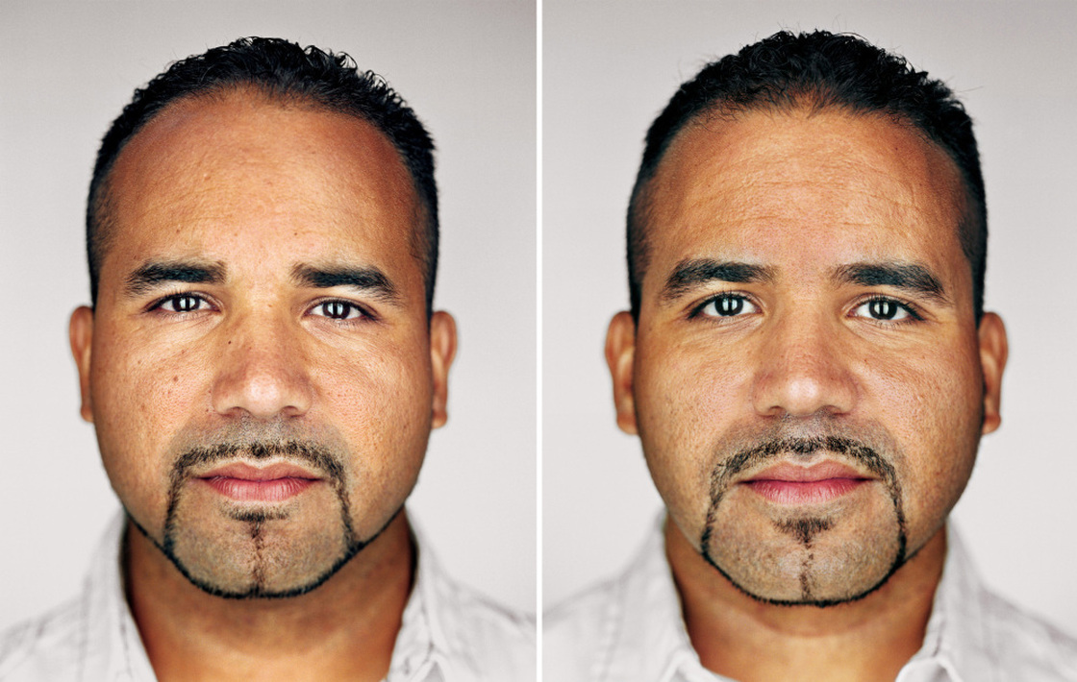
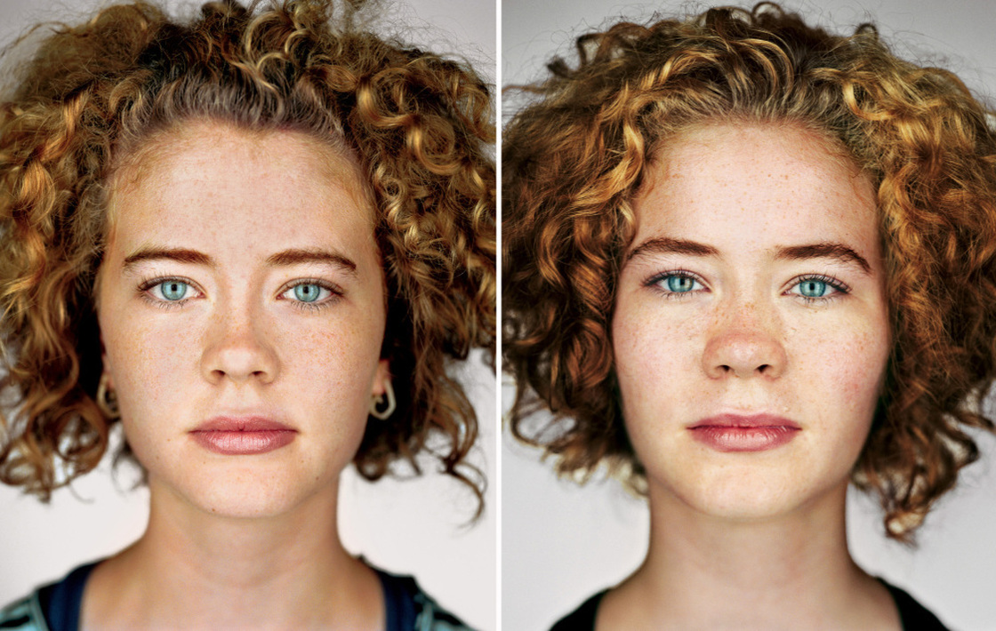


Epidemiological Studies of Twins

Slide 21
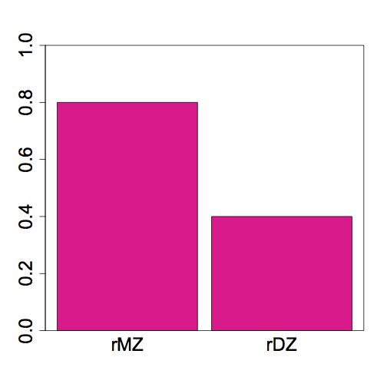
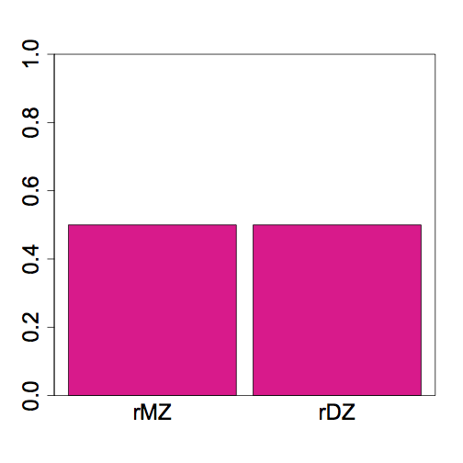
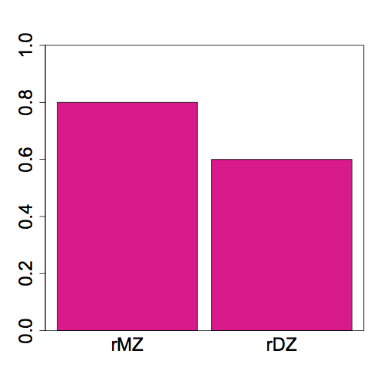
Patterns of Twin Correlations
rMZ = 2rDZ
Additive
DZ twins on average share 50% of additive
effects
rMZ = rDZ
Shared Environment
Additive & “Shared Environment”
A = 2(rMZ-rDZ)
C = 2rDZ – rMZ
E = 1- rMZ

Slide 23
Summary- Twin Correlations
Both additive genetic and shared environmental effects are important in smoking behaviors for boys and girls
Additive genetic effects may also function differently across development by sex

Slide 24
Genetic Modeling
Estimated genetic and environmental effects in males and females
Adjusted for country differences in prevalence
Separately for each age group

Slide 25
Classical Twin Model + Sex Differences
MZ = 1/ DZ= 0.5
1
Which sources of variance influence liability to smoking in males and females?
1
1
1
1
1
1
A
C
E
A
C
E
a
c
e
a
c
e
P_{T1}
P_{T2}
Are the contributions of genetic/env effects equal in males and females?
Are there different sets of genes/environments in males and females for smoking?
1
OppSex =r_{g/}r_{c}*0.5
1
1
1
1
1
1
A_{M}
C_{M}
E_{M}
A_{F}
C_{F}
E_{F}
a
c
e
a
c
e
P_{M}
P_{F}

Slide 26
Results- Smoking Initiation
Additive Genetic Effects
Increasing contribution throughout late adolescence/early adulthood
Shared Environmental Effects
Decreasing contribution throughout late adolescence/early adulthood
Unique Environmental Effects
Consistent across development

Slide 28
  Genetic Epidemiology Recommendations
Genome-Wide Association Studies- Better chance at finding significant associations at older ages
Age-specific genetic effects throughout development

Slide 29
Public Health Genomics Framework
Research
Discoveries
T1
Intervention Testing
T0
Knowledge Synthesis
Stakeholder Engagement
T2
Population Health Outcomes
Evidence-Based Recommendations
T3
T4
Organizational & Community
Utilization
Modified from Khoury et al, 2007
Notes:
Integrating basic, behavioral, organizational, clinical & population science research

Slide 30
Public Health Genomics Framework
Evidence-Based Recommendations
????

Slide 31

Public Health Genomics Framework
Evidence-Based Recommendations
Smoking Initiation – General Programs
Early adolescents- Life skills related to environmental risk factors (school/peer groups)

Slide 32
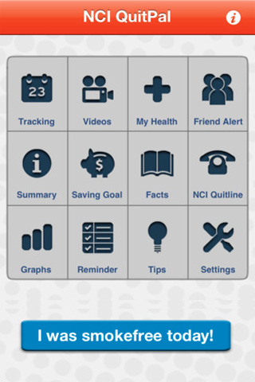
Public Health Genomics Framework
Evidence-Based Recommendations
Individualized Messages to Address Regular Use/ Dependence-
Older Adolescents/Young Adults – Etiology of dependence
Improving success of quit attempt by discussing parental influences (genetic/environmental) on lowering risk for nicotine dependence

Slide 33
Limitations
Western samples- Generalizability
  Nicotine use in low/middle income countries
Data are currently analyzed as discrete time points
  Possibly no significant differences across ages

Slide 34
Can Genetic Information Reduce the Burden of Smoking-Related Illness?
Personalized approach to increase effectiveness of pharmacotherapy/treatment
Increase motivation to change behaviors
Weak evidence to encourage use
Few studies have studied efficacy of approaches
Few, if any, compare against low-tech, cost effective approaches (ie: family history)

Slide 35
Public Health Applications are Slow to Develop Relative to Basic Discovery

Slide 36
Public Health Genomics Framework
Research
Discoveries
T1
Intervention Testing
T0
Knowledge Synthesis
Stakeholder Engagement
T2
Population Health Outcomes
Evidence-Based Recommendations
T3
T4
Organizational & Community
Utilization
Modified from Khoury et al, 2007
Notes:
Integrating basic, behavioral, organizational, clinical & population science research

Slide 37
Barriers to Utilization of Effective Community-Based Approaches to Nicotine Dependence
Streamlined Knowledge Acquisition/Dissemination
Few partnerships across all levels (patient advocacy, investigators, IRBs)
Clinician literacy/interest/knowledge
Patient interest/literacy/knowledge/adherence
Patient/research participant privacy

Slide 38
Thank You!

Slide 40
How Can Brain Structure Help to Understand the Etiology of Nicotine Dependence and Inform Public Health Approaches to Smoking Cessation?
Identification of Mechanisms Related to Nicotine Dependence
Notes:
68.8% of current smokers wanted to stop smoking
80% of quit attempts result in relapse

Slide 41
Cigarette Use is Associated with Decreased Brain Structure Size
Cerebellum
Nucleus accumbens
Thalamus
Frontal cortex
Orbitofrontal cortex
Prefrontal cortex
Cingulate gyrus
Anterior cingulate

Slide 42
Cortical Measures
Volume
  Surface Area * Cortical Thickness
Surface Area
  Pial surface (red)
Cortical Thickness
  Distance between white matter & pial surfaces
  Space between red and yellow
  Implied neuronal connectivity and function

Slide 43
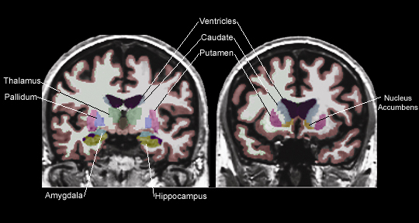
Subcortical Regions

Slide 44
Study Aims
Identify associations between cigarette use and brain structure (volume, SA and CT)
Determine the degree to which any significant associations are due to common genetic/environmental effects

Slide 45
Study Population
The Vietnam Era Twin Study of Aging (VETSA) MRI Study
473 individuals with MRI data
  110 complete MZ pairs
  92 complete DZ pairs
Age Range = 51-59
Mean Age = 55.8 ± 2.3
Males only

Slide 46
Methods- Image Acquisition & Cigarette Use
Siemens 1.5 Tesla scanners
  241 at UCSD/233 at MGH
  Image processing via FreeSurfer
  Adjusted for effects of age, testing site and global brain measures
Packyears
  (Number of Cigarettes Smoked per Day * Number of Years Smoked)/20

Slide 47
Univariate Estimates
Measure | rMZ | rDZ | A | 95% CI | C | 95% CI | E | 95% CI
Packyears | 0.60 | 0.45 | 0.28 | (0; 0.66) | 0.32 | (0; 0.60) | 0.40 | (0.30; 0.54)
Measure | rMZ | rDZ | A | C | E
Subcortical Volume | 0.53 - 0.87 | 0.05 - 0.48 | 0.60 - 0.85 | 0 - 0.14 | 0.12 - 0.40
Cortical Volume | 0.04 - 0.65 | -0.09 - 0.27 | 0 - 0.62 | 0 - 0.39 | 0.46 - 0.95
Cortical Thickness | 0.17 - 0.79 | -0.09 - 0.28 | 0 - 0.75 | 0 - 0.27 | 0.25 - 0.76
Cortical Surface Area | 0 - 0.79 | 0.1 - 0.50 | 0 - 0.79 | 0 - 0.23 | 0.21 - 1

Slide 48
MZ = 1
DZ = 0.5
MZ = 1
DZ = 0.5
~600 models
1
1
A1
C1
A2
C2
A1
C1
A2
C2
c₂₁
c₂₁
a₂₂
c₁₁
a₂₂
a₁₁
a₂₁
c₂₂
a₁₁
a₂₁
c₂₂
Twin 1
Tobacco Use
Twin 1
ROI
Twin 2
Tobacco Use
Twin 2
ROI
e₁₁
e₂₂
e₁₁
e₂₂
e₂₁
e₂₁
E1
E2
E1
E2
Notes:
Region of Interest (ROI) 30 subcortical + 562 cortical (Volume, SA and CT)
Current estimate of Packyears
Approximately 1700 models

Slide 49
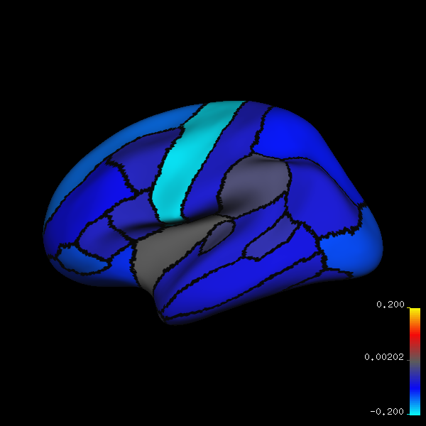
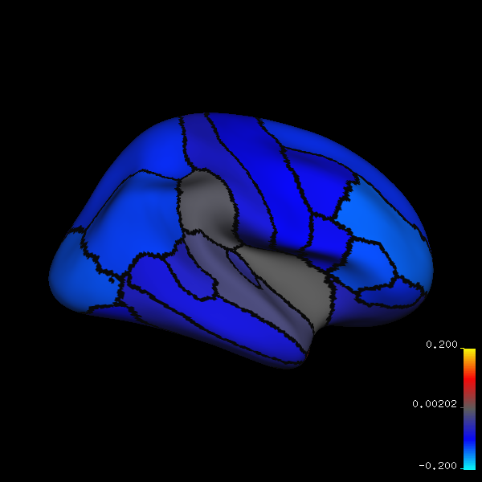
Negative Phentoypic Correlations between Packyears & Cortical Volume
Left Lateral
Right Lateral
Lobes
* Frontal
* Parietal
* Occipital
* Temporal
* Cingulate
*
*
*
*
*
*
*
*
*
*
*
*
*
*
*
*
*
+0.2
0
-0.2
+0.2
0
-0.2
Left Medial
Right Medial
Subcortical Regions
L/R Thalamus
L/R Cerebellum WM
*
*
*
*
*
*
*
+0.2
0
-0.2
*
+0.2
0
-0.2

Slide 50
Genetic Covariances Highlight Pathways Related to Control of Cravings
Right lingual gyrus (occipital cortex)
Right caudal anterior cingulate
Right pars opercularis (prefrontal cortex)
Right precuneus (parietal cortex).
Previously identified in structural and functional MRI studies
Attention processing and visiospatial analysis of the environment
  Involved in visually related cigarette cravings
Prefrontal cortex and anterior cingulate cortex process the cognitive decision to act to obtain a reward

Slide 51
Gene | Human Expression
A2BP1 | Cerebellum, cerebral cortex, frontal cortex, occipital pole, temporal lobe
ABCC4 | Hippocampus
ACTN2 | None
BDNF | Parietal lobe, brain, prefrontal cortex, cerebral cortex, temporal lobe, thalamus
CDI4 | Brain
CHRM1 | Cerebral cortex, dorsolateral prefronal cortex, frontal cortex, caudate, occipital love, putamen, temporal lobe, thalamus
CHRM5 | Cerebral cortex frontal cortex, dorsolateral pre-fronal cortex, occipital lobe, putamen, temporal lobe, thalamus
DRD2 | Brain, thalamus, putamen
DRD3 | Parietal lobe, thalamus, frontal cortex, nucleus accumbens, hippocampus,
DRD4 | Brain, thalamus, caudate nucleus, putamen
MAOA | Brain
NTRK2 | Prefrontal cortex, cerebral cortex, frontal cortex, temporal lobe

Slide 52
Environmental Covariances Highlight Pathways Related to Pleasure-Related Features of Nicotine Dependence
Left posterior cingulate (Cingulate)
Bilateral rostral middle frontal gyrus (prefrontal cortex)
Left pars orbitalis (prefrontal cortex)
Right inferior temporal gyrus (temporal cortex)
Left middle temporal gyrus (temporal cortex)
Increased neural response in these regions to smoking cues as measured by fMRI after exposure to stress
  Stressful environments
  Situational cues
  Lifestyle (ie: alcohol use, diet/exercise)
Notes:
Involved in the hedonic enhancement of the environment. Liking and Wanting.

Slide 53
Implications for Treatment
Small reductions in brain structure
  Genetic and environmental systems identified
Small Effect Sizes might not be so bad
  Brain as a dynamic system
Multiple quit attempts would be expected to be normal

Slide 54
Limitations
All male, middle-age, Caucasian sample
  Generalizability
Fewer significant ROIs after adjusting for multiple testing
Underpowered to test for causality
  Cigarette use could be considered an environmental risk factor as well as an outcome
Alternative handling of packyears measure

Slide 55
The Potential of Biological Markers
Provide additional information to current psychiatric tools
Provides indicators of biological pathways to ask additional questions of genetic data
Identification of most relevant features for a specific purpose

Slide 56
Public Health Genomics Framework
Research
Discoveries
T1
Intervention Testing
T0
Knowledge Synthesis
Stakeholder Engagement
T2
Population Health Outcomes
Evidence-Based Recommendations
T3
T4
Organizational & Community
Utilization
Modified from Khoury et al, 2007
Notes:
Integrating basic, behavioral, organizational, clinical & population science research

Slide 57
Can Genetic Information Reduce the Burden of Smoking-Related Illness?
Personalized approach to increase effectiveness of pharmacotherapy/treatment
Increase motivation to change behaviors
Weak evidence to encourage use
Few studies have studied efficacy of approaches
Few, if any, compare against low-tech, cost effective approaches (ie: family history)

Slide 58
Public Health Applications are Slow to Develop Relative to Basic Discovery

Slide 59
Barriers to Utilization of Effective Community-Based Approaches to Nicotine Dependence
Streamlined Knowledge Acquisition/Dissemination
Few partnerships across all levels (patient advocacy, investigators, IRBs)
Clinician literacy/interest/knowledge
Patient interest/literacy/knowledge/adherence
Patient/research participant privacy

Slide 60
Thank You!

