Slide 1

The Role of Academic Medical Centers
in Safety Net Health Care Delivery Systems
Sheryl L. Garland, M.H.A.
Vice President, Health Policy and Community Relations
VCU Health System
Interim Director
VCU Office of Health Innovation

Slide 2
Learning Objectives
Provide an overview of the health care Safety Net
Describe the development of a community-academic medical center partnership to address the health care needs of the uninsured
Outline the implementation steps of a program designed to coordinate services for an uninsured population
Review ideas regarding the transition of the safety net under health reform

Slide 3
Presentation Outline
What is a “Health Care Safety Net”?
Overview of the VCU Health System
Partnership with the Richmond City Department of Public Health
Virginia Coordinated Care for the Uninsured Program (VCC)
Safety Net Delivery Systems and Health Reform

Slide 4
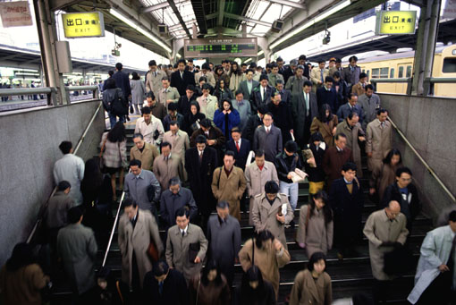
Growing concern for many health care administrators is where will
the 47 million uninsured in the U.S. get health care services?

Slide 5
Statistics on the Uninsured
Approximately 64% are below 200% FPL; 35% are below the poverty line
52% are below the age of 30; 18% are below 18
62% of the uninsured have no education beyond high school
Minorities represent approximately 35% of the population, but 54% of the uninsured
80% of the uninsured are native or naturalized citizens
80% of the uninsured are employed (66% work full time and 14% work part-time)
The Uninsured: A Primer, Key Facts about Americans without Health Insurance, Kaiser Commission On Medicaid and the Uninsured, October 2009, pages 4-6.
Health Coverage in Communities of Color: Talking about the New Census Numbers, Fact Sheet from Minority Health Initiatives, www.familiesusa.org/assets/pdf/minority-health-census-sept2009/pdf., p.1.

Slide 6
According to the Institute of Medicine:
“In the absence of universal comprehensive coverage, the health care safety net has served as the default system for caring for many of the nation’s uninsured and vulnerable populations.”
Institute of Medicine, America’s Health Care SafetyNet: Intact but Endangered (Washington, D.C: National Academy Press, 2000) p.2.

Slide 7
Growth of the Health Care Safety Net
Safety Net system has grown
Varies by community
Includes various configurations of providers such as public and private hospitals, community health centers (FQHC’s), local health departments, free and school-based clinics and physician charity care.
Laurie E. Felland, Kyle Kinner, John F. Hoadley, “The Health Care Safety Net: Money Matters but Savvy Leadership Counts”,
Issue Brief No. 66, August 2003, p.1.

Slide 8
Safety Net Health Systems Have
Two Distinguishing Characteristics:
Maintain an “open door”
Provide a significant proportion of the preventive, acute and chronic health care services delivered to uninsured, Medicaid and other vulnerable populations in their region
America’s Health Care Safety Net: Intact, but Endangered”, Institute of Medicine Report, 2000

Slide 9
The Uninsured Seek Care at Academic Health Centers
High utilization of services by the uninsured in Emergency Rooms
Provide specialty care for patients referred from primary care Safety Net facilities (free clinics and federally qualified health centers)
Academic Health Centers continuously struggle with “social admissions”

Slide 10
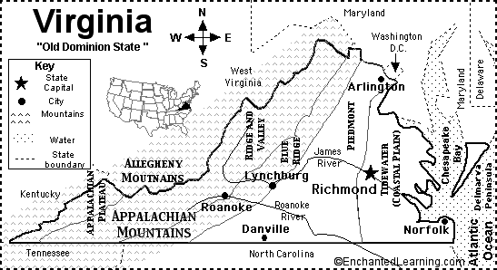
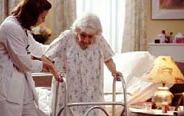

Throughout the
Commonwealth,
communities are
adopting strategies
to address the
issue of caring
for the uninsured through the development of Safety Net Health Care Delivery Models

Slide 11


VCU Health System and
UVA Medical Center
receive funding from
the Commonwealth of Virginia
to provide care to the
Uninsured

Slide 12
Virginia’s Indigent Care Program
Established in the late 1970’s to provide coverage to the uninsured
Virginia’s Medicaid program only covers those who are pregnant, under 18, aged, blind or disabled
Indigent Care Program marries federal DSH dollars and State General funds (50/50 match)
Eligibility criteria:
- Reside in the Commonwealth
- U.S. Citizen
- At or below 200% FPL
- Meet asset test criteria

Slide 13
VCU Health System is the
provider of the majority of health care for the
uninsured and underinsured in the
Central Virginia region.

Slide 14
VCU Health System Indigent Care Distribution
FY12 Projected Distribution of Indigent Care Funding

Slide 15

About The VCU Health System
VCU Health System: only academic medical center in Central Virginia, with 32,500 admissions and > 500,000 outpatient visits annually.
MCV Hospitals: 865 licensed beds, with 80,000 emergency visits each year; region's only Level I Trauma Center.
MCV Physicians: 550-physician, faculty group practice.
Virginia Premier Health Plan: 145,000 member Medicaid HMO.

Slide 16
Payer Mix
73% uninsured or
government sponsored

Slide 17
The Ecology of Safety Net Care
Catastrophic
event
Acute
hospitalization
Healthy
with
episodic
needs
Chronically ill
Healthy
with unmet
needs
Presentation: Governor’s Covering the Uninsured Conference, Dr. Sheldon M. Retchin, 2003

Slide 18
VCUHS Partnership Timeline
RCHD and
VCUHS
partner to create
South Richmond
Health Center
The VCC program is established in partnership with community PCP’s
RCHD turns over
management of
the SRHC
to VCUHS
VCUHS
launches the
City Care program
Virginia General
Assembly passes
SJR179
1991
1992
1994
1996
1998
1999
2000
2011
Community and VCUHS
reps examine the feasibility
of expanding City Care to
Uninsured adults
Intro of the Enhanced Delivery System model
for Health Care Reform
SRHC is renamed
the Hayes Willis
Health Center
RUPCI determines
there is a need for
primary care in
South Richmond
Notes:
18

Slide 19
Partnership with the Richmond City Department of Public Health

Slide 20
Assessment of Primary Care Capacity
In 1991, the Virginia General Assembly passed SJR 179
Required all health departments to review the availability of primary care in their health districts
Dr. Kim Buttery, Director of the Richmond City Department of Public Health (RCDPH) convened a group to assess this issue
Study concluded that there was adequate primary care in Richmond City, however, there was a maldistribution of providers

Slide 21
Richmond Urban Primary Care Initiative
(RUPCI)
A coalition of community leaders and health care providers including representatives from private practices, the RCDPH and the VCU Health System focused on improving access to primary care for City residents
The group recommended that a primary care clinic be established in South Richmond

Slide 22
South Richmond Health Center
In 1992-93, the RCDPH and the VCU Health System partnered to establish the South Richmond Health Center (SRHC)
Funding was received from foundations including the Virginia Health Care Foundation, the Jenkins Foundation and the Robert Wood Johnson Foundation
In 1994, the RCDPH established a contract with the VCUHS to manage the clinic and integrate traditional public health services into a primary care model

Slide 23


Clinical Services for Low Income Patients
Integrated public health and primary care in one clinic site
Women’s and Children’s Services
Family Medicine
Screening and Treatment for STD’s
Arthur Ashe HIV/AIDS Early Intervention Program
Case Management Services
WIC
Lab
Pharmacy
Financial Counseling

Slide 24
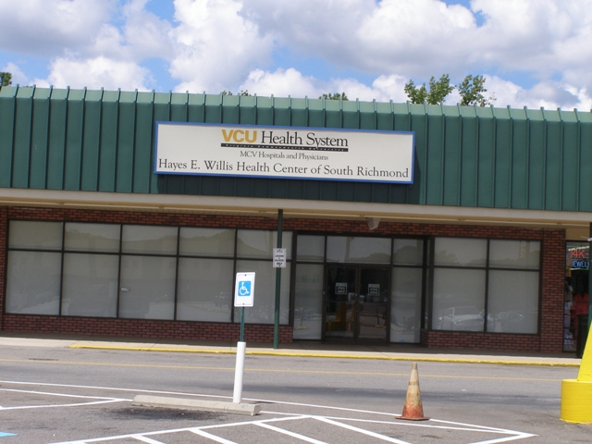
Hayes E. Willis Health Center
In 1996, the Center was renamed for its Medical Director, Dr. Hayes Willis
Major provider of primary care in South Richmond
Annually serves over 4,000 patients
Visit volume is approximately 10,000 visits/year
Approximately 45% of patients are uninsured; another 35% have Medicaid
Serves a large Hispanic population (approximately 10% of patients)

Slide 25
Expansion of the RCDPH/VCUHS Partnership
In 1998, the RCDPH expanded the partnership with the VCUHS
The “City Care” program developed partnerships with community private practices and the VCUHS clinics to provide care to 5,000 low income patients
Partnership included the AIDS Drug Assistance Program (ADAP)
Foreign Travel Immunization Clinic

Slide 26

Goals of the City Care Program
Integration of traditional public health and primary care services
Continuity of care for uninsured patients
Reduction in the inappropriate utilization of the VCU Health System’s Emergency Room
Reduction in the cost of health
care services
Leverage funding (Indigent Care
and Health Department) to
provide services

Slide 27
Jenkins Care Coordination Program
In 1998, received a 5-year grant from the Jenkins Foundation, for $1.3 million
Collaborated with the Richmond City Department of Public Health (RCDPH) to identify patients who inappropriately sought care in the Emergency Department
Program Goals:
  Coordinate services across organizational boundaries
  Increase appropriate and cost-effective utilization of health resources

Slide 28
Virginia Coordinated Care for the Uninsured
(VCC)

Slide 29
Geographic Distribution of VCUHS Uninsured Patients (FY2000)
Locality Percentage
Richmond City 50.1%
Henrico/Chesterfield 19.3%
Petersburg/Tri-Cities Area 3.5%
Rest of State 21.5%
Out of State 0.1%
Unknown 5.5%

Slide 30
VCU Health System Indigent Care Distribution
FY12 Projected Distribution of Indigent Care Funding

Slide 31
Virginia Coordinated Care for the Uninsured (VCC)
Established in the Fall of 2000
Primary objective was to coordinate health care services for a subset of the patients who qualified for the Commonwealth’s Indigent Care program utilizing managed care principles
Target population is uninsured in the Greater Richmond and Tri-Cities

Slide 32

Virginia Coordinated Care (VCC) Program
Recognized as a model for managing care for uninsured patients
Provides “medical homes” to patients who qualify for the VCU Health System’s Indigent Care program
Partners with 50 community-based physicians to improve access to care
Virginia Premier Health Plan is the Third Party Administrator (TPA)
Care coordinators and outreach workers assist patients with case management and navigation support

Slide 33
VCC Program Goals
Establish Medical Homes
Establish community specialist relationships based on VCUHS access needs
Reduce the overall cost per unit of service
Educate patients regarding how to access health care services
Improve health outcomes of a population

Slide 34
VCC Community Primary Care Sites
Green Medical Center
Montpelier Family Practice
Dominion Medical Associates
Hanover
Dominion Medical Associates
Dominion Medical Associates
Henrico
James River Physicians
Carolyn Boone, MD
Frank S. Royal, MD
Joseph W. Boatwright, III, MD
VCU Health System
Richmond
MCV Hospitals and Physicians
Joyce L. Whitaker, M.D., LTD.
Chesterfield
Vernon J. Harris East End
Community Health Center
Manchester Pediatric Associates
Charles City Medical Group
Hopewell Medical Group
Colonial Heights
AWK. Durrani, MD, P.C.
Petersburg Health Alliance
Hopewell
Richard W. Dunn, MD
Charles City Medical Group
Convenient Health Care
Petersburg

Slide 35
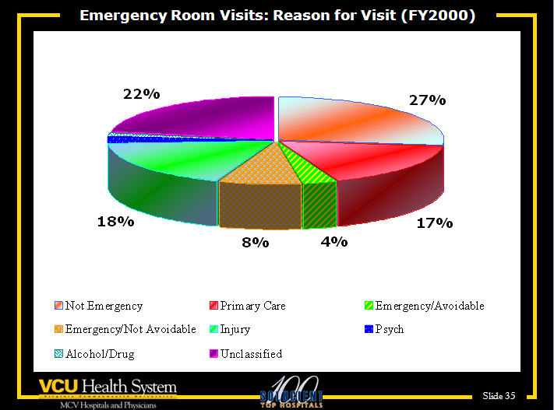
2%
2%

Slide 36
Jenkins Care Coordination Highlights
Assisted VCC patients with the transition from the VCUHS to community “medical homes”
Reduced ED utilization by 4.6% for the entire population (19% for patients enrolled for more than 18 months)
Received a grant from the Jesse Ball duPont Fund in 2004 to expand the program to assist Self-Pay “frequent flyers” who visit the ED

Slide 37
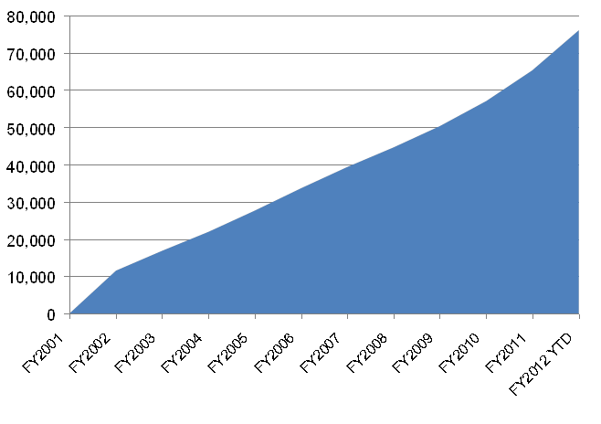

VCC Historical Enrollment
FY2001 through FY2012 YTD (8 Months)
80,000
70,000
60,000
50,000
40,000
30,000
20,000
10,000
0
FY2001
FY2002
FY2003
FY2004
FY2005
FY2006
FY2007
FY2008
FY2009
FY2010
FY2011
FY2012 YTD

Slide 38
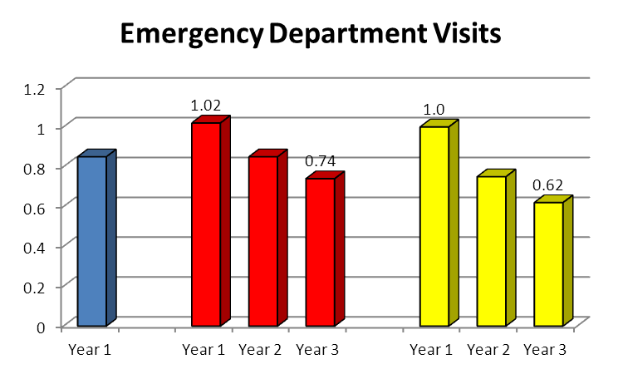
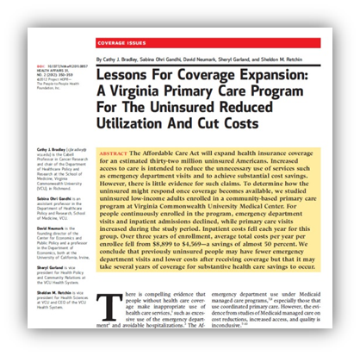
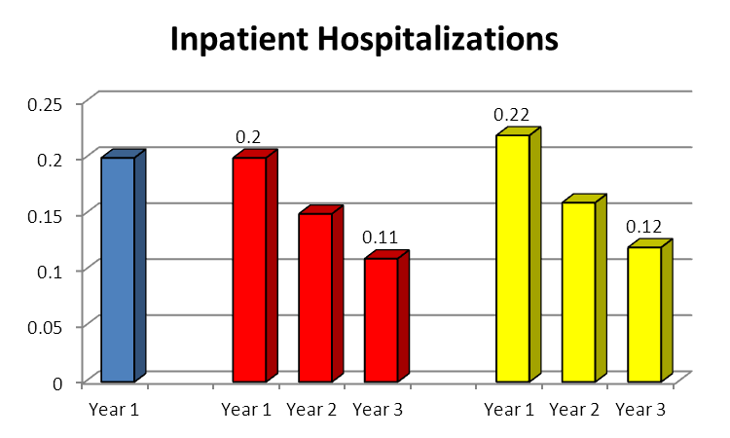
VCC Program has Demonstrated Utilization Reductions
Emergency Department Visits
1.2
1
1.02
1.0
38%
reduction
0.8
0.74
0.6
0.62
0.4
0.2
0
Year 1
Year 1
Year 2
Year 3
Year 1
Year 2
Year 3
Inpatient Hospitalizations
0.25
0.22
0.2
0.2
45%
reduction
Bradley, C, Gandhi, S, Neumark, D, Garland, S, Retchin, S, Lessons for Coverage Expansion: A Virginia Primary Care Program for the Uninsured Reduced Utilization and Cut Costs, Health Affairs 31, No. 2 (2012): 355
0.15
0.11
0.12
0.1
0.05
0
Year 1
Year 1
Year 2
Year 3
Year 1
Year 2
Year 3

Slide 39
VCC Program has Demonstrated Cost Reductions
VCC Population
Average Cost/Year
(2000 – 2007)
Bradley, C, Gandhi, S, Neumark, D, Garland, S, Retchin, S, Lessons For Coverage Expansion: A Virginia Primary Care Program For the Uninsured Reduced Utilization And Cut Costs, Health Affairs 31, No. 2 (2012): 350-359

Slide 40
Not Only have ED Visits been Reduced, but Fewer are for Non-Emergent Conditions
Not Only have ED Visits been Reduced, but
Classification of ED Visits for VCC Patients
Fiscal Year

Slide 41
Inpatient Services
Many admissions were for services that could be provided in community hospital settings
The Case Mix Index (CMI or measure of acuity) for VCC patients in FY01 was 1.22 as compared to the Hospital average of 1.5
Most prevalent discharge diagnoses for the VCC population were:
  Psychoses
  Disorders of the Pancreas
  Chest Pain
  Alcohol or Substance Abuse
  Diabetes

Slide 42
Access to Medical Homes has Reduced the Number of Admissions for Ambulatory Sensitive Conditions

Slide 43

VCC Today
Enrollment in FY12 was approximately 30,000 patients
Over 50 Providers participating from Community Physician Practices and Safety Net Providers
Community partnerships are driving costs down
Program has resulted in reduced utilization of services

Slide 44
Safety Net Delivery System Models and Health Reform

Slide 45

VCC is a “Bridge” to Health Reform
Enrollees will be eligible for Medicaid or Health Insurance Exchanges beginning in 2014
VCC community providers may play a critical role in addressing access issues for the “newly insured”
Transitioning VCC to an Enhanced Delivery System Model that focuses on the Institute of Healthcare Improvement’s “Triple Aim” objectives:
  Improve the health of the population
  Enhance the patient care experience
  Reduce, or at least control, the per
  capita cost of care
IHI Triple Aim Initiative, Institute for Healthcare Improvement, www.ihi.org/offerings/Initiatives/TripleAIM, 2012

Slide 46

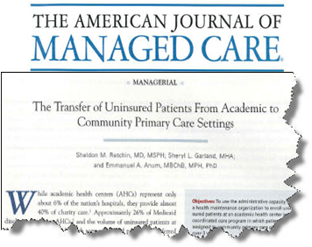
VCC is a Model that can be used to Support Other Populations
Publications have shown that VCC is an innovative program that can provide the framework for future health care delivery models
The lessons learned from the VCC program will be beneficial in shaping health care policies for newly insured populations under health reform

Slide 47
VCC Can Fit into Various Health Reform Models
New care delivery models and organizations
Accountable Care Organizations (ACOs)
Healthcare Innovation Zone (HIZ)
Patient Centered
Medical Home
Coordinated Care Networks

Slide 48
Conclusion
The role the Academic Medical Center plays is critical in a Safety Net System due to the resources (financial, human, clinical) available
Leveraging resources through partnerships provides expanded opportunities to enhance access to care for the Uninsured
The history of the partnerships developed in the Richmond area demonstrate the level of success that can be achieved.

Slide 49
“University-based urban
academic medical centers….
function most
effectively and for the greater good
when their care is a complement to,
and not a substitute for,
community health care providers.”
Hill, Laurence and Madara, James, “Role of the Urban Academic Medical Center in US Health Care”,
Journal of the American Medical Association, November 2, 2005 – Vol 294, No. 17, p.2219.

